Slide 1
SELEP Assurance Framework
Adam Bryan
Managing Director
Strategic Board Meeting
3rd March 2017
1

Slide 2
Why we need a SELEP Assurance Framework?
Set out the systems and processes which are necessary to manage the delegated funding from Central Government Budgets effectively.
Provides Government and local partners with assurance that decisions over funding are proper, transparent, and deliver value for money.
To reflect changes to the National Assurance Framework, LEPs are required to review, refresh and sign off and implement their Local Assurance Framework.
The requirements set out in the National Assurance Framework must be incorporated in SELEP’s Assurance Framework as a condition of funding in future Growth Deal grant offer letters.
2

Slide 3
Agreeing the SELEP Assurance Framework
November 2016 – National Assurance Framework published
24th January - Circulated to Strategic Board for sign off by Electronic Procedure to:
Agree the revised SELEP Assurance Framework 2017 which has been updated to reflect changes to the National Assurance Framework and the refreshed SELEP Terms of Reference approved by the Strategic Board (the Board) in December 2016.
Note the intention for SELEP to develop an SELEP Assurance Framework Implementation Plan
Approved by 19 Board Members ( including 11 business representatives)
23rd February – Accountable Body letter to Government to confirm that the SELEP Assurance Framework has been agreed, is being “implemented and meets the revised standards set out in the National Local Enterprise Partnership Assurance Framework”.
3
Notes:
Voting Quorum -
3

Slide 4
Minor Changes
‘Federal’ to be replaced by the word ‘Federated’
Responsibility for Federated Boards to shape, define a, endorse and sign-off the Strategic Economic Plan in advance of Strategic Board sign –off (to be updated in Assurance Framework and Terms of Reference
Re-insert reference to the SELEP Annual General Meeting
Remove reference to Accountable Body sign – off of Accountability Board reports, but have added wording to state that the Accountable Body “will include the details of any implications arising as a result of the decision being sought within the report”.
Amend wording of Accountability Board non-voting membership (retain status quo for the meeting to be attended and Chaired by only one nominated Strategic Board vice- chair).
Minor formatting changes to more clearly show Private Sector Strategic Board reps.
Updated version is available on SELEP website
Notes:
Accountable Body approval of Accountability Board reports - And that the reason for this is that the Accountable Body are required to ensure that decisions and activities of the SELEP conform with all relevant law and are responsible for its management if challenged; any they are required to ensure that the SELEP Assurance Framework is adhered to.

Slide 5
Message from Government
“I am pleased with the improvements you have made to ensure compliance with the revised National Assurance Framework. It is vital that the LEP continues to take this matter seriously and maintain your strong record of delivery, as demonstrated by your track record on Growth Deals funding”.
Kris Krasnowski
Deputy Director, BEIS London and East
5

Slide 6
Implementation Plan

Slide 7
Implementation Plan
An Implementation Plan has been developed to ensure that all of the Assurance Framework minimum requirements are being put in place
SELEP’s progress in actioning the points included in the Implementation Plan will be reported to and monitored by SELEP Accountability Board.
In addition to the key requirements set out in the Assurance Framework, the Accountable Body have also advised that for best practice:
All Accountability Board meeting information is made available on County/ Unitary Authority websites (Forward Plan, Agenda Pack, Meeting Minutes)
Board members expenses made available on SELEP website

Slide 8
Responding to the Industrial Strategy Green Paper
Formal consultation response
Strategic Economic Plan refresh
Adam Bryan, Managing Director
Strategic Board Meeting, 3rd March

Slide 9
Government’s Industrial Strategy
Green Paper
Stated aim to ‘deliver a high wage, high skilled competitive economy that works for all’ and ‘make sure the UK remains one of the best places in the world to innovate, do business and create jobs’
Ideas and feedback sought through the consultation period. Feedback, evaluations or social media metrics to stakeholders@beis.gov.uk
Response deadline 17th April

Slide 10
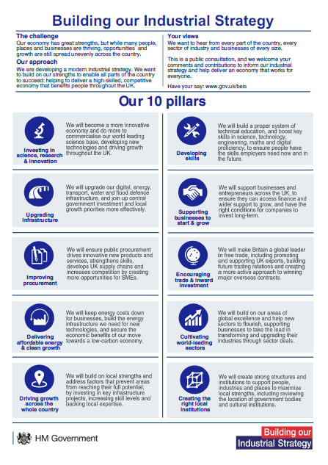
Government’s Industrial Strategy
Green Paper – the 10 pillars

Slide 11
Responding to the consultation
Awareness raising:
SELEP website
Weekly mail-outs to end March
Twitter
Response development:
Align with local areas where possible and co-signed by Chair and Vice Chairs to reflect
Formation of T&F group led by SELEP Director, to meet virtually twice and once in person before end of March to formulate response. Suggestion to have maximum 8 reps with at least 50% business. Senior officers to ensure consistency with local positions
Draft final version circulated to SELEP Board for comments by 3rd April

Slide 12
SEP: why?
No further Local Growth Fund in this Parliament… an opportunity to be less reactive. An opportunity to push for what we want.
A manifestation of a shift in approach

Slide 13
SEP: why?
Existing SEP is three years old. Major change since
Existing SEP written as a bidding document and not as a strategy with a clear vision for the whole place
Existing SEP came together from four separate documents
SEFUND is obsolete
We have made investments which need to be reflected
There are newer local strategies to amplify
Brexit; global economics
Need to have a narrative on the broader agenda, incorporating innovation, 5G, and the enabling role of our universities
Combined voice on TEGC 2050; Lower Thames Crossing
Say what we cannot say individually
Address the Housing White Paper
Align with the Industrial Strategy
Get more money!

Slide 14
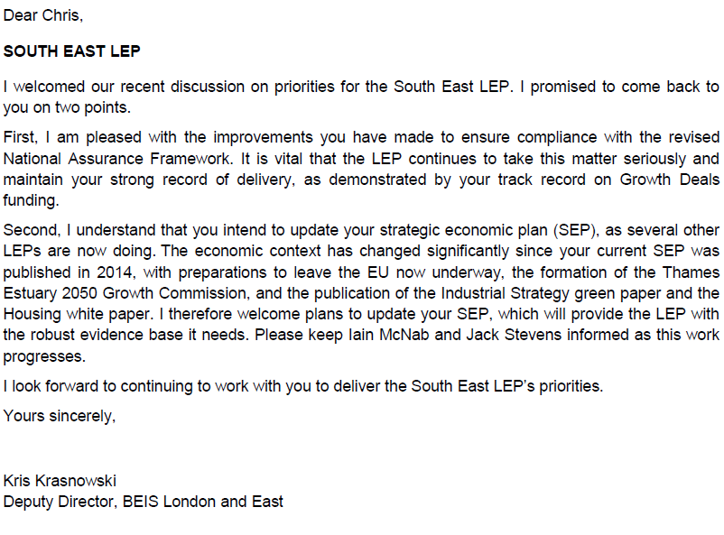
SEP: why?

Slide 15
A new Strategic Economic Plan
Concise
Cohesive
Consistent with policy
Concrete outcomes
Cognisant of federated area priorities
Big hitting, proactive; much more than LGF at stake
Visionary
Building on momentum; using our aggregate power to best effect
…our Productivity Statement?

Slide 16
SEP: engagement
It’s what matters the most
Two phases of engagement, either side of June board
Is this the right approach?
SELEP side | Industry side
Strategic Board | Local Chambers of Commerce workshops
Federated boards | FSB, CBI or IoD consultation
Chairman and Vice Chairmen group | Open business events/workshops
Leaders and Executive Leadership teams at local authorities | Chairs and leading businesses from neighbouring LEPs
Existing SELEP working groups | Developer sessions
Secretariat & Senior Officer Group | Utility providers
U9 group and University Vice Chancellors
Local MPs
Whitehall leads

Slide 17
SEP: pieces of the jigsaw
Shared Foreword
Report on delivery to date
Example of how we manage the Growth Fund effectively
Strategic priorities – SELEP’s hit list for action – the common agenda
Place focus: the federal boards, our universities, and their role in supporting the success of the LEP
How we will deliver the Industrial Strategy locally
A vision of the economy in 2022

Slide 18
SEP: pieces of the jigsaw
Cross-cutting themes – sector based? Sector based plans? Think-piece/issue papers?
Joint work with neighbouring LEPs/areas
Response to London’s growth. Shared position?
Packages of skills, housing or transport interventions? Defining our own deal?
Impact of Brexit
Innovation and supporting the knowledge economy
Policy positions – STBs, devolution, ISCF

Slide 19
SEP: notional timeline
Description | Deadline
Commence procurement of consultants | March
Award of contract | March/April
First round of engagement | April - May
Receipt of progress report | June Strategic Board
Second round of engagement | June - September
Sign-off | September Strategic Board
Launch | September - October

Slide 20
Strategy suite…
Strategic Economic Plan
SELEP’s productivity statement
Driven by Strategic Board
Maximise investment interventions
Align with Industrial Strategy
Reflect local priorities
Amplify the shared agenda
Take clear policy positions
Provide a 5 year vision
Skills Strategy
Articulate skills priorities to inform funding, drive activity and shape future
Employer-led
Define the volume of need
Convey the critical role of skills in economic growth
Show the positives and what has worked well
Shared evidence base; simplify the landscape
Infrastructure and Investment Plan
Set out where future investment targeted
Define SELEP’s pipeline
Summary of delivery to date
Strengthening case for funding through other means
Priorities defined by federated areas
Energy strategy

Slide 21
Q&A

Slide 22
South East LEP Development of new logo and brand
Zoe Gordon, Business Engagement & Communications Manager

Slide 23
Why?
Current logo developed in 2010, focussed on the geographical area, lack of context
Feedback is that this image does not translate well
SELEP does not have the original artwork for this logo
Change in landscape, roles, responsibilities and expectations of LEPs

Slide 24
How?
Approach based on a ‘design competition’ - working with Universities and FE Colleges, to provide a ‘real world’ opportunity for students to gain commercial experience
Support from external branding and design consultant
£1000 prize for winning design
Cost of project – no more than £3000 for prize fund and brand development.

Slide 25
The Creative Brief
Brand values to be attributed to the ‘new’ SELEP brand:
Progressive
A true partnership
Able to attract investment and growth
A strong business voice
A positive influence
Outward-looking

Slide 26
Creative requirements
New logo and brand guidelines to be delivered across all media.
Logo design (hi-res, multi-format, colour and mono versions)
Brand guidelines inc. fonts, typeface, colour palette, page layouts, Power Point templates etc
Logo usage restrictions and co-branding guidelines
Icons to identify specific SELEP activity areas

Slide 27
Submissions and shortlisting
24 submissions in total from across the geographical area
7 shortlisted based on meeting the requirements of creative brief
4 very strong ‘finalists’ based on industry branding standards:
DISTINCTIVE, RECOGNISABLE, ATTRACTIVE, VERSATILE, RELEVANT

Slide 28
Ryan Mills - Harlow College

Slide 29
Benjamin Hart – East Kent College

Slide 30
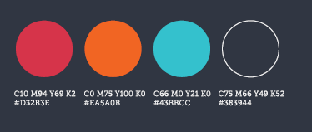
Anastasia Pirogova – University of Greenwich

Slide 31
Innocent Salbanda – Harlow College

Slide 32
Next steps
3rd March 2017 - Comments from SELEP Board
Monday 6th March - Chris, Adam, Zoe and branding consultant to choose final design
31st March 2017 – deadline for Full branding pack
Spring - Summer 2017 - Brand roll out

Slide 33
SELEP Strategic Board
Capital Programme Update
Rhiannon Mort, SELEP Capital Programme Manager
3rd March 2017

Slide 34
Local Growth Fund update

Slide 35
Local Growth Fund
Growth Deal summary
Commitment to deliver:
23,000 new homes and 40,000 new jobs through LGF Rounds 1 & 2
6,129 new homes and create or safeguard 30,785 jobs through LGF 3
By the end of 2016/17 it is forecast that our total LGF spend will amount to:
£139.4m - excluding retained schemes
£147.9m - including retained schemes

Slide 36
Local Growth Fund
At the last SELEP Accountability Board on the 24th February 2017, LGF was approved for the following projects:
A20 Junction Improvements (£5m)
M20 Junction 10a (£19.7m)
Coastal Communities Housing Intervention (£2m)
Stanford – le – Hope (£7.5m)
A131 Chelmsford to Braintree Route Based Strategy (£3.66m)
Kent Strategic Congestion Management (£0.8m)
Hailsham/Polegate and Eastbourne Movement and Access Transport Scheme (£2.1m)

Slide 37
Local Growth Fund

Slide 38
Swallows Business Park, East Sussex
Kent Elms Corner, Southend
Medway Cycle Action Plan
Maidstone Gyratory, Kent

Slide 39
Local Growth Fund
Total LGF spend forecast in 2016/17:
£83.7m excluding retained schemes
£90.8m including retained schemes

Slide 40
Local Growth Fund

Slide 41
Local Growth Fund
At the last Accountability Board, acceleration of LGF spend was approved for the following Growth Deal projects:
East Sussex Strategic Growth Project (£0.3m)
A226 London Road/ B255 St Clements Way (£0.934m)
Strood Town Centre Journey Time and Accessibility Enhancements (£0.081m)
Chatham Town Centre Place-making and Public Realm Package (£0.120m)
Medway Cycling Action Plan (£0.100m)
Medway City Estate Connectivity Improvement Measures (£0.157m)

Slide 42
Local Growth Fund

Slide 43
Growing Places Fund

Slide 44
Growing Places Fund
Project | Allocation (£m) | Investment to date (£m) | Repayment (£m) | Update | Delivery of jobs
 |  |  |  |  | Forecast | Achieved to date
Priory Quarter Phase 3 (East Sussex) | 7.000 | 7.000 | 0.400 | Complete and repayments being made | 440 | 67
North Queensway (East Sussex) | 1.500 | 1.500 | 1.000 | Complete and repayments being made | 6 | 0
Bexhill Business Mall (East Sussex) | 6.000 | 6.000 | 0.025 | Complete and repayments being made | 125 | 125
Parkside Office Village (Essex) | 3.250 | 3.250 | 0.540 | Complete and repayments being made | 169 | 120
Chelmsford NE Urban Expansion (Essex) | 1.000 | 1.000 | 1.000 | Complete and repaid in full | 2105 | 0
Grays Magistrates Court (Thurrock) | 1.400 | 1.400 | 0.200 | Complete and repayments being made | 200 | 69
Sovereign Harbour (East Sussex) | 4.600 | 4.600 | 0.000 | Completed and repayments expected | 240 | 55
Workspace Kent (Kent) | 1.500 | 1.437 | 0.000 | Complete and repayments expected | 183 | 48
Rochester Riverside (Medway) | 4.410 | 4.410 | 0.000 | Developers for the site have been identified and outline masterplan is being prepared and detailed planning application for Phase 1. | 402 | 0
Chatham Waterfront (Medway) | 2.999 | 2.999 | 0.000 | Outline planning application has ben submitted for the development. Still awaiting decision but looking to market the site in 2017. | 211 | 0
Harlow West Essex (Kent) | 3.500 | 0.000 | 0.000 | Working to agreements | 4000 | 0
Live Margate (Kent) | 5.000 | 0.000 | 0.000 | Working to agreements | 0 | 0
Discovery Park (Kent) | 5.300 | 0.000 | 0.000 | Working to agreements | 130 | 0
Total | 47.459 | 33.596 | 3.165 |  | 8211 | 484

Slide 45
Growing Places Fund

