Slide 1
South East LEP
Strategic Board Meeting
High House Production Park
9th June 2017

Slide 2
Sub-National Transport Body for the South East
SELEP Strategic Board - 9 June 2017

Slide 3
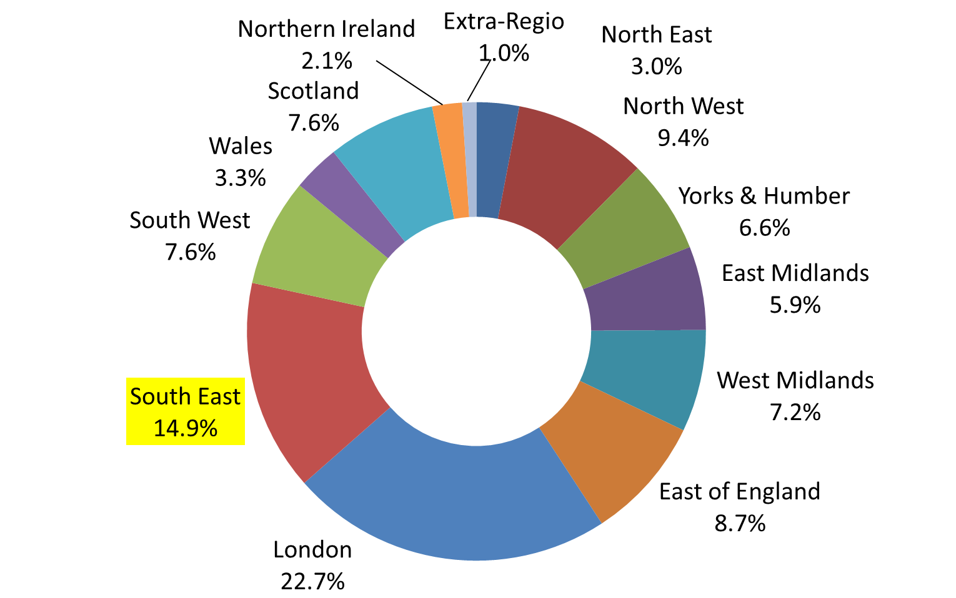
Why have an STB?
Percentage Share of UK GVA 2015
Source: ONS
Notes:
The South East is a powerful motor for the national economy and is a gateway to the rest of the UK
Continued success is threatened by intense pressure on congested transport networks
The existing transport network needs investment to remain resilient
Investment in new infrastructure is necessary to unlock further growth potential

Slide 4
Why have an STB?
Planning
Infrastructure
National
National Government
National Planning Policy Framework + Guidance
Highways England
Network
Rail
Sub-National
Invest Strategies
Route Studies
Sub National Transport Body
LTAs
LEPS
Operators
Local
Local Planning Authorities
LTP
LGF
Local Plans & IDPs
Notes:
‘Strategic’ gap between national Government interventions and LTP and LGF regimes
Meanwhile business as usual in the devolved administrations in London, Wales and Scotland – SE Losing out!
Local organisations best placed to adopt integrated approaches to transport, land use and economic development activity
Improved accountability by moving strategic planning to those that know their economies and customers best
Better value for money by aligning investment programmes with potential for new financing arrangements

Slide 5
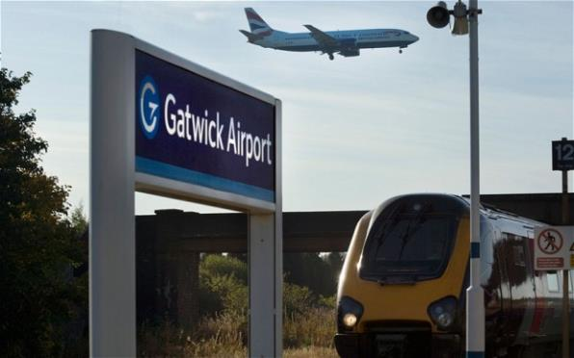
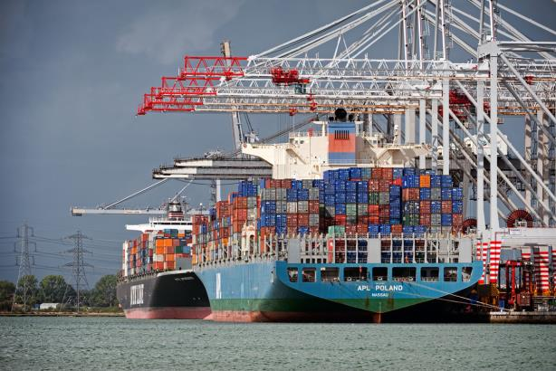
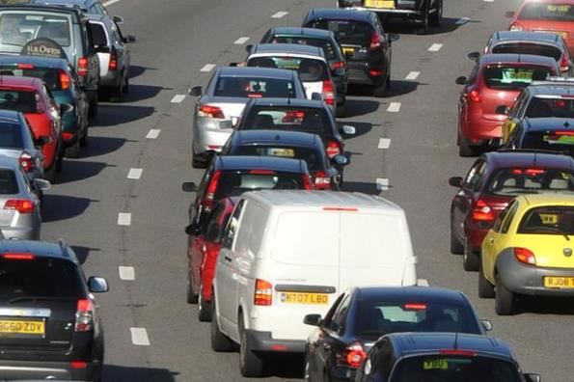
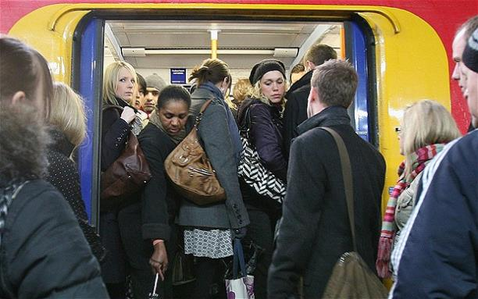
Why have an STB?
Notes:
‘Strategic’ gap between national Government interventions and LTP and LGF regimes
Meanwhile business as usual in the devolved administrations in London, Wales and Scotland – SE Losing out!
Local organisations best placed to adopt integrated approaches to transport, land use and economic development activity
Improved accountability by moving strategic planning to those that know their economies and customers best
Better value for money by aligning investment programmes with potential for new financing arrangements

Slide 6
Why have an STB?
To ensure economy and contribution to Exchequer continue to grow
Speak with one voice to make the case for investment in our creaking infrastructure
Improved quality of life for all

Slide 7
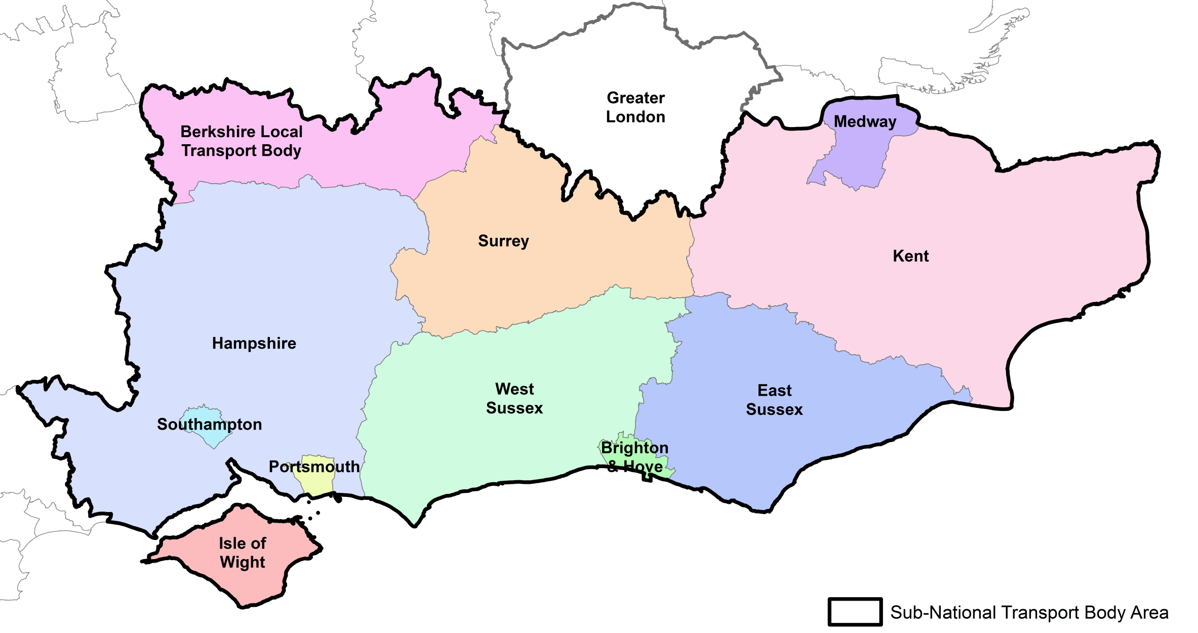
STB Geography

Slide 8
STB - Shadow Governance
Partnership Board
Senior Officer Group
Transport Forum
PMO
Transport Strategy
Governance
Communications & Engagement

Slide 9
Transport for the South East
Potential roles and responsibilities:
specifying the investment priorities for the strategic road and rail networks
influencing, specifying and letting of future passenger rail franchises?
bus service franchising?
integrated and smart and ticketing?
delivery of major transport schemes?

Slide 10
STB - Transport Strategy
Vision
The South East is a powerful driver of the UK economy and the nation’s major international gateway for people and businesses.
We will grow the South East’s economy by delivering a quality, integrated transport system that makes us more productive and competitive, improves quality of life for all and protects the environment.

Slide 11
STB - Transport Strategy
Strategic Priorities
1. Deliver a high quality, sustainable and integrated transport system that improves productivity to grow our economy and compete in the global marketplace by:
  facilitating housing and employment space growth and regeneration
  connecting international gateway ports and airports with their markets;
  providing efficient movement for people and goods along major radial road and rail corridors to and from London;
  improving the linkages and orbital routes between the major centres within the South East and the rest of the UK;
  harnessing new digital technologies to reduce the need to travel, promote shared transport and improve network efficiency, and;
  creating and maintaining a network that is resilient to incidents and climate change.

Slide 12
STB - Transport Strategy
Strategic Priorities
2. Deliver a high quality, sustainable and integrated transport system that works to improve safety, quality of life and access to opportunities for all by:
  providing value for money rail services for commuting and leisure travel to London, within the South East, and for longer journeys to the rest of the UK and Europe;
  creating a bus network that meets local needs, both urban and rural;
  enhancing accessibility through the roll out of digital technologies to increase connectivity and opportunities for shared transport; and
  facilitating increased levels of walking and cycling as part of all journeys to benefit public health and wellbeing and reduce congestion.
.

Slide 13
STB - Transport Strategy
Strategic Priorities
3. Deliver a high quality, sustainable and integrated transport system that protects and enhances the South East’s unique natural and historic environment by:
  considering the impact of transport on the South East’s National Parks, Areas of Outstanding Natural Beauty (AONB), UNESCO World Heritage Sites and other environmental and heritage designed sites;
  minimising emissions to improve local air quality and reduce the South East’s contribution to global climate change;
  reducing noise and disturbance to maintain tranquillity in rural areas across the South East.

Slide 14
Key contacts
Rupert Clubb
Director Communities Economy & Transport
East Sussex County Council
rupert.clubb@eastsussex.gov.uk
Mark Valleley Rachel Ford
East Sussex County Council Surrey County Council
mark.valleley@eastsussex.gov.uk rachel.ford@surreycc.gov.uk

Slide 15
European Structural and Investment Funds:
SELEP’s involvement in decision making
Lorraine George
EU Funding Programmes Strategic Lead

Slide 16
Decision making framework:
Operational Programmes
Managing Authorities – DCLG, DWP and Defra
SELEP ESIF strategy, including a rural chapter locally agreed by Strategic Board and Defra
SELEP ESIF Sub-Committee
National Growth Board

Slide 17
European Regional Development Funding:
Calls for applications proposed and launched by DCLG
Outline and full applications assessed for strategic fit and value-for-money by ESIF Sub-Committee
Quarterly reports to Strategic Board including updates and issues arising

Slide 18
European Regional Development Funding:
Progress reports and issues to SOG/EU officer group on ad hoc basis
Quarterly reports to Strategic Board: updates and issues
Federated Area Board updates as required
ERDF facilitator as a LEP-wide resource
SELEP ERDF Projects Network group
Thematic workshops as required

Slide 19
European Regional Development Funding:

Slide 20
ERDF project outcomes:

Slide 21
European Social Fund:
£50 million indicative allocation match-funded by Opt-in agencies: Big Lottery, DWP, Job Centre+ and Skills Funding Agency (SFA)
Contracts between Opt-in agencies and DWP Managing Authority based on ESIF Strategy and developed by SELEP secretariat in consultation with Employment and Skills Boards in the Federated Areas and the SELEP Skills Advisory Group (SAG)
ESIF Sub-Committee consulted and endorse this approach and is consulted on future calls for applications

Slide 22
European Social Fund:
Approximately £20 million of indicative allocation left to tender, all requiring match funding
Key role of consultation of SELEP skills lead with ESBs and SAG in terms of future tenders
Tender out now for “Sustainable Integration of Young People into the Labour Market”
Small bids are allowed to ensure match funding can be identified by bidders
Tenders will be evaluated by DWP Managing Authority
ESIF Sub-Committee invited to comment on strategic fit and value-for-money

Slide 23
~ £50m ESF contracted to date:

Slide 24
CLLD
3 CONTRACTS
YOUTH EMPLOYMENT INITAITVE
1 CONTRACT
ESFA
5 CONTRACTS
ESF
BIG LOTTERY
11 CONTRACTS
DWP
1 CONTRACT

Slide 25
European Agricultural Fund for Rural Development:
SELEP Rural Strategy developed
Close working at development stage with 9 Leader groups in the SELEP area
DEFRA/RPA announces calls for applications endorsed by ESIF Sub-Committee

Slide 26
European Agricultural Fund for Rural Development:
Working group of the ESIF sub-committee considers local strategic fit
ESIF sub-committee endorses Expressions of Interest and Full Applications
ESIF sub-committee informed and considers communications plan to promote the fund
Strategic Board updated on issues and progress quarterly

Slide 27
European Agricultural Fund for Rural Development:

Slide 28
ERDF: Jo Simmons jo.simmons@eastsussex.gov.uk
ESF: Louise Aitken louise.aitken@essex.gov.uk
EAFRD: Lorraine George lorraine.george@eastsussex.gov.uk

Slide 29
LGF Capital Programme Update
Rhiannon Mort
Capital Programme Manager
9th June 2017
SELEP Strategic Board

Slide 30
LGF Delivery
LGF projects completed at end of 2016/17
- Colchester LSTF
- A414 Maldon to Chelmsford Route Based Strategy
- Colchester Broadband Infrastructure
- Colchester Park and Ride
- Folkestone Seafront : onsite infrastructure and engineering works
- M20 Junction 4 Eastern Overbridge
- Maidstone Gyratory
- Southend and Rochford Joint Area Action Plan
- Strategic Site Investment Package, East Sussex
- Swallow Business Park, Hailsham (A22/A27 Growth Corridor)
- TGSE LSTF – Essex
- TGSE LSTF – Southend
- TGSE LSTF – Thurrock

Slide 31
Projects approved by SELEP Accountability Board
31st March 2017
A13 Widening - £66.1m LGF
Devonshire Park – £5m LGF
Kent Sustainable Interventions Programme - £0.5m LGF
26th May 2017
Ashford International Rail Connectivity - £4.173m LGF
Sussex Downs College 3rd Phase of refurbishment of Science Facilities at the Lewes Campus - £39,515 LGF
Technical and Professional Skills Centre at Stansted - £3.5m
Basildon Integrated Transport Package Tranche 2 - £6.4m LGF
-

Slide 32
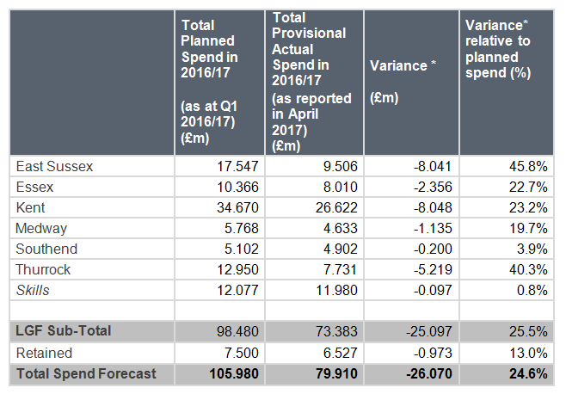
LGF spend in 2016/17 (£m)
Total provisional spend in 2016/17 of £79.9m LGF in 2016/17
A total of £137m LGF spent to date

Slide 33
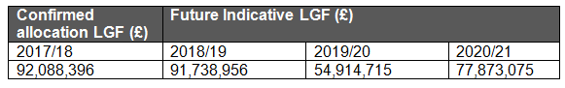
LGF allocation indicative profile
LGF Grant Offer Letter 2017
Award of project change flexibilities by Department for Communities and Local Government
Excluding Department for Transport retained schemes

Slide 34
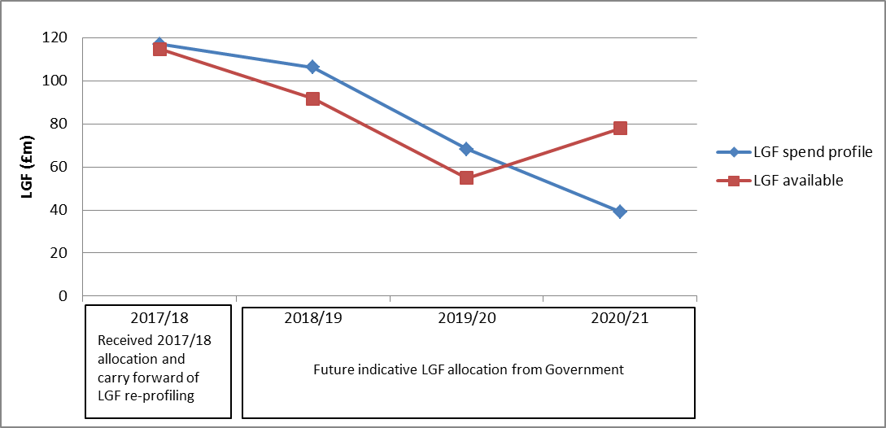
LGF spend profile relative to LGF available

Slide 35
LGF spend forecast 2017/18 (£m)
 | Total Forecast Spend in 2017/18
 | (as reported in April 2017)
East Sussex | 25.998
Essex | 17.204
Kent | 31.785
Medway | 12.296
Southend | 12.640
Thurrock | 8.669
Skills | 0.096
M20 Junction 10a | 8.300
LGF Sub-Total | 116.988
Retained | 30.764
Total Spend Forecast | 147.752
Total forecast spend of £147.752m LGF in 2017/18.

Slide 36
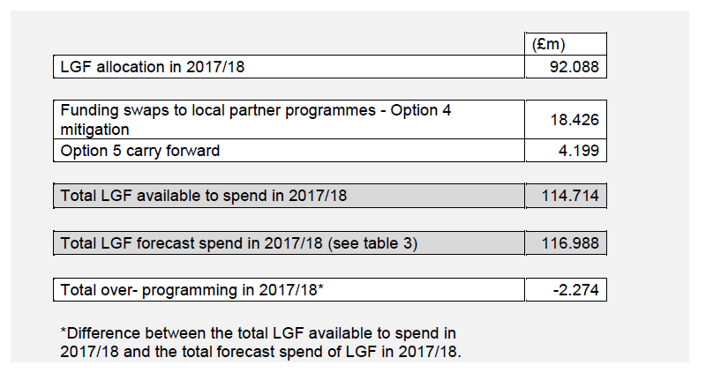
Forecast LGF spend in 2017/18 relative to LGF available

Slide 37
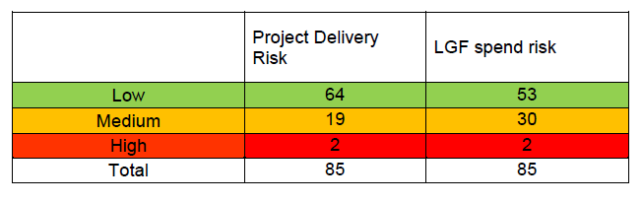
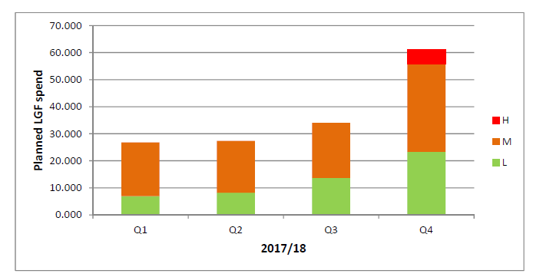
Deliverability and Risk
13 Projects Completed
21 Projects due to complete in 2017/18
LGF spend risk relative to planned spend in 2017/18

Slide 38
LGF delivery
LGF projects due to be completed by the end of 2017/18
 | Project Update | Project Risk (RAG rating) | LGF Spend Risk (RAG rating)
East Sussex
Newhaven Flood Defences * | On Track | L | L
Queensway Gateway Road | Construction works have started on site but project delays were experienced in 2016/17. £3.460m LGF spend forecast in 2017/18. | M | M
North Bexhill Access Road | Phase 1a is now substantively complete. Project delays in 2016/17. New planning application has been submitted for design change. | M | M
Coastal Communities Housing Interventions - Hastings | Change request to come forward to next Board meeting, but no substantial change to outputs are expected. | L | L
Essex
Colchester Town Centre** | Completion of Lexdon Bus Road Improvements required. The rest of the schemewas completed in 2016/17. | L | M
A414 Pinch Point Package: A414 First Avenue & Cambridge Rd junction** | Delayed delivery from 2016/17. Four packages of works programmed to be completed by December 2017. | L | M
Chelmsford Station / Station Square / Mill Yard | Contractor on site but complex project and project delays experienced in 2016/17 | M | M
Coastal Communities Housing Interventions - Jaywick | Agreement required to transfer LGF to District Council. | L | L

Slide 39
LGF delivery
 | Project Update | Project Risk (RAG rating) | LGF Spend Risk (RAG rating)
Kent
Tonbridge Town Centre Phase 2 | Phase 1 complete and Phase 2 underway. LGF fully spent. | L | L
Middle Deal Transport Improvements | Planning permission granted and good progress being made on site, focussing on road development. | M | L
Sittingbourne Town Centre Regeneration | LGF fully spent, but third party delivery of the project ongoing. | M | L
Rathmore Road | Site works progressing as planned. Next phase is to complete phase 2 A of the works to the forecourt of the Station | L | L
Dover Western Docks Revival A20 Junction Improvements ** | Legal agreement being implemented to committee the Port to the delivery of the Marina Pier works. | L | L
Maidstone Integrated Transport Package - Phase 1 | The outline design for A274 Sutton Road scheme has been delayed but procurement route has now been agreed to reduce further delay to delivery. | M | M
Tunbridge Wells Junction Improvement Package | Phase 1 works completed. Buisness Case required for Phase 2. | L | M
Coastal Communities Housing Intervention Thanet | Funding agreement has been progressed to transfer LGF to District Council | L | L

Slide 40
LGF delivery
 | Project Update | Project Risk (RAG rating) | LGF Spend Risk (RAG rating)
Medway
Chatham Town Centre Place-making and Public Realm Package | The detailed design for the route improvement scheme between the train station and the town centre is complete and a contractor has been appointed to deliver the works. | L | L
Medway Cycle Action Plan | A new route along the A289 has been constructed and improvement work on the existing route through Riverside Country Park has been completed. Design work is continuing on other routes in preparation for construction before the end of 2017/18. | L | L
Southend
A127 Kent Elms Corner** | Project due to be completed in May 2017. | L | M
Southend Central Area Action Plan (Phase 1) | Near completion. £200,000 to be carried over to complete improvements to public realm and cycling facilities along Victoria Avenue service road in 2017/18 | L | L
Thurrock
Purfleet Centre** | Land acquisition continues. | L | H

Slide 41
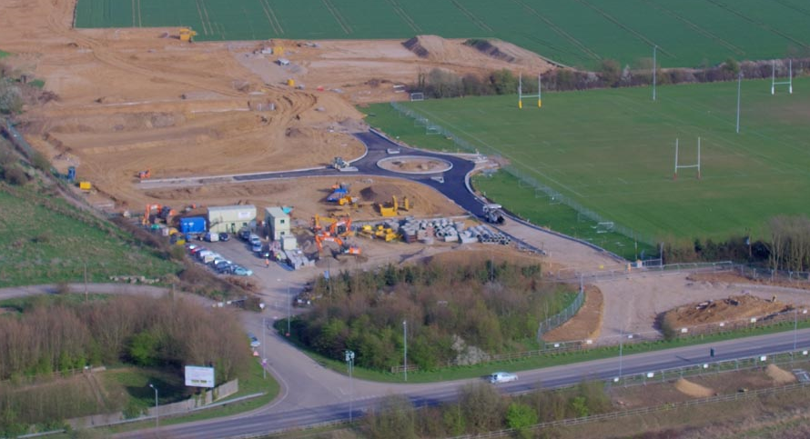

Slide 42
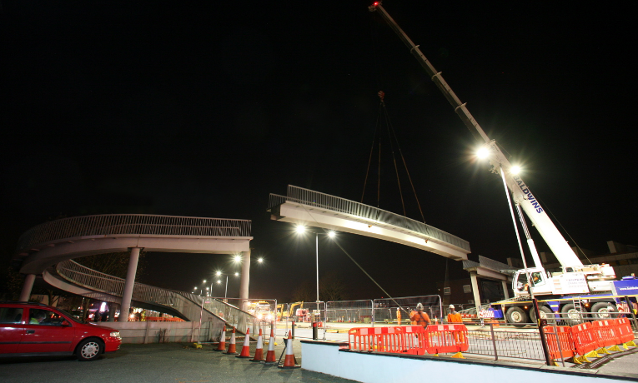

Slide 43
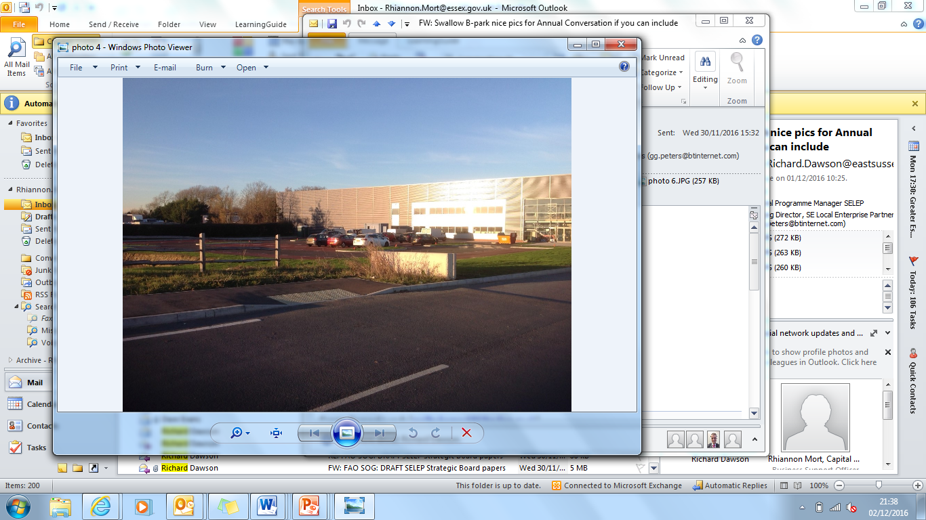

Slide 44
Growing Places Fund Update

Slide 45
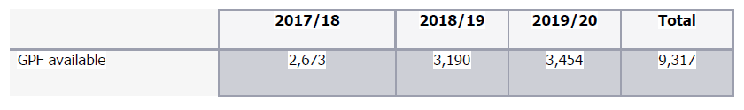
Growing Places Fund
Growing Places Fund (GPF) available for re-investment
The proposed approach aims to support projects which:
are most closely aligned with SELEP’s strategic objectives,
can quickly move to delivery and benefit realisation, and
can make repayments on the loan with a five year period, to support the continued and successful operation of GPF as a recyclable loan fund.

Slide 46
Stage 1
Expressions of interest template completed
Consideration of the project against edibility criteria:
  Alignment with SELEP objective to support economic growth
  Require capital loan funding investment
  Identify benefits which are expected to exceed project cost
  Complies with legal requirement for spend of public funds
  Can repay the loan by 31st March 2022
  At least a 30% local funding contribution
Federated Boards nominate projects to SELEP up to 50% of the total GPF available

Slide 47
Stage 2
Strategic Outline Business Case developed
SELEP consideration of projects based on:
Expected benefits;
Deliverability;
Contribution to GPF as a revolving fund;
Strategic Fit
Viability; and
Amount of GPF sought
Recommendations made to SELEP
Investment Panel

Slide 48
Stage 2
Investment Panel
- Investment Panel to comprise of:
6 County Council/Unitary Authorities
SELEP Accountability Board FE and HE representatives
Strategic Board Chair
Strategic Board Vice – Chairs
The Panels role is to agree the pipeline of GPF projects, based on the methodology and criteria agreed by Strategic Board
Terms of Reference to be agreed at the first meeting of the Panel
Final funding decision for the projects prioritised by SELEP
Investment Panel will be taken by SELEP Accountability Board

Slide 49
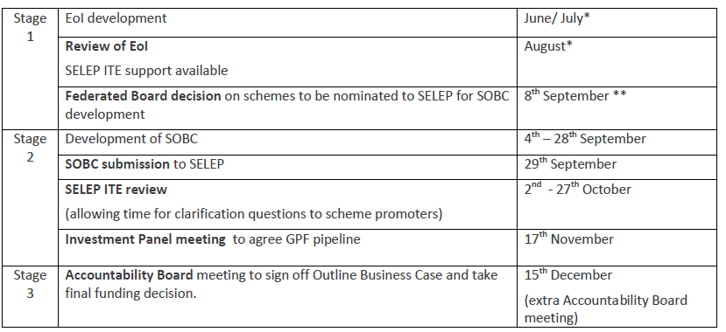
GPF re-investment

Slide 50
GPF re-investment
Charging of interest
Option A: Charging of interest at market rate
Option B: Charging of interest at two percent below the Public Works Loan Board (PWLB) Fixed Maturity Rate (preferred option).
Option C: No charging of interest but a late repayment fine is applied where projects fail to meet their agreed re-payment schedule.
Option D: No charging of interest.

