Slide 1
Innovation
in the South East
Howard Partridge
Regional Manager, East of England
Howard.Partridge@InnovateUK.gov.uk @HowardPeartree
Notes:
Thank Iain and Nigel as appropriate

Slide 2
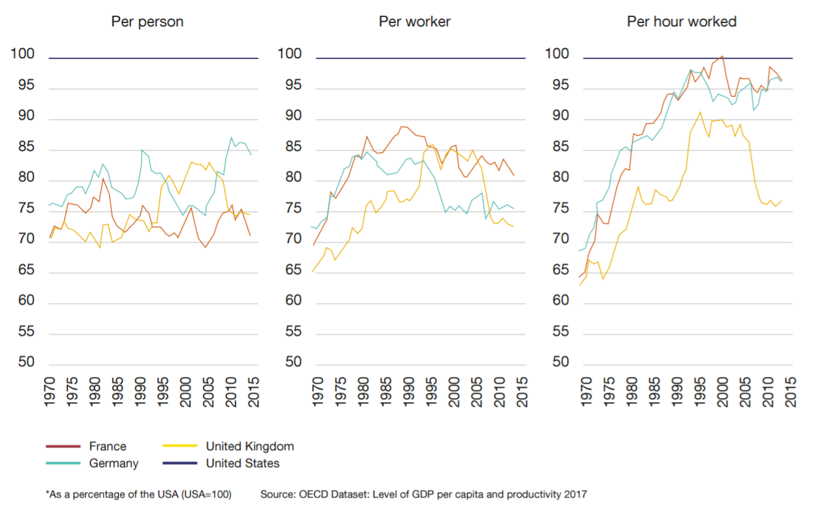
The Productivity Gap

Slide 3
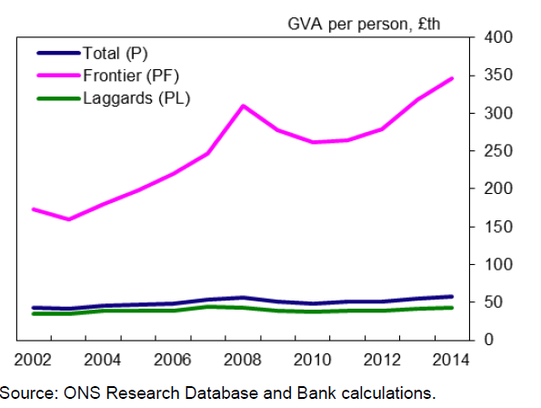
The Productivity Gap
Note: Frontier defined as top 5% of firms by GVA per worker in a given year and sector as defined by 2-digit SIC 2007 industrial classification.

Slide 4
Innovation and growth – the vital 6 per cent
High-growth companies are rare, but generate a majority of jobs
6 per cent of UK businesses with the highest growth rates generated half of the new jobs created by existing businesses 2002 - 2008
It’s not just about start-ups:
Young firms are more likely to be high-growth but 70% of high-growth firms are ≥ five years old and create 80% of the new jobs in high growth firms.
High-growth firms generate spill-overs in their regions
They create jobs over and above direct effect on employment
Innovation drives firm growth
Innovative firms grow twice as fast, both in employment and sales, as firms that fail to innovate
This effect is more marked the faster a company is growing
Notes:
This map shows where we’ve invested our funds. In the last six years, we have committed over £231 million to 2000 business innovation projects. It’s not a complete measure. There are other sources of funding, including business itself.
Health and life sciences in Hertfordshire, Cambridge, Norwich, Kent and Meadway. Agritech in similar areas.
Manufacturing and materials has large spikes in Peterborough and Basildon, also Stevenage and Cambridge and Norfolk.
And ICT with a big concentration in Cambridge, but BT’s global R&D HQ hardly shows. More fundamental research and spending their own money.
Where we are today is a great example of the range of capabilities in the region. TWI have world class engineering research and testing facilities. They’re partnering with several of the UK’s leading universities. And on the same park we have companies like Meddimune, owned by AstraZenica, who’ve chosen this place as the best for their health research and development.
It’s quite easy to see these patterns and recognise the large businesses. But getting to understand what the strengths are in detail, and what opportunities there are in new subsectors, like bioelectronics, takes the local knowledge and understanding of people in the industries themselves.
The rest of this morning will be about exploring what we – or you – know about the strengths of the region. Particularly what’s just good, and what’s world class. How do we stack up against the competition? How can that knowledge inform your business strategy?
That’s what the Science and Innovation Audit aims to do. Really put the region on the map!

Slide 5
Innovation doesn’t just happen
It happens as a consequence of coordinated collaboration between:
Business
Government
Research
This is where comes in.
We can’t stop thinking about the future
Notes:
We know innovation is challenging and doesn’t just happen. It takes many things to create the right environment and the right opportunities. Government needs to work with researchers and businesses to do that.
…and that’s where we come in.

Slide 6
Innovate UK – the UK’s innovation agency
We work with people, companies and partner organisations to find and drive the science and technology innovations that will grow the UK economy - delivering productivity, new jobs and exports.
Our aim at Innovate UK is to keep the UK globally competitive in the race for future prosperity.
We can’t stop thinking about the future
Notes:
What do we do?
We work to find and drive the science and technology innovations that, through business, will grow the UK economy, make us more competitive and, in some cases, will change the world.

Slide 7
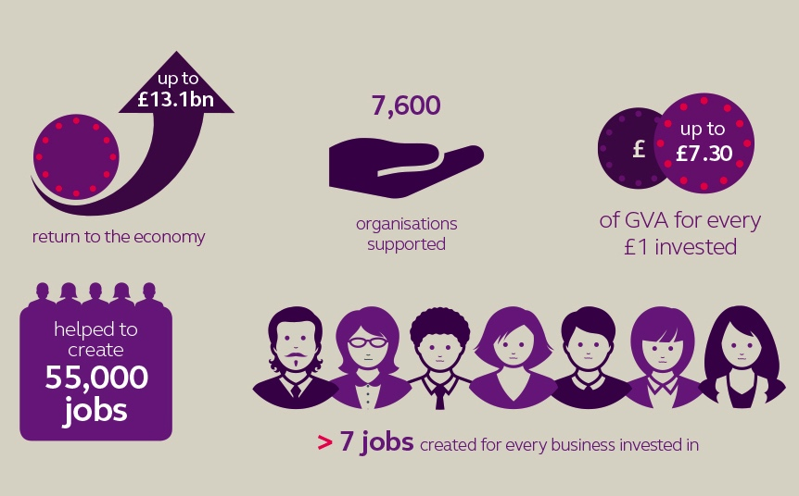
Notes:
How’s that going?
So far we’ve supported 7600 organisations, mostly businesses. Through them, we have helped to create 55,000 jobs, that’s typically about 7 in each business. And that’s returned £13bn to the UK economy.
So we think it’s going quite well. But we have a plan to do better.

Slide 8
Our 5-point plan
Working with the research community and across Government to turn scientific excellence into economic impact
Accelerating UK economic growth, nurturing small, high-growth companies, with strong productivity and export success
Evolving our funding models; helping public funding go further
Developing Catapults within a national innovation network
Building on innovation excellence throughout the UK, investing locally in areas of strength
1
2
3
4
5
Notes:
This is our 5 point plan:
What I said earlier about working with government and the research base to turn knowledge into innovation.
Supporting innovative business with the potential to grow. I’ll explain how we do that next.
Building on innovation excellence. Investing locally in areas of strength. This event and work on the Science and Innovation Audit is one of the ways in which we can establish in more detail what those strengths are.
Developing Catapults as part of the national innovation landscape. Catapults are national centres of excellence that are there to help business. We want to better connect them to the networks and institutions in their fields so that their resources are even more accessible to businesses here and everywhere.
Evolving our funding models to increase the impact that our funding has. We’ll be piloting new Innovation Loans in the coming year, that will allow us to support businesses as they grow.

Slide 9
Sectors approach to supporting businesses
Infrastructure
Systems
Health
and Life
Sciences
Emerging
and
Enabling
Manufacturing
and
Materials
Open
Programme
£150M
2016-17 budget
£117M
2016-17 budget
£86M
2016-17 budget
£137M
2016-17 budget
£71M
2016-17 budget
Jan 2017
Next sector competition closes March ‘17
~May 2017
Next sector competition
~June 2017
Next sector competition
Connect
Feb 2017
Next sector competition closes April ‘17
Mar 2017
Next sector competition closes May ‘17
Our competitions schedule includes programmes run with partners – more details on our webpage
Notes:
So, a key part of our approach is that we FUND business innovation projects.
We’ve reorganized into key sector groups, that cover most aspects of science and technology innovation.
Infrastructure systems includes energy, future cities and transport systems.
Health and life sciences includes Agritech
Emerging and Enabling thechnologies includes all sorts of clever things like robotics, graphene, quantum technologies and synthetic biology
Manufacturing and materials, Includes automotive and aerospace, also introducing digital technologies and new materials to manufacture at scale.
And an open programme that covers just about everything else.
We award funding through a series of competitions. Large ones covering all our activities in these sectors, like £15m for Health andLlife Sciences that we’re introducing today, and some more specific ones, often with partners, such as the biomedical catalyst. Projects can involve just one company, or collaborations between businesses and a research organization.
The other thing that we do is CONNECT people to the knowledge or partners that they need to pursue their innovation. It’s easy to say that money isn’t everything but, sometimes, that’s not what’s missing. It’s the ability to solve a particular problem that’s standing in the way. And it’s a lot easier to find the cutting edge of your industry if you can talk to someone who knows where that is.

Slide 10
Connecting business innovation
Notes:
Our ‘family’ helps to make those connections in a number of different ways. We’re going to explain this in more detail in our session later but, wherever you start, we’ll make sure you find the help that you need.
The Knowledge Transfer Network has sector expertise in depth. They’ll know what that cutting edge is in your industry and who’s working there. Or connect you with experts in other areas.
This is just one of the fantastic events that they run throughout the year to introduce our competitions and to connect innovators like you to the knowledge you need.
The Enterprise Europe Network does far more than it says on the tin. It’s the world’s largest business support network, with partners in 60 countries. They can help you to find new markets or partners in those counties, advise on licensing and IP, and much more.
Knowledge Transfer Partnerships, or KTPs, is a programme that helps businesses to work with a university for up to three years to solve a particular business innovation challenge.
As I said earlier, Catapults are national centres of excellence, with world-class knowledge and facilities that are there to help business. They’re a resource to solve technical challenges. A place to test and fail in private and in safety.
All of them can also advise on sources of funding that are best suited to your project.

Slide 11
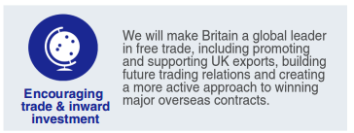
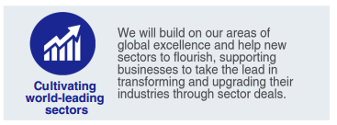
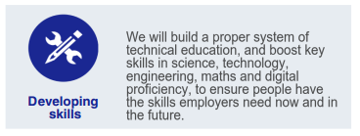
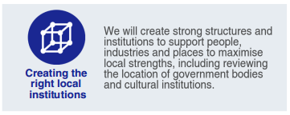
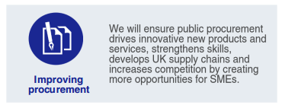
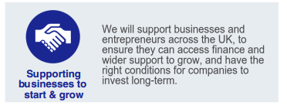
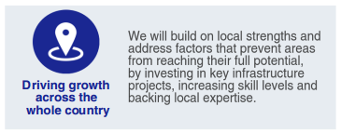
Industrial Strategy
Notes:
Important to note that investing in Science, Innovation and Research is the first of ten pillars, putting that at the heart of the industrial strategy.
The Industrial Strategy Challenge Fund will be a substantial increase in the funding available. Hundreds of millions next year, £2BN by 2020/21.
The Industrial Strategy Challenge Fund will:
Support business led collaborations with research;
Identify challenges that may well cut across boundaries of research;
Focus on areas with the potential to transform existing industries and create entirely new ones.
All the other pillars are important and interlinked. Won’t read them all but….
Cultivating world leading sectors, supporting business growth, creating the institutions, skills and infrastructure that will support innovation and industry
Building on local strengths to do this – so it is important to be able to identify and describe those strengths in relation to other areas and the world.

Slide 12
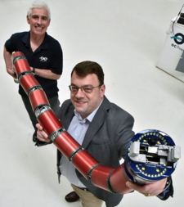
Industrial Strategy Challenge Fund
Medicines manufacturing technologies £197m
Robots for a safer world £93m
Batteries for clean and flexible energy storage £246m
Self-driving vehicles £38m
Manufacturing and materials of the future £26m
Satellites and space technology £99m
Fund values are over four years. 3 4 & 5 are subject to approval of business case

Slide 13
Innovate UK in the South East LEP area

Slide 14
Innovate UK in the South East LEP area
Since 2010/11 Innovate UK has awarded:
£71.5 million to 580 businesses for innovation projects, including:
£19.7m to Materials & Manufacturing (94 businesses)
Plus £11.8m to the Advanced Propulsion Centre at HSSMI
£16.5m to Health and Live Sciences, inc. £5.5m to AgriTech (102)
£7.5m to Infrastructure Systems (72)
£5.8m to Emerging & Enabling tech, inc. digital, electronics & space (79)
£499 for every business in the area over 7 years

Slide 15
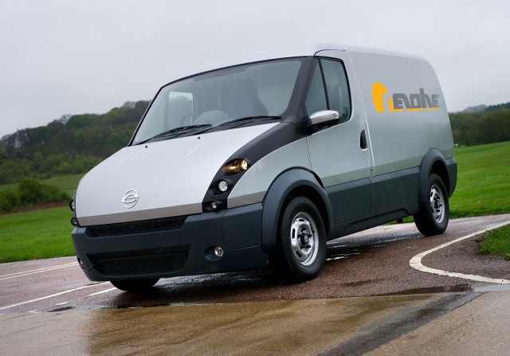
Fund – Low Carbon Vehicle innovation Platform
£230m grants awarded to 220 projects involving 650 partners 2007-14
We estimate that follow-on investment is 5x grant value and…
return on each UK £ invested is £8-14 over ten years and £20-34 over 15 years
Revolve Technologies, Brentwood, received £5.1m
Collaborating in 11 projects, receiving £34.6m grant
Partners include Ford, Honda, Hyundai, Jaguar Land-Rover, London Taxi and HSSMI
Plug-in hybrid electric vehicles, hydrogen power, etc.
“Our success has been heavily reliant on R&D, ultimately ensuring that we are able to stay ahead of the game.” Paul Turner, Technical Director, Revolve Technologies

Slide 16
Connect – Enterprise Europe Network
Blue Abyss plan to create a world-class aquatic research, training and development centre at University of Essex
Struggled to find advice on how to access finance and attract investment
EEN gave advice on IP and gained input from six countries on commercial diving markets and applications for market report
That supported their bids for funding and underpinned their presentations
"The Network helped us get access to market specialists and that support proved vital” John Vickers, Blue Abyss
Read more and watch our video here

Slide 17
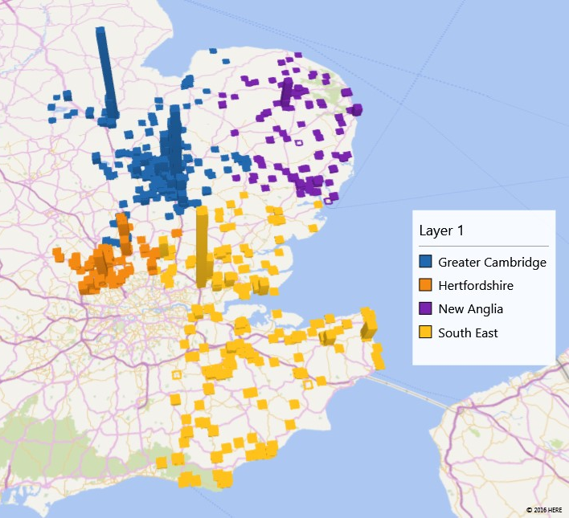
East of England innovation landscape
Total Innovate UK grant and unique applicants 2010/11 – 2016/17
Over £231 million to 2000 business innovation projects*
GCGP £159m 1,228
South East £71m 580
Hertfordshire £44m 436
New Anglia £18m 286
*LEP areas overlap, affects totals.
Not the only measure of innovation activity
All Innovate UK grants inc. large projects 2009 - Aug 2016
Notes:
This map shows where we’ve invested our funds. In the last six years, we have committed over £231 million to 2000 business innovation projects. It’s not a complete measure. There are other sources of funding, including business itself.
Health and life sciences in Hertfordshire, Cambridge, Norwich, Kent and Meadway. Agritech in similar areas.
Manufacturing and materials has large spikes in Peterborough and Basildon, also Stevenage and Cambridge and Norfolk.
And ICT with a big concentration in Cambridge, but BT’s global R&D HQ hardly shows. More fundamental research and spending their own money.
Where we are today is a great example of the range of capabilities in the region. TWI have world class engineering research and testing facilities. They’re partnering with several of the UK’s leading universities. And on the same park we have companies like Meddimune, owned by AstraZenica, who’ve chosen this place as the best for their health research and development.
It’s quite easy to see these patterns and recognise the large businesses. But getting to understand what the strengths are in detail, and what opportunities there are in new subsectors, like bioelectronics, takes the local knowledge and understanding of people in the industries themselves.
The rest of this morning will be about exploring what we – or you – know about the strengths of the region. Particularly what’s just good, and what’s world class. How do we stack up against the competition? How can that knowledge inform your business strategy?
That’s what the Science and Innovation Audit aims to do. Really put the region on the map!

Slide 19
Embargoed until publication
Notes:
CHART EMBARGOED UNTIL PULICATION LATER IN JUNE

Slide 20
Encouraging innovation in the South East LEP area
£74.1 million ERDF for Sustainable growth
Promoting research and innovation - £14.3 million
Supporting SME growth and competitiveness - £38.3 million
Supporting a shift to a low carbon economy - £16.9 million
£3.8 million (26%) of innovation budget been awarded to:
KEEP+ Innovation and Knowledge Exchange
Supply Chain Innovation for Offshore Renewable Energy (SCORE)
Calls in all three themes open until 12 January 2018
Workshop to engage stakeholders in new innovation project development
15th June in London

Slide 21
Understand and focus on innovation strengths
Science and Innovation Audit - East of England
Life Sciences ▪ Agritech ▪ ICT including digital/creative technologies
Advanced Engineering and Materials including advanced manufacturing
Cleantech as a cross-cutting theme
SIA - Innovation South. ▪ Digital Enabling Technologies and influence on:
Connected digital systems, services & products
Advanced engineering ▪ Marine and maritime ▪ Bioscience
Smart Specialisation Hub
Detailed profiles of each LEP
Facilitates strategy development
http://smartspecialisationhub.org/

Slide 22
Encouraging innovation in the South East LEP area
Increasing awareness, engagement and success
Raising awareness and responsiveness through social media
Connecting our networks with South East networks and Growth Hubs
Enhancing links between universities and businesses / networks
Helping companies to find the right support and funding for their needs
Events to engage and inform
275 people attended Innovate UK in the East of England in February
Venturefest East, 21 September www.venturefesteast.co.uk
Competition launches around the country and on-line
Catapult centre drop-ins and open days
Sharing more data to understand successes and challenges

Slide 23
Connect with Innovate UK
Start at our website www.innovateuk.gov.uk
Follow @innovateuk on Twitter
Watch guidance and success stories on YouTube
Sign up to receive our monthly newsletter and our blog
We’re on LinkedIn, Facebook and Google+ too
@Catapult_UK @KTNUK @EENEAST @EENSouthEast
Notes:
How do you find out more? Our website has lots of information on funding competitions and how we can help you to connect.
You can follow us on all the usual channels, including YouTube, which has advice on applying for funding, on promoting new innovations and examples of companies that have succeeded.
You can join in today using #LocalInnovations and #EastofEngland.
I hope you have a great day.
Thanks again to my KTN colleagues for putting on this event!

Slide 24
Innovation
in the South East
Howard Partridge
Regional Manager, East of England
Howard.Partridge@InnovateUK.gov.uk @HowardPeartree
We can’t stop thinking about the future
Innovate UK Driving business innovation and economic growth
Howard Partridge, Strategic Partnerships
Howard.Partridge@InnovateUK.gov.uk

