Slide 1
Business Case Best Practice Workshop
The Local Funding Framework
Steven Bishop

Slide 2
Contents
Policy context
Devolved funds
Single Assurance Framework
Changes to the Assurance Framework

Slide 3

Policy context
Localism → Decentralisation → Devolution
Government has devolved aspects of decision making on how best to use funding to achieve local objectives and forecasts
Follows Lord Heseltine’s report, No Stone Unturned – in pursuit of growth, making 89 recommendations, of which the government accepted 85
Local business and civic leaders best placed to identify the funding, resources and powers required to generate higher levels of economic growth
Formation of the Local Growth Fund - £12 billion from 2015/16 to 2020/21
Government likes to make ‘deals’
  City Deals (Wave One: 8 cities and Wave Two: 20 cities, including Southend-on-Sea)
  Growth Deals (SELEP-wide)
  Devolution Deal (enabled through the Cities and Local Government Devolution Act – what next for SELEP?)

Slide 4



Devolved funds
Growth Deals: The deal each LEP agreed with central government, and associated allocation of the Local Growth Fund for projects that benefit the local area and economy:
  Round One: £442m (July 2014)
  Round Two: £46m (January 2015)
  Round Three: £102m (January 2017)
Skills Capital Funding: Funding to improve the estate, facilities and equipment of FE colleges and approved training organisations. This is now part of the LGF.
Growing Places Fund: Funding to support key infrastructure projects designed to unlock wider economic growth, create jobs and build houses in England. Funded projects include site access/site clearance, broadband and transport infrastructure, utilities, refurbishment of buildings and flood defence barriers.

Slide 5
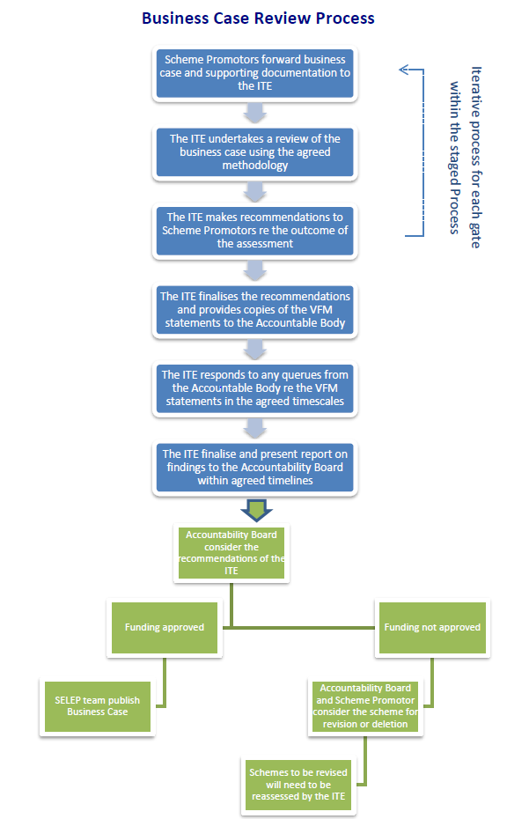
Local Enterprise Partnership Assurance Framework
As part of the Growth Deal it was Government’s wish to develop a single national Assurance Framework covering all Government funding flowing through LEPs, to ensure all LEPs have robust processes in place in assessing value for money, with transparent, robust and democratically accountable processes.
The purpose of the national Assurance Framework is to build confidence in the delegation of funding from central budgets and programmes via a un-hypothecated funding mechanism (i.e. Local Growth Fund).
The Assurance Framework establishes general principles for LEPs with regards to Local Growth Fund allocations. These include guidelines for ensuring value for money, governance, decision making, and partnership working.

Slide 6
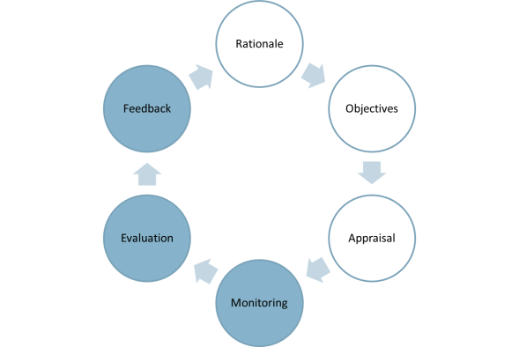
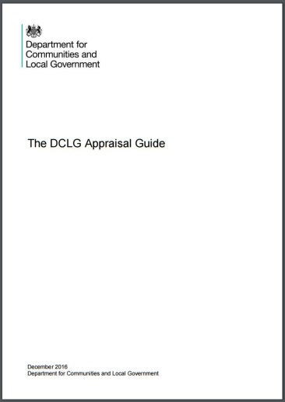
Key changes to the national Assurance Framework
The single Assurance Framework has now been revised to reflect current policy and current expectations of LEPs in relation to accountability, transparency and value for money. The principal changes are:
  To cover governance of City Deals not just Growth Deals.
  Requirement for the LEP to have an identified board member Board to represent and engage with SMEs.
  Must provide the basis for how projects and programmes are initially identified, commissioned, appraised and prioritised and list requirements.
  The framework encourages the use of the new DCLG Appraisal Guidance for the economic assessment of residential and non-residential development schemes.
  Local Enterprise Partnerships will need to ensure that there is appropriate output and outcome monitoring and evaluation of projects taken forward.

Slide 7

SELEP process for the award of funding
Rhiannon Mort
SELEP Capital Programme Manager
8th March 2017

Slide 8
SELEP decision making
SELEP Assurance Framework
Delivering our Growth Deal
Q&A

Slide 9
SELEP Assurance Framework
Why do we need an Assurance Framework?
Sets out the systems and processes to manage the delegated funding from Central Government Budgets effectively
Assurance that decisions over funding are proper, transparent, and deliver value for money
Compliance with National Assurance Framework

Slide 10
SELEP Assurance Framework
Sets out the federated way in which SELEP operates
SELEP
Strategic Board
Independent Technical Evaluation
Gate Review
Value for Money
Business Case Development
Federated Boards
Accountable Body
Accountability Board
Notes:
Complex process. What does all this mean?

Slide 11
How SELEP operates
SELEP Strategic Board
SELEP Accountability Board
SELEP Federated Boards
Sets the strategic direction of the LEP
Makes funding decisions and assures Value for Money
Define local priorities and set the vision for the federal area

Slide 12
Identifying Investment Priorities
Allocation and award of funding
Project Delivery
Monitoring and Evaluation

Slide 13
Identifying Investment Priorities
Project identification
Strategic Outline Business Case developed using SELEP template
Federated Area prioritisation
  Applying common prioritisation approach
  Engaging with SELEP Independent Technical Evaluator (ITE)
Informing a single prioritised list – to be agreed by Strategic Board

Slide 14
Identifying Investment Priorities
Assessment of projects based on Green Book approach
Considering phasing, suitability and availability of funding
Proportionate approach to the scale of the intervention
Strategic Case
Economic Case
Commercial Case
Financial Case
Management Case
Notes:
Strategic Case – Project should be aligned with the SELEP Strategic Economic Plan
Economic Case – Projects are expected to deliver high or very high value for money
Commercial Case – The proposed deal is attractive to the market place, can be procured and is commercially viable
Financial Case – The project should demonstrate the proposed funding streams to finance the total project costs and the expected phasing of the funding, seeking opportunities to leverage private sector investment and other match funding
Management Case – Project should set a proposed plan for project delivery, evaluation, progress reporting and monitoring of benefit realisation. It should also include details of any risks and how these will be managed, including the costs of mitigating these risks.

Slide 15
Identifying Investment Priorities
Allocation and award of funding
Project Delivery
Monitoring and Evaluation

Slide 16
Allocation and award of funding - LGF
SELEP single prioritised list and bid to Government
SELEP funding allocation from Government
Business Case development and ITE review Gate Review process
Funding decision by SELEP Accountability Board
Different for Growing Places Fund projects

Slide 17
Allocation and award of funding - LGF
 | LGF Round 1 | LGF Round 2 | LGF Round 3
Award | £442m | £46m | £103m
Total | £591m

Slide 18
Allocation and award of funding - GPF
Operates as a recyclable loan fund
£49.2m GPF has been made available to SELEP and invested through previous rounds of bidding
Availability of GPF for re-investment (£000)
 | 2017/18 | 2018/19 | 2019/20 | 2020/21 | Total
Expected GPF available to reinvest | 3,500 | 2,600 | 1,700 | 7,200 | 15,000
Cumulative amount available | 3,500 | 6,100 | 7,800 | 15,000

Slide 19
Allocation and award of funding - GPF
Broad approach agreed for the re-investment of Growing Places Fund
Stage 1 – Expressions of Interest (to be lead by Federated Areas)
Stage 2 – SELEP Scheme Prioritisation
Stage 3 – SELEP Accountability Board funding decision (including ITE process)

Slide 20
Allocation and award of funding
Business Case development and ITE process
The Independent Technical Evaluator assessment is based on adherence of scheme business cases to the guidance set out in The Green Book, and related departmental guidance such as the Department for Transport’s WebTAG (Web-based Transport Analysis Guidance) or the Homes and Communities Agency’s The Additionality Guide
Each project is assessed following a standard SELEP Business Case assessment template and given a ‘RAG’ (Red – Amber – Green) rating

Slide 21
Allocation and award of funding
ITE Business Case review process
Gate 0 – Scoping: This stage requires the scheme promoter to discuss the process and procedures and proposed method for developing the business case.
Gate 1 – Outline Business Case (OBC): Following Gate 0, project promoters must develop a business case commensurate with an Outline Business Case as guided by The Green Book guidance on appraisal and evaluation and relevant Government departmental guidance.
Gate 2 – Final Outline Business Case (FOBC): A revised version of the OBC modified based on the Gate 1 assessment. This version is then assessed for a recommendation to made to the Accountability Board for whether the scheme presents high value for money and, therefore, should receive funding.

Slide 22
Allocation and award of funding
ITE Business Case review process
Gate 3: This gate is used for projects that have funding retained by the Department for Transport or where the business case is being developed by another Government Department or Statutory Body - typically larger and higher risk.
Gates 4 and 5 – Full Business Case: For large schemes over £8 million and those considered high risk by the Accountability Board, will be required to go through Gate 4 and 5 to develop a Full Business Case, where agreed with Accountability Board on the completion of Gate 2. Gate 4 and 5 should take place within the procurement phase of the project.

Slide 23
Allocation and award of funding
To receive a recommendation for approval, projects should have:
  A clear rationale for the interventions linked with the strategic objectives identified in the Strategic Economic Plan
  Clearly defined outputs and anticipated outcomes, with clear additionality, ensuring that factors such as displacement and deadweight have been taken into account
  Considers deliverability and risks appropriately, along with appropriate mitigating action (the costs of which must be clearly understood)
  A Benefit Cost Ratio of at least 2:1 or comply with one of the two exemptions

Slide 24
Allocation and award of funding
Value for Money Exemptions
Exemption 1: This may be applied where a project does not present High Value for Money (a Benefit Cost Ratio of over 2:1); but has a Benefit Cost Ratio value of greater than 1.5:1; or where the project benefits are notoriously difficult to appraise in monetary terms; and only if the following conditions are satisfied:
  the project must be less than £2.0m and to conduct further quantified and monetised economic appraisal would be disproportionate; and
  where there is an overwhelming strategic case (with minimal risk in the other cases); and
  there are qualitative benefits which, if monetised, would most likely increase the benefit-cost ratio above 2:1

Slide 25
Allocation and award of funding
Value for Money Exemptions
Exemption 2: This may be applied where a project does not demonstrate a High Value for Money (a Benefit Cost Ratio of over 2:1), but has a Benefit Cost Ratio of over 1:1, and only if the following conditions are satisfied:
  there is an overwhelming strategic case for the project
  there is demonstrable additionality - intervention address a clear market failure
  there are no project risks identified as high risk and high probability after mitigation measures have been considered; and
  where Value for Money assurances are provided by Government Department, Highways England, Network Rail, Environment Agency or Skills Funding Agency

Slide 26
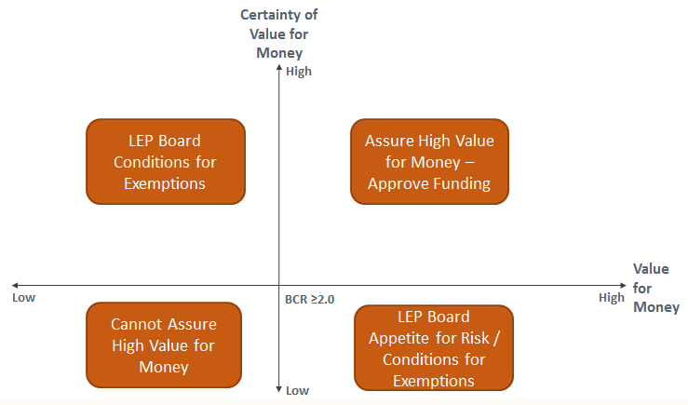
Allocation and award of funding

Slide 27
Identifying Investment Priorities
Allocation and award of funding
Project Delivery
Monitoring and Evaluation

Slide 28
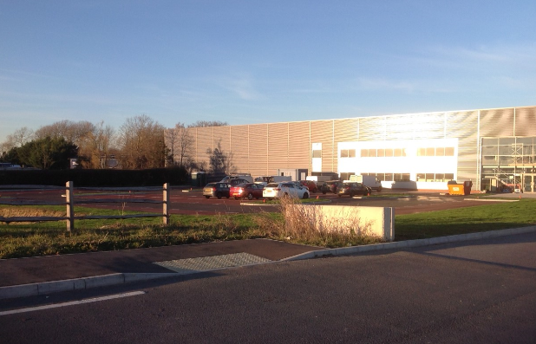
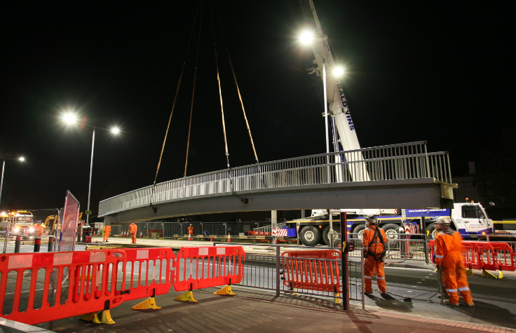
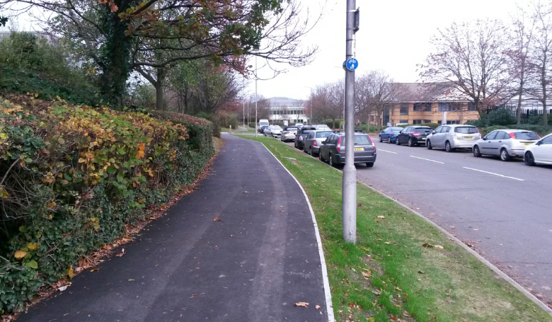
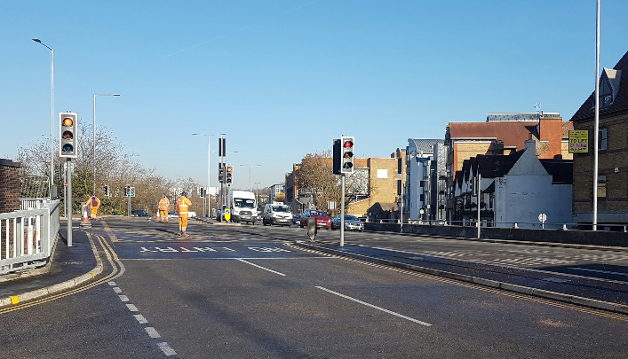
Swallows Business Park, East Sussex
Kent Elms Corner, Southend
Medway Cycle Action Plan
Maidstone Gyratory, Kent

Slide 29
Project Delivery
Monitoring of project delivery, risk, and spend by delivery body
Programme Consideration Meetings
Quarterly transfer of LGF to county/unitary authority – based on spend forecast
Quarterly reporting to SELEP Secretariat, SELEP Accountability Board and Government
Reporting of project changes through the Change Request process – ensuring projects continue to present Value for Money

Slide 30
Project Delivery
Changes the project during delivery are reported to Accountability Board
The following changes require a decision from Accountability Board:
Cancellation of a Growth Deal project
Inclusion of a project not included in the Growth Deal
Accelerate of LGF spend between financial years
Delays to project start or end dates of more than six months
All changes to LGF allocations above the 10% threshold
Re-profiling of LGF between financial years
Any changes to total project costs above a 30% or a £500,000 threshold
Any substantial changes to the expected project benefits, outputs and outcomes as agreed in the business case
Notes:
Impact on VfM

Slide 31
Identifying Investment Priorities
Allocation and award of funding
Project Delivery
Monitoring and Evaluation

Slide 32
Monitoring and Evaluation
Monitoring and evaluation will focus on those outcomes that are most relevant to the impact of the project’s objectives as defined in the project business case.
Where appropriate, an evaluation of the impact of the intervention on the following Growth Deal outcomes:
    Housing unit completion
    Jobs created or safeguarded
    Commercial/employment floor space completed
    Number of new learners assisted
    Area of new or improved learning/ training floor space
    Apprenticeships

Slide 33
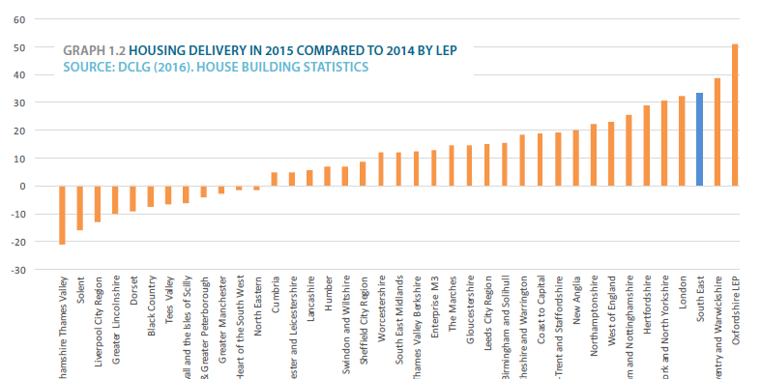
Monitoring and Evaluation
Commitment to deliver:
29,129 new homes and 70,785 new jobs by 2021
10,600 completed homes in 2015/16

Slide 34
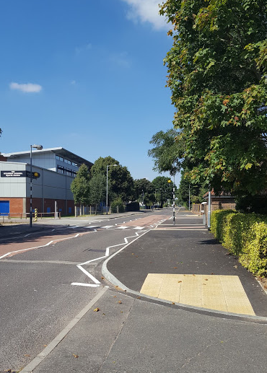
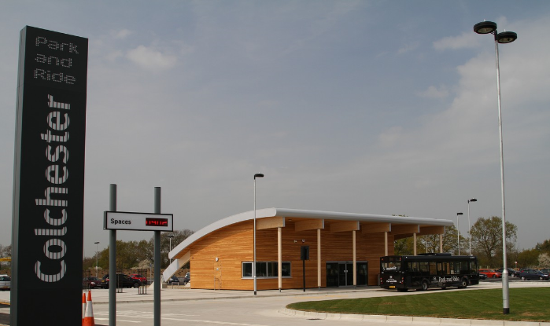
Colchester LSTF, Essex
£2m LGF investment to improve pedestrian and cycling facilities
Final measures completed in October 2016
Colchester Park & Ride, and Bus Priority Measures, Essex
£5.8m LGF
Project completed in 2015
Both projects support the delivery of Colchester North Growth Area Urban Expansion – 2,200 new homes

Slide 35
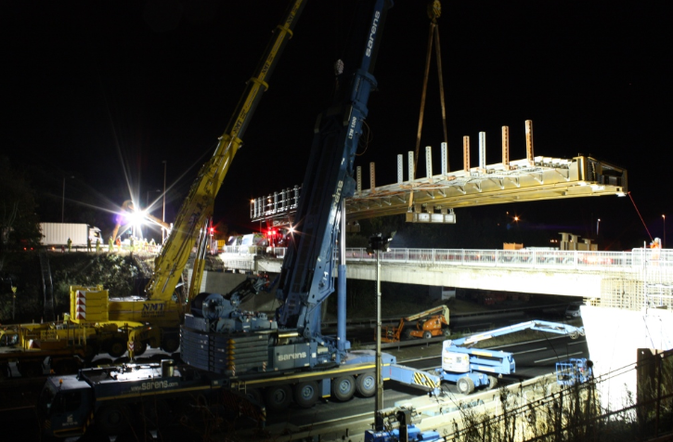
M20 Junction 4
£2.2m LGF and £3.5m private sector match
Project completed in January 2017
Supporting the delivery of 1,695 new homes

Slide 36
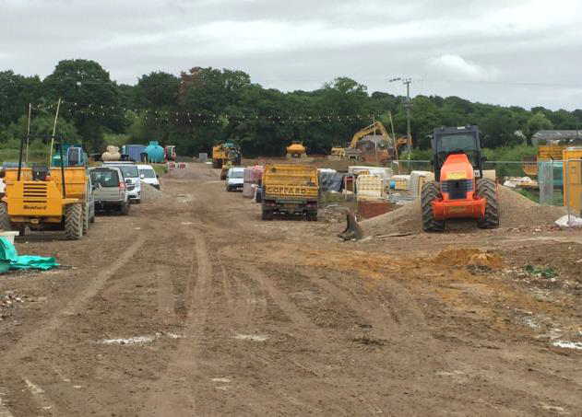
Swallow Business Park, East Sussex
£1.4m LGF
£11.2m match funding
Utilities
Site enabling works
Site access road
Completed in December 2016
Delivering 10,344m² of new commercial space

Slide 37
The DCLG Appraisal Guide
Presentation to LEP Workshop
8th March 2017
Rishi Mandavia, Economic Advisor
Eduin Boater Latimer, Assistant Economist
Growth & Places Analysis
Analysis and Data Directorate
Department for Communities and Local Government

Slide 38
Introduction to Appraisal at DCLG
What is the Guide & how has it been produced?
Suggested methodology and framework

Slide 39






Policy areas DCLG is responsible for
Housing
Decentralisation and local growth (commercial development)
Planning
Local Government, Troubled Families, Integration & Community Rights

Slide 40
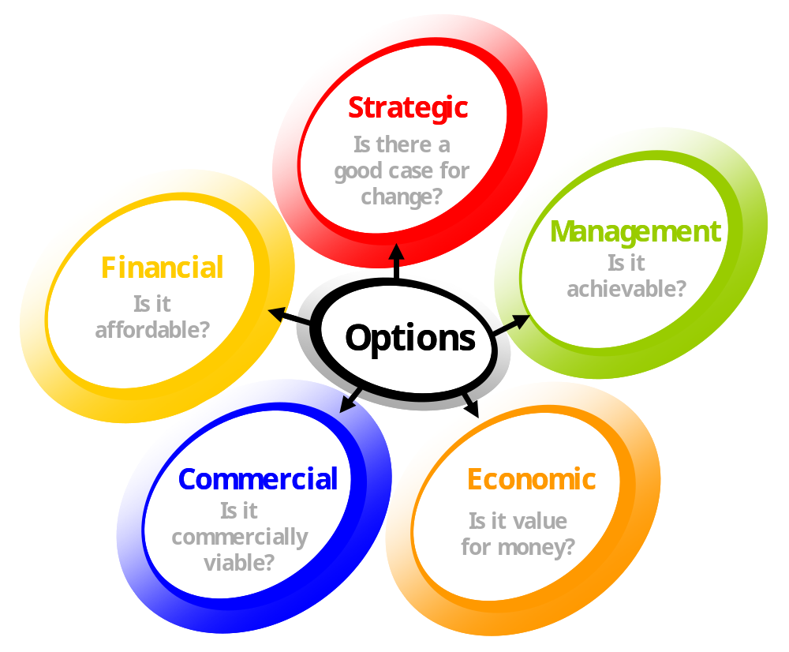
Business cases set out the justification for a spending proposal and are structured in a 5 case model. Appraisals feature in the economic case.
The appraisal of different options features here

Slide 41
An appraisal is about calculating the costs and benefits of a policy and determining its value for money
Benefits
Improved Health
Costs
Public sector costs
Land remediation costs
Build costs
Land value uplift

Slide 42
Introduction to Appraisal at DCLG
What is the Guide & how has it been produced?
Suggested methodology and framework

Slide 43
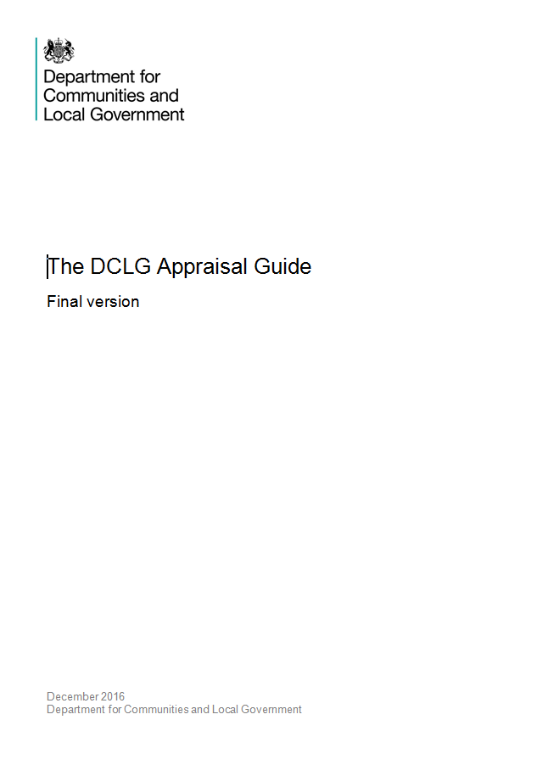
What is the DCLG Appraisal Guide?
A document containing the methodology, assumptions, and metrics that should be the default in DCLG economic appraisals
Should be used for business cases, Impact Assessments and policy advice
Is consistent with the ‘refreshed’ version of the Green Book & WebTAG

Slide 44
How have we produced the DCLG Appraisal Guide?
A DCLG Appraisal Group was set up to oversee its production and future updates
Used DfT’s WebTAG as a benchmark
Developed the Appraisal Guide in tandem with Green Book refresh
Had sought advice and obtained peer reviews of the Guide from Other Government Departments (HMT, DfT, BEIS & HCA) and external partners

Slide 45
Introduction to Appraisal in DCLG
What is the Guide & how has it been produced?
Suggested methodology and framework

Slide 46






In DCLG, economic appraisals are often about valuing the costs and benefits of a change in land use
Before
After

Slide 47
Residual method of land valuation
Our preferred approach to valuing the private benefits of developments…
Land values allows you to measure the value to society of a planning decision to grant planning permission for new development;
There are two elements to this:
The Private Benefit associated with a change in land use (LVU); and
2) The Net External Impact of the resulting development such as:
External cost
Increased congestion
External Benefit
Improved Amenity

Slide 48
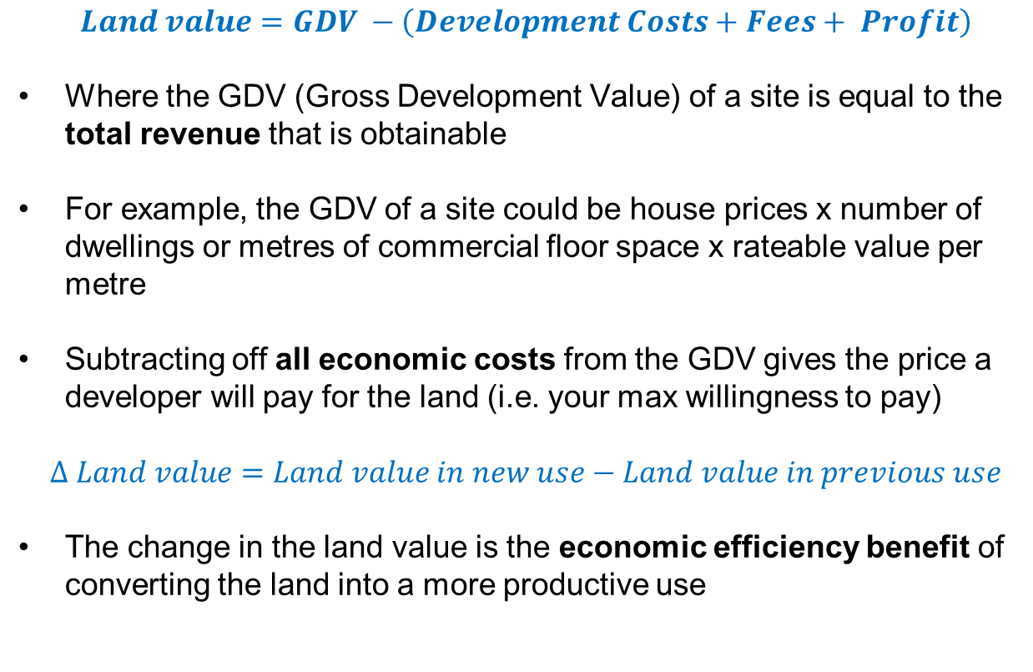
Residual method of land valuation
Our preferred approach to valuing the private benefits of developments…
$$Land value=GDV −\left(Development Costs+Fees+ Profit\right)$$
Where the GDV (Gross Development Value) of a site is equal to the total revenue that is obtainable
For example, the GDV of a site could be house prices x number of dwellings or metres of commercial floor space x rateable value per metre
Subtracting off all economic costs from the GDV gives the price a developer will pay for the land (i.e. your max willingness to pay)
$$∆ Land value=Land value in new use−Land value in previous use$$
The change in the land value is the economic efficiency benefit of converting the land into a more productive use

Slide 49
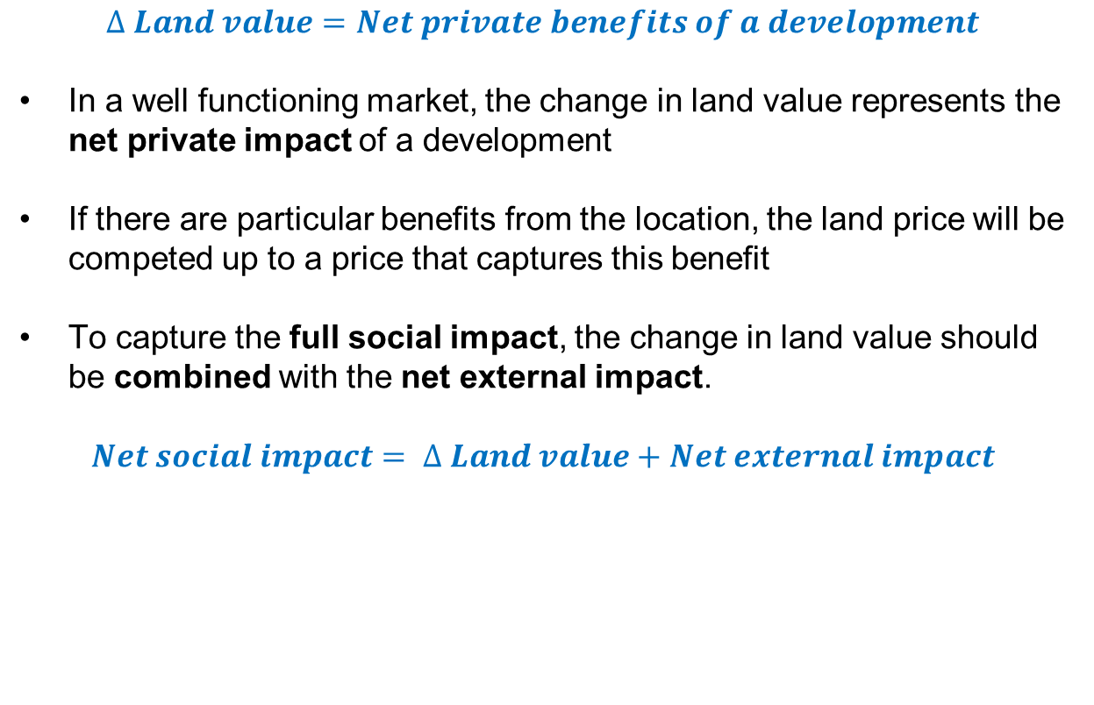
Residual method of land valuation continued
$$∆ Land value=Net private benefits of a development$$
In a well functioning market, the change in land value represents the net private impact of a development
If there are particular benefits from the location, the land price will be competed up to a price that captures this benefit
To capture the full social impact, the change in land value should be combined with the net external impact.
$$Net social impact= ∆ Land value+Net external impact$$

Slide 50
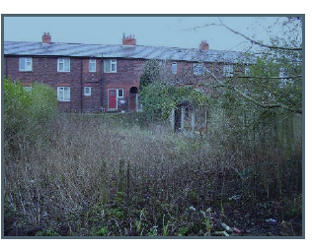

A residential example
Land Value Uplift in Ince Estate in Wigan
Ince Estate in Wigan was a textile factory. The land was decontaminated and redeveloped as flats in 2010.
The decontamination cost of £7,500,000 was paid by the Local Authority and enabled the development of 300 dwellings.
The average flat price in Wigan in 2011 was £75,000.
The gross development value is 300*£75,000=£22.5m
We assume the total private costs (development costs, fees to contractors and developer profits) are £5m
The land value in the new use is therefore £22.5m-£5m=£17.5m

Slide 51
A residential example continued…
Land Value Uplift in Ince Estate in Wigan
The Ince Estate is 10 hectares of Land.
VOA estimates for the value of land in industrial use in the North West is £400,000 per hectare
The total land value in its previous use is therefore
£400,000*10=£4m
Land Value Uplift therefore equals
£17.5m-£4=£13.5m
The Benefit Cost Ratio is calculated by dividing the net private benefits by the public sector costs:
£13.5m/£7.5M=1.8
This suggests that the project is Acceptable Value for Money, but this does not include external impacts

Slide 52
Land Value Estimates
We recommend that practitioners use local land values if available.
If local land values are not available, DCLG provide estimates for residential land values and non-residential land value uplifts.
These can be found in the Data Workbook published alongside the DCLG Appraisal Guide
Region | Business Park 'Greenfield uplift' per m² | Business Park 'Brownfield uplift' per m² | City Centre 'Greenfield uplift' per m² | City Centre 'Brownfield uplift' per m²
East
Cambridge | £278 | £229 | £2,538 | £2,489
Peterborough | £38 | (£11)* | £263 | £214
East Midlands
Nottingham | £43 | £12 | £238 | £207
Leicester | £43 | £12 | £238 | £207
London
Victoria |  |  | £3,455 | £3,244
Croydon |  |  | £239 | £28

Slide 53




But private impacts aren’t the only consideration
Externalities should be separately accounted for in the appraisal.
There are a number of potential externalities associated with a development such as:
- transport externalities
- agglomeration impacts on third parties
- the amenity impact of development
- the wider environmental impact
There is also a distributional impact associated with a change in land value
If an impact is measured based on Green Book Guidance it should be included in the ‘initial BCR.’ Otherwise it should be included in a separate ‘adjusted BCR.’

Slide 54



Land value captures a range of impacts so need to be careful when quantifying externalities
Captured in land value
Not captured in land value
Private benefits to existing firms from the increased clustering of economic activity
Private benefits from co-location to the firm / individuals ‘moving in’
Environmental / amenity impact on the firm / individuals ‘moving in’
Environmental / amenity impact on the rest of society from the development
Congestion impact on existing firms and individuals as a result of development
Congestion impact on the firm / individuals ‘moving in’

Slide 55
A critical issue in economic appraisal is establishing the level of additionality associated with an intervention
Additionality is the real increase in public value (welfare) that would not have occurred in the absence of an intervention
Any value that would have occurred (deadweight) or reductions in value in other locations (displacement) should be deducted from the estimated gross increase in public value
Additionality is tricky to determine and there is limited evaluation evidence available
Therefore, determining the size of the additionality will involve judgement and a sound understanding of the rationale for intervention

Slide 56
Possible characteristics of different additionality factors
Additionality factor | Examples
Low: 0-25% | Demand focussed Bringing forward housing delivery Market failure less prevalent than in the past
Low to Medium: 25-50% | Demand or supply focussed More muted economic conditions Targeted at a specific market failure e.g. SME finance, first time buyers
Medium to High: 50-75% | Supply focussed Good supporting local evidence Affordable housing
High: 75%+ | Strong supply focus Good supporting local evidence Significant site preparation costs Housing in area of high housing need More muted economic conditions

Slide 57


There are two approaches that can be used to value a project undertaken to improve land use
Estimation of changes in land value; or
Estimation of the value of the factors that cause the land value to change (GVA)
In theory, both approaches should lead to a similar answer depending on the extent to which 2 captures external impacts;
Notes:
I would explain GVA modelling in more detail

Slide 58


A comparison to GVA modelling
Three reasons to use Land Value Uplift
LVU is based on observable data (land prices and construction costs) which reveals the net private benefits of a development. GVA modelling requires assuming employment to floorspace ratios and assuming employment to GVA multipliers.
Additionality is easier to identify using Land Value Uplift. It is easier to assess whether a commercial development displaced an alternative development, than if added employment displaces other jobs.
The direction of Green Book ‘refresh’ and recent Spending Review guidance indicates employment changes should not be included in an appraisal unless there is a demonstrable supply side impact

Slide 59
Business cases for funding land & property projects
Simon Pringle, Director
South East Local Enterprise Partnership

Slide 60
Introduction
Purposes
  Application of the 5 Case Model in the Land & Property domain
  Focus on Strategic Case & Economic Case – for capital projects
What I am drawing on
  25 years’ experience of appraising & evaluating interventions across the UK & Europe
What I’m going to cover – avoiding duplication with others!
  The 5 Case Model
  Main elements of the Strategic Case
  Main elements of the Economic Case – the importance of options, risk & optimism bias
Concluding thoughts/observations

Slide 61
Basics 1
We operate in a market economy
Markets should work perfectly
When they don’t, failures arise
Occurrence of market & other failures - & failures of outcome - provide the justification for public-sector intervention

Slide 62
Basics 2a – logic chain
Conditions
Impacts
What’s broken?
Is there a Rationale?
Objectives SMART!
Inputs
Activities
Outputs – gross/net
Outcomes – gross/net
Economy
Efficiency
Effectiveness

Slide 63
Basics 2b: the Logic Chain – the key questions
Where do we start – what’s the problem? | Rationale
What might happen if we do nothing? | Reference Case
What would we achieve if we acted? | Strategic Fit & Objectives
What are the options for us & others (& how can risks be minimised & managed? | Options/Risk Assessment
What will we need to spend on inputs to deliver the things we propose? | Costs & Activities
What are the expected outputs, results & beneficiaries? | Outputs, Outcomes & Impacts (Gross & Net)
Are the costs acceptable given the benefits? | Value for Money
Will the benefits continue without our support? | Delivery & Capitalisation

Slide 64
In a nutshell - the 5 Case Model
Where are we now?
  Current policy, strategy, & programmes
Where do we want to be?
  Objectives & outcomes
How are we going to get there?
  Options, solution/activity, delivery, implementation & funding
  Delivery
  Costs & resourcing

Slide 65
The 5 Case Model - in more depth for Land & Property
Strategic Case | Economic Case | Commercial Case | Financial Case | Management Case

Slide 66
The 5 Case Model - in more depth for Land & Property
Strategic Case | Economic Case | Commercial Case | Financial Case | Management Case
Rationale Background Policy context Strategic Fit SMART objectives Dependencies Constraints Risks

Slide 67
The 5 Case Model - in more depth for Land & Property
Strategic Case | Economic Case | Commercial Case | Financial Case | Management Case
Rationale Background Policy context Strategic Fit SMART objectives Dependencies, Constraints Risks | Options: long & short lists Economic costs & benefits Distributional analysis (if required) Non-quantifiable costs & benefits Sensitivity analyses (worst case scenario) Optimism bias Benefits realisation/ delivery plan Best VfM/max NPV

Slide 68
The 5 Case Model - in more depth for Land & Property
Strategic Case | Economic Case | Commercial Case | Financial Case | Management Case
Rationale Background Policy context Strategic Fit SMART objectives Dependencies, Constraints Risks | Options: long & short lists Economic costs & benefits Distributional analysis (if required) Non-quantifiable costs & benefits Sensitivity analyses (worst case scenario) Optimism bias Benefits realisation/ delivery plan Best VfM/max NPV | Commercial feasibility Procurement requirements Procurement strategy Contractual issues Milestones & delivery dates Risks identified & allocated HR issues e.g. TUPE

Slide 69
The 5 Case Model - in more depth for Land & Property
Strategic Case | Economic Case | Commercial Case | Financial Case | Management Case
Rationale Background Policy context Strategic Fit SMART objectives Dependencies, Constraints Risks | Options: long & short lists Economic costs & benefits Distributional analysis (if required) Non-quantifiable costs & benefits Sensitivity analyses (worst case scenario) Optimism bias Benefits realisation/ delivery plan Best VfM/max NPV | Commercial feasibility Procurement requirements Procurement strategy Contractual issues Milestones & delivery dates Risks identified & allocated HR issues e.g. TUPE | Affordability Budgeting parties Confirmation of budgets Impacts on income & expenditure & balance sheet (if applicable) Contingency for cost overruns Contingent liabilities (e.g. cost of cancellation of contract) Guarantees

Slide 70
The 5 Case Model - in more depth for Land & Property
Strategic Case | Economic Case | Commercial Case | Financial Case | Management Case
Rationale Background Policy context Strategic Fit SMART objectives Dependencies, Constraints Risks | Options: long & short lists Economic costs & benefits Distributional analysis (if required) Non-quantifiable costs & benefits Sensitivity analyses (worst case scenario) Optimism bias Benefits realisation/ delivery plan Best VfM/max NPV | Commercial feasibility Procurement requirements Procurement strategy Contractual issues Milestones & delivery dates Risks identified & allocated HR issues e.g. TUPE | Affordability Budgeting parties Confirmation of budgets Impacts on income & expenditure & balance sheet (if applicable) Contingency for cost overruns Contingent liabilities (e.g. cost of cancellation of contract) Guarantees | Delivery Plan Milestones & delivery dates Programme/ project management process/ techniques Contract management Change management plan (if necessary) Contingency & Risk Management Benefits Realisation

Slide 71
The Strategic Case
Strategic Case should include the rationale for intervention & a clear definition of outcomes
Rationale for intervention should be based on:
  Market failure/s – where the market has not & cannot be expected to deliver an efficient outcome and/or
  Government’s distributional objectives
The different types of ‘market failures’ are:
  ‘Externalities’ – positive & negative (commonly used)
  Information & co-ordination failures (commonly used & abused)
  Public Goods – non-rival & non-excludable (rarely used in our domain)
  Monopoly (rarely used in our domain)
Should establish a credible counterfactual
  What would happen in the absence of the proposed intervention?
  Note - something will always happen!

Slide 72
Economic Case 1/7 – Options development & longlisting
Purpose of Economic Case is to demonstrate spending proposal optimises public value
To do this properly, need a wide range of realistic & achievable options – the ‘longlist’
  A vital step – often skipped . . . followed by a trip-and-fall
  10-12 ways in which the issue might be nailed
How do you develop a longlist?
  Do your research – know what others have tried & where they have succeeded or failed, & why
  Adopt a creative & challenging approach
  Test the market context – especially the supply side
  Consult stakeholders, including potential users
  Maybe some feasibility studies . . .

Slide 73
Economic Case 2/7 – Shortlisting & Preferred Option
What does a shortlist look like?
  Typically 4 options, plus the counterfactual (i.e. don’t intervene)
    Beware the ‘scale options con’ - Do Noth, Do Min, Do Something & Do Max
    Think about discrete, differentiated options
Develop a short list?
  Develop sensible selection criteria to filter the longlist
    E.g. strategic fit, market conditions, planning feasibility, risk & deliverability, financial returns, quality of product
How do you move from a shortlist to a preferred option?
  Economic Appraisal of Costs & Benefits
  Taking account of:
    Distributional impacts (where relevant)
    Risk Assessment . . . & Sensitivity Analysis
    Optimism Bias

Slide 74
Economic Case 3/7 – Benefits
To date, in ec dev, GVA & employment have been King in terms of the quantified & ‘monetised’ benefits achieved
Estimating benefits entails gross-to-net calculations of jobs & GVA
  I.e. Allowing for
    Deadweight in funding/activity
    Leakage
    Displacement
    Substitution
    Multiplier effects – supply chain & spending
    Persistence & Decay
GVA & jobs still King for Local Growth Fund etc. but central government is looking to use land value uplifts as prime tool for appraisal in future

Slide 75
Economic Case 4/7 – Assessing Risk
‘The problem is not that the public sector is risk averse . . . rather, it’s risk ignorant’ (NAO)
Typical types of risk to consider for L&P projects?
  Third Party
  Project Control
  Client Control
  Design
  Procurement
  Site Control
  Construction
  External influences
How do we assess risk?

Slide 76
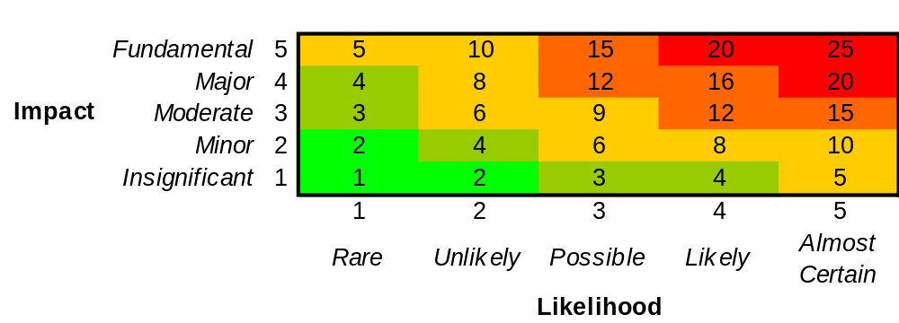
Economic Case 5/7 – Assessing Risk
Use of risk matrix to plot identified rick categories – assess risk ‘shape’ shape & ways in which this might be reduced
Sensitivity testing to understand residual risk which can't be designed out
Most critical assumption or variable identified . . . & monitored

Slide 77
Economic Case 6/7 – Optimism Bias 1/2
. . . is the tendency towards optimism, no matter what history says
 | Works duration |  | Capital expenditure
 | Upper | Lower | Upper | Lower
Standard Building | 4% | 1% | 24% | 2%
Non-standard Building | 39% | 2% | 51% | 4%
Standard Civil Engineering | 20% | 1% | 44% | 3%
Non-standard Civil | 24% | 3% | 66% | 6%
HM Treasury recommended ranges

Slide 78
Economic Case 7/7 – Optimism Bias 2/2
Out- turn
What are the typical sources of optimism bias?
  Capital costs
  Works’ duration
  Operating costs
  Under-delivery of benefits
  Receipts
Contract
award
Optimism
Bias
Full
Business
Case
Costs
Outline
Business
Case
Time

Slide 79
Concluding thoughts/observations
A good logic change/theory of change must be the start point
The 5 Case Model needs to be applied proportionately
Local capacity to develop (& appraise) proposals needs to be developed & maintained among local partners to embed knowledge & generate continuous improvement
A balance needs to be struck between commissioning projects & deployment of competitive bidding
Appropriate appraisal arrangements need to be in place to ensure appraisals are conducted in an even-handed manner
Present point in time where national guidance on appraisal & local assurance & governance frameworks not fully aligned
Devo of Business Rates may generate a shift in local policy priorities towards land value uplifts . . . how will this appear to the general public, esp where land values already high?

Slide 80
Business cases for Skills & Training projects
Simon Pringle, Director
South East Local Enterprise Partnership

Slide 81
Introduction
Purposes
  Look at business cases for Skills & Training interventions – capital & revenue projects – in context of failures in the labour market
  Use of logic-model approach to show how to design a project & show routes to impact
What I’m going to cover
  Indicators of labour market failure
  Causes of labour market failure
  Responses to market failures in labour markets
  Making the case for intervention
Concluding thoughts/observations
Useful references

Slide 82
Indicators of labour market failure
Skills gaps in a particular workforce
Skills shortages in a particular sector/sectors
Structural, long-term unemployment in particular places
Plus
  Income inequalities – not addressed in this presentation, as not easily affected by local initiatives
  Underemployment – not addressed here, as more often associated with lack of demand, not easily addressed at the local level

Slide 83
Causes of labour market failure 1/2
Poaching/’free-rider’
  Where one employer accesses the benefits of training paid for by another one
  Leads to under provision/investment in skills & training, as employers are reluctant to invest in staff who might then leave them
Information failures
  Information on jobs & returns on training is not available - jobseekers, learners &/or employers
  . . . finding information on jobs/learning confusing for individual job seekers or potential learners jobseekers, learners &/or employers
  Leads to unemployment, mismatches & under-investment in training
Coordination failures
  Benefit traps – doesn’t make financial sense to work

Slide 84
Causes of labour market failure 2/2
Labour immobility
  Geographic immobility
    Workers can’t/won’t move location e.g. due to the costs of moving house; in this case the failings in the property market affect the operation of the labour market
  Industrial immobility
    Workers can’t easily switch sectors – culture, skills, information on jobs
  Occupational immobility
    Workers find it hard to switch jobs within an industry – affordability &/or availability of training

Slide 85
Responses to labour market failures
Responses to Skills’ gaps & shortages
  Public sponsorship of the provision of vocational training
  Grants to support individuals who undertake vocational training
  Add vocational elements to existing academic courses
  Apprenticeship levy to avoid ‘free riders’
Immobility
  Subsidies to workers &/or employers to support relocation &/or subsidised housing
  Subsidies/incentives/tax breaks to attract inward investment & start-ups, to increase demand for workers in an area
  Provision of more/better information on job opportunities, e.g. job clubs
  Training programmes to improve employability, e.g. team working
  Re-training programmes to re-skill workers for jobs in new sectors
  Upskilling programmes to enable workers to progress within a sector

Slide 86
Making the case for interventions in skills & training
Logic Model in a nut shell
Context | Signs of labour market failure, e.g. skills shortages
Rationale | Need to address a market failure in order to increase employment &/or productivity, e.g. fear of poaching
Objectives | Training leading to jobs, progression, ↑ productivity
Inputs | Training facilities, trainers, employment counsellors, information & knowledge etc.
Activities | Delivery of counselling & advice, job matching services, training courses, apprenticeships etc.
Outputs | Qualifications awarded, vacancies filled etc.
Outcomes | People find new jobs, achieve promotion etc.
Impacts | Increased Gross Value Added of a place per worker

Slide 87
Routes to impact – Theory of Change
How do Skills & Training projects generate employment & GVA impact?
  Direct employment & GVA of provision
    New training facilities, operational jobs, lecturers, trainers
    GVA estimated by average GVA/worker in sector/region
  Support individuals’ moving into work
    Work experience, qualifications enhancing employability & mobility
  Support career development, leading to promotion/progression
    ↑ earnings for individuals related to ↑ productivity – returns to qualifications
  Improved productivity
    Higher skills allow the introduction of, or better use of, new work process &/or equipment, which raise productivity

Slide 88
Assessing impact of a scheme to re-skill workers to shift sectors
Steps | Cost per job | Benefit Cost Ratio*
Gross additional impact
Additionality ratio
Net additional impact
Public sector cost
Cost per job BCR

Slide 89
Assessing impact of a scheme to re-skill workers to shift sectors
Steps | Cost per job | Benefit Cost Ratio*
Gross additional impact | Additional direct employment + people supported into jobs
Additionality ratio | Deadweight, leakage, substitution, displacement & multipliers
Net additional impact | Gross impact x additionality ratio
Public sector cost | Public sector costs, discounted, net of income or receipts
Cost per job BCR | Public sector cost/net additional jobs

Slide 90
Assessing impact of a scheme to re-skill workers to shift sectors
Steps | Cost per job | Benefit Cost Ratio*
Gross additional impact | Additional direct employment + people supported into jobs | (Increase in direct employment x GVA/worker) + (people supported into jobs x GVA/worker) + (people trained x increase in GVA/worker associated with qualification)
Additionality ratio | Deadweight, leakage, substitution, displacement & multipliers | Deadweight, leakage, displacement & multipliers
Net additional impact | Gross impact x additionality ratio | Gross impact x additionality ratio
Public sector cost | Public sector costs, discounted, net of income or receipts | Public sector costs, discounted, net of income or receipts
Cost per job/BCR | Public sector cost/net additional jobs | Net additional GVA/public sector cost
Note: DWP & wages uplifts

Slide 91
Concluding thoughts/observations
Case-making needs to be based on evidence & backed up by theory
Proposals should be in response to particular problems, based on what works
And what works?
  In-firm & on-the-job programmes more effective than ‘classroom’ courses
  Short programmes have a positive impact on larger numbers of people, so appear to be better value for money
  Little difference in success rates between locally delivered & nationally delivered programmes
  Impact of training on employment is modest & should not be oversold
  Participants forgoing income for long training programmes may need support

Slide 92
Useful References
HM Treasury’s guidance on appraisal & evaluation in central government: http://www.hm-treasury.gov.uk/d/green_book_complete.pdf
HM Treasury’s Green Book supplementary guidance on optimism bias: https://www.gov.uk/government/uploads/system/uploads/attachment_data/file/191507/Optimism_bias.pdf
HM Treasury’s Green Book supplementary guidance on using the Five Case model: https://www.gov.uk/government/uploads/system/uploads/attachment_data/file/469317/green_book_guidance_public_sector_business_cases_2015_update.pdf
HCA’s Additionality Guide: https://www.gov.uk/government/publications/additionality-guide
What works centre for local economic growth : http://www.whatworksgrowth.org/

Slide 93

Wider Economic Impacts
LEP Business Case Workshop 8th March

Slide 94
Structure
Introduction
How transport can affect the economy
The new framework
  Economic narrative
  Supplementary economic modelling (SEM)
  Reconciling GDP and welfare
  Reporting analysis
Dependent development
Summary and next steps

Slide 95
We have re-examined the wider economic impacts guidance in response to criticism of “missing impacts”
DfT commissioned the Transport Investment and Economic Performance report
  Work led by Professor Tony Venables
  Published December 2014
Key recommendations
  Transport appraisals should be context specific & more transparent
  Stronger links between strategic and economic cases
  Assess land use change in wider range of projects
In response, we launched a consultation on updated guidance
  Consultation ran from 22nd September until 22nd December 2016

Slide 96

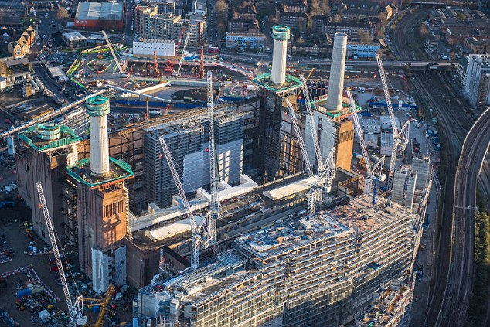
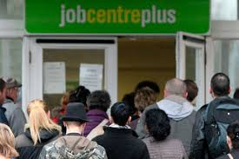
There are three categories of economic impacts
Productivity | Investment | Employment

Slide 97
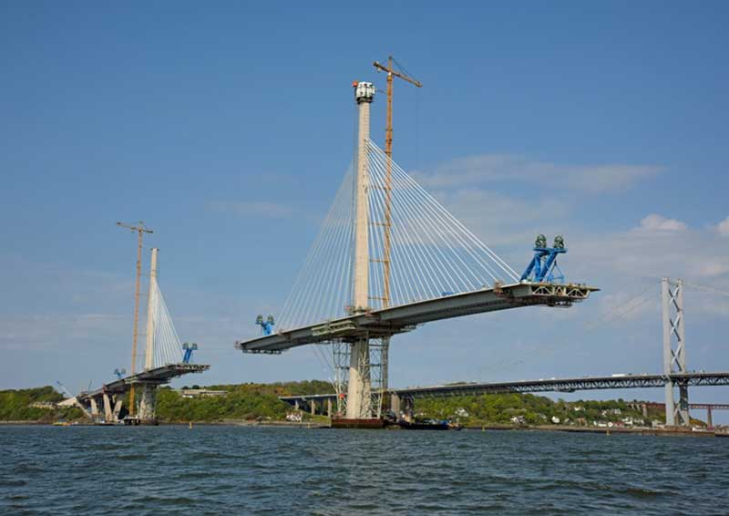


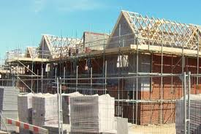
Economic impacts arise as transport benefits pass through into the broader economy
Transport investment changes level of accessibility
Change in accessibility induces behavioural changes
Changes in travel behaviour pass through to other parts of the economy (economic impacts)
Transport Market
Other Markets e.g. property markets

Slide 98
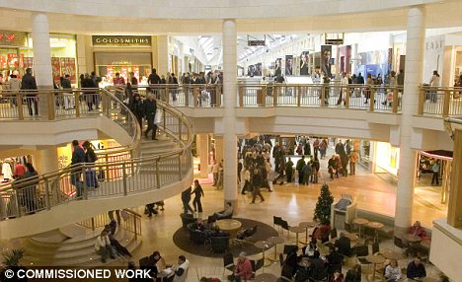
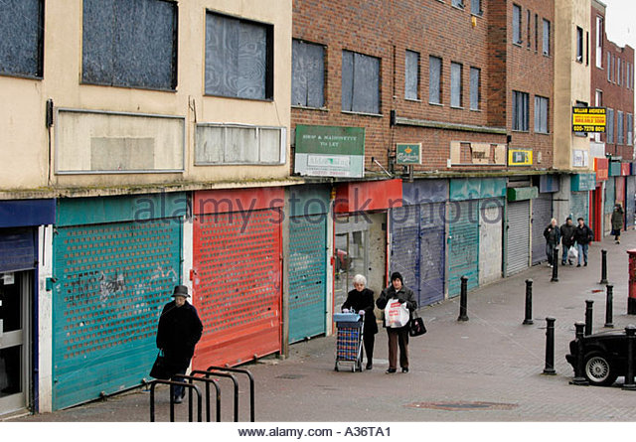
Economic impacts predominantly represent local rather than national changes in economic performance
Warning: Some locations may benefit at the expense of others
(aka. displacement of economic activity)
Value for money assessment only considers national economic impacts
Challenge: disentangle these local impacts to determine change in economic performance at the national level

Slide 99




Economic impacts captured in the value for money assessment through the associated change in welfare
There are different metrics to value economic impacts
  Welfare vs. GDP
The value for money assessment only considers national welfare changes
  Welfare is a broader measure than GDP

Slide 100

Within welfare appraisal economic impacts primarily captured through estimation of user benefits
User benefits measure the welfare change to transport users e.g. value of travel time savings
Challenge: understand how user benefits translate into economic impacts.
  Important for decision makers
  Required for the estimation of wider economic impacts
Transport Market
Other Markets e.g. property markets

Slide 101
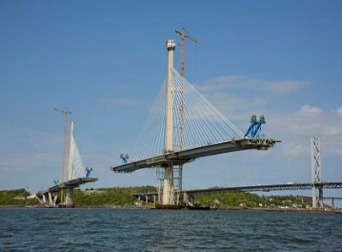

Wider economic impacts can arise as user benefits pass through to other parts of the economy
Wider Economic Impacts arise from distortions (e.g. planning constraints) in other markets
  Distortions mean user benefits only capture part of full welfare change associated with economic impacts
Other Markets e.g. property markets
Transport Market

Slide 102



Market failures arise due to distortions in other parts of the economy
Market Failure | Example
Agglomeration | Companies benefit from being in close proximity to one another
Tax Wedge | Income tax creates a wedge between a private individual and society as a whole
Output in imperfectly competitive markets | Prices are higher and output lower than in competitive situation
Planning Restrictions | Prices are higher and output lower than in absence of planning controls

Slide 103
WebTAG has methodologies to estimate wider economic impacts
Productivity | Investment | Employment
More than one type of WEI may be relevant within an appraisal
Warning: care needs to be taken to avoid double counting
(in case of dependent development other types of WEI should not be estimated)
Dependent Development
Labour Supply Impacts
Agglomeration
Imperfect Competition
Move to More Productive Jobs
Dependent Development
Imperfect Competition

Slide 104
We have developed a new framework for the appraisal of wider economic impacts
Quantification | Valuation | Reporting
User Benefits
Induced Investments
Transport Model
Economic Case
Employment Effects
Productivity

Slide 105
We have developed a new framework for the appraisal of wider economic impacts
Context Specificity | Quantification | Valuation | Transparency | Reporting
User Benefits
Transport Model
Economic Case
Induced Investments
Economic Narrative
Economic Impacts Report
Employment Effects
Supplementary Economic Modelling
Strategic Case
Productivity

Slide 106

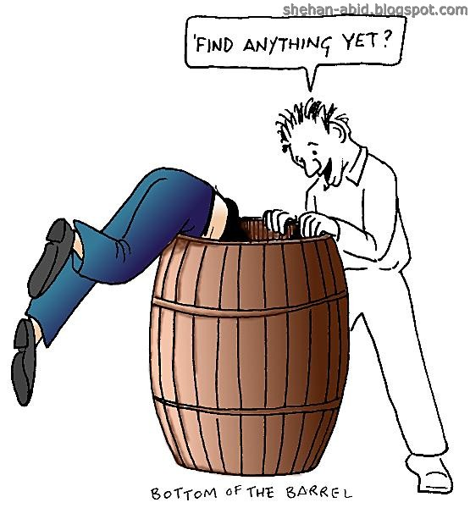

The economic narrative defines scope of analysis – identifies relevant impacts and proportionate assessment
  Warning: assessing wider economic impacts is not a means to bail out a scheme which is poor value for money!
✓
✘
✘

Slide 107


The relevance of economic impacts is scheme specific – not all schemes will have the same impacts
Identify and justify the economic impacts expected to occur as a result of the scheme
  Economic objectives and any significant induced impacts
Identify and justify the welfare change associated with economic impacts
  User benefits
  Wider economic impacts
Logic?

Slide 108
To help with the identification of relevant economic impacts and the associated welfare there is a new unit structure
The technical units are organised around the types of economic impact
Provide information on the following:
  Transmission mechanisms
  Types of market failures which may be associated with these impacts
A2.2 Induced Investment
A2.3 Employment Effects
A2.4 Productivity Impacts

Slide 109

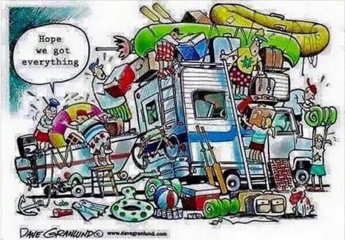

What constitutes a proportionate assessment is scheme specific – there is no one size fits all approach
Important to consider “which of the relevant impacts will be assessed and how?”
Judgement needs to be exercised – there is no one size fits all approach
Assessing economic impacts can be:
Complicated Resource Intensive Time Consuming

Slide 110
To help with decisions on proportionality we introduced the concept of “levels of analysis”
Level 3: Land use quantified or supplementary economic modelling
(sensitivity test)
Level 2: Land use fixed or change not quantified
(adjusted BCR)
Level 1: Fixed land use
User Benefits (initial BCR)

Slide 111
Supplementary economic modelling (SEM) can be used to supplement results derived from WebTAG methodologies
SEM refers to non-standard methods
  Surveys e.g. Economic Activity and Location Impacts
  Modelling e.g. econometrics, LUTI and SCGE models
Could be used in the following circumstances:
  Land use change
  Economic impacts not covered in WebTAG
  Context specific estimates of WebTAG parameters
  Sub-national economic impacts
SEM is only likely to be proportionate in a minority of cases

Slide 112
The outcome of the analytical assurance will determine the weight placed on SEM in the value for money assessment
New modelling unit M5.3 sets out a series of principles (criteria) which will be used to assess analytical assurance
The appropriateness of these principles will depend upon the type of SEM undertaken.
The Department intends to create a panel of expert to review SEM and their outputs
Results should only be included in Business Cases, if the associated welfare reported

Slide 113
GDP can be reported in Business Cases, if the associated welfare change also reported
Stakeholders and Ministers are also interested in GDP not just welfare
Estimates of GDP change can be derived from WebTAG methodologies
There are a number of reporting criteria:
  Central GDP estimate must be derived from WebTAG methodologies
  GDP change must be reconciled with welfare estimate
  GDP does not inform the Value for Money assessment

Slide 114
GDP change must be reconciled with welfare estimate to ensure Business Case is internally consistent
GDP and welfare are two methods to values economic impacts.
The estimates of GDP and welfare should draw on common forecasts of economic impacts
Economic Impacts
Welfare
GDP
Reconciliation
Notes:
GDP should be consistent with the welfare reported in the value for money statement

Slide 115
Analysis of economic impacts should be presented in an Economics Impacts Report (EIR)
Technical document containing all analysis of economic impacts whether reported in strategic or economic case
EIR
Assumption & parameters
Results
Methodologies
Economic narrative
Uncertainty analysis
Reconciliation of GDP and Welfare

Slide 116
Welfare should be reported in the Economic Case and GDP under the appropriate objective in the Strategic Case
Ministers are presented evidence from all 5 parts of the Business Case
  Ministers see more than just the value for money statement
  Ultimately Ministers decide upon the relative importance assigned to different pieces of evidence when arriving at an investment decision
Economic Impacts
Welfare
GDP
Reconciliation
Value for money statement
(Economic Case )
Economic objective
(Strategic Case)
Decision makers
Notes:
GDP should be consistent with the welfare reported in the value for money statement

Slide 117
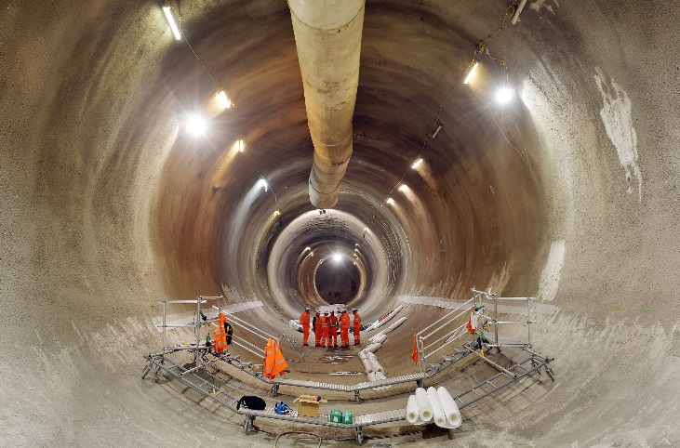

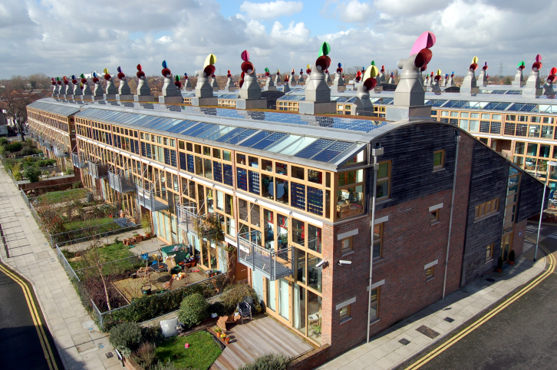
Transport can unlock housing/commercial developments (Dependent Developments)
Challenge is to demonstrate dependency
  How many of these could be accommodated without new transport infrastructure?

Slide 118

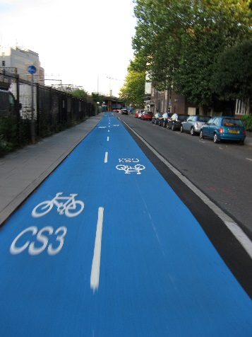
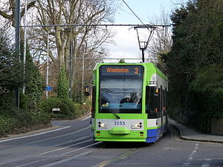


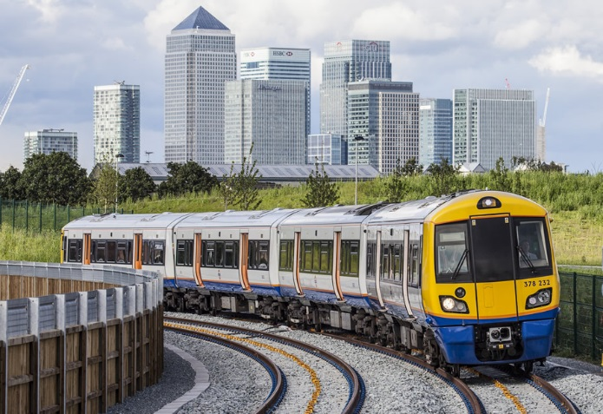
What is the most efficient way to unlock these houses/commercial developments?

Slide 119

When valuing the dependent developments need to also consider impacts on value of existing properties
Will the new developments negatively impact upon existing prices of houses/commercial properties?
Warning: other types of WEIs should not be added to land value uplift due to risk of double counting

Slide 120
Summary of Changes
Introduced Economic Narrative
Restructured the Units
Introduced Levels of Analysis
Developed new guidance on Supplementary Economic Modelling
Introduced Economic Impacts Report
Clearer guidance on reporting of impacts in Business Case
Updated dependent development guidance to include commercial developments

Slide 121
Next steps in the development of the wider economic impacts guidance
Consultation closed 22nd December
Department Response (incl. updated research strategy) 2017
New WEI guidance in late 2017/early 2018
Begin next phase of research strategy

Slide 122
Business Case Best Practice Workshop
Preparing a Transport Business Case
Steve Hunter

Slide 123
Contents
Purpose of the Economic Case
Relationship with the other four cases
Appraisal 101
Monetised appraisal
Reporting the appraisal
Value for Money

Slide 124
Purpose of the Economic Case – a Reminder
The aim of the Economic Case is to demonstrate that the public sector is justified in delivering the specified scheme
This demonstration is based on the HM Treasury Green Book construct of Value for Money. To be justified the:
  benefits/positive impacts must exceed the costs/negative impacts
  scheme must perform better than alternative solutions to the problems
Application of the option selection process should rule out options which are not affordable, deliverable or acceptable
Value for Money also allows different schemes to be compared and prioritised against the available budget

Slide 125
Relationship with the Strategic Case
Commercial Case
Financial Case
Management Case
Strategic Case
Economic Case
The explanation of why the scheme is required should be backed up by evidence and analysis within the Economic Case

Slide 126
Relationship with the Commercial Case
Economic Case
Commercial Case
Financial Case
Management Case
Strategic Case
The recommended contracting strategy should demonstrate that the scheme can be procured as represented in the Economic Case

Slide 127
Relationship with the Financial Case
Economic Case
Commercial Case
Financial Case
Management Case
Strategic Case
The affordability assessment should use the same costs as the Economic Case
The financial sustainability assessment should be based on cost/revenue from the Economic case

Slide 128
Relationship with the Management Case
Economic Case
Commercial Case
Financial Case
Management Case
Strategic Case
The governance arrangements and programme should demonstrate that the scheme can be delivered as represented in the Economic Case
The monitoring and evaluation arrangements should be consistent with the Economic and Strategic Cases

Slide 129
Appraisal 101
An appraisal is a comparison of two ‘futures’
  The Do Minimum (DM), with committed schemes and forecast changes in travel demand
  The Do Something (DS), where the only difference to the DM should be the tested scheme
WebTAG appraisal is all about consistency, ensuring that different scales and types of schemes in different areas can be compared, including:
  All monetised impacts (costs, revenue, benefits) should be converted to the same price base (2010 GDP Deflator Real Market Prices) and discounted to 2010 values
  The impacts are assessed over the effective lifetime of the scheme (usually no more than sixty years) with renewal costs included for any shorter life elements
  The appraisal represents the scheme from the decision-point, excluding costs which have already been incurred
  WebTAG sets out a tight definition of which impacts can be monetised within the core scheme appraisal (those which apply to all schemes)
The WebTAG approach aims to disaggregate impacts as far as possible
  One result of this is that benefits and costs to different modes are calculated in isolation

Slide 130
Getting The Right Do Minimum
Establishing a credible Do Minimum forecast can be harder than establishing the impacts of a scheme
  Getting it ‘right’ has at least the same influence on the business case as the representation of the scheme – both in terms of robustness and the result
Expect it to be more challenging to demonstrate that your scheme is the solution to a future problem (and that it is needed now)
  Particularly where describing the future problem is unpalatable
Material future developments/traffic growth can overload the network
  A ‘gridlocked’ DM cannot be used in an appraisal
  Needs consideration of whether this really would (be allowed to) happen or what mitigation would naturally occur or be put into place
A plot of land (or portion of it) where development cannot proceed without complementary transport investment is ‘Dependent Development’
  The measure of whether development can proceed is based on whether the transport network would provide a ‘reasonable level service’

Slide 131
Monetised Appraisal
Much of the focus of the analysis for the Economic Case is on deriving the Benefit Cost Ratio (BCR)
  For most schemes, DfT’s TUBA Software should be used to calculate the benefits
For highways, TUBA calculates:
  Always: journey time savings; vehicle operating costs; carbon emissions; indirect taxes
  Sometimes: impacts during construction/maintenance; tolls/charges
For public transport, TUBA calculates:
  Always: journey time savings; fare changes; operator revenue; indirect taxes
  Sometimes: impacts during construction/maintenance
Use of TUBA ensures compliant calculations, but not the correct inputs:
  The TUBA result is no more robust than the underlying models
  TUBA warnings provide a useful check of input consistency and appropriateness
  Particular care is needed with annualisation and journey purpose splits

Slide 132
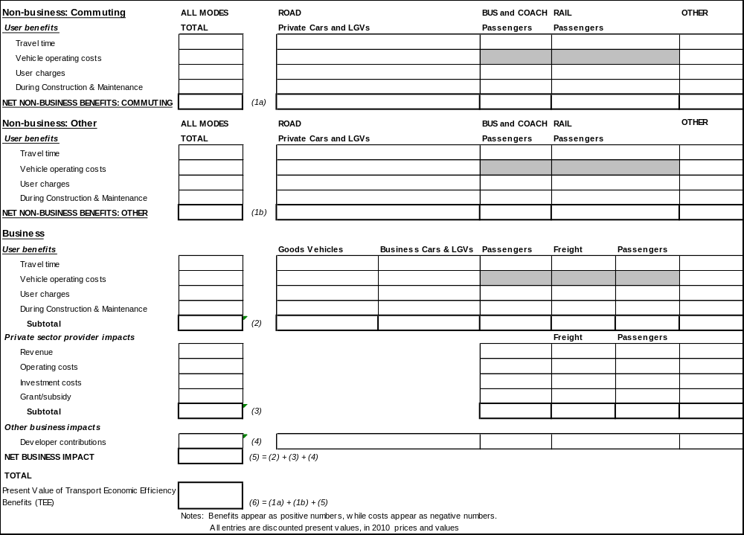
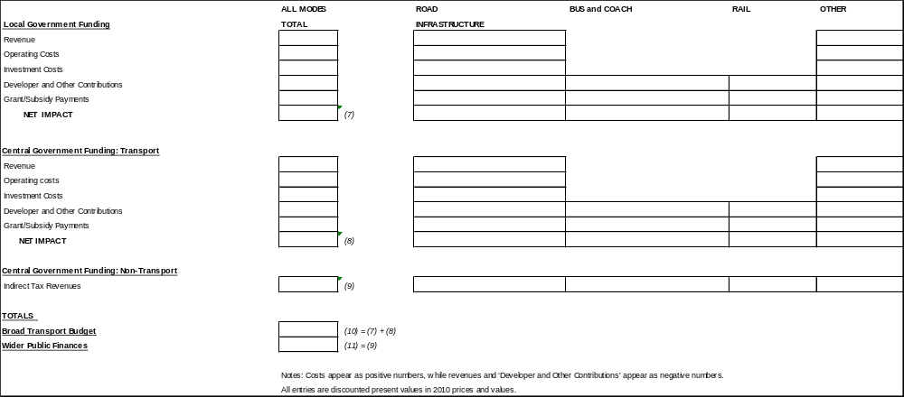
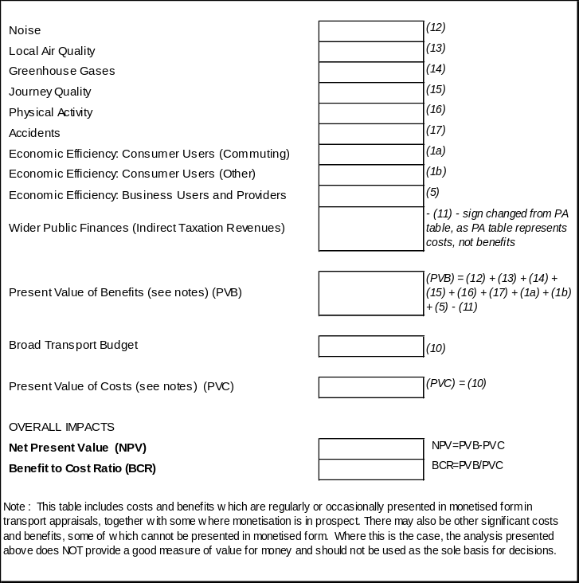
Monetised Appraisal - Outputs
DfT economic appraisal proformas guide the analyst to a BCR which meets its definition
  Cost (the denominator) represents the net call on transport budgets
  Benefits (the numerator) represents the sum of everything else:
    Traveller impacts (separating time and monetary)
    Effects on private sector transport providers and developers
    Effects on society (accidents and environment)
    Indirect tax receipts

Slide 133
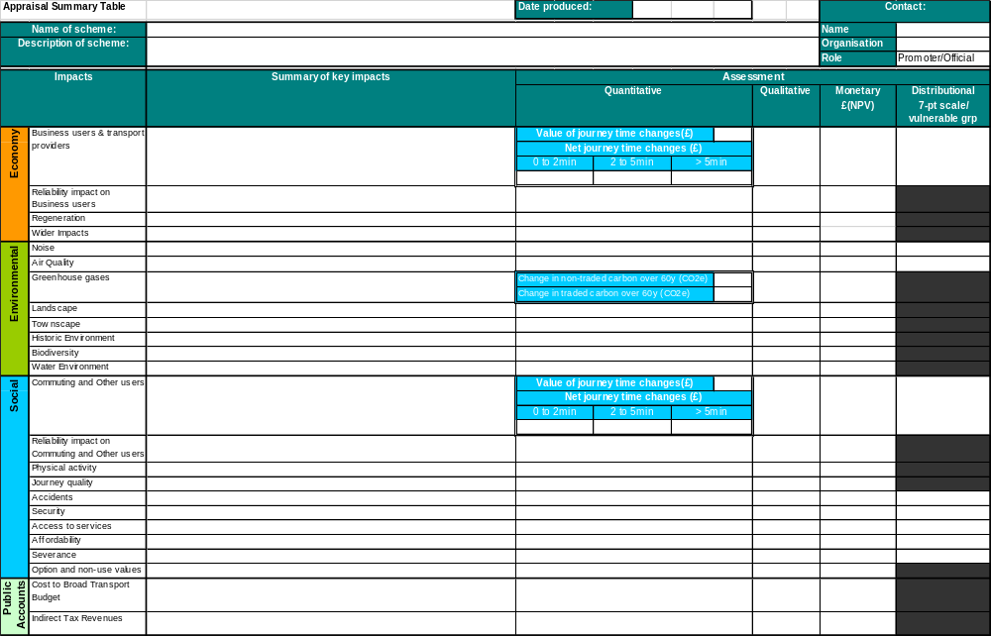
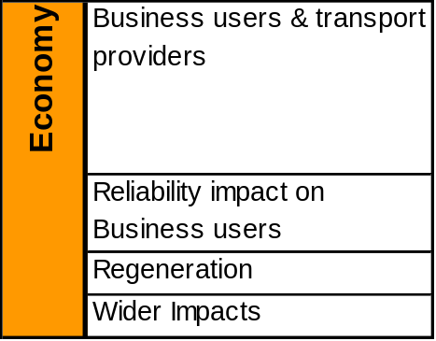
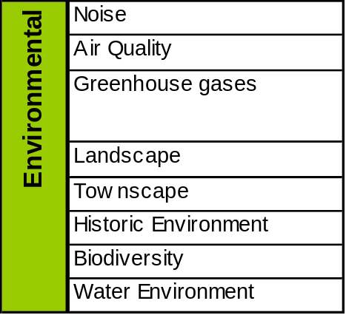
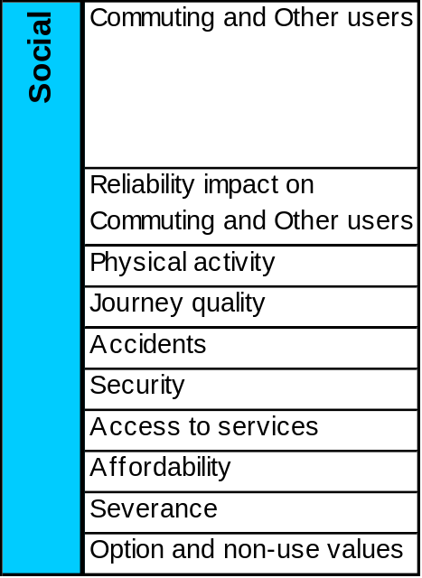
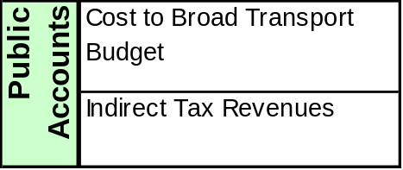
Reporting the Appraisal

Slide 134

Value for Money Assessment
Explains the appraiser’s VfM categorisation
Initial VfM
Category
Adjusted VfM Category constructed, considering:
  Below the line monetised impacts
  Other quantified and non quantified impacts
  Uncertainty
The adjustment process is quite clear in DfT guidance, but often given insufficient consideration
  BCR Obsession
  Value for Money Assessment is the Art rather than the Science

Slide 135
VfM Guidance
“Depending upon the expected magnitude of these impacts, an assessment should be reported of whether consideration of these non-monetised impacts is likely to alter the VfM category of the proposal”
https://www.gov.uk/government/uploads/system/uploads/attachment_data/file/255126/value-for-money-external.pdf

Slide 136
Proportionality
The effort put into appraisal should be relative to:
  The funds involved
  Outcomes at stake, eg scale of the impact group or its potential influence on the decision
  Time available
Temptation is to repeat the analysis done for the last business case
  perhaps throwing in a few more benefits that have previously shown to be material
  And some non-material benefits (because the only way to robustly show that they aren’t material is to calculate them/so we might as well include them)
It would be more useful to ask whether the analysis:
  addresses the reasons the project is needed?; or
  supports a ‘strong beneficial’/not ‘strong adverse’ scoring?; or
  better distinguishes between options?; or
  reduces uncertainty?

Slide 137
The LEP Monitoring and Appraisal Framework
Requirements for scheme promoters

Slide 138
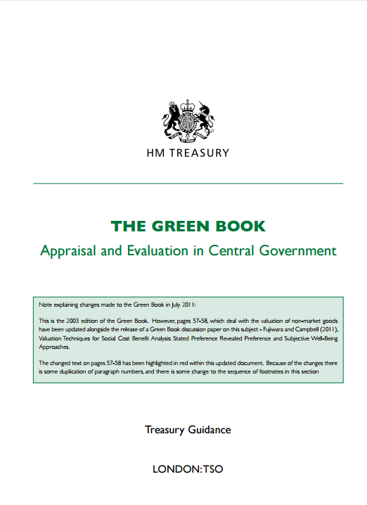
The ROAMEF cycle
Rationale
Objectives
Monitoring
Evaluation
Appraisal
Feedback
The Appraisal Manual: HMT Green Book

Slide 139
The ROAMEF cycle
Rationale
Objectives
Monitoring
Evaluation
Appraisal
Feedback

Slide 140

Alignment with the theory of change
A methodology for planning, participation and evaluation.
Explains the process of change by outlining causal linkages in an initiative
Identified changes are mapped - showing each outcome in logical and chronological relationship to all the others i.e. the logic chain
Distinguishes between desired and actual outcomes
Models outcomes before identifying interventions

Slide 141
Back to basics – the logic chain terms
Activities
    things that are done [within programme/project's timeframe]
Outputs
    direct measures of an Activity that can be counted [within programme/project's timeframe]
      e.g. no attendees at workshop, no businesses advised, collaborations formed
Outcome
    subsequent effects caused by the Outputs, which can again be measured, ideally [within/after programme/project]
      ↑ understanding of new policy, ↑ knowledge/confidence among SMEs
Impacts (aka ‘long term effects’)
    wider economic, social or other effects that can be credibly attributed to an intervention [generally after programme/ project]

Slide 142
The SELEP Assurance Framework
In addition to intervention-specific measures, SELEP must report quarterly against programme-wide outputs and outcomes to Central Government;
High level outcomes include:
  Jobs connected to intervention (permanent, paid FTE);
  Commercial floor-space planned and constructed to date (class and m²); and
  Housing unit starts and completions forecast and to-date
It is, therefore, imperative that good quality monitoring and evaluation arrangements are in place (and have sufficient budget cover)
 | Outputs | Outcomes
High Level |  | ✓
Transport | ✓
Land, Property and Flood Protection | ✓ | ✓
Business, Support, Innovation and Broadband | ✓ | ✓*
Skills Capital | ✓ | ✓*
* Only one outcome explicitly identified

Slide 143
46 metrics are reported against, including:
Group | Outputs | Outcomes
High level |  | Jobs connected to intervention Commercial floor space planned Housing unit starts Housing units completed
Transport | Total planned length of resurfaced roads Total planned length of newly built roads Total planned length of new cycle ways Type of service improvement
Land, property and flood protection | Actual area of site reclaimed Anticipated area of land experiencing a reduction in flooding likelihood
 |  | Follow-on investment at site Actual commercial floorspace occupied
Business support, innovation and broadband | Anticipated number of new enterprises supported Actual number of potential entrepreneurs assisted to be enterprise ready Actual number of enterprises receiving financial support other than grants Financial return on access to finance schemes
Skills capital | Anticipated new build training/learning floorspace Anticipated floor space rationalised
 |  | Post code for new build sites

Slide 144
Requirements for scheme promoters
It is important for bids to demonstrate delivery against these programme level outputs and outcomes.
Scheme promoters should, therefore, explicitly identify the outputs and outcomes against which monitoring and evaluation will take place, aligned to the LEP reporting framework.
Sufficient budget should be set aside within funding requirements (to be funded by the scheme promoter and, ideally, included within S151 commitment) to demonstrate a robust approach to monitoring and evaluation against these and scheme specific metrics.
A named individual (usually the senior responsible officer) should be responsible for benefits realisation. Where scheme timescales are long evidence of succession planning should be provided.

Slide 145
Doing Monitoring & Evaluation well
Me, again . . .
South East Local Enterprise Partnership

Slide 146
Back to Basics – the logic chain
Conditions
Impacts
What’s broken?
Is there a Rationale?
Objectives SMART!
Inputs
Activities
Outputs – gross/net
Outcomes – gross/net
Economy
Efficiency
Effectiveness

Slide 147
Back to Basics – the logic chain terms
Activities
    things that are done [within programme/project's timeframe]
Outputs
    direct measures of an Activity that can be counted [within programme/project's timeframe]
      e.g. no attendees at workshop, no businesses advised, collaborations formed
Output
    subsequent effects caused by the Outputs, which can again be measured, ideally) [within/after programme/project]
      ↑ understanding of new policy, ↑ knowledge/confidence among SMEs
Impacts (aka ‘long term effects’)
    wider economic, social or other effects that can be credibly attributed to an intervention [generally after programme/ project]

Slide 148
Back to Basics – the Programme/Project Life Cycle
Secures Objectives & Value for Money
Crystallises the activity from the options
Minimises inputs & maximises results
Provides feedback to inform future Programme design & development
Allows for results/impacts reporting
Makes for better project specification
Develop & appraise
Spend Decision
Post-completion learning
Contracting
Monitoring & mngt
Completion
Reaches a formal decision with a clear audit trail
Facilitates effective use of resources & allows contingency action
  Monitoring & evaluation – providing the ‘Controlling Mind’

Slide 149
Back to Basics – Data & Indicators framework
149
Monitoring & evaluating the state of 'the programme‘ environment, & how this is changing (through socio-economic baselining)
Re-aligning the strategic objectives of 'the programme' (in the light of empirical evidence)
Condition Indicators . . .
Monitoring & evaluating the Outputs & Results attributable to the strategic objectives of 'the programme' (through bottom-up project monitoring & review)
Response Indicators . . .
Monitoring strategic inputs & activities in support of the development of 'the programme'
Notes:
149

Slide 150
The critical importance of the Big O (Objectives)
The link that holds the logic chain/ToC, Project Life Cycle, & M&E frameworks together
All good interventions revolve around clear & sound Objectives
‘You should sweat blood when you are drafting programme/project objectives’
So, 3 tests:
  Do your objectives align with the context & the rationale for getting involved?
  Are the objectives that you have defined ‘SMART’
    Specific, Measurable, Achievable, Realistic, & Time Bound
  Do the outcomes you have defined intelligently & fully capture what the objectives are seeking

Slide 151
Our Added Value – something to watch
5 aspects of SAV – the English Experience
  Strategic leadership & catalyst: Articulating & communicating development needs in the programme area, opportunities & solutions to partners & solutions to partners & stakeholders in the programme area & elsewhere
  Strategic influence: Carrying-out or stimulating activity that defines the distinctive roles of partners, gets them to commit to shared strategic objectives & to behave & allocate their resources accordingly
  Leverage: Providing/securing financial & other incentives to mobilise partner & stakeholder resources – equipment & people, as well as funding
  Synergy: Using organizational capacity, knowledge & expertise to improve information exchange & knowledge transfer & coordination &/or integration of the design & delivery of interventions between partners
  Engagement: Setting-up the mechanisms & incentives for the more effective & deliberative engagement of stakeholders in the design & delivery of programme emphases

Slide 152
Monitoring specifics
Monitoring is central to performance management of projects
It should be carried out against specific output & outcome targets
Five key stages to monitoring
  Define – adopt clear definitions of the indicators to be used – inputs, activities, outputs & results - & who is responsible for collection
  Forecast – as part of the programme’s/projects appraisal process, a profile of the outputs should be forecasted
  Collect – ensure that that applicants have the systems in place to collect the activity & output data
  Report – applicants report quarterly to the programmes who should check activities/outputs claimed against profile, & as part of payment
  Verify – a rolling audit of projects will provide verification of outputs
If done well, monitoring ensures all data also in place for subsequent evaluation

Slide 153
Monitoring specifics
Other considerations
  Be clear on the different types of data & indicator
    Secondary data from existing data sets (often as Condition data)
    Primary data (project reports/returns, ad hoc surveys, other intelligence feeds, often as Response indicators)
  What sorts of data/indicator ‘shapes’ (esp. Response indicators) you might except if things are running to plan
    The value of benchmark & evaluations evidence – ‘ how did this similar intervention perform?’
    Think about performance risks in your data & indicator strategies – where could you be exposed?
  Be constructively sceptical & probing about what is sent to you!

Slide 154
Driving information back into an actively managed project cycle
Secures Objectives & Value for Money
Crystallises the activity from the options
Minimises inputs & maximises results
Provides feedback to inform Programme design & development
Allows for results/impacts reporting
Makes for better project specification
Develop & appraise
Spend Decision
Post-completion learning
Contracting
Monitoring & mngt
Closure
Reaches a formal decision with a clear audit trail
Facilitates effective use of resources & allows contingency action
Do not treat your programme, or its projects, as being fixed in concrete. Use the data to flex & amend your interventions as they progress

Slide 155
Driving information back into an actively managed project cycle
For what’s working well
  Understand why, & may be do more of?
What’s performing poorly
  Understand why, is it fixable, & potentially terminate contract to reduce further risk?
No programmes or projects are initially perfect in the design & operation . . . high quality monitoring helps then become so

Slide 156
The trip wires to watch in working with monitoring data
Attribution
  How much of what is being reported is actually down to our input?
Double-counting
  Same outputs (usually) counted/reported multiple times – a major headache for evaluators!
Quant, no qual
  Numerical indicators easy for applicants to report . . . qualitative activities & outputs much harder, so often get overlooked
Wood & Trees
  Too much time on auditing the data compliance, not enough hard thinking if these are the right indicators

Slide 157
And on to evaluation . . .
Primary purpose of evaluation is to learn lessons, both positive & negative
Evaluation can focus on:
  A single project
  A programme of activity or
  The effectiveness of processes & management systems . . . as well as economic impact
Evaluations usually have three elements:
  A baseline – ‘snapshot’ of the Conditions that exist at the time that the project starts
  Interim evaluation – a review of programme/projects at mid-point to consider any changes
  Final evaluation – focusing on impact & lessons learnt or transferable to others
Make sure you budget for evaluation in the Financial/Management Cases

