Slide 1
An Employment Support Programme for Essex, Southend and Thurrock.
Tom Fowler and Rachel Nedwell

Slide 2
When developing HeadsUp employment support programme in 2017, our focus was on members of our community who were struggling to find employment or training but were also tackling issues impacting their mental health and wellbeing. These things presented significant barriers to taking positive steps forward.
Our participants were from across Essex, Thurrock and Southend
Our model was multi-layered, participant centred and with Peer Support at it’s core

Slide 3
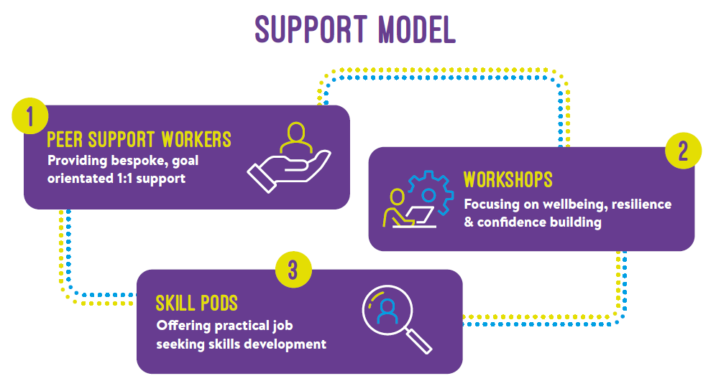
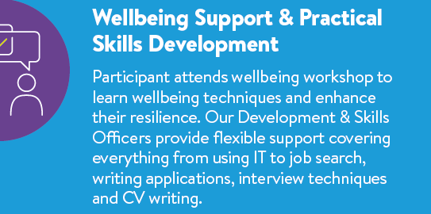
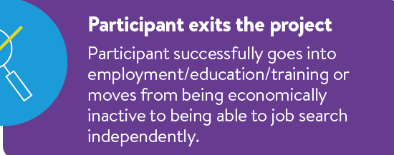

Slide 4
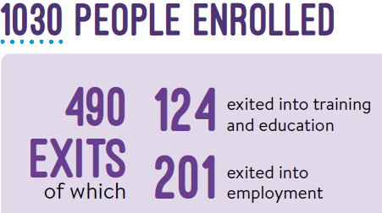
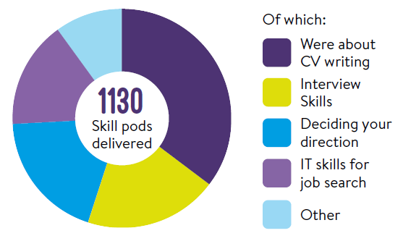
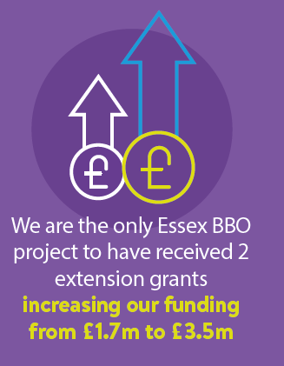
Project Outcomes

Slide 5
Participants
Programme lead
Delivery
Flexibility
Peer Support Workers
Challenges
Learning
Communication

Slide 6
What next?
Continue to circulate the good news stories and learning from the HeadsUp programme
A new bid is on the horizon which will have strong links to HeadsUp
To continue our goal to help our local communities thrive through the delivery of grant and commercial funded programmes e.g. Multiply: Financial Wellbeing Support
We strongly value co-production and collaboration – please get in contact if you are interested in working with us in the future

Slide 7
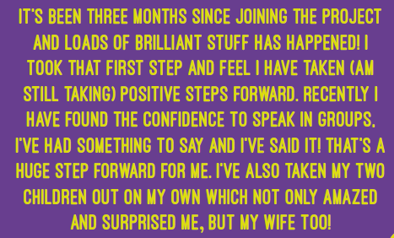
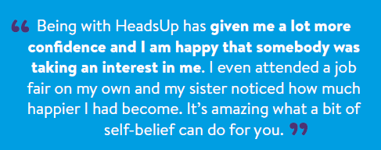
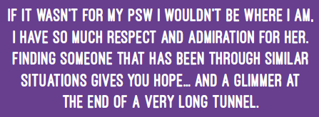
Contact us about HeadsUp or our other grant funding aspirations. enableeast.org.uk epunft.enableeast@nhs.net

