Slide 1
LoCASE: Lessons Learned Rob Robinson KCC Sustainable Business Programme Manager
Wednesday 8th November 2023

Slide 2
In the beginning…

Slide 3
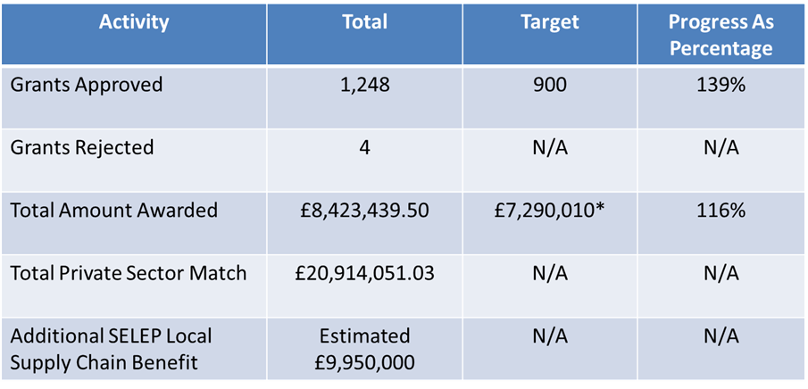
LoCASE

Slide 4
Learning our lessons…
“I believe more work is needed in marketing to the LCEGS sector, sector support fund work will help this going forward and will be vital as part of the green recovery and promotion of funding and opportunities in the SELEP.”
“Brexit added to the level of uncertainly for business which is always a negative and makes it difficult for SMEs to make decisions and commit resources.”
“Remote audits helped to speed up the process of getting SMEs through to grant and made it clear that site audits are frequently not necessary… claims became simpler to complete by having more information going on-line and not requiring hard copy signatures of things like time sheets.”

Slide 5
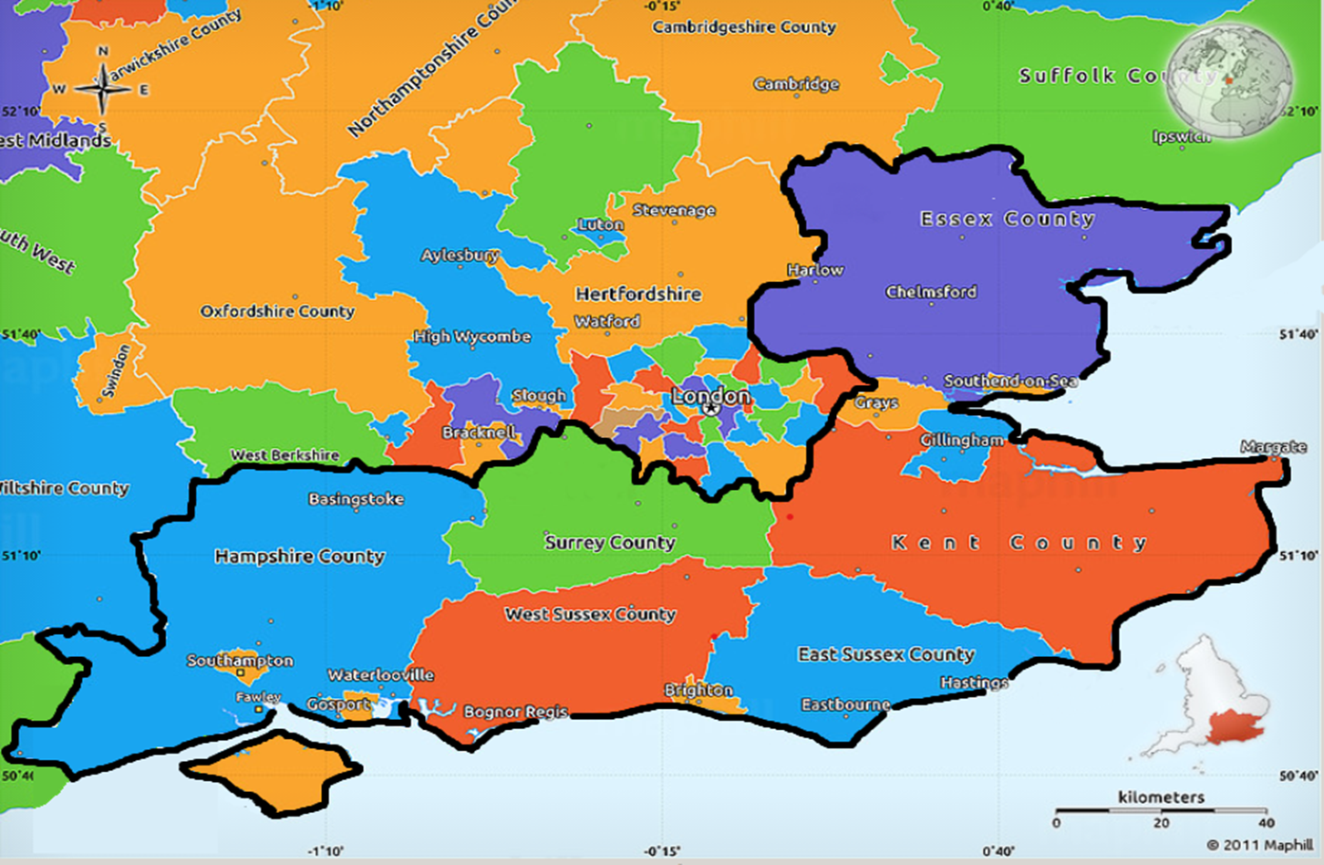

Slide 6
Target Outputs
Support 2,060 SME’s
Cut emissions by 11,232 CO₂ tonnes
Support 140 new businesses
Assist 159 new to firm products
Assist 91 SME / Research collabs

Slide 7
Partnership Budget
LoCASE 2 (SELEP) £14.7M
LoCASE 3 (Multi-LEP) £16.2M
ERDF £7.14M
ERDF £7.61M
Private match £6.375M
Private match £7.575M
KCC match £98K
KCC match £100K
Partner match £1.108M
Partner match £1.023M
Notes:
Overall grants pot = £10.625M (L2) of which KCC is administering £5.775M & L3 £12.625M which KCC is administering all

Slide 8
What could LoCASE fund?
Funding from LoCASE (40% of eligible project costs) may be used to cover the following types of expenditure for SMEs:
Resource Efficiency Measures: including energy efficient heating, lighting, insulation, refrigeration, investment in renewables, machinery upgrades, waste reduction projects.
Transport Efficiency: including second-hand Ultra Low Emission Vehicles (ULEVs), sustainable travel planning and fleet management software.
For businesses offering low carbon/environmental goods and services:
Development Costs: including marketing, new IT hardware and systems, materials for R&D, website development, certification and accreditation.
Plant and Machinery: re-tooling and installation of new or replacement machinery and hardware upgrades (including circular business cases).
Consultancy Costs: such as comms and business planning consultancy
Notes:
LoCASE grants can be used to fund a wide range of SME projects…

Slide 9
SELEP Projects Leader Board

Slide 10
LoCASE Key Figures
Grants Approved = 606 (Target 619)
Total Grant Awarded = £4,385,160 (£4.25million)
Claimed = £3,596,615 (550 SMEs)
Average Grant = £6,539.30
Total Project Value = £12,222,781
SME Match = £7,837,621
Estimated SELEP Supply Chain Spend = £4.9M
Jobs Created = 120+

Slide 11
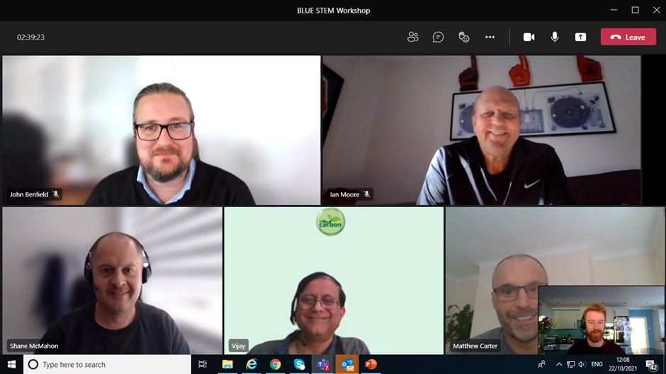
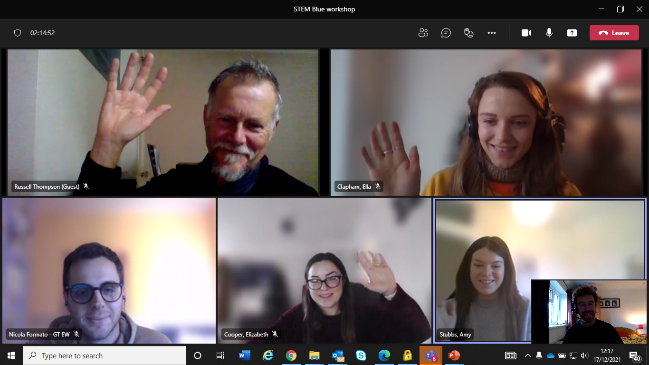
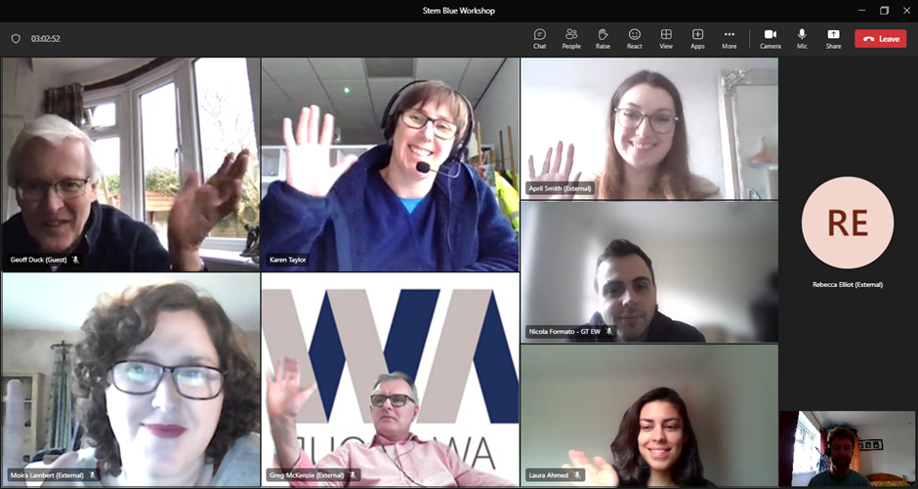
STEM Attendees & Feedback
Incredibly useful advice, especially for a free event! Particularly pleased with all the templates which offer a very helpful starting point for generating our EMS (Frewer Engineering)
STEM inspired us to work towards fulfilling our legal requirements and understanding these further as we didn’t fully prior to these workshops. It enabled us to state we had STEM accreditation on tenders and may have contributed us to winning contracts where environmental considerations were required. We are seeing this more and more on tenders.

Slide 12
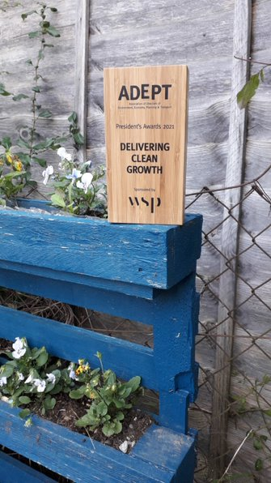
LoCASE Programme Successes
£9.3M awarded to 1,193 SMEs (£4M in 9 months!)
First (and last) of its kind
Met (head on) the imperfect storm and survived!
Helped create (and brand) clean growth and green economy
Saved huge amounts of CO2e resources and ££££
Created renewable production capacity & business cases
Embedded resilience and adaptation
Laid best practice foundations across most sectors

Slide 13
Challenges
Capacity & capabilities across the wider patch
Socio-economic backdrop
Change management theme
Shifting priorities (internal & external partnerships)
Condensed delivery schedule
Limitations of eligibility/outputs & managing expectations

Slide 14
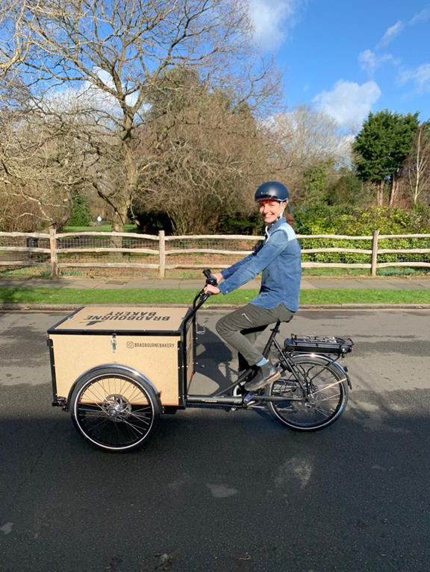
‘Legacy’ & Learning
The noun not the adjective,
never been more relevant (SDGs!)
Follow on and/or follow up?
Collaborate with the right partners & linked projects, at the right level
Alignment of vision with strategy & replication not duplication

