Slide 1
Dan Chilcott Strategic Lead, Create South East
formerly a Local Coordinator, South East Creatives
Sarah Wren Cultural and Creative Economy, Kent County Council

Slide 2
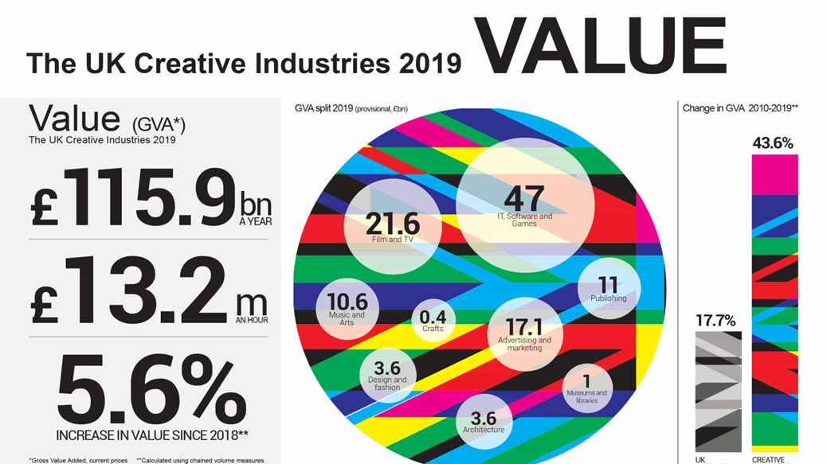

Slide 3
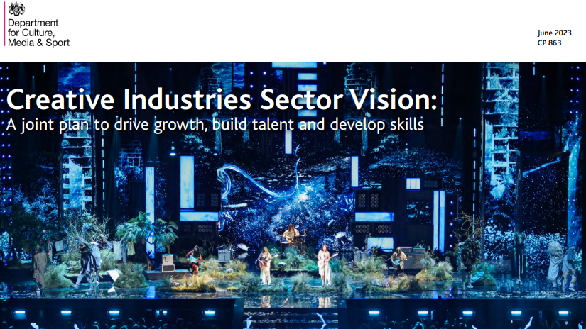

Slide 4
Collaboration on bid at SECEN level
Sector-led, with some compromises
Sector-specific business support programme
While some programme design was included in the bid, there was also retro-fitting
Local Hubs, local coordinators, and sector events delivered resonance and traction
Notes:
Sector specific business support programme, formerly known as SECCADS - filled the gaps left by mainstream business support delivery. Understood there was a creative process in play, as well as a business process.
Sector-led, but with compromises - there had to be because of the ERDF framework and led by a risk averse local authority. Sector was involved in the design, there were no sector organisations on the partnership board.
12 hours of support? The standard EDF framework does not work for business need – some businesses need three hours with a great mentor, some need much longer. How do we build that flexibility into the future?
While some programme design was included in the bid, there was also retro-engineering - hubs, local coordinators, and events programme that delivered local resonance and traction. The South east is a patchwork of creative microclusters, no one federated area would have had enough businesses to deliver the outputs. So, there was high level bureaucratic collaboration, with hyper-local delivery through a series of creative hubs and coordinators built in. Hard won battle. The events programme was hugely successful in delivering traction and reputation, but came too late in the day.

Slide 5
Funding
Funded through a call for projects under Priority Axis 3 – Enhancing the Competitiveness of SMEs. ERDF provided 50% of total project costs.
Total value £5,157,946
ERDF investment £2,578,973
Private sector match from supported enterprises £1,625,000
Matched funding partners £954,009
Outputs (following PCR): Target Actual
C1 Number of Enterprises Receiving Support 370 536
C2 No. of Enterprises Receiving Grants 279 403
C4 Number of enterprises receiving non-financial support 91 132
C5 Number of new enterprises supported 50 67
C6 Private investment matching public support to enterprises £1,625,000 £1,625,000
C8 Employment increase in supported enterprises 40 43.7
ERDF Output Guidance:
Financial support of at least £1,000 or a minimum of 12 hours of support
Evidence of Grant Investment of at least £1,000
Evidence of 12 hours active consultancy support
A new business is one which has been registered at Companies House or HMRC for less than 12 months before support is provided or is a business locating in the England programme area for the first time
The sum of private contributions to the supported project (£)
Jobs created following an intervention with an enterprise that result in an increase in the overall number of staff employed in that enterprise. Measured as a new, permanent, paid, full-time equivalent (FTE) jobs created

Slide 6
Partnership
Strategic & matched funding partners
Covering entire SELEP geography, named at the time of the bid:
Thurrock Council (lead partner and accountable body), East Sussex County Council, Kent County Council, Medway Council, Southend-on-Sea Council, Essex County Council, Colchester Council ,The University of Essex, Essex County Council
Local hubs & sector delivery partners
Commissioned, post-bid, to deliver sector expertise and give local traction:
SPACE Studios (Procured to provide business support and workshops)
The Hub (Business support and workshop provider)
Resort Margate (Local Cultural Hub)
Creative Folkstone (Local Cultural Hub)
Towner Gallery Eastbourne (Local Cultural Hub)
De La Warr Pavilion, Bexhill (Local Cultural Hub)
Local Coordinators
East Sussex, Essex and Kent (mirroring the three Growth Hub areas) each had a full time equivalent Local Coordinator (employed centrally by Thurrock Council) who acted as a link between local businesses and the wider SECCADS programme. This included coordinating activity on the ground and undertaking some client management of local creative businesses (helping to navigate an appropriate path through the programme).

Slide 7
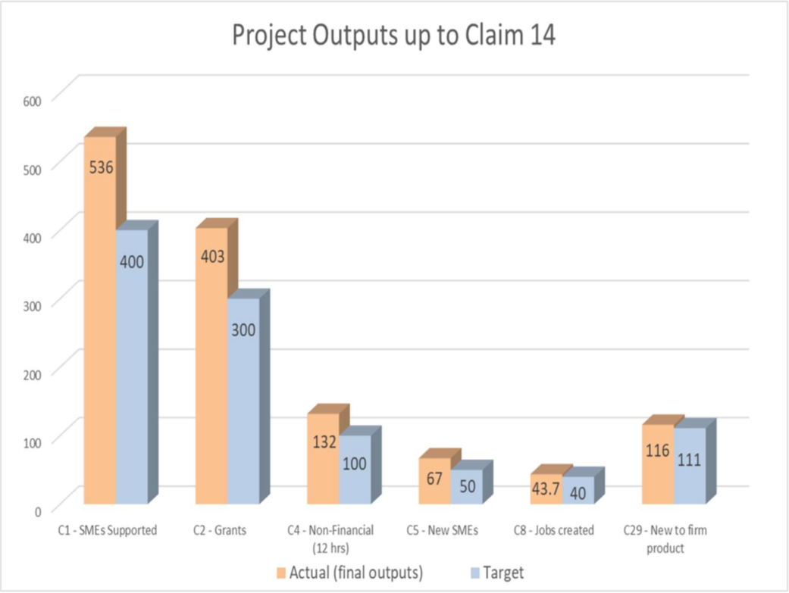
Supported 536 businesses.
Approved £442,073.85 of grant funding
Invested in cultural hubs now equipped to deliver creative sector business support
Supported programmes of business support, networking and advice reached over 10,000 creative industry workers.
Invested in local coordinators who have developed extensive networks and the knowledge and skills to broker relationships with creative freelancers and SME’s, supporting start-ups and growing businesses.

Slide 8
Notes:
Supported 536 businesses.
Approved £442,073.85 of grant funding
Invested in two cultural hubs now equipped to deliver creative sector business support in the future: Resort Studios, Margate; Creative Folkestone.
Supported programmes of business support, networking and advice led by the hubs across Kent that have reached over 10,000 creative industry workers.
Invested in 2 local coordinators in Kent who have developed extensive networks and the knowledge and skills to broker relationships with creative freelancers and SME’s, supporting start-ups and growing businesses.

Slide 9
South East Creatives Learning
Who is in the room for programme design?
Generic versus specialist knowledge. Design programmes with evidence and specialist knowledge of the sector (not managing business support programmes).
Getting money spent versus programme design. Who is doing something well? Where is the good practice? Where are on the ground relationships able to bring market credibility and specialist suppliers? How do we continue to share knowledge? It doesn’t need to be sharing a pot of money/funds but using / sharing good practice and knowledge eg who is doing work in the music venue sector
Which programme is right on the ground? e.g South East Creatives hubs were a local focal point and recognition of sector need eg freelance challenges = need for local knowledge and connections
Bureaucracy needs to be hidden from businesses. Every half an hour a business spends filling in a form = loss of their time to the business, it is not an investment.
Programmes need to be flexible and meet businesses need, offering a range of products including online and in real life workshops, webinars, mentoring and access to investors and investor networks. A mix of generic and specialist support.
Businesses do not need identical activity e.g. 12 hours support. In the absence of the ERDF defined outputs framework what do we use? What do we use to monitor as programme managers? How do we focus on business need rather than delivery outputs?
Virtual versus face to face – does it work?
Size and structure of grants – smaller or bigger?
Test demand, pilot ideas, constantly evaluate delivery and be prepared to change your programme.

Slide 10
South East Creatives Learning
The trajectory of business development:
A progressive journey that hasn’t flowed brilliantly. The experience of South East Creatives to Create South East is a loss of fluidity, traction and learning.
A clear customer journey for businesses through the programme from entrance point to finish, where options and choices are clear and there is alignment to other programmes that can add value. e.g a blend of generic and specialist support.
Acknowledge that most businesses remain at a standstill after support. Growth, when it happens, might not be bound by geographic boundaries: align programmes across the region to build legacy, a shared narrative.
Support the whole ecology: Eg fashion industry – the majority of businesses are 10 employees or less, alongside some large-scale companies and we need to support both. Know your patch, use the data = what are your businesses, where are your clusters
Geographic collaboration is important…. but takes its toll on programme resources re travel etc
A broad partnership reaches local networks eg Screen South, Creative UK.
Managing the funnel – responding to a geography of microclusters
Share knowledge and resources
Build a programme on trust, networks, credibility, connectivity, understanding our geography - this needs local knowledge, access to local networks and players
Use business and sector language - it’s a different language to funders
To extend reach, think local - local hubs, local networks, local events led by target companies

Slide 11
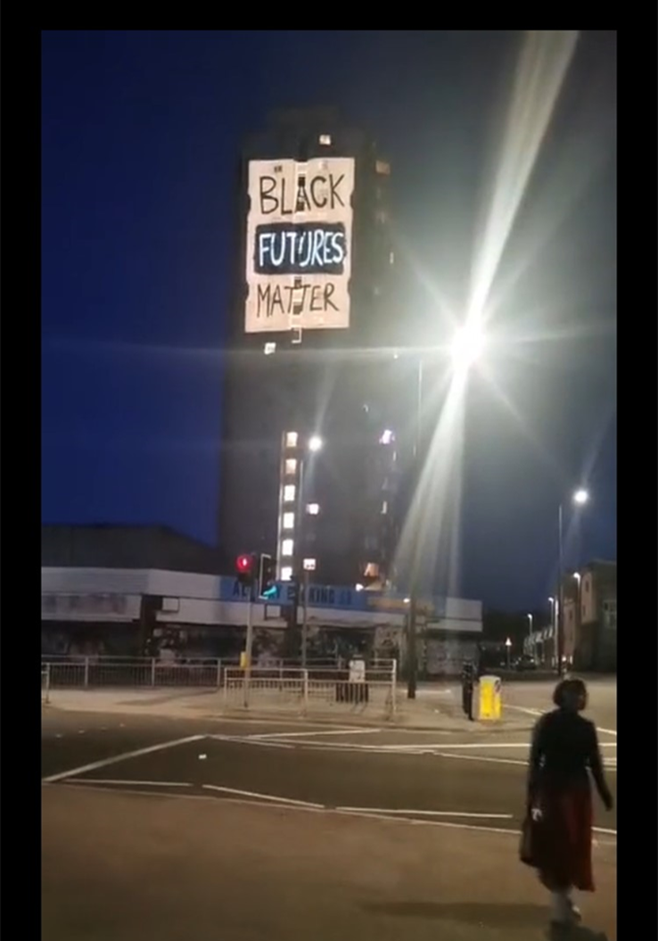
South East Creatives - Legacy Principles
a. Cultural Sector leadership: sector leadership and knowledge are embedded into future delivery.
b. Appropriate and recognisable branding: the look and feel of programmes reflect the values of the sector and is the trusted gateway to wider business support programmes.
c. Agglomeration and collaboration: microclusters and markets don’t recognise bureaucratic boundaries, they work across the region.
c. Responsive to local need: programmes supported are designed to meet the needs of businesses of the region’s diverse microclusters.
d. Promote diversity and inclusion: in how we deliver, choice of delivery partners and how people are engaged as customers.
f. A customer journey managed by sector experts: the customer journey should demonstrate an understanding of the sector, reflecting its values, meeting creative people and organisations on their own terms through local coordinators working in microclusters to “translate” the language of business support within a creative business context.

Slide 12
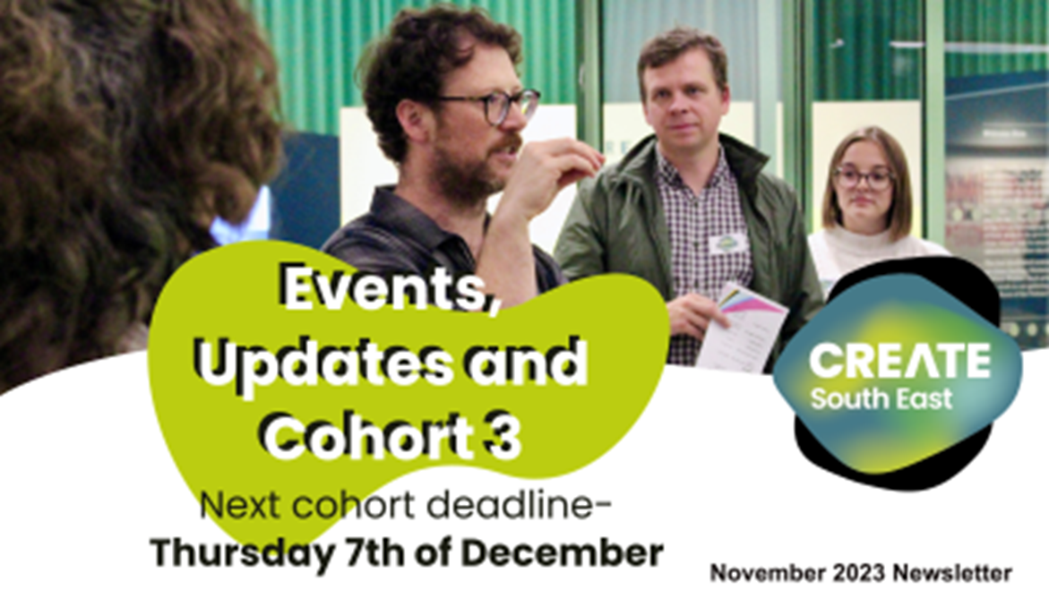
Create South East - where we are now
Legacy programme to South East Creatives – mind the gap
Didn’t lose what we have learnt with partner continuity - but we did lose branding
We brought on more partners to increase knowledge and reach
Success relies on collaboration across areas and teams and will deliver legacy
DCMS reporting now very different and testing new approaches, a little scary for the risk averse. ‘Do not default to ERDF’ - you will lose businesses. ERDF is a habit that can be broken.
But it does mean …programme change responding to need is possible e.g some businesses on an earlier journey so now creating a pipeline with support stream . Bravery to change a project in play.

