Slide 1
Technology in teaching – what could new models look like… Neala Whybrow executive director of education – EKC group 7th June 2023

Slide 2
the EKC Group and our specific challenges
SDF Project
The project aimed to support the transition towards a more data-driven, automated and digital economy by addressing skills gaps in digitisation, data literacy, virtual reality and automation
13 Immersive classrooms (6 within the EKC Group)
VR Consumption
VR Campus
6 colleges spanning across East Kent
Find recruitment in our coastal colleges challenging, with agency costs at these being significantly higher than our more central campus’
Current challenging recruitment areas are Computing, Electrical, Engineering and Plumbing.

Slide 3
COLLABORATION AGREEMENTS WITH KEY EMPLOYERS
How can we maximise these relationships to support the skills gaps and recruitment challenges in our colleges?
Could the new technology we have support to these new partners in being a part of our curriculum delivery?

Slide 4
EKC Groups ambitions with this technology
“Letters of engagement”
Build ‘support with specialist delivery’ into Stakeholder partnership agreements.
In cases of staff shortages within EKC, explore dual delivery across our 6 sites.
Kent Further Education Colleges (and potentially more colleges in the future) to collaborate on recruitment in hard to fill roles and consider immersive technology to make this more achievable.
Development of regional/national subject specific networks to consider key points in curriculum for collaboration and sharing of expertise immersively.

Slide 5
Effective models of recruitment and retention… strategic priorities and early ideas Neala Whybrow executive director of education – EKC group 14th June 2023

Slide 6
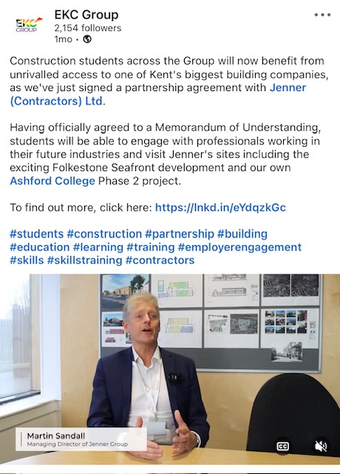
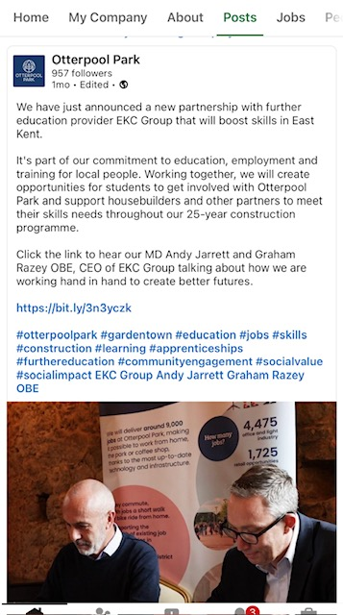
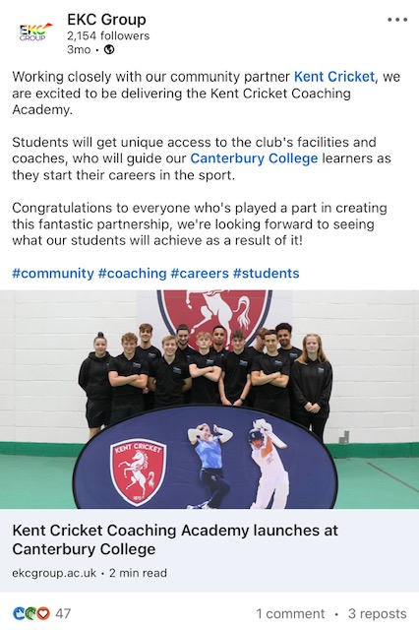
Recap of last time...
6 Immersive Classrooms with VR Consumption
10 Key Long Term Strategic Partnerships
Signed MOUs and accompanying action plans to secure long term commitments.
Notes:
Tier 1 employers
T Level Placements
CPD for staff – back to floor days.

Slide 7
Problems to solve and questions to answer…
How might we consider finding and recruiting different types of roles?
How do we access specialists and make the aware of working in Further Education?
How can we make working in FE more attractive a career option?
Are we targeting sector specialists at the wrong point of their career? (heading into retirement)
Do we have enough “pre- service” teacher training?
Not attracting enough candidates for specific roles

Slide 8
Potential Solutions…
Personalised and targeted recruitment strategies by sector.
Working with partners through MOUs to bring sector specialist into FE for curriculum design/delivery.
Letters of engagement, secondment opportunities, immersive only contracts, recruitment focused around knowledge, skills and behaviours.
Graduate Training Schemes – Attracting enthusiastic graduates ahead of sector experience.
Working with partners through MOUs to consider levy spend for “pre- service” teacher training opportunities.
Not attracting enough candidates for specific roles
Notes:
Like what Dan said about maximising sector seasonality – how can we work with our MOU partners to consider using resource in less busy periods.

Slide 9
Problems to solve and questions to answer…
How do we best introduce new to teaching staff in a way that is sustainable whilst not impacting negatively on learners?
How do we manage line managers desperation to get them in the classroom ahead of inducting them properly?
How can we get them early in their career whilst ensuring they are industry relevant/knowledge?
First year in employment
Notes:
Those leaving in first 2 years has doubled.

Slide 10
Potential Solutions…
Introduction to Teaching Year – Foundation knowledge and “toolkit building”
Leadership Development programme to include Resourcing and Retention workshops, first line manager training and the role of the hiring manager.
Work with Stakeholder partners to agree a commitment to graduate resource developing their technical and specialist skills with them.
First year in employment

Slide 11
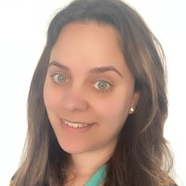
Thanks for your time and look forward to questions and collaboration
Executive Director of Education at EKC Group
www.linkedin.com/in/Neala-whybrow
Talks about #education, #resourcing #teachinginFE #inclusion, #furthereducation, #teachingandlearning, and #educationalleadership

