Slide 1
Sizewell C and Hinkley Point C
Approach to Skills and Training (FE/HE/Social Partnerships)
June 2023

Slide 2
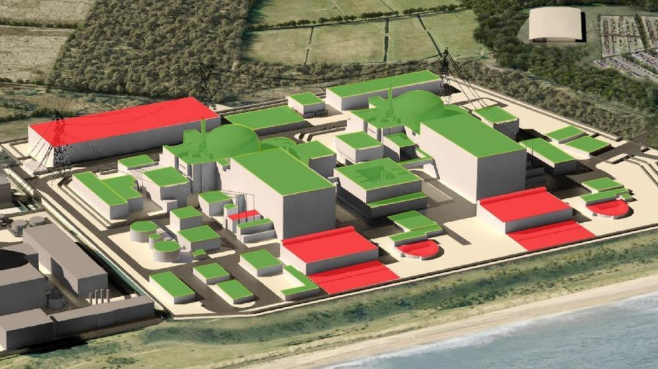
All the objects shown green on the picture will
copy the UK approved design of HPC

Slide 3

SZC Summary of SZC DCO / External pledges / Commitments
We will:
Play an active and influential role in regional skills development
Create a SZC Jobs Service in partnership with the region – ensuring that local employment is maximised
Provide a substantial fund for skills enhancement of facilities and resources in local colleges, Higher Education and training providers
Fund a regionally-based skills manager, to coordinate the region’s response to skills requirements at SZC and other Energy projects
Create a ‘conveyor’ of opportunity for people from East Anglia to gain work at HPC, returning to SZC in progressive and high-level roles.
Work with local schools and colleges and create a ‘Young SZC’ initiative to help raise young people’s aspirations, and help them gain important opportunities on the SZC project and our supply chain.
Establish a bursary scheme to help young people find an alternative pathway to work,
Offer 1,500 SZC apprenticeships
Maximise opportunities for diverse and hard-to-reach groups to gain life-enhancing career opportunities at SZC
Fund a pre-employment training and outreach initiative, working in close partnership with the LEP, Councils, DWP and the 3rd sector.

Slide 4
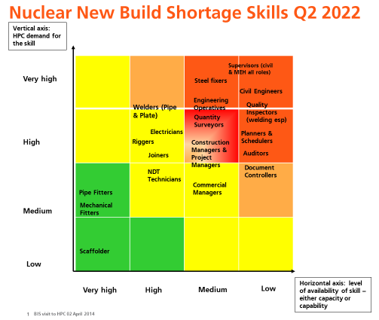

HPC
Lessons Learnt
HPC Criticality Grid
Requires an honest space
Deconflict skills requirements from supply chain capability issues
Requires input from National bodies
Criticality Grid is not static and requires regular review/update to reflect the situation

Slide 5


Slide 6


Slide 7
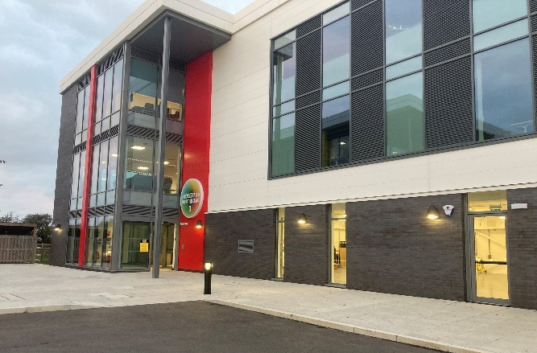
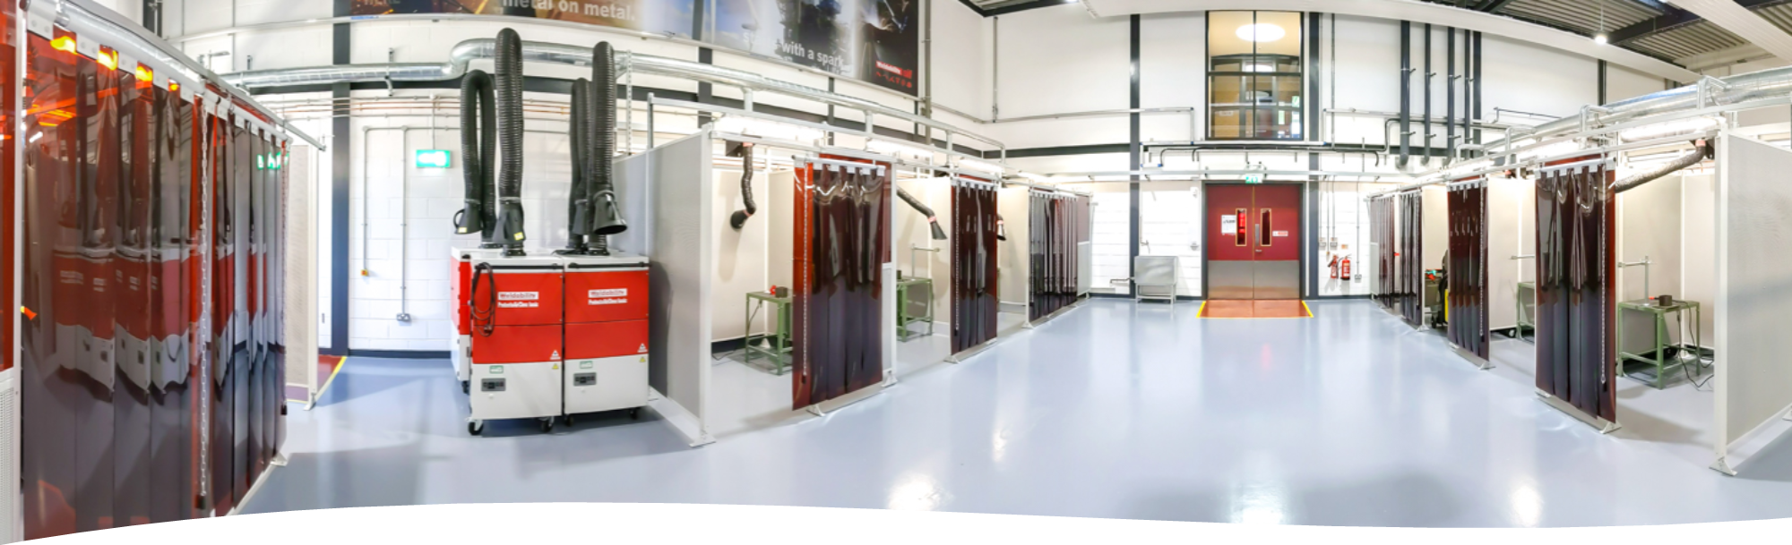
COEs’ Core Functions – delivered in partnership with FE
Setting the HPC/SZC training standard for nuclear skills
Providing Trade and competence testing for all HPC/SZC welders
The HPC ‘Home’ and centre for re-certification / Top Ups
Creating a pipeline of new recruits at VQ Level 1 and 2 .
Delivering HPC/SZC Apprenticeships
Providing training for Level 4+ roles
Associated technology training
– NDT, Orbital, Coatings etc.
RCC-M and Process upskilling
– first of a kind in the UK

Slide 8
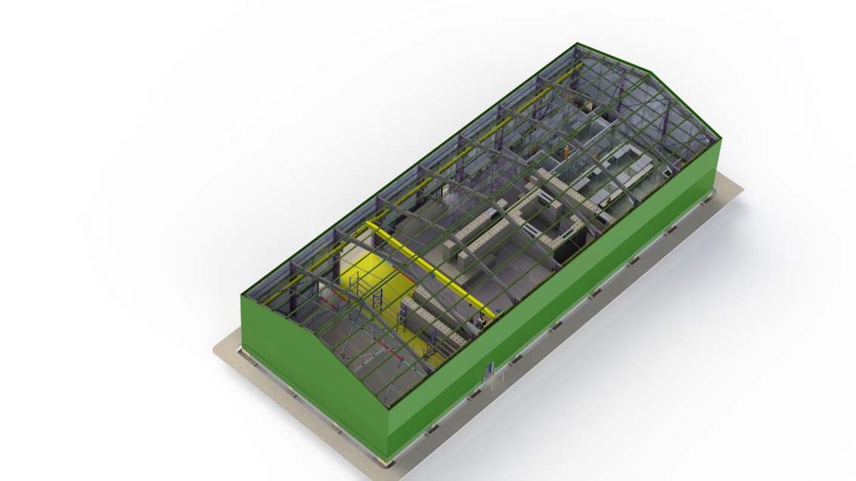
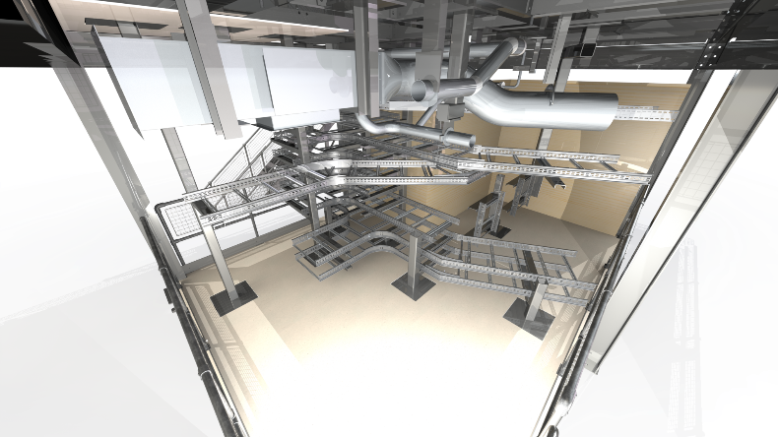
Curriculum and Trainees through centre – delivered by College and Industry Trainers

Slide 9
Trainer Engagement – Models Piloted at HPC
Industrial Relations Framework and Incentivisation
  Training as ‘In-Work’ Progression (Craft to Supervisor)
  Secondments (2wk to 6 Months)
  Seasonal Placements can be attractive to industry trainers
Experienced Hands Programme
  Targeted at 50+
  Retention of workforce at risk of ‘outflow’ from the sector
  Scenario Based training
Academics into industry
  Train the Trainer in National Industry ‘Hubs’

Slide 10

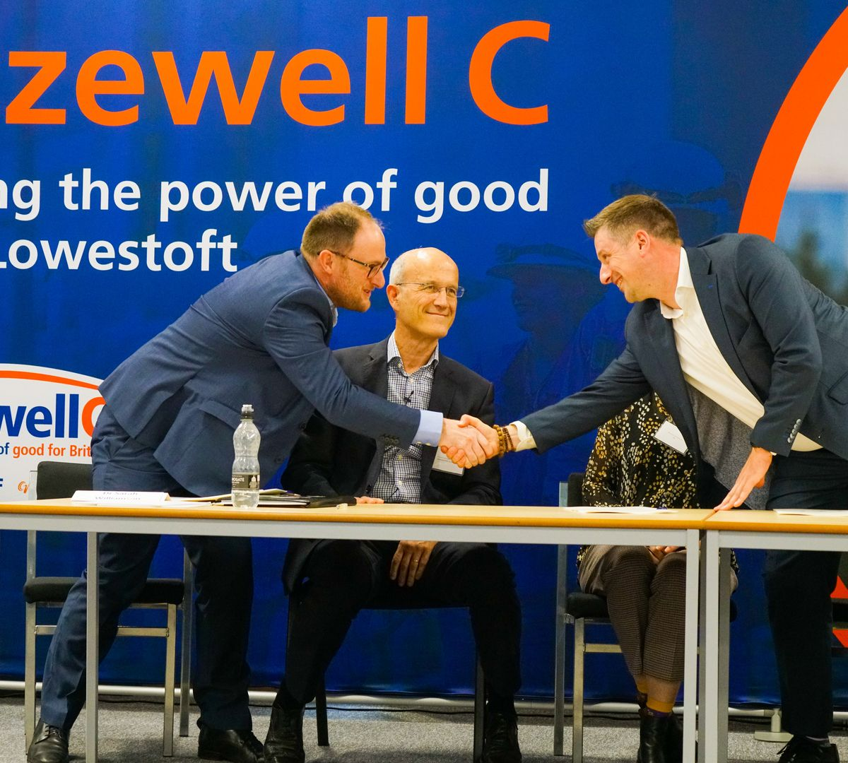
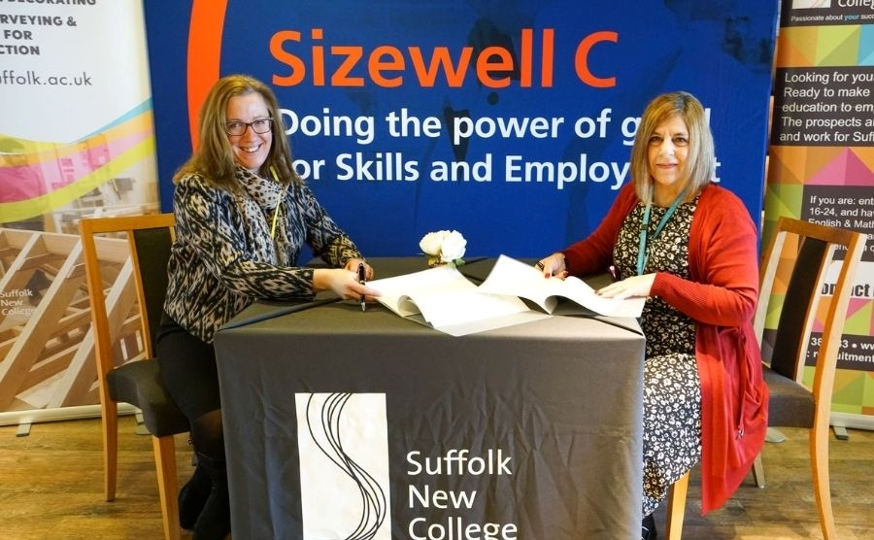
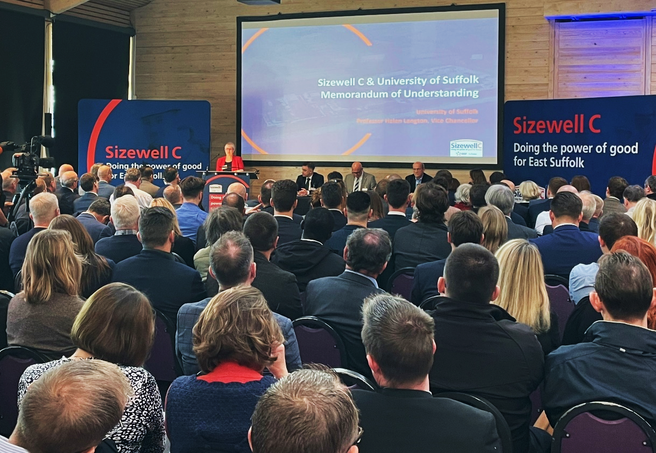
Memoranda of Understanding with Colleges – New for SZC
Five MOUs signed with Suffolk Education and Academic Partners.
Regular meetings of all CEOs & Principals to plan for delivery, implementation, and supplier collaboration.
Trainer and capacity issues addressed from the outset
Contractor Partners being engaged to directly support MOU partners.
Innovation in Delivery discussed from the outset.
Industry should engage with College’s own ‘Industry Partner’ MOUs
West Suffolk College MOU at Bury St Edmunds
OCTOBER 2021
East Coast College MOU at Lowestoft
SEPTEMBER 2021
Suffolk New College MOU at Ipswich
JANUARY 2022
University of Suffolk / National College for Nuclear MOU at Ipswich – NOVEMBER 2021

Slide 11
Some Lessons Being Learned
No silver bullet
  Major projects can be disrupters
  Partnerships essential
Centres of Excellence Model brings industry and college trainers together
Use IR Frameworks, Contracts, Incentive and Reward to support delivery
Becoming a trainer avoids unwanted and early outflows from sector
MOU’s provide a good platform – works both ways
Pay differential needs to be addressed
Regional and Major Project co-coordination Essential
  No individual project provides a sustainable solution on its own
Digital has great un-tapped potential
  avoids ‘Lift and Shift’ solutions and maximises impact and transcends boundaries

