Slide 1
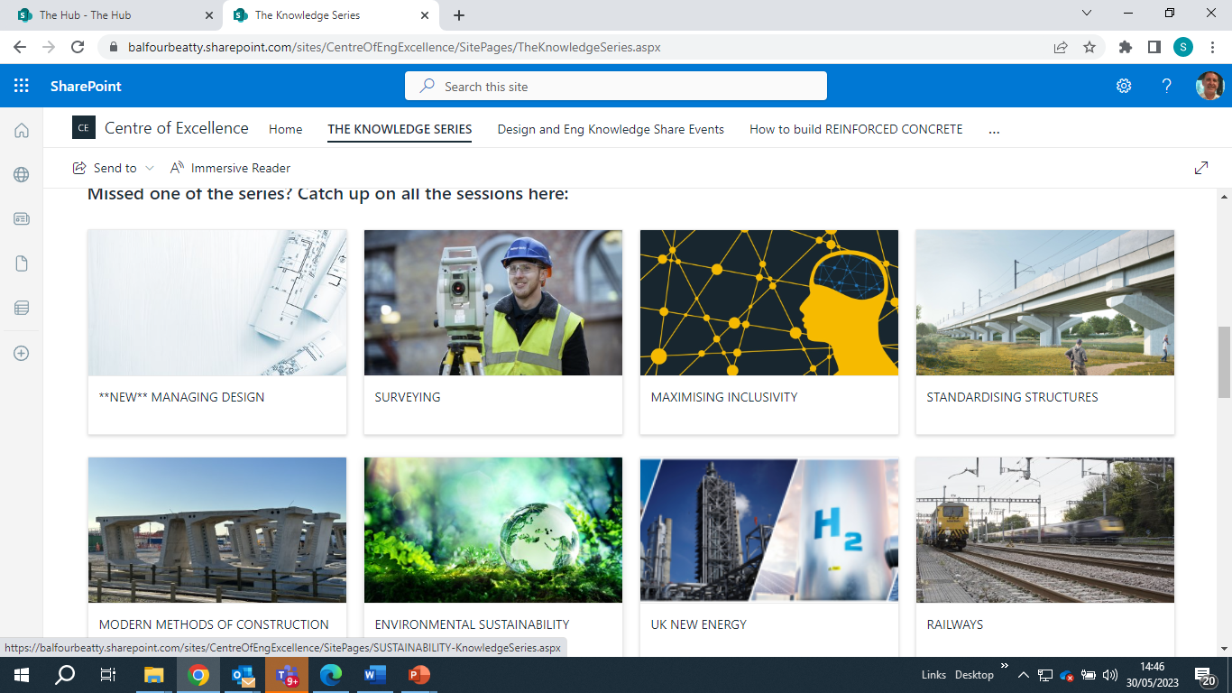
What is the knowledge series?
The Knowledge Series is a collection of webinars focused around a single topic and is open to everyone in Balfour Beatty our joint ventures partners, supply chain and clients.
The live lectures are delivered by our experts both from across Balfour Beatty Group and our partners. You don't need any prior experience in the topic to listen in and learn
Over 100 webinars and approx. 20,000hrs of CPD
Notes:
Unable to access EDI data for in progress candidates in Talentlink but able to provide manual data for candidates at offer stage.
This has been influenced by previous placements and candidates sources outside of EC resourcing team.
No concerns that this data will shift in the right direction over the coming months as we progress remaining Graduate offers and start Apprentice interviews

Slide 2
Aims
Develop knowledge of FE/HE lecturers
Support co-delivery in specialist topics
Ensure curriculum is relevant and up to date
Foster greater relationships between industry and education
Attract diverse talent to the built environment sector
Notes:
Unable to access EDI data for in progress candidates in Talentlink but able to provide manual data for candidates at offer stage.
This has been influenced by previous placements and candidates sources outside of EC resourcing team.
No concerns that this data will shift in the right direction over the coming months as we progress remaining Graduate offers and start Apprentice interviews

Slide 3
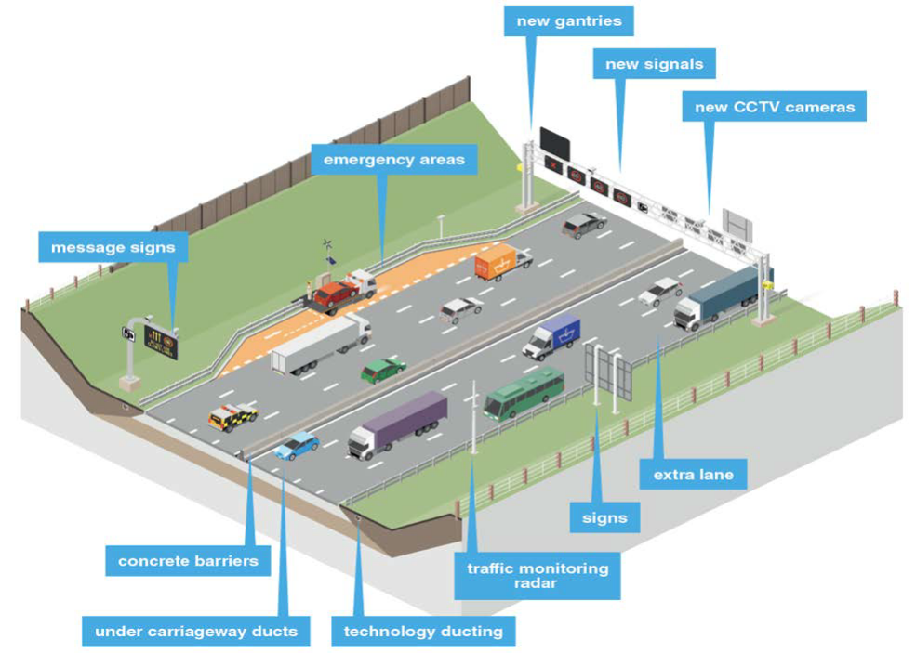
Why do we build roads? The Benefit
Reduce congestion – smooth flow of traffic to improve journey times and make journeys more reliable
Support and facilitate the growth of the local and regional economy – by providing required capacity on the road
Continue to deliver high level of safety performance - using latest technologies
Provide environmental improvements to existing infrastructure

Slide 4
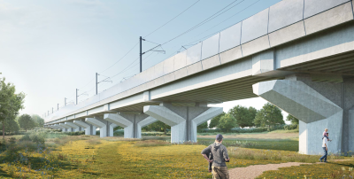
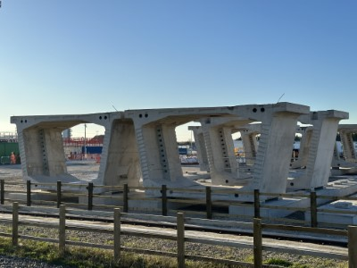
Development of Educational Portal
Selection of Knowledge Series video and resources available to access on demand
Access for both lecturing staff and students
Completely free
Expected launch Sept 23
40 webinars
Links to our careers portal
REINFORCED CONCRETE
EARTHWORKS
TUNNELLING
TEMPORARY WORKS
ROADS
FOUNDATIONS AND RETAINING STRUCTURES
BRIDGING STRUCTURES
RAILWAYS
ENERGY TRANSITION
GREENER
MODERN METHODS OF CONSTRUCTION
STANDARDISED STRUCTURES
SURVEYING
Notes:
Unable to access EDI data for in progress candidates in Talentlink but able to provide manual data for candidates at offer stage.
This has been influenced by previous placements and candidates sources outside of EC resourcing team.
No concerns that this data will shift in the right direction over the coming months as we progress remaining Graduate offers and start Apprentice interviews

Slide 5
Next Steps
Plan Knowledge Series launch with SELEP and key partners
Establish FE/HE Advisory Group to help embed Knowledge Series into the curriculum and lesson plans
Develop reporting and impact measures
Develop further expansion ie: live student webinars, co-delivery of specialist topics, teacher experiences, creation of KS2/3 content
FE/HE staff to register their interest in accessing the educational portal
Notes:
Unable to access EDI data for in progress candidates in Talentlink but able to provide manual data for candidates at offer stage.
This has been influenced by previous placements and candidates sources outside of EC resourcing team.
No concerns that this data will shift in the right direction over the coming months as we progress remaining Graduate offers and start Apprentice interviews

