Slide 1
SELEP Annual Conference
7 October 2022

Slide 2
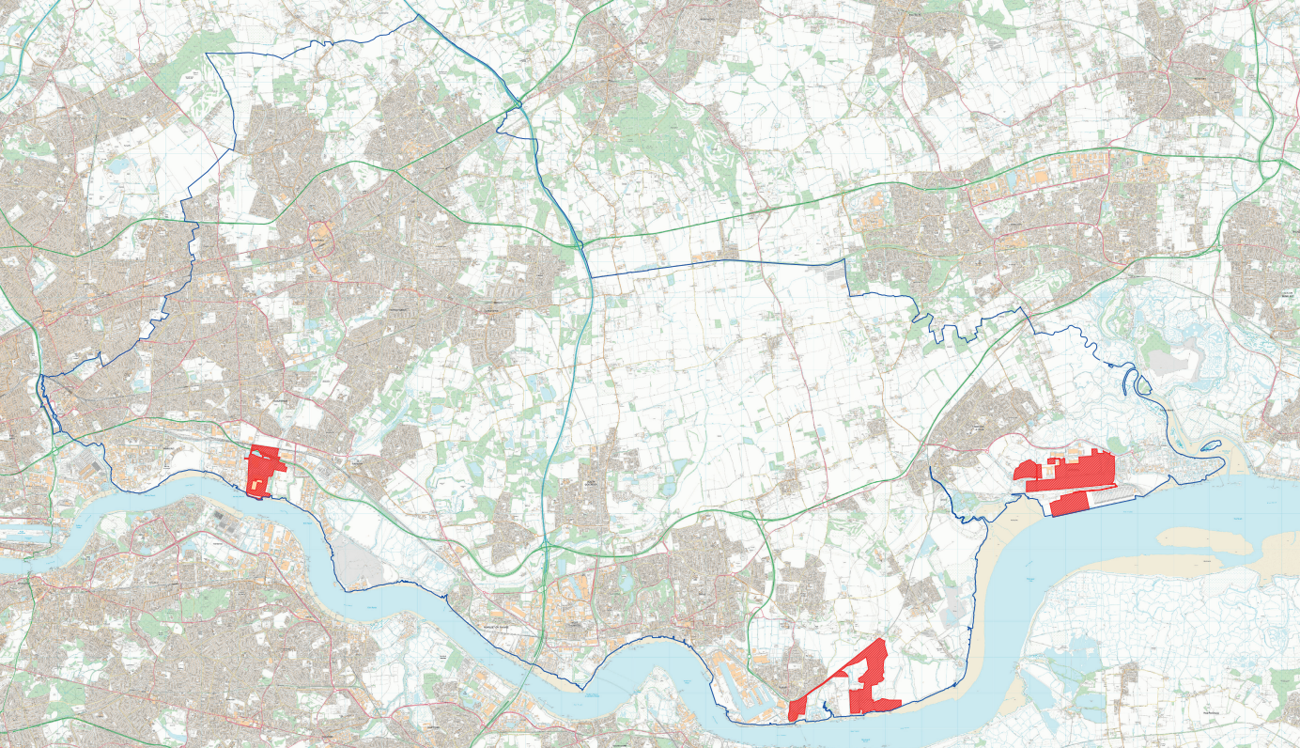
Thames Freeport
An efficient multimodal logistics and manufacturing hub, ideally located on the Thames and next to the major population centres, supporting innovative and low carbon trade sectors.
Ford
Havering
World
DP World
Thurrock
Barking & Dagenham
Thames Freeport zones includes three tax sites located at:
London Gateway – the UK’s most integrated logistics hub and one of the world’s fastest growing ports.
Tilbury – London’s major port, with a throughput of 16 million tonnes per annum with an estimated value of £8.7 billion.
Ford’s World-Class Dagenham Engine Plant – London’s largest manufacturing location for over 90 years.
Consortium partnership

Slide 3
Thames Freeport USP
The Thames Freeport has a unique value proposition due to the number of the fundamental ingredients, which include:
1,700 acres of land ready for development – at the heart of Europe’s largest consumer market
Global connectivity - global shipping routes and onward multimodal transit by road, river and rail, including connections to the A13 and Lower Thames Crossing, national rail network and European and Asian Rail network via HS1,
Renewable energy generation and storage: London Gateway will be home to the largest on-grid battery storage, and the Freeport outer boundary includes low emission energy generation from Tilbury Green Power and on-site wind turbines at Tilbury and Ford.
Accelerated investment – £4.3bn in new inward investment
Regeneration – £310m public sector programme and £25m seed funding to support transport infrastructure and site enabling projects
Economic impact – £2.6bn per year of additional GVA to 2045
New employment and skills:
21,000 net additional jobs
Thames Freeport Skills Accelerator
Multi-million pound Skills Fund

Slide 4
Thames Freeport Sectors
Thames Freeport has a clear strategy to develop and grow three primary sectors:
Key Sectors
Advanced manufacturing & processing
Advanced logistics
The Freeport will enable value adding manufacturing associated with importing supply chains, such as consumer electronics, food and beverage, medical appliances, among others. Assembling, processing and packaging closer to the end market will contribute to a more efficient and less carbon intensive supply chain.
The Freeport will also enable the UK to take a leading role in the development and deployment of autonomous, connected, electric and shared (ACES) vehicles. Connected to the Ford Engine Plant and Tilbury, automotive-related companies are well-placed to enter this £67 billion market that exports to over 150 countries.
Thames Freeport is focused on delivering provide net zero logistics solutions, such as last mile E-commerce goods that can have streamlined supply chains. There are already examples on the river such as DHL river parcel delivery. The Freeport will offer an incubator and accelerator for low-emission logistics technologies and services.
Clean energy & circular economy
The Thames Freeport will catalyse the Thames hydrogen economy in collaboration with the Thames Estuary Growth Board and Port of London Authority to pilot the production of green hydrogen and operation of hydrogen-powered maritime vessels. We will also grow our base of waste to energy and recycling businesses.

Slide 5
Thames Freeport Innovation
Our approach is to identify and focus on strategic opportunities, building credibility, confidence and demonstrating success. This will create a platform to develop an eco-system of innovation and a natural testbed of cutting edge technology.
Key Projects
Future Fuels Hub
The Freeport will offer a multi-fuel, multimodal and multi-user platform. Each tax site will be able to offer HVO, electric (solar and wind), hydrogen and others fuels to supply HGVs, Vessels, Port Infrastructure and operations. The first phase will be completed by 2025, with EV charging and low carbon fuel hub opening to the public and with the start of the operation of the H2 electrolysers.
River Freight
At present, food and goods are distributed in London through thousands of trips in/out of the city in vans with diesel engines via heavily congested roads. The Freeport will allow for goods to come into the port into large vessels, be processed on land and then use autonomous vessels river haulage to take light freight goods from local jetties into the central London wharfs and on to last-mile transit.
Smart Freeport
Plans are being brought forward for the UK’s largest data center within Freeport boundary - supported by Gigabit Full Fibre Broadband and 5G. Our ports are pioneers of new technologies, tracking real-time movement of goods. In partnership with CNS, BT and Plymouth University, the Freeport will refine and trial a technology platform adapted from DP World’s Dubai Freezone that will bring the UK to the global frontier of digital connectivity and intelligent customs systems, helping to deliver a frictionless trading system.

Slide 6
Thames Freeport – Economic Impact & Skills
20% of the UK’s most deprived communities are in London and the South East
Thurrock
Barking & Dagenham
Thames Freeport Skills Fund and Accelerator Programme: To match workers to jobs created at the Freeport and maximise our levelling up impact, we are establishing our own Skill Fund and Accelerator, with commitment from our private sector partners to invest up to £ 6 million to develop the local workforce.
Partnership with the South East Institute of Technology (SEIOT) – 15 dedicated learning delivery sites will be created, involving 9 core education partners. Key industries that will be supported through applied research and skills development include: Engineering and Manufacturing; Transport and Logistics and Information and Communication Technology.
South Essex Technical University – An innovative, comprehensive and consistent portfolio of work-based learning courses, including Degree Apprenticeships. This is a business-led model with bespoke undergraduate courses from a world leading university delivered on the employer site.
-14%
-29%
lower GDP per capita
lower GDP per capita
+23%
+74%
higher unemployment
higher unemployment
top 10% areas of deprivation for skills
unemployment in Tilbury double the national rate.
top 5 most deprived areas in the UK
14,000 people looking for work

Slide 7
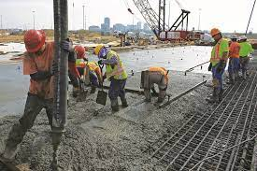
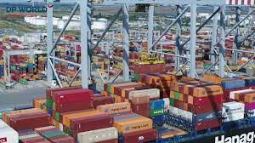
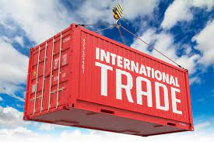
Working alongside local businesses
Areas of opportunity to explore and develop:
Construction and development of the Freeport
Inward investors and supply chains
Trade & Exports
Skills and workforce development

Slide 8
Questions and Thank You
https://thamesfreeport.com/
Contact:
Martin Whiteley – martin.whiteley@thamesfreeport.com

