Slide 1



Slide 2
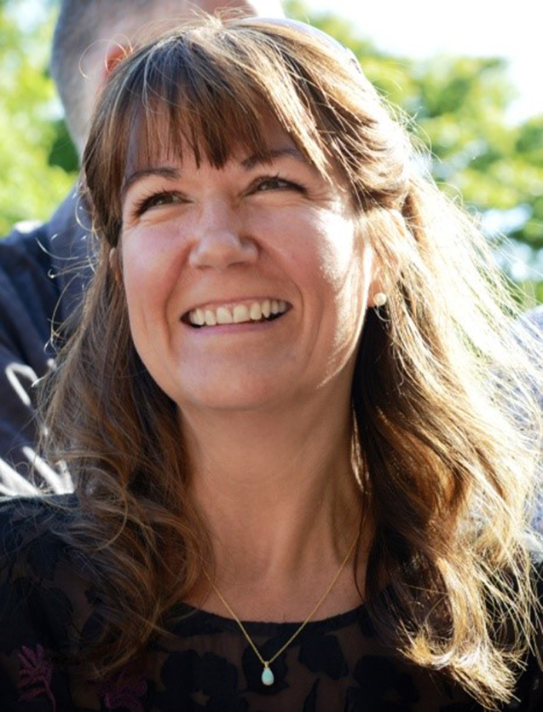
Welcome and Introductions
SOUTH EAST FUTURES
OUR EVOLVING ECONOMY
Sarah Dance
Deputy Chair, South East LEP

Slide 3
Poll
SOUTH EAST FUTURES
OUR EVOLVING ECONOMY
Which of the following represent the biggest opportunities for growth in the South East economy?
The development of key business sectors
Strengthening supply chains
Increasing international trade
Accelerating green technologies
Implementing freeports and investment zones
Major infrastructure projects

Slide 4
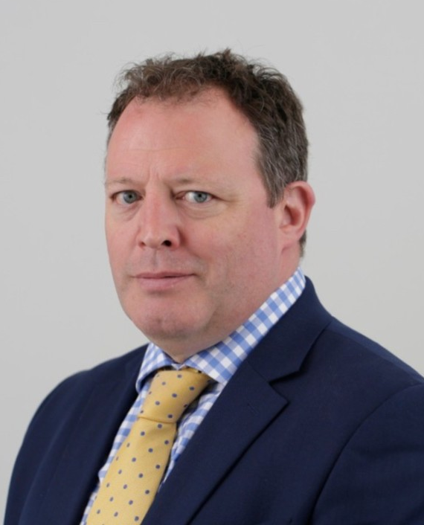
Keynote Address
SOUTH EAST FUTURES
OUR EVOLVING ECONOMY
Future economy and what this means for South East businesses
Mark Goldstone
Head of Regional Policy, CBI

Slide 5
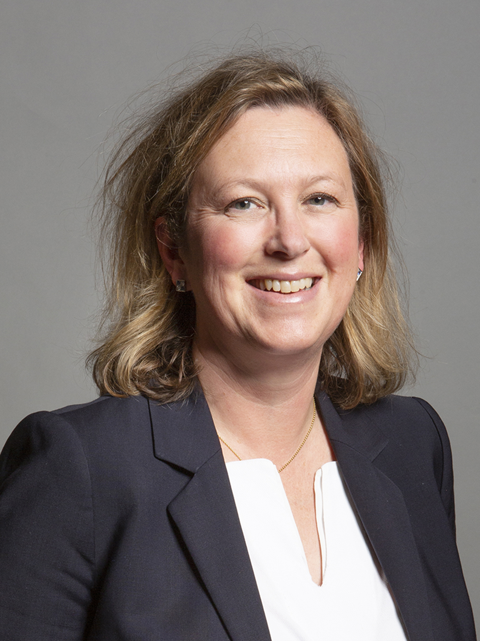
MP Address
SOUTH EAST FUTURES
OUR EVOLVING ECONOMY
The work of the South East APPG
Sally-Ann Hart MP
Hastings and Rye

Slide 6
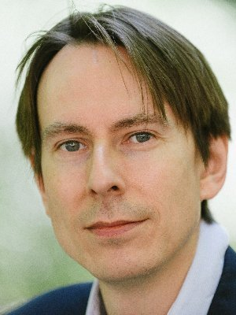
Regional Address
SOUTH EAST FUTURES
OUR EVOLVING ECONOMY
South East and the Levelling Up challenge
Jonathan Werran
Chief Executive, Localis

Slide 7
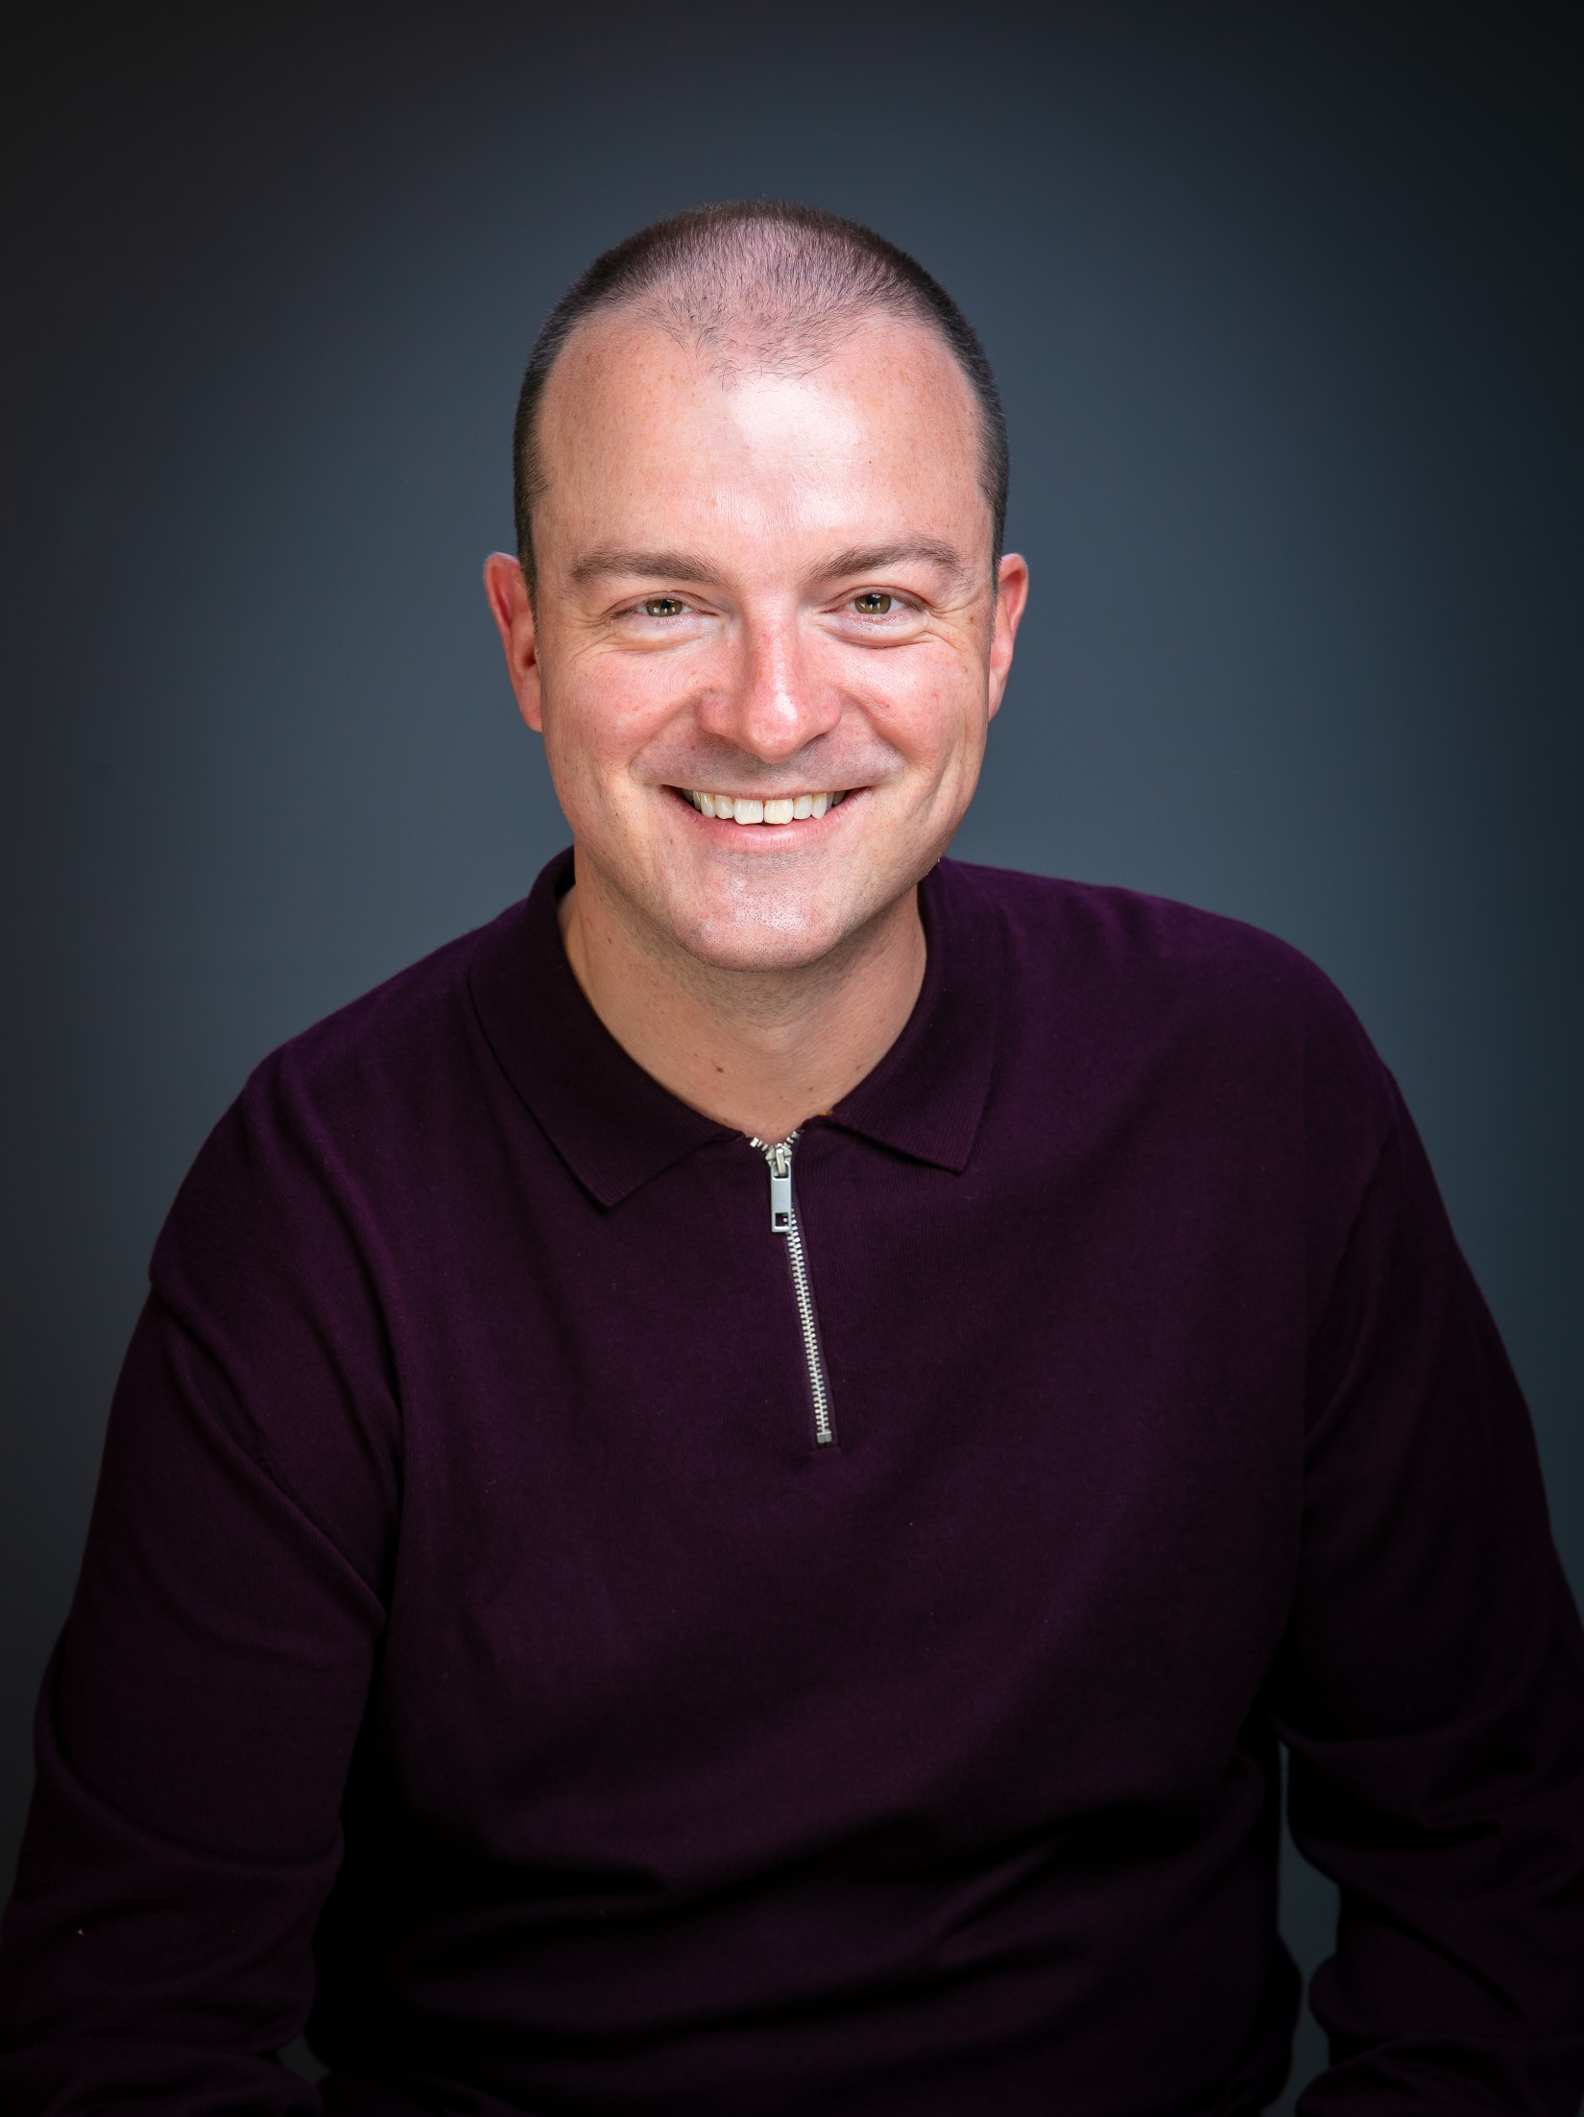
SELEP’s Achievements and Future Direction
SOUTH EAST FUTURES
OUR EVOLVING ECONOMY
Adam Bryan
Chief Executive, South East LEP

Slide 8
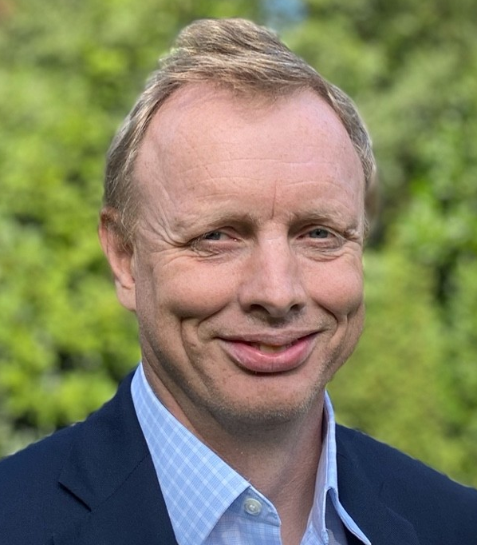
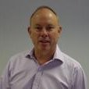
Opportunities for future growth in the South East including the work of the South East Major Projects Group
SOUTH EAST FUTURES
OUR EVOLVING ECONOMY
Matt Palmer
Executive Director, Lower Thames Crossing
Martin Whiteley
Chief Executive, Thames Freeport

Slide 9


SOUTH EAST FUTURES
OUR EVOLVING ECONOMY
Opportunity for
Questions

Slide 10
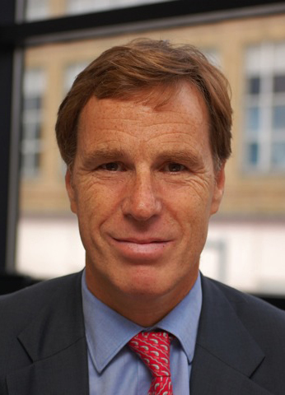
Thanks and Next Steps
SOUTH EAST FUTURES
OUR EVOLVING ECONOMY
Christian Brodie
Chair, South East LEP

Slide 11




SOUTH EAST FUTURES
OUR EVOLVING ECONOMY
THANK YOU FOR ATTENDING
IF YOU ARE INTERESTED IN JOINING OUR AGM FROM 11.00-12.00, PLEASE SIGN UP USING THE LINK IN THE CHAT
FOLLOW US
@southeastlep
linkedin.com/company/south-east-lep
GET IN TOUCH
hello@southeastlep.com

