Slide 1
SOUTH EAST LEP LTD
ANNUAL GENERAL MEETING
2021-2022
11.00-12.00
FRIDAY 7TH OCTOBER 2022

Slide 2
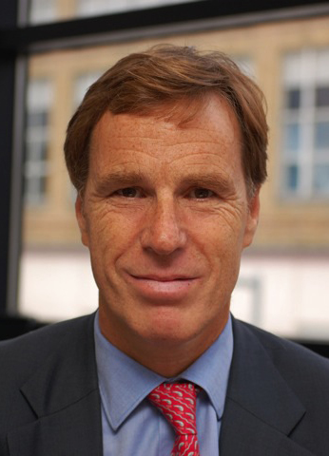
Welcome and Introductions
SOUTH EAST LEP LTD AGM 2021-22
Christian Brodie
Chair

Slide 3
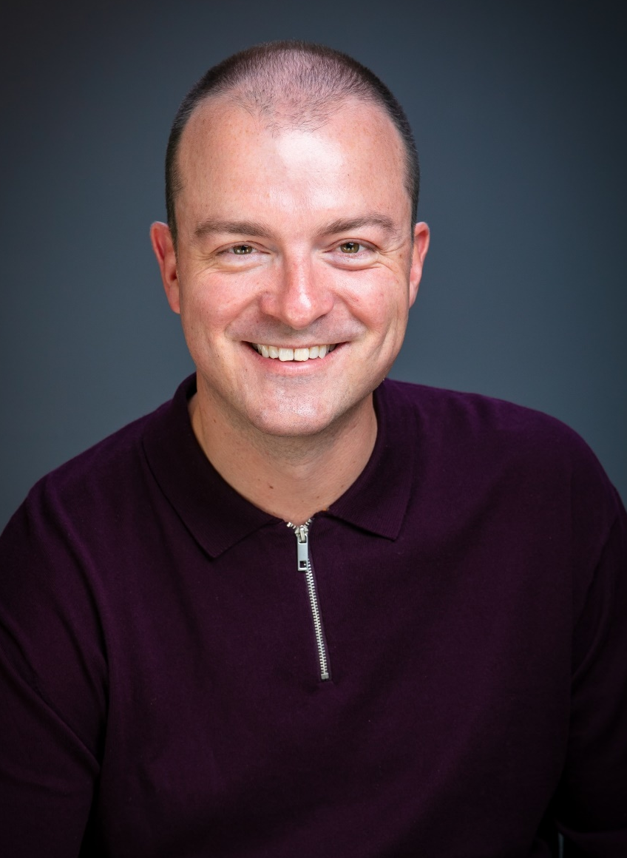
SELEP Progress and Achievements 2021-22
SOUTH EAST LEP LTD AGM 2021-22
Adam Bryan
Chief Executive

Slide 4
Poll
SOUTH EAST FUTURES
OUR EVOLVING ECONOMY
What do you think will have the biggest impact on business survival in the next year?
Government policy
Local action
Individual action
International collaboration

Slide 5
Our Economic Recovery and Renewal Strategy
SOUTH EAST LEP LTD AGM 2021-22
In March 2021, the SELEP Board approved its Economic Recovery and Renewal Strategy. It responds to the devastating impact of the COVID-19 pandemic on the economy, but also the implications of Brexit on supply chain issues and the labour market and the need to level up within the South East. These issues continue to have implications and more recent ones are adding further pressure, such as high inflation, tax rises, all putting additional strain on already stretched businesses and individuals.
The strategy highlights four priority areas that have been identified as the unique driving forces behind the South East economy. These are:
Business Resilience and Growth
UK’s Global Gateway
Communities for the Future
Coastal Catalyst

Slide 6
SOUTH EAST LEP LTD AGM 2021-22
Our COVID-19 Recovery Funds Programme
Business Support Fund
£2.4m
Skills Recovery Fund
£1.5m
Starting and Succeeding in Business
£565,000
Provider: WSX Enterprise Ltd
Adapting with Digital
£750,000
Provider: WSX Enterprise Ltd
Supporting the Visitor Economy
£1,050,000
Provider: Visit Kent and consortium partners
COVID Recovery Academy
£1,045,000
Provider: Shaw Trust
Digital Skills Programme
£279,960
Provider: Tech Talent Academy
The Digital Bridge
£300,000
Provider: We are Digital

Slide 7
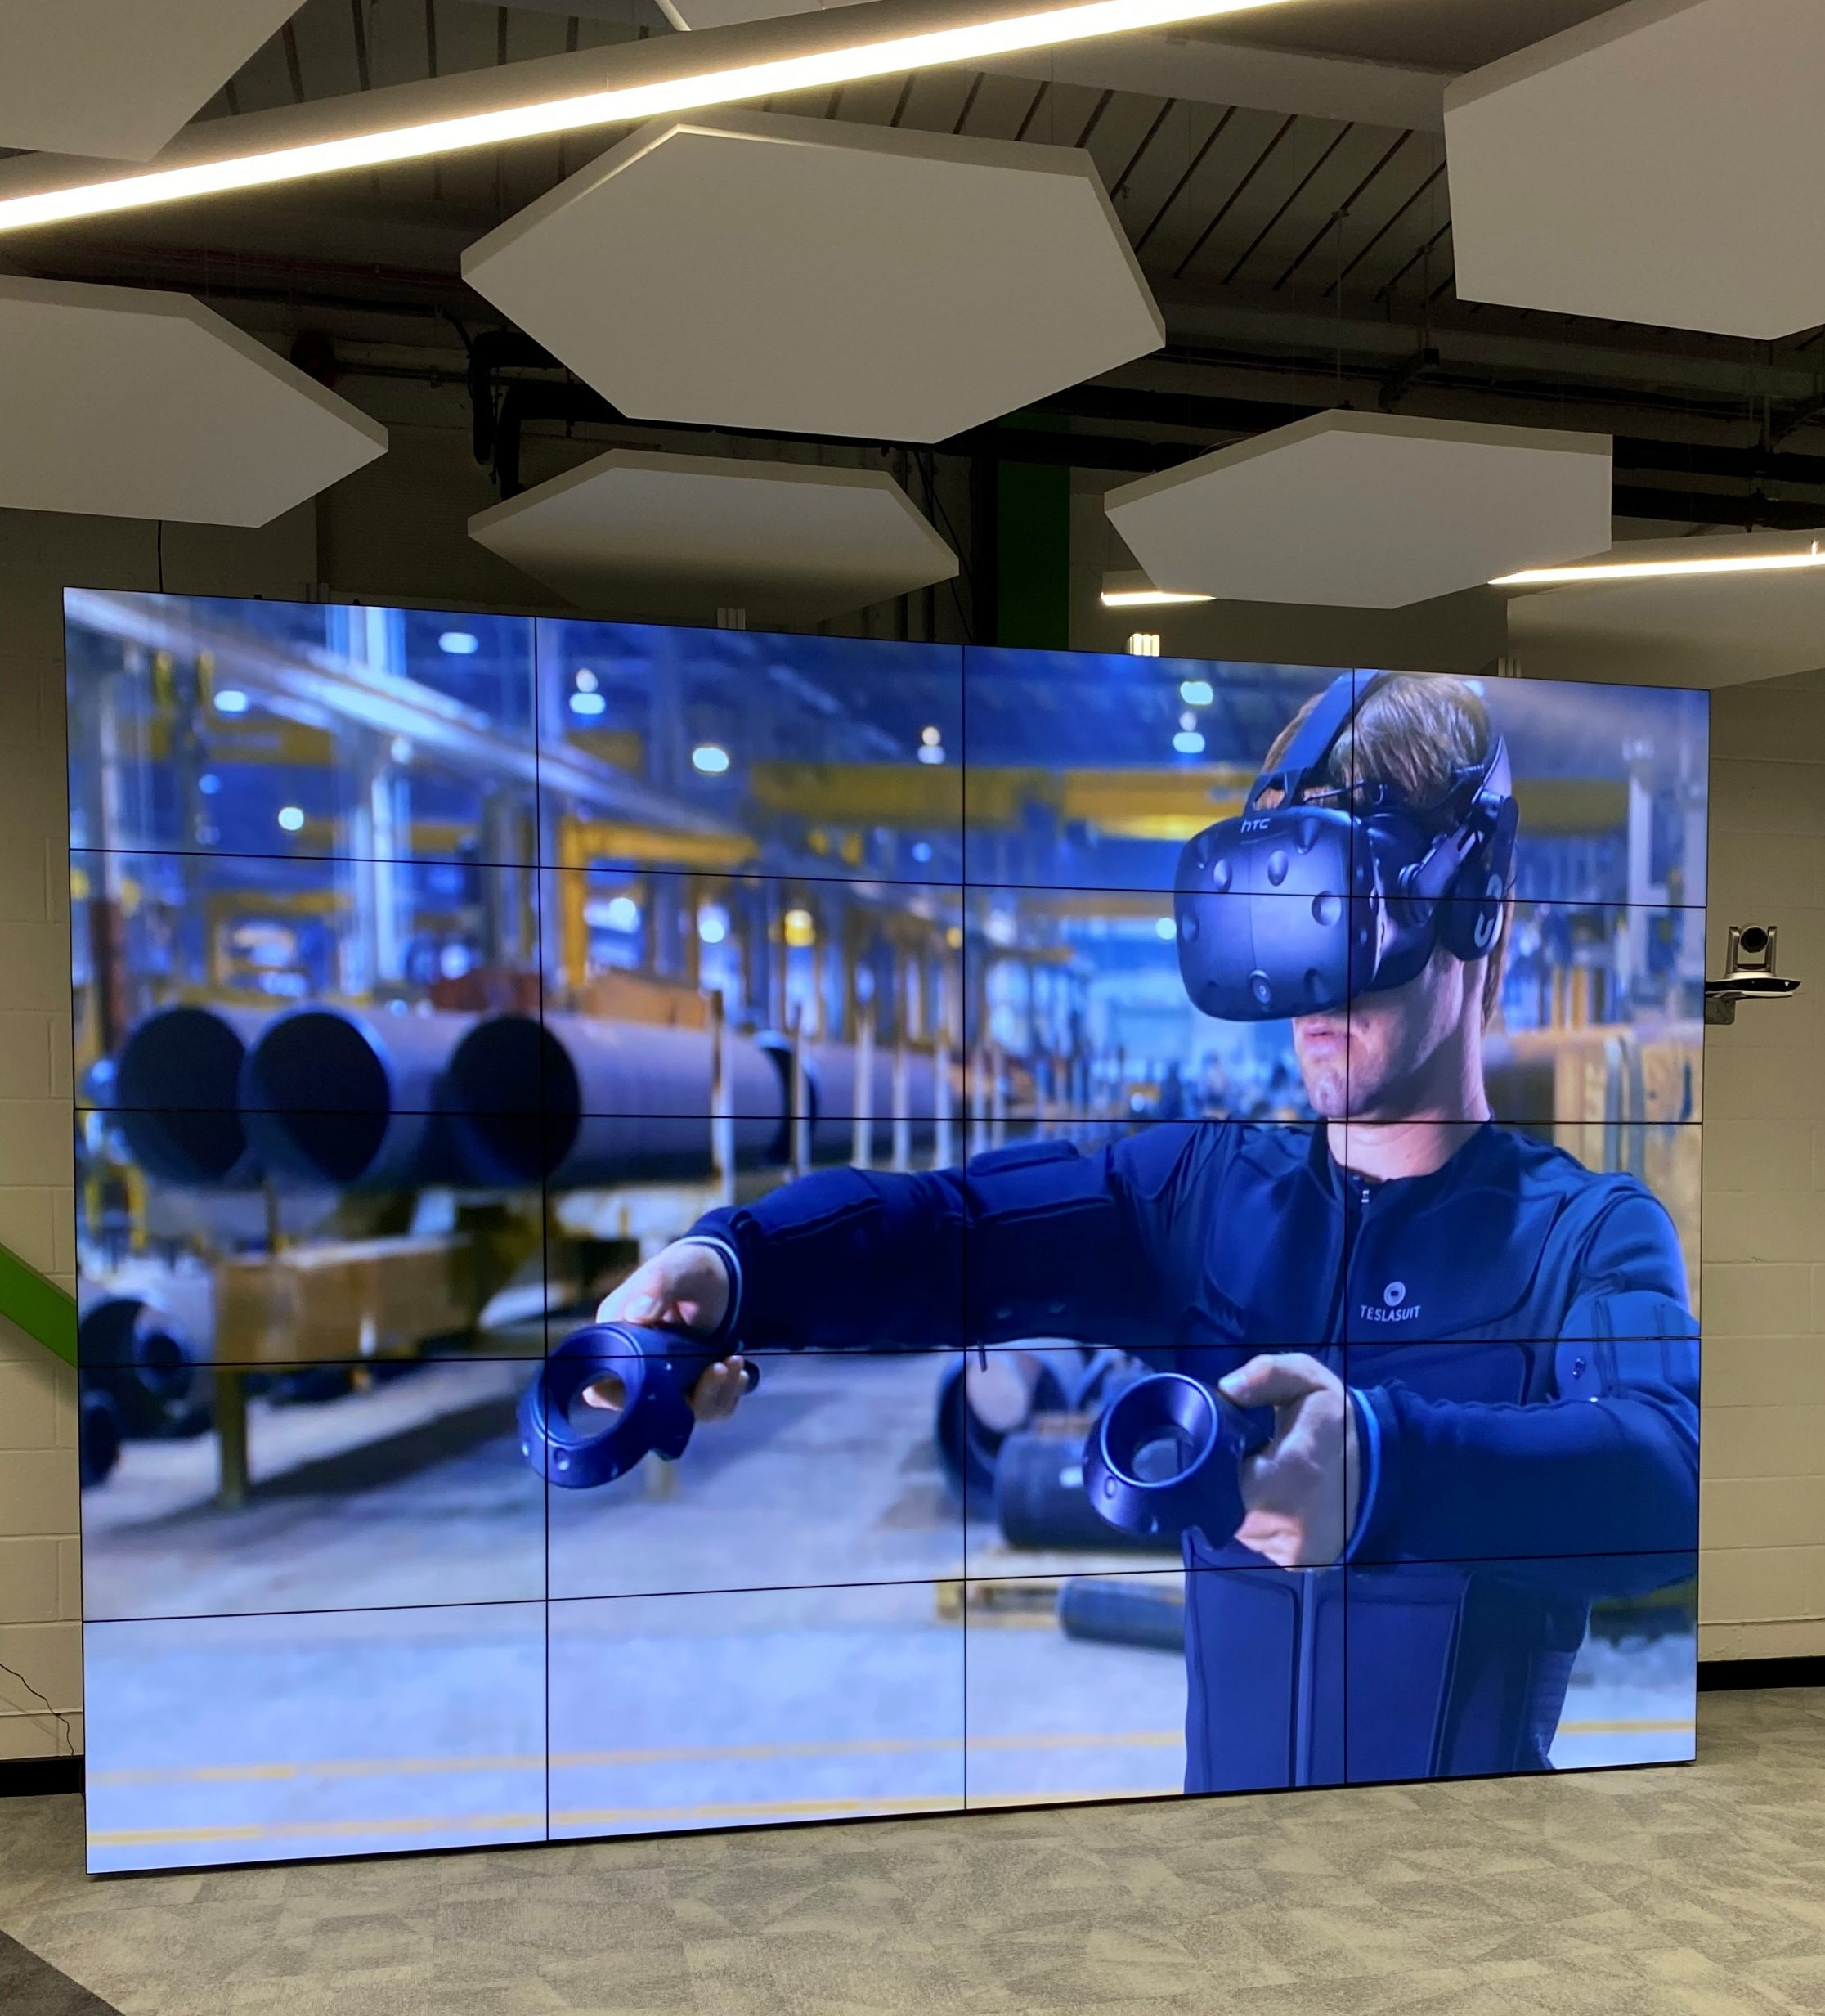
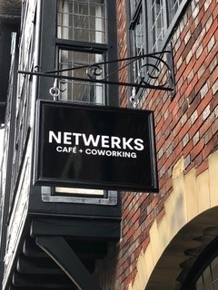
SOUTH EAST LEP LTD AGM 2021-22
Our Capital Programme: Case Studies
Local Growth Fund
USP College’s Xtend Digital Campus
Getting Building Fund
Creative Hub, 4 Fisher Street
LGF Funding: £900,000
Project Completion: August 2021
Location: Canvey Island
GBF Funding: £250,000
Project Completion: Autumn 2021
Location: Lewes
USP College’s brand new XTEND Digital Campus is the first of its kind in the UK. The facilities boast a full range of the newest technologies, including opportunity for end-to-end development of Augmented Reality (AR) and Virtual Reality (VR) applications.
Conversion of a vacant Grade-II listed former office premises in Lewes town centre into a co-working hub for the creative industries.
- Street level co-working café
- Reception and information point
- Co-working and freelance desk area
- High speed broadband connection with Wi-Fi access as well as fixed terminals
- Contemporary office spaces
- Boardroom and mini conference space

Slide 8
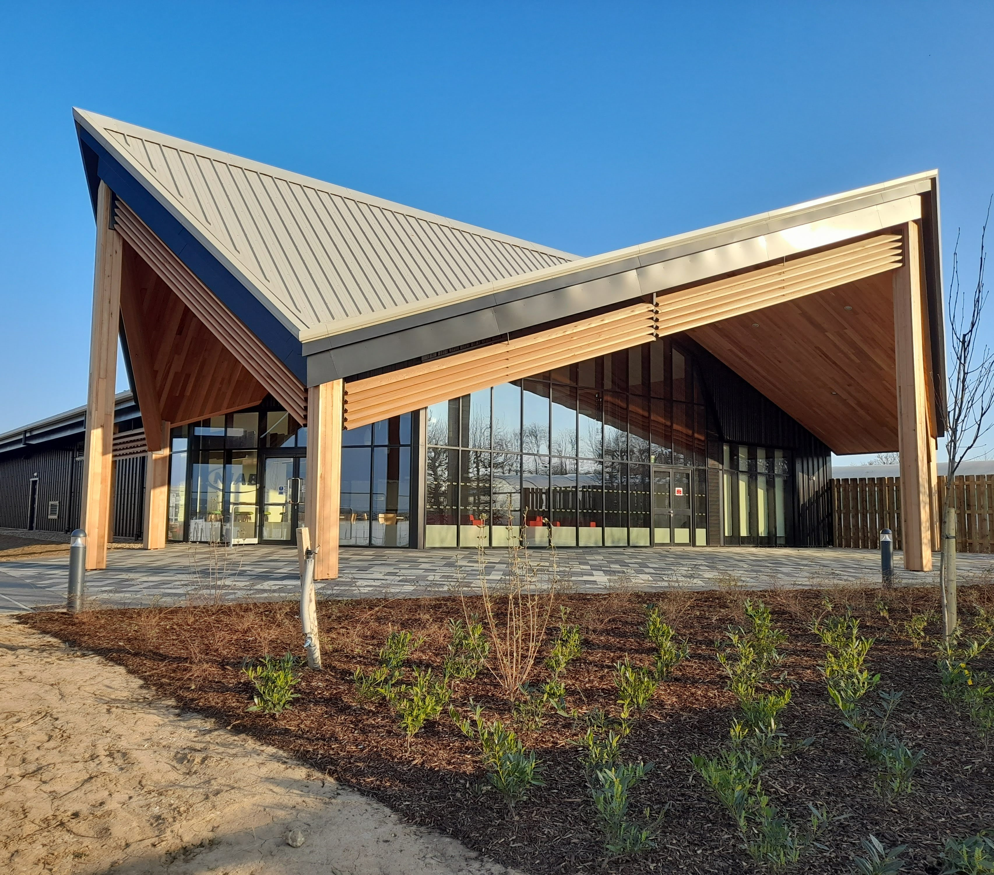
SOUTH EAST LEP LTD AGM 2021-22
Our Capital Programme: Case Studies
Growing Places Fund
Wine Innovation Centre
Sector Support Fund
Catalyst for Culture
GPF Funding: £600,000
Project Completion: Spring 2022
Location: East Malling
SSF Funding: £181,700
Location: Pan-LEP
This project has delivered a Wine Innovation Centre at the East Malling Estate. It complements NIAB EMR’s investment in the only UK research vineyard to support Kent’s wine sector to develop as global leaders in innovation.
The Catalyst for Culture Programme is a partnership between established performing arts institutions of national and international standing in the SELEP region, providing live and online theatre experiences for audiences throughout Kent, Medway, Thurrock, Southend, East Sussex, South Essex and Essex, and supporting the creative, production and technical workforce, artists and freelancers across the SELEP region.

Slide 9
SOUTH EAST LEP LTD AGM 2021-22
Our Business Support: South East Business Hub
A fully funded, impartial signposting and advice service for businesses and entrepreneurs navigating the support landscape and looking to succeed, change or grow.
3,375 businesses helped last year
41,029 unique visitors to the Growth Hub website
3,698 referrals were made to other provisions such as mentoring, skills and training, finance and funding, R&D and innovation, and import and export
80.5% overall satisfaction rating across the Growth Hubs

Slide 10
Our Future Direction and Areas of Focus
SOUTH EAST LEP LTD AGM 2021-22
The provision of strategic planning and intelligence to provide a clear regional strategy for growth, underpinned by a robust evidence base.
OUR STRATEGY
We are setting out our actions to help boost the economy of the South East by encouraging collaboration and investment. Building on our existing strengths, knowledge of the area and well-established relationships after 10 years of activity, the South East LEP’s approach will be focussed on three areas.
Communicating, collaborating, and convening across our network of businesses, academia, and the public sector to provide a business voice and joint activity around key strategic objectives.
OUR NETWORK
Delivering strategic economic projects to seize opportunities to accelerate growth.
OUR DELIVERY

Slide 11
OPEN QUESTIONS FOR BOARD DIRECTORS
SOUTH EAST LEP LTD AGM 2021-22
An opportunity for members to ask board directors questions about the operations and future work of the organisation

Slide 12
SOUTH EAST LEP LTD
ANNUAL GENERAL MEETING
2021-2022
THANK YOU FOR ATTENDING
FOLLOW US
@southeastlep
linkedin.com/company/south-east-lep
GET IN TOUCH
hello@southeastlep.com

