Slide 1
Kent & Medway Economic Partnership
Presentation by Ian McAulay, CEO, and Dr Toby Willison, Director of Environment & Corporate Affairs, Southern Water
November 25, 2021

Slide 2
The water challenge
In England – climate change predicted to reduce supply by 600 million litres of water per day by 2054
The National Infrastructure Commission reports a 1 in 4 chance of severe drought before 2050
Demand for water is growing from an increasing population of 62 million by 2043
Current levels of abstraction are unsustainable with huge risks for our precious chalk stream habitats
300,000 extra homes built each year will increase the burden on already stretched networks
Our inherited sewer system - many parts of the system laid over 50 to 100 years ago

Slide 3
Our targets
By 2025 – Event Duration Monitoring (EDM) technology installed at 100% of our sites ensuring greater transparency
By 2030 – 80% reduction in the use of storm overflows
By 2040 – Zero pollution incidents
By 2040 - Target 100 is a commitment to our customers.
By 2040 - Operating a fully integrated water environment working seamlessly with all water users

Slide 4
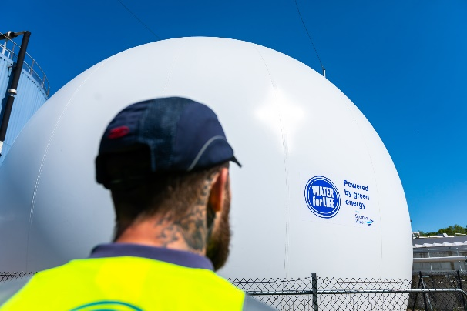
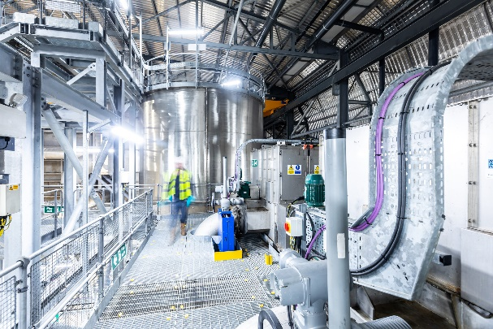
How do we get there
Investing over £1.5 billion in our wastewater network between 2020-2025 and £600 million on environmental improvements
In Kent - £298 million investment between 2020-2025 in 61 wastewater systems

Slide 5
Investment in Kent includes:
Wastewater catchment area | Investment
Ashford WTW | £39.3m
Weatherlees Hill WTW (Thanet) | £36m
Swalecliffe WTW (Canterbury) | £25.7m
Sittingbourne WTW | £20.2m
Motney Hill WTW (Medway) | £14.6m
Faversham WTW | £11.26m
Tunbridge Wells South WTW | £10.4m
Northfleet WTW (Gravesham) | £8.37m
Oxted WTW (Tandridge) | £8m
Gravesend WTW | £7.7m
Refurbishment of sites to protect the environment
Additional storm storage capacity to reduce spills to the environment
Increasing capacity to accommodate growth
Upgrading treatment processes to improve river water quality
Upgrading treatment works to reduce phosphorous being discharged to the environment
Sewer rehabilitation
Wastewater catchment area

Slide 6
Headlines from Kent investment 2020-2025
Thanet sewers – groundwater protection scheme; involves sealing chalk adits and sewers in adits to prevent sewers leaking into the chalk - £22m
Chilmington Green - sewer reinforcement scheme; laying new system to transfer flows within part of the Ashford system to allow a major house development to be drained - £14m
Military Road rising main - to replace the rising main which serves Ramsgate and conveys flow to Weatherlees WTW -£13m
Margate pumping station - phase 2 of refurbishment and resilience measures at Margate -£6m
Growth related investment to allow developments to connect to the sewer network and to reinforce sewers where required to reduce the risk of flooding as a result of these new connections – total of £26m

Slide 7
Nutrient neutrality Responding to a growing number of estuaries and water bodies affected by nitrates and phosphates
How this can be achieved
Offsetting nitrates by changing land use e.g. by creating a wetland, planting trees or by taking land out of agricultural use
Working with groups like the Wildlife Trust on nutrient trading
Neutral removal using low phosphate technologies - high chemical and carbon footprint (Hailsham Wastewater Treatment Works)
Biological Nutrient Removal – process used in wastewater treatment works for nitrogen and phosphorous removal from wastewater before it is discharged into surface or ground water – reduced chemical and carbon footprint

Slide 8
Nutrient neutrality
Biological Nutrient Removal
requires high strength sewage which is not always possible if the sewerage network is combined (foul and surface water).
removing surface water from networks will provide greater opportunities for this technology to be exploited
will also reduce the frequency, volume and occurrence of storm overflows which is a nationwide challenge for regulators and the industry

Slide 10
Reduction of storm overflows – tackling the problem of Combined Sewer Overflows

Slide 11
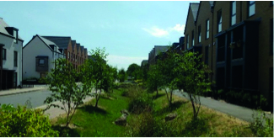
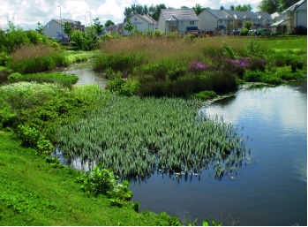
Reduction of storm overflows
Separating surface water from the sewer system – most cost effective and environmentally beneficial way of reducing storm overflow from combined sewers
Cross-party approach needed to find practical solutions
40% reduction in surface water from highways = 80% reduction in storm overflows
Separation of rainwater would free up growth capacity for future development
Avoids need for larger concrete storage
Holistic approach means water utility customers don’t pay for the changes
November 2021: Formation of a special task force to focus on this issue

Slide 13
CSO Task Force
Set up to go further and faster to reduce overflows by 80% by 2030
Regulated and permitted activity to protect homes during intense rainfall. However the use of CSOs is no longer acceptable
Innovative nature-based solutions to be pursued working with local stakeholders
Reduced carbon footprint compared to traditional solutions and opportunities for biodiversity gain
Five Pathfinder projects designated to test and prove concept and delivery options: Swalecliffe, Deal, Margate, Sandown and Pan Parishes (Andover)

Slide 14
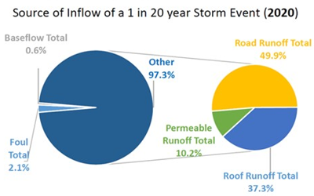
Swalecliffe is dominated by road and roof runoff in storm conditions, we estimate that removing 5,000m³ (17%) will reduce the use of outfalls by 80%.
Context \ current | Number
Population in the catchment (equivalent) | 37,000
Average daily flows received from catchment | 9,000 m³\d
Volume received during a 1 in 20 storm for a 1 hour duration | 30,000 m³
Number of outfalls spilling in 2020 \ total in the system | 8 \ 10
Total number of spills in 2020 | 76
Estimated discharge volume during the storm event | 5,000 m³
Bathing Water | 2
Shellfish | 2
International designations | 2
97% of water in this sewer system in a storm is rain water, of which most is direct runoff from roads and roofs.
The remaining 3% is made up of ‘Baseflow’ (0.6%) which is infiltration from ground water into the sewer, ‘Foul’ (2.1%) is domestic wastewater (showers, sinks, toilets).
Volume of rainfall to separate or store to prevent overflows in a 1\20 storm = 5,000m³ (17%)
* This is only and estimate and needs more analysis. For this preliminary study it has been assumed that 80% of discharges will be avoided by removing 5,000 m3. It could be less than 80%. It is not 100% because a more intensive storm could still have discharges or a localised rainfall event in the catchment could cause a discharge.

Slide 15
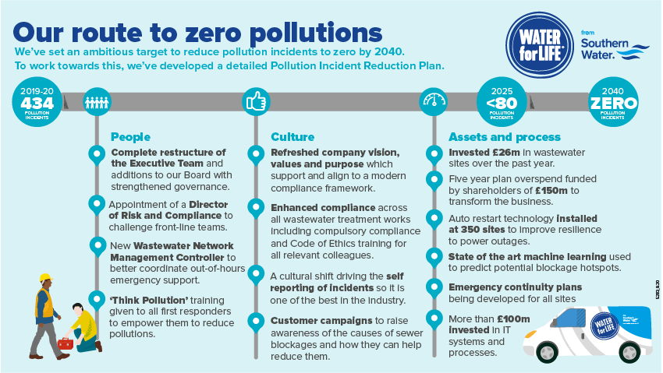
Notes:
SW committed to adopting SUDS

Slide 16
Drainage & Wastewater Management Plans
New long term plans – spanning 25 years or more – to improve drainage and wastewater systems to reduce flooding and pollution and improve water quality
They will:
Identify current and future risks from wastewater systems
Provide information to customers with information on current and future risks
Enable greater collaboration with other drainage authorities to co-create plans
Prepare for population growth and more water recycling

Slide 17
Building water neutral developments
Why
Potential to deliver large scale water and carbon savings
To help ensure sufficient water is available to meet the needs of people, business and the environment
New housing developments could be unlocked in the planning process in areas of water stress
How
Reduce water use – water efficient devices, smart metering, water saving culture
Reuse water – rainwater harvesting, greywater recycling, blackwater recycling
Offset water

Slide 18
Building water neutral developments
Benefits
Water saving – around 112,000 litres could be saved every year for each water neutral home built
Carbon saving – 43.8kg CO2 equivalent per year per household
Money saving – annual savings on water and energy bills of around £44-£78 per home can be achieved
Improves resilience – through minimising additional pressure on water resources and networks
Enables future housing – can help enable future housing growth particularly in areas of water stress or with environmental constraints

Slide 19
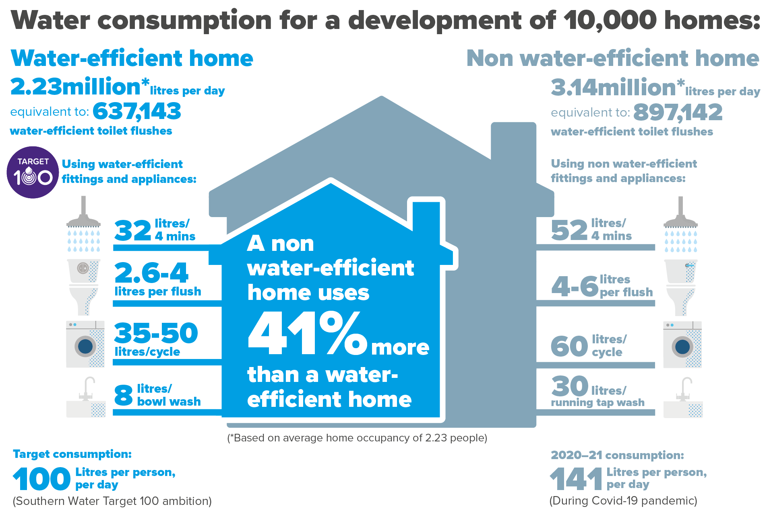

Slide 20
How we are working with developers
Engaging to build water efficient homes
Engaging to adopt Sustainable Drainage features (SuDs) – ponds and wetlands, tanks to control and manage surface runoff, basins to provide flow control through attenuation of storm water runoff, bio-retention systems including tree pits, ponds and wetland and rain gardens
Appointment of designated adoption managers for pre-start site inspections, provisional inspections and final inspections

Slide 21
How you can help
Support the build of water neutral developments – increase awareness of potential
Support policies that could require water neutrality
Collaboration to reduce storm overflow from combined sewers
Target 100 – our industry leading commitment to reduce customers’ use of water to 100 litres per person per day by 2040
Unflushables – (wet wipes, nappies, cotton buds and sanitary items) 60% of sewer blockages are caused by human behaviours.

