Slide 1
Professor Helen James OBE
Professor Mohamed Abdel-Maguid

Slide 2
Key Regional Challenges
Talent pipeline’ - Skills gap in engineering and technology and STEM-related fields
‘Work-ready graduates’ - Businesses reported that ‘traditional’ engineering and technology degrees did not produce the skills and behaviours necessary to fill skills shortages
‘Brain drain’ - difficulty in attracting and retaining graduate talent in engineering and technology within the area
‘Inclusion and diversity’ - lack of diversity in engineering and technology in general and particularly within the South East region

Slide 3
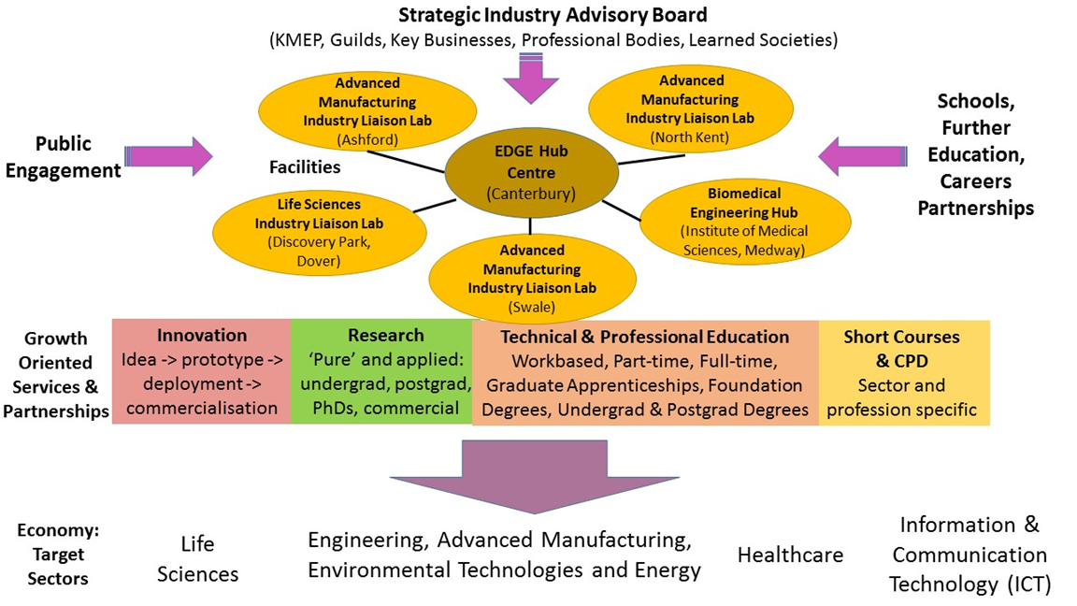
Kent and Medway EDGE Hub

Slide 4
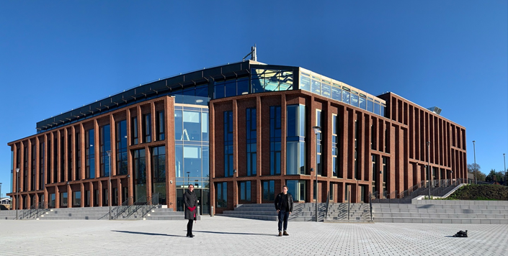
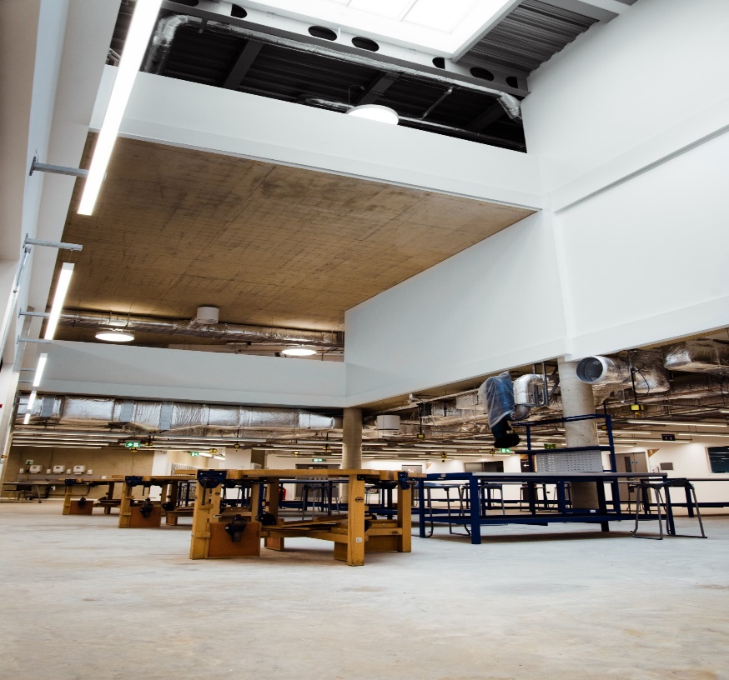
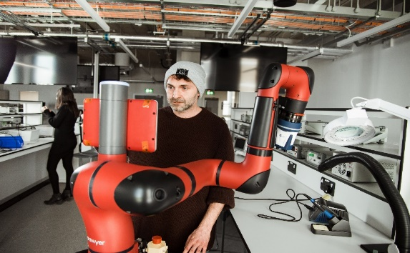
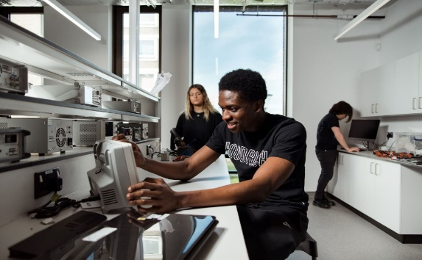
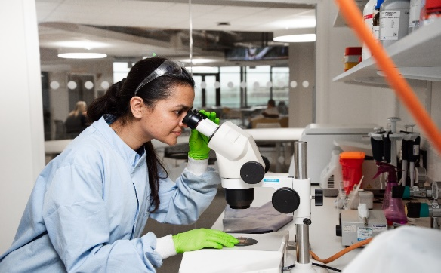
Specialist Facilities (~£70M)

Slide 5
Talent Pool: Outreach and Engagement
1 Million interactions delivered to young people
Engaged over 3,500 young people
Engages over 2,000 young people annually, achieving nearly 50/50 gender split each year

Slide 6
Talent Pool: Closing the Gap
Student who apply for STEM Subjects at Level 3
Kent and Medway
National Average
2015
20%
2020
3.55%

Slide 7
Talent Pool: Closing the Gap
Gender Gap in Leve 3 STEM Subjects
UK
Kent and Medway
2017
5.5%
5.1%
2020
8%
7.7%

Slide 8
CDIO: Work Ready Graduates
Placing businesses at the centre
Learning
by
Learning
Learning
thinking
by doing
by use
C
D
I
O
Conceive
Design
Implement
Operate
Problem identified
Students find CDIO
Range of possible
from Industry
solution to problem
solutions presented
brief
back to industry

Slide 9
Engineering Courses
MEng/BEng/BEng with FY (Hons) Chemical Engineering
MEng/BEng/BEng with FY (Hons) Mechanical Engineering [4 pathways]
MEng/BEng/BEng with FY(Hons) Biomedical Engineering
MEng/BEng/BEng with FY (Hons) Product Design Engineering
MSc Advanced Manufacturing Systems & Technology [2 Pathways]

Slide 10
Digital and Creative Courses
MA/BA (Hons) Games Design
BEng/BEng with FY/ BEng with Year in Industry (Hons) Software Engineering
BSc/BSc with FY/BSc with Year in Industry (Hons) Computer Science
BSc/BSc with FY (Hons) Computing
BSc/BSc with FY/BSc with Year in Industry (Hons) Computer Security and Forensics
BSc/BSc with FY/BSc with Year in Industry (Hons) Business Information and Systems
MSc Data Intelligence

Slide 11
Apprenticeship Courses
Manufacturing Engineer (Degree) Apprenticeship
Control/Technical Support Engineer (Degree) Apprenticeship
Product Design and Development Engineer (Degree) Apprenticeship
Science Industry Process/Plant Engineer (Degree) Apprenticeship
Chartered Manager Degree Apprenticeship
Senior Leader Apprenticeship (MBA level)

Slide 12
Student Enrolment

Slide 13
EDGE Hub New Jobs
~34 new jobs created

Slide 14
KM EDGE Hub Industrial Engagement

Slide 15
KM EDGE Hub Industry Engagement

Slide 16
KM EDGE Hub Industry Engagement

Slide 17
KM EDGE Hub Outputs Summary
To provide a catalyst for change within the region through engineering and technology, securing by 2024:
Additional 56 jobs (to date 33.91 out of 34.5)
£1.8m additional income from employer research & consultancy (to date £801,074 out of £600,000)
420 employer student research projects (to date 130 out of 60)
Additional £45,000 Innovation Service IP-Related Income (to date £5,290 out of £5,000)
12,900 additional school students visits (to date 13,048 out of 3900)
375 additional short course & CPD learners (to date 169 out of 100)
1250 additional UG & PG enrolments (inc. FY & apprenticeships) (to date 583 out of 380)
By 2030, 207 additional degree apprenticeship enrolments (included in additional UG & PG enrolments) (to date 93 out of 66)

Slide 18
Industry 4.0 and 5.0
Facilities
Facilities designed and selected to support wider access to Industry 4.0 and 5.0 technologies, including advanced manufacturing, robotics, Internet of Things and digitisation
Facilities supporting research and consultancy projects with regional businesses
Expertise
Staff recruited with a range of expertise around Industry 4.0 and Industry 5.0, including biomechanical, advanced manufacturing, digital twins, digitisation, circular economy
Supporting regional businesses through consultancy and research, as well as events and CPD sessions aiming to upskill local business owner/ managers
Curriculum
Industry 4.0 and 5.0 fully embedded within each area of the engineering and computing curriculum, as well as specific courses such as MSc in Advanced Manufacturing and MSc in Data Intelligence
CDIO projects embedded alongside relevant learning, to enable I4.0 and 5.0 technologies to be applied to industry problems; biomechanics module being developed for KMMS to ensure that the next generation of doctors also have access to the latest thinking

Slide 19
Industry Engagement
Research and Knowledge Exchange Collaborations
Short courses, CPD and events
Corporate social responsibility through young people outreach
Student projects , recruitment and placements
Upskilling through apprenticeships and postgraduate courses
Strategic Industry Advisory Board with representatives from nine regional businesses and strategic bodies
Over 60 companies engaged in curriculum development
Supporting specific networks and industries on an ongoing basis
Over 250 companies engaged with around a specific service offering and over 1,000 companies engaged overall

