Slide 1
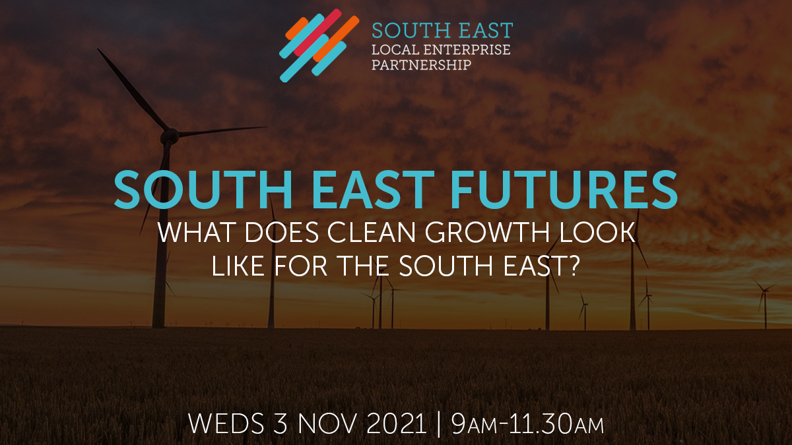


Slide 2
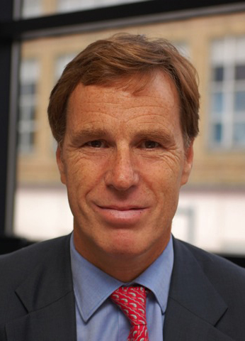
Welcome
SOUTH EAST FUTURES
WHAT DOES CLEAN GROWTH LOOK
LIKE FOR THE SOUTH EAST?
A summary of the LEP’s focuses and how net-zero plays an important role in our economic strategy
Christian Brodie
Chair

Slide 3
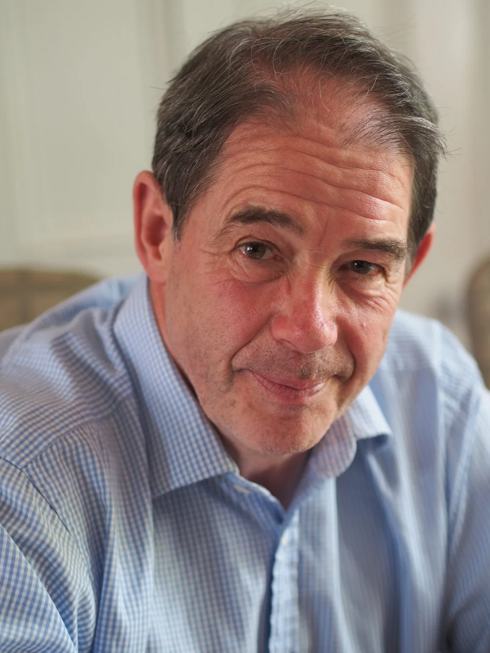
Keynote Address
SOUTH EAST FUTURES
WHAT DOES CLEAN GROWTH LOOK
LIKE FOR THE SOUTH EAST?
How we can still achieve economic growth and progress for the South East economy through clean technology, new models of economic growth, investment and innovation
Sir Jonathon Porritt
Founder and Director,
Forum for the Future

Slide 4
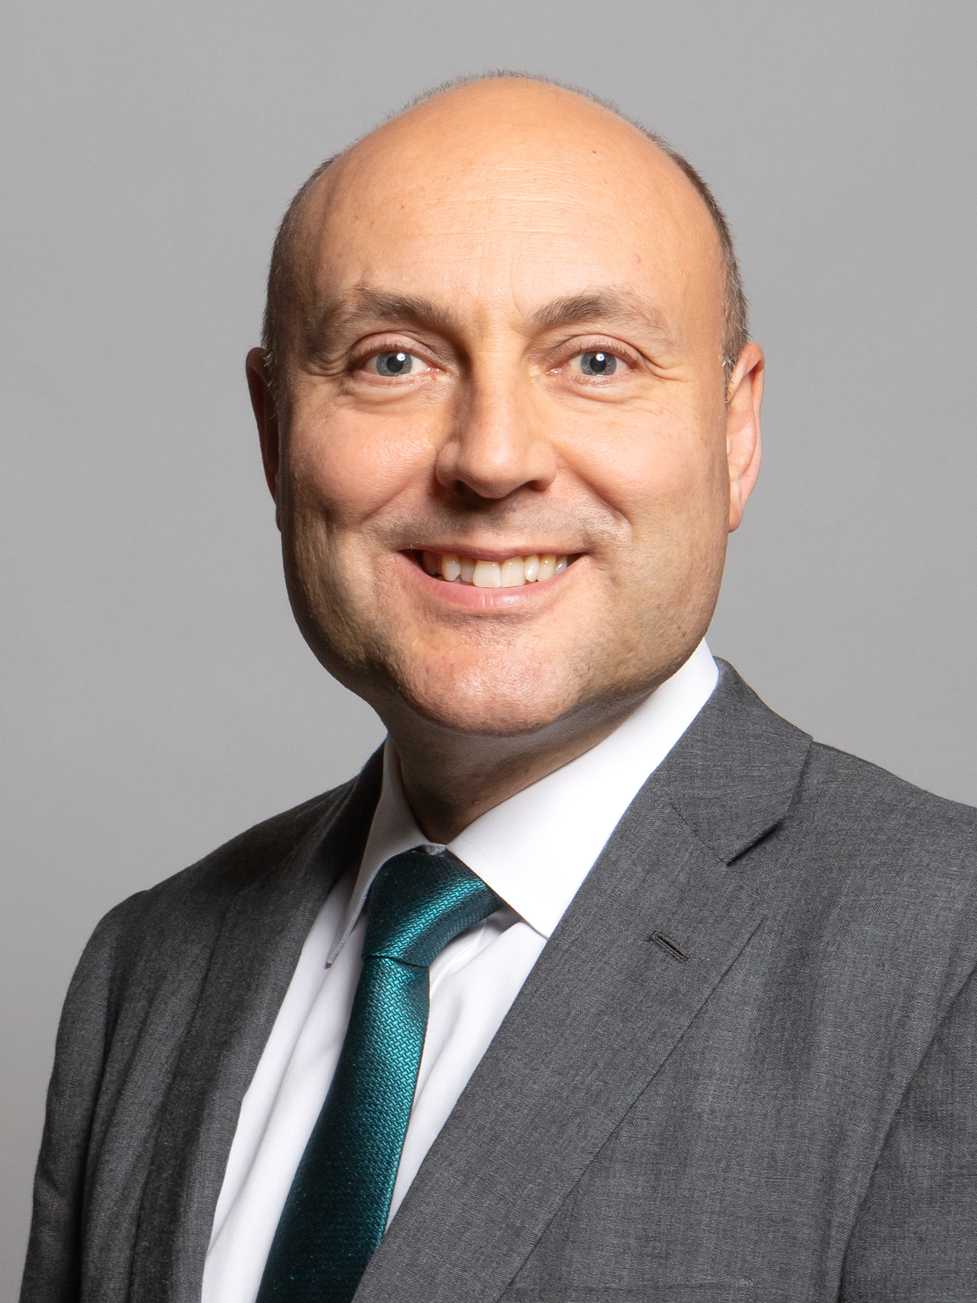
Ministerial Address
SOUTH EAST FUTURES
WHAT DOES CLEAN GROWTH LOOK
LIKE FOR THE SOUTH EAST?
Andrew Griffith MP
SME Champion for
Clean Growth

Slide 5
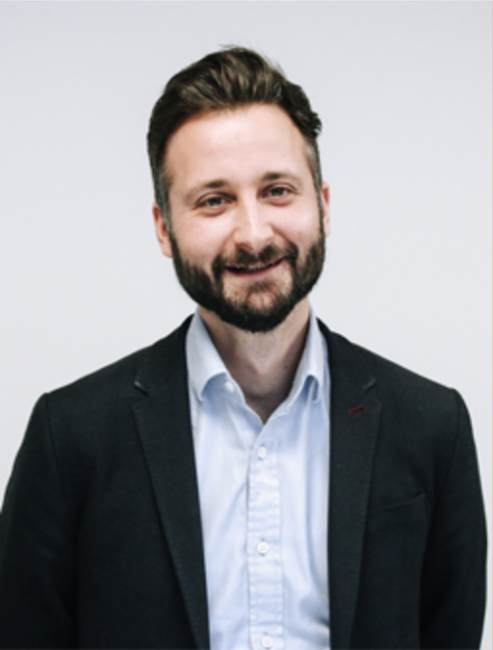
Expert Speaker
SOUTH EAST FUTURES
WHAT DOES CLEAN GROWTH LOOK
LIKE FOR THE SOUTH EAST?
The New Industrial Revolution:
What does net-zero and reducing carbon mean in business and what is the process to get started?
Jonathan Withey
Head of Business
Development, Planet Mark

Slide 6
OPPORTUNITY FOR QUESTIONS
SOUTH EAST FUTURES
WHAT DOES CLEAN GROWTH LOOK
LIKE FOR THE SOUTH EAST?

Slide 7
DISCUSSION PANELS
CLEAN GROWTH IN THE SOUTH EAST
SOUTH EAST FUTURES
WHAT DOES CLEAN GROWTH LOOK
LIKE FOR THE SOUTH EAST?
ATTENDEES TO CHOOSE TWO
OF FOUR SESSIONS TO ATTEND
YOU WILL BE PROMPTED TO JOIN
A BREAK-OUT ROOM SHORTLY

Slide 8
CLEAN GROWTH AND BUSINESS
IN WHAT WAYS CAN FIRMS BE SUPPORTED TO ‘GROW CLEAN’ AND UNLOCK NEW OPPORTUNITIES?
HOSTED BY
ANA CHRISTIE
SUSSEX CHAMBER OF COMMERCE
SOUTH EAST FUTURES
WHAT DOES CLEAN GROWTH LOOK
LIKE FOR THE SOUTH EAST?
10.00-10.30
CLEAN GROWTH IN A GLOBAL GATEWAY
HOW CAN THE SOUTH EAST LEAD THE SHIFT TO LOW CARBON TRANSPORT AND TRADE?
HOSTED BY
LUCY DIXON-THOMPSON
TRANSPORT FOR THE SOUTH EAST

Slide 9
Q&A
AND
LIVE POLLS
SOUTH EAST FUTURES
WHAT DOES CLEAN GROWTH LOOK
LIKE FOR THE SOUTH EAST?

Slide 10
CLEAN GROWTH
AND PLACEMAKING
HOW CAN THE SOUTH EAST LEAD IN THE DEVELOPMENT OF NET ZERO HOMES AND COMMUNITIES OF THE FUTURE?
HOSTED BY
LIZ GIBNEY
LEE EVANS PARTNERSHIP LLP
SOUTH EAST FUTURES
WHAT DOES CLEAN GROWTH LOOK
LIKE FOR THE SOUTH EAST?
10.45-11.20
CLEAN GROWTH, NATURALLY
HOW CAN THE SOUTH EAST USE ITS NATURAL ASSETS TO DRIVE UP GROWTH AND DRIVE DOWN EMISSIONS?
HOSTED BY
JOHN TAYLOR
GREATER SOUTH EAST ENERGY HUB

Slide 11
Q&A
AND
LIVE POLLS
SOUTH EAST FUTURES
WHAT DOES CLEAN GROWTH LOOK
LIKE FOR THE SOUTH EAST?

Slide 12
FUTURE FOCUS
AND
NEXT STEPS
SOUTH EAST FUTURES
WHAT DOES CLEAN GROWTH LOOK
LIKE FOR THE SOUTH EAST?
Christian Brodie
Chair

Slide 13
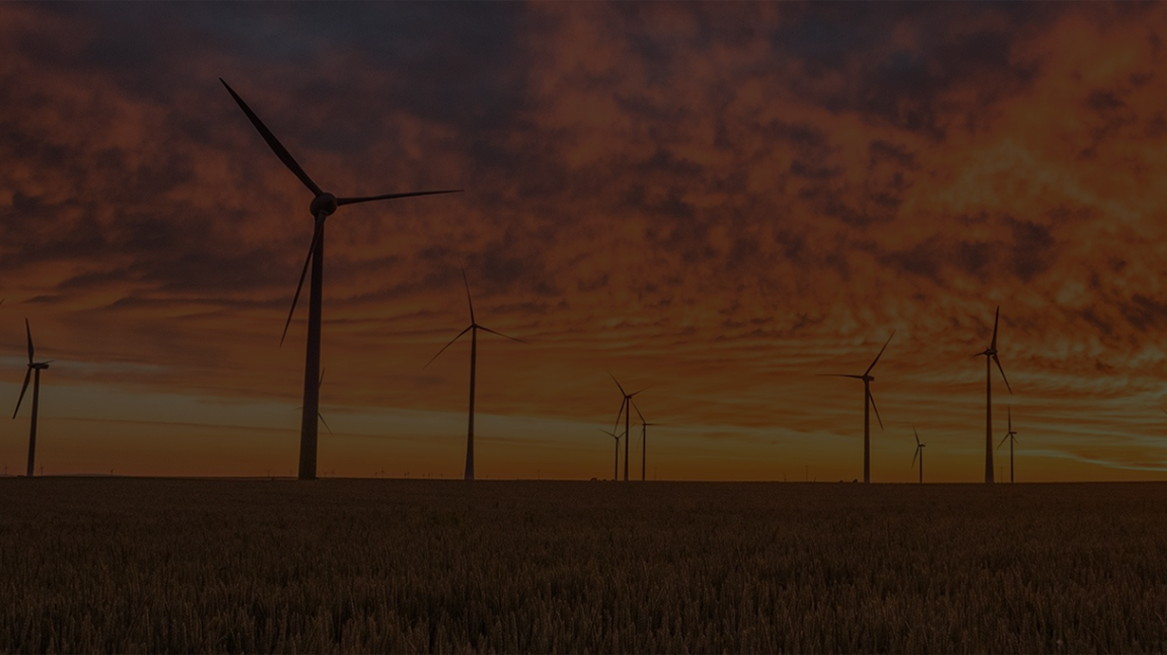






SOUTH EAST FUTURES
WHAT DOES CLEAN GROWTH LOOK
LIKE FOR THE SOUTH EAST?
THANK YOU FOR ATTENDING
THOSE JOINING US FOR OUR AGM WILL HAVE RECEIVED A SEPARATE ZOOM LINK
FOLLOW US
@southeastlep
linkedin.com/company/south-east-lep
GET IN TOUCH
hello@southeastlep.com
STAY UP TO DATE
southeastlep.com
SIGN UP TO OUR NEWSLETTER
southeastlep.com/news/newsletter-archive

