Slide 2
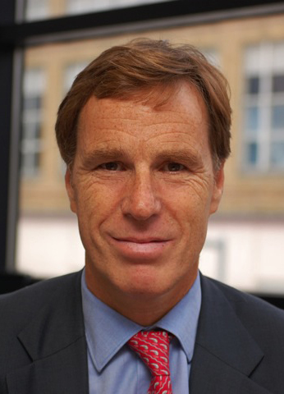
Welcome and Introductions
SUPPORTING SOUTH EAST RECOVERY
SOUTH EAST LEP AGM 2020-2021
Christian Brodie
Chair

Slide 3
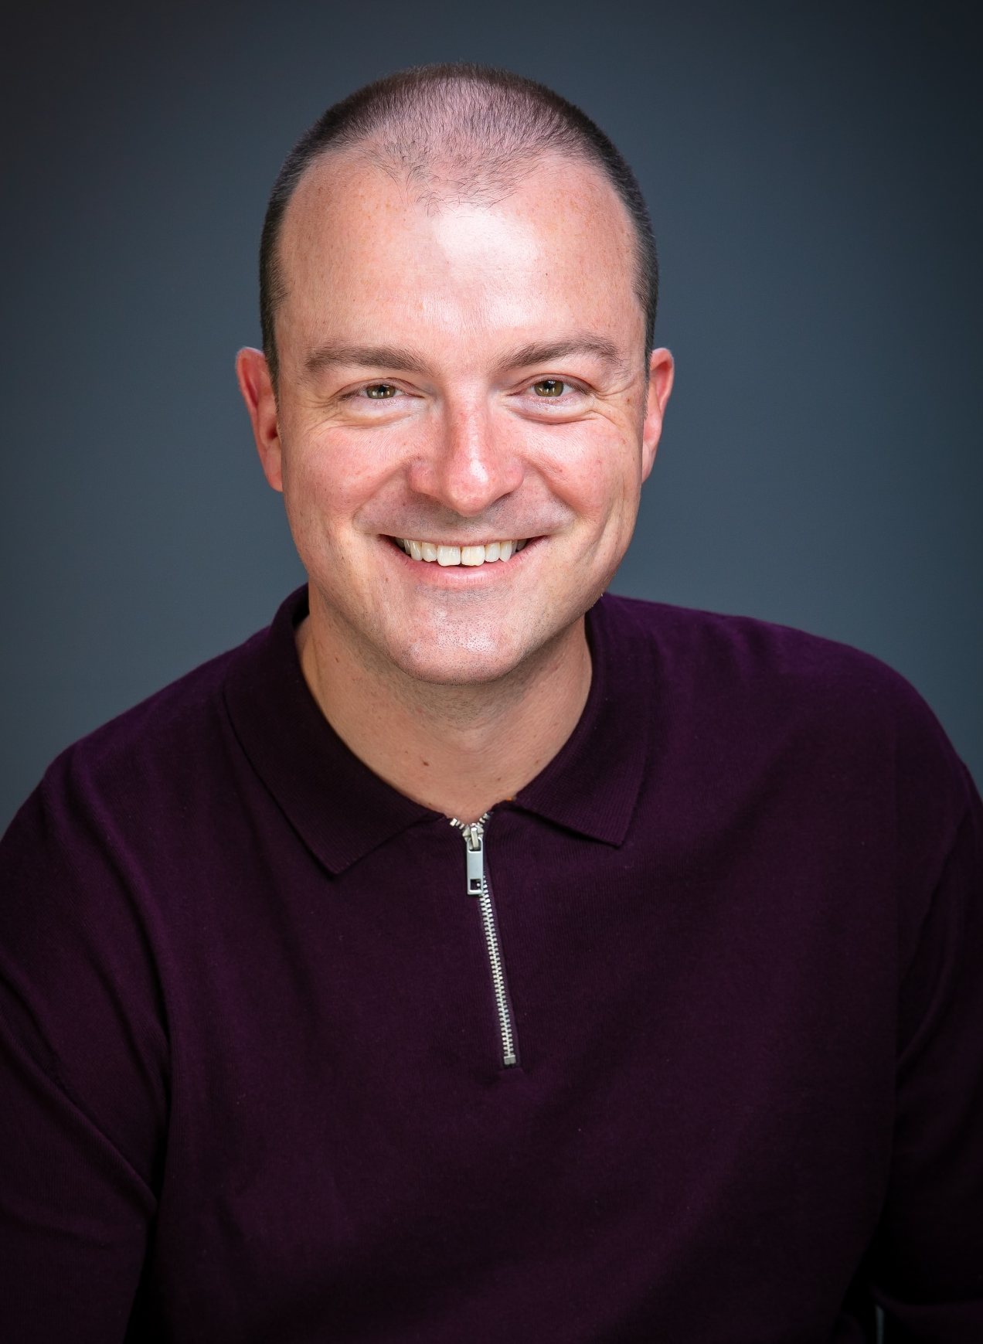
SELEP Progress and Achievements 2020-21
SUPPORTING SOUTH EAST RECOVERY
SOUTH EAST LEP AGM 2020-2021
Adam Bryan
Chief Executive

Slide 4
GETTING BUILDING FUND
SUPPORTING SOUTH EAST RECOVERY
SOUTH EAST LEP AGM 2020-2021
36 PROJECTS
£85 MILLION VALUE

Slide 5
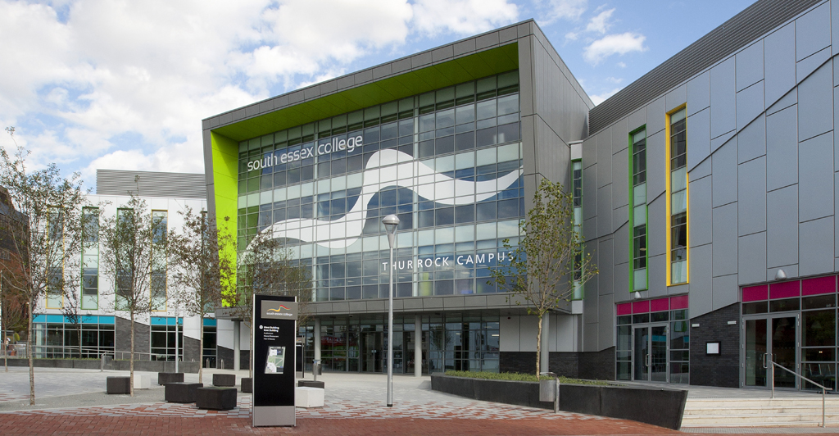
SUPPORTING SOUTH EAST RECOVERY
SOUTH EAST LEP AGM 2020-2021
Transport and Logistics Hub at South Essex College in Thurrock
TOTAL PROJECT COST: £999,840
GETTING BUILDING FUND: £600,000
The Transport and Logistics Hub at South Essex College is being delivered over two phases. At the moment we are in phase 1 whereby the equipment is currently being received and installed within the current Logistics Centre to be used to train students up until the end of the 2021/22 academic year.
Phase 2 will see building works take place over the summer of 2022 to create the new Logistics Hub. This will be ready for students at the start of the 2022/23 academic year in September.
The completion of phase two will coincide with the launch of our new Supply Chain Logistics Level 3 programme which will be delivered over two years and taught in collaboration with national and international partners.

Slide 6
SUPPORTING SOUTH EAST RECOVERY
SOUTH EAST LEP AGM 2020-2021
Observer Building in Hastings
TOTAL PROJECT COST: £4,274,000
GETTING BUILDING FUND: £1,713,000
GROWING PLACES FUND: £3,370,000
JOBS CREATED/SAFEGUARDED: 102
LEARNERS ASSISTED: 180
COMMERCIAL SPACE UNLOCKED: 2,100SQ M
BUSINESSES ASSISTED: 40
The project will support the full redevelopment of the 4,000sq m Observer Building in Hastings, which has been empty and increasingly derelict for 35 years, into a highly productive mixed-use building, creating new homes, jobs and enterprise space.
The Observer Building will include leisure and retail uses on the lower three floors, a wide range of workspaces including studios, offices and open space, 16 capped-rent flats and a public roof terrace and bar with sea, castle and town views.
The scale, ambition and connectivity of this community-led local redevelopment will help to transform the fortunes of the immediate area and the wider Hastings town centre.

Slide 7
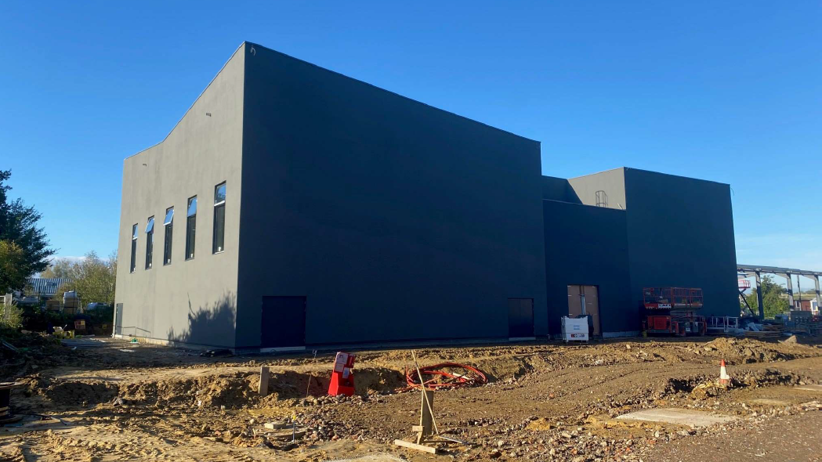
SUPPORTING SOUTH EAST RECOVERY
SOUTH EAST LEP AGM 2020-2021
Javelin Way, Ashford
TOTAL PROJECT COST: £11,199, 648
GETTING BUILDING FUND: £578,724
GROWING PLACES FUND: £1,597,000
JOBS CREATED/SAFEGUARDED: 256
LEARNERS ASSISTED: 48
COMMERCIAL SPACE UNLOCKED: 3,916SQ M
BUSINESSES ASSISTED: 1,293
Javelin Way is an employment site on the Henwood Industrial Estate in Ashford. The project will support the development of the site for employment use, with a focus on the development of Ashford’s creative economy.
The scheme consists of two elements:
The construction of a ‘Creative Laboratory’ production space (with a ground floor internal area of 1,293 sqm). This will house the Jasmin Vardimon Company, a world-renowned dance company and creative organisation.
The development of 29 light industrial units (with a gross internal area of 3,916 sq m), for sale and/or lease, suitable for additional creative businesses as well as the general market. Mezzanine floors will be available for the 29 industrial units, with full flexibility on the sizes of mezzanines to meet market demand.

Slide 8
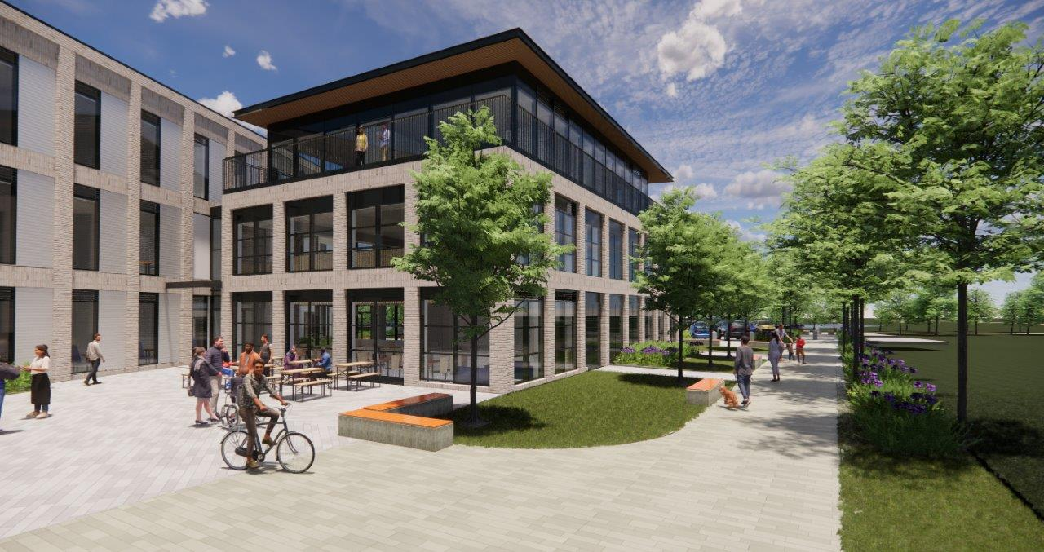
SUPPORTING SOUTH EAST RECOVERY
SOUTH EAST LEP AGM 2020-2021
Enterprise Centre for Horizon 120 Business Park
TOTAL PROJECT COST: £16m
GETTING BUILDING FUND: £7m
JOBS CREATED/SAFEGUARDED: 200
COMMERCIAL SPACE UNLOCKED: 3,100SQ M
The project will support the delivery of an Enterprise Centre for local businesses, including small business start-ups, small businesses focusing on innovation and growth as well as businesses aiming to stabilise and consolidate their activities.
The new 3,100 m² Enterprise Centre building will offer a variety of office spaces. There will also be a flexible conference space that can be transformed into smaller units. The Enterprise Centre will provide a purpose built physical and virtual environment designed to drive collaboration, encourage idea generation and underpin problem solving. As the focal point for Horizon 120 Business Park, the building will provide accommodation and support to germinate employment, interest and occupation.
Expected to complete in June next year.

Slide 9
OUR GROWTH HUB
SUPPORTING SOUTH EAST RECOVERY
SOUTH EAST LEP AGM 2020-2021
SOUTH EAST BUSINESS HUB
BEST GROWTH HUB
BUSINESS EAST SUSSEX
KENT AND MEDWAY
GROWTH HUB

Slide 10
SUPPORTING SOUTH EAST RECOVERY
SOUTH EAST LEP AGM 2020-2021
South East Business Hub
A fully funded, impartial signposting and advice service for businesses and entrepreneurs navigating the support landscape and looking to succeed, change or grow.
6,021 businesses helped last year
34,000 unique visitors to the Growth Hub website
3,726 referrals made to support interventions such as mentoring, skills and training, finance and funding, R&D and innovation, and import and export
75% satisfied with the quality of Growth Hub service
79% likely to recommend the Growth Hub

Slide 11
SUPPORTING SOUTH EAST RECOVERY
SOUTH EAST LEP AGM 2020-2021
South East Business Hub during COVID-19
The service transitioned rapidly to operating digitally in response to the pandemic
Calls to the Growth Hub surged, and focus shifted to light touch, high volume support around pivoting business models, Government’s support measures, and access to funding, finance and new skills/ training
Additional funding for EU transition provided additional Brexit readiness specialist support
The service performed a key data and intelligence role for and on behalf of business communities, stakeholders and Government
Additional Growth Hub funding was deployed to expand local Growth teams in response to the crisis

Slide 12
COVID-19 RECOVERY FUNDS
SUPPORTING SOUTH EAST RECOVERY
SOUTH EAST LEP AGM 2020-2021
£4.4 MILLION FOR BUSINESS SUPPORT AND SKILLS

Slide 13
SUPPORTING SOUTH EAST RECOVERY
SOUTH EAST LEP AGM 2020-2021
In June 2020, the SELEP Board agreed to a support package to respond to the challenges presented by the pandemic.
Challenges included increased unemployment, a need to re-skill for sectors recruiting, addressing the digital divide and growing need to support SMEs and individuals with digital and finance.
SELEP was one of the only LEPs nationally to re-purpose Growing Places Funding for such programmes of support.
This included £2 million to establish a Skills fund and £2.4 million to establish a Business Support Fund.
From June to December, a procurement framework was created to run a competitive process from January 2021. The Framework was unique and has enabled other local authorities to procure similar activities.
Successful bidders were confirmed in March/April 2021 and launched shortly afterwards.
A webinar was held in May 2021 to set out the projects.

Slide 14
SUPPORTING SOUTH EAST RECOVERY
SOUTH EAST LEP AGM 2020-2021
£2.4m Business Support Fund
Starting and Succeeding in Business
Offering learning, advice and mentoring and delivered by WSX Enterprise.
Adapting with Digital
A programme of online business support including masterclasses, networking and 1-2-1s also delivered by WSX Enterprise.
Revi-VE - South East Visitor Economy Fund
Offering small 100% grants between £1000-£3000 to visitor economy businesses across the South East and delivered by the Visitor Economy delivery partners.

Slide 15
SUPPORTING SOUTH EAST RECOVERY
SOUTH EAST LEP AGM 2020-2021
£2m Skills Fund
SELEP Digital Bridge
Offering training, equipment and internet access to individuals impacted by COVID-19. Delivered by We are Digital.
SELEP Digital Skills Programme
Supporting individuals into tech roles with a particular focus on increasing diversity in the sector. Delivered by Tech Talent Academy.
SELEP Covid Recovery Academy
Supporting individuals to re-train where they have been unemployed as a result of COVID-19. Delivered by Shaw Trust/Ixion.

Slide 16
SKILLS ADVISORY PANEL AND DIGITAL SKILLS PARTNERSHIP
SUPPORTING SOUTH EAST RECOVERY
SOUTH EAST LEP AGM 2020-2021

Slide 17
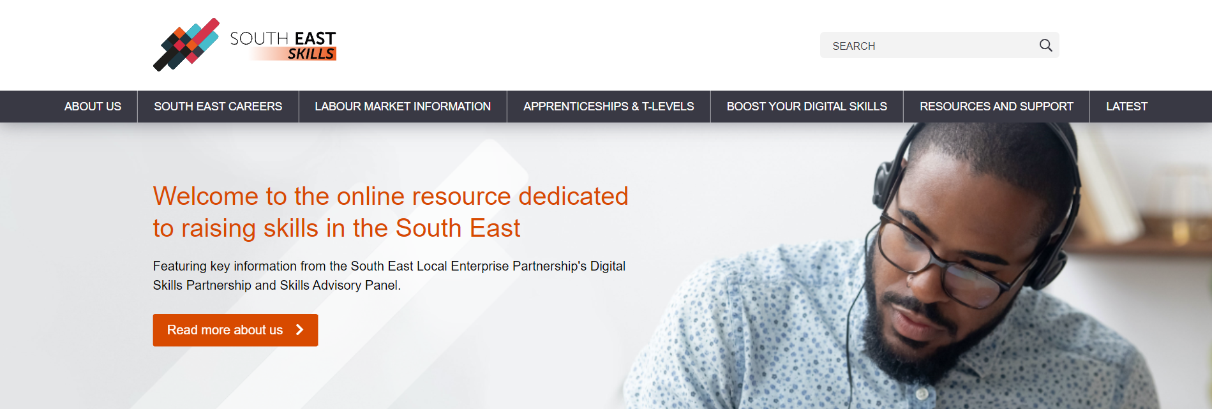
SUPPORTING SOUTH EAST RECOVERY
SOUTH EAST LEP AGM 2020-2021
A Tutor bursary programme and awareness raising campaign gaining national attention.
A new website dedicated to skills (southeastskills.org.uk) and supporting resources.
A highly successful SAP and DSP event (Oct 2020) featuring a range of employers and with over 230 delegates.
A huge response during National Apprenticeship Week to a call for videos.
Year three of the SELEP Digital Skills Partnership - one of eight nationally working with DCMS.
Eight Google Garages, 2,200 enrolments to online learning, 100+ attending SME DSP event.
SAP and DSP input to COVID-19 funding.
Further information in the SAP Skills Report published for the DfE at SELEP-Local-Skills-Report-March-2021-FINAL.pdf (southeastlep.com) - to be refreshed as an Executive Summary.
Planning for the South East Careers magazine/event began in 2020/21.

Slide 18
EUROPEAN SOCIAL FUND (ESF) PROGRAMMES
SUPPORTING SOUTH EAST RECOVERY
SOUTH EAST LEP AGM 2020-2021

Slide 19
SUPPORTING SOUTH EAST RECOVERY
SOUTH EAST LEP AGM 2020-2021
SELEP and partners have a role in shaping the focus and priorities for ESF (£80 million). This includes working with DWP, ESFA and the National Lottery on Calls for Tender and project monitoring.
By Q4, nearly 42,000 individuals have been supported into training or work through the original £80 million.
Through 2020/21, new Calls for tender were issued and new programmes commenced to respond to need in the SELEP area.
These have included a Call to support NEET young people, a Call to support transport to work and training and a Call to provide a Community Grants programme.
New programmes in 2020/21 include Transform, supporting apprenticeships in East Sussex and Enabling Progressions in the Workplace programmes. Projects continue to 2023.
All current and new projects are now outlined in SELEP's careers magazine at South East Careers - South East Skills.

Slide 20
SECTOR SUPPORT FUND
SUPPORTING SOUTH EAST RECOVERY
SOUTH EAST LEP AGM 2020-2021
21 PROJECTS
£2.5 MILLION PROGRAMME

Slide 21
SUPPORTING SOUTH EAST RECOVERY
SOUTH EAST LEP AGM 2020-2021
Energy and Clean Growth – Supply Chain Mapping
TOTAL PROJECT COST: £185,000
SECTOR SUPPORT FUND: £129,500
The low carbon economy is predicted to grow four times faster than the rest of the economy. This project seeks to provide a SELEP wide assessment of opportunities within the emerging local energy and clean growth sector.
The project will undertake an in-depth analysis of the supply chain for the local energy and clean growth sector and through the analysis, companies will inform on key barriers and challenges that are currently restricting growth in key opportunity areas, such as offshore renewables and nuclear.
This will enable a targeted Clean Growth Support Programme to be created. Sector-based interventions will be prioritised and selected from the Clean Growth Support Programme and will be piloted as part of the project.
The project aims to unlock one of the biggest barriers and bottlenecks to skills training and jobs growth, which is currently stifling productivity and growth locally.
The project is expected to report in Autumn 2021 and its findings will be taken by our Clean Growth Working Group.

Slide 22
SUPPORTING SOUTH EAST RECOVERY
SOUTH EAST LEP AGM 2020-2021
Rebuilding Confidence and Demand in the Visitor Economy
TOTAL PROJECT COST: £356,835
SECTOR SUPPORT FUND: £200,000
COVID-19 has heavily impacted the visitor economy, targeted support is needed to help businesses survive the winter, protect jobs and support a sustained recovery. This requires support over and above business as usual as the market will be competitive with destinations from across the country targeting the same pool of visitors to aid recovery in their areas. The emerging economy recovery plans across the SELEP region all identified that visitor economy as a sector mostly badly effected by COVID-19.
To address this, partners from Kent, Essex and East Sussex proposed a significant programme to aid the recovery of the SELEP visitor economy. The project seeks to address key opportunities and challenges, including:
Raising destination awareness and supporting sustainable tourism management through visitor dispersal
Support consumer confidence in travelling by public transport
Using key themes to showcase the diverse and high-quality tourism offer to key domestic markets and increase length of stay
Protect businesses and safeguard jobs by extending the season
Product development and business support to address seasonality
Build positive engagement and confidence among SELEP residents

Slide 23
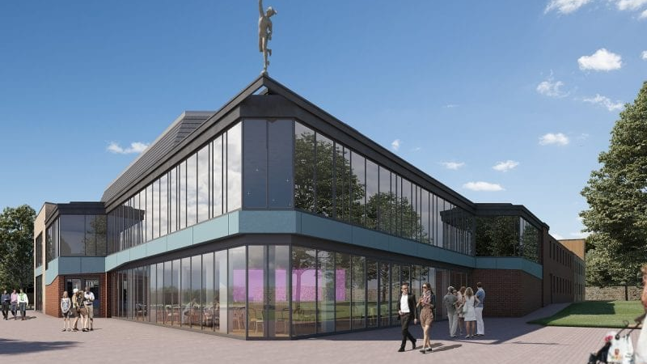
SUPPORTING SOUTH EAST RECOVERY
SOUTH EAST LEP AGM 2020-2021
Catalyst for Culture
TOTAL PROJECT COST: £268,200
SECTOR SUPPORT FUND: £181,700
Helping to get the cultural sector back on its feet, covering The Marlowe Theatre in Canterbury, The Mercury Theatre in Colchester and Glyndebourne in East Sussex, a real pan-LEP collaboration. This project is to develop industry knowledge in the creation, presentation and dissemination of socially distanced performance to existing and new audiences; invest in the future with talent development opportunities for young people; and drive growth and productivity through a series of new regional productions.
The Catalyst for Culture Programme is a new partnership between established performing arts institutions of national and international standing in the SELEP region, providing live and online theatre experiences for audiences throughout Kent, Medway, Thurrock, Southend, East Sussex, South Essex and Essex during the Covid crisis, and supporting the creative, production and technical workforce, artists & freelancers across the SELEP region.
The partnership is the first of its kind between SELEP performing arts institutions, raising the profile of performing arts in the region and acting as a pilot for future development, as a base for performing arts production and skills development and as the foundation for a wider regional touring circuit.

Slide 24
OPEN QUESTIONS FOR BOARD DIRECTORS
SUPPORTING SOUTH EAST RECOVERY
SOUTH EAST LEP AGM 2020-2021
AN OPPORTUNITY FOR MEMBERS TO ASK BOARD DIRECTORS QUESTIONS ABOUT THE OPERATIONS AND FUTURE WORK OF THE ORGANISATION

Slide 25
SUPPORTING SOUTH EAST RECOVERY
SOUTH EAST LEP AGM
2020-2021
THANK YOU FOR ATTENDING
FOLLOW US
@southeastlep
linkedin.com/company/south-east-lep
GET IN TOUCH
hello@southeastlep.com
STAY UP TO DATE
southeastlep.com
SIGN UP TO OUR NEWSLETTER
southeastlep.com/news/newsletter-archive

