Slide 1
Southeast LEP
20 July 2021
Notes:
Security classification options: – Public
– Internal
– Confidential
– Highly Confidential

Slide 2
Today’s Agenda
10:00: Introductions and welcome –Jane Thomas, Sarah Dance
10:10: Adastral Park overview and how BT innovates – Mike Williams
10:25: Internet of Things (IoT) Futures – Simon Beddus
11:05: Showcase – Shane Allum
11:45: The Digital Fabric – delivering outcomes – Matt Millar
12:00: Wrap up and close – Jane Thomas, Sarah Dance

Slide 3
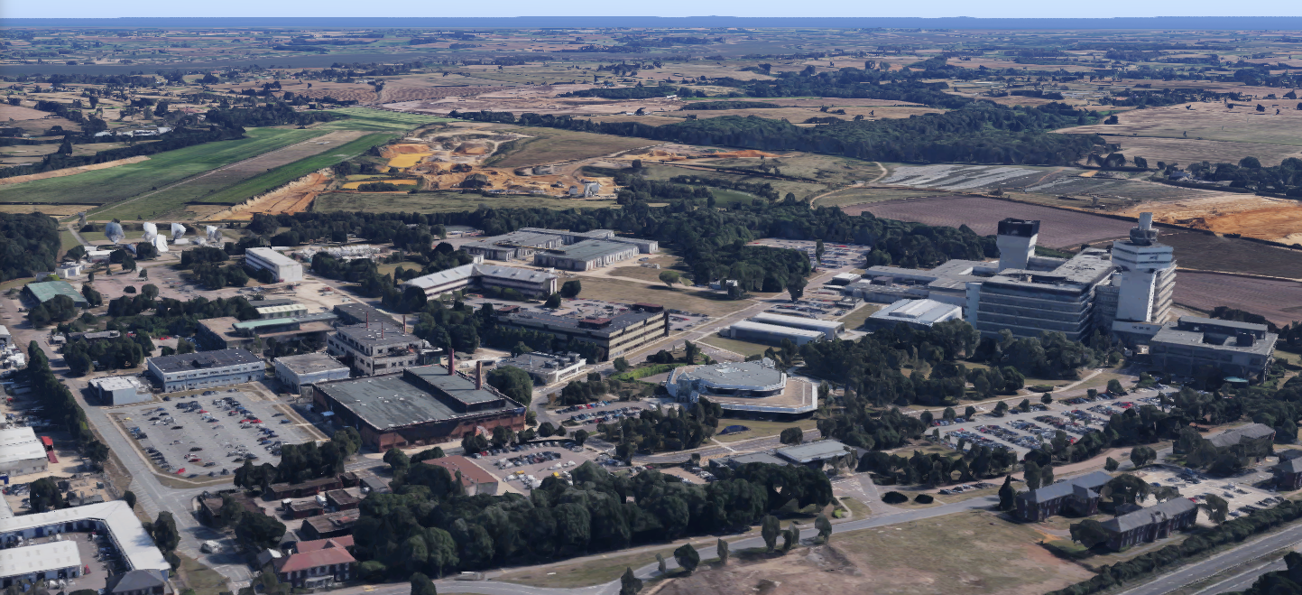
Welcome to BT Adastral Park Customer Centre

Slide 4
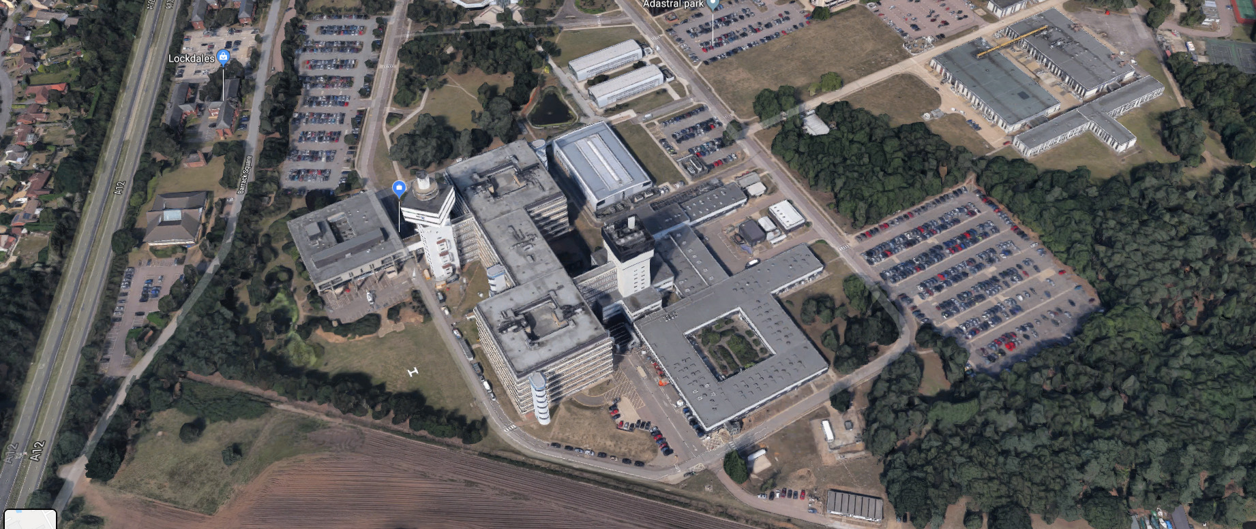
Adastral Park
4,000
BT’s Global engineering HQ
2,500 BT people, 500 Openreach and 1,000 partners
185 Graduates and Apprentices last year
UK Operations Centre
150+
Companies in our high tech cluster
Largest test & integration
facility in Europe
60,000
Visitors a year, including 8,000 school visitors
A national centre for digital and communications innovation
1,100
VIP customers, civil servants and policy makers hosted in our customer centre
4
Notes:
4

Slide 5
Investing in Research & Development
£2.5 billion
4th
Highest number of patents filed with the European Patent Office of UK-based companies
Spent on R&D over
the last five years
1,027
30+
103
5,000+
Direct university research relationships
Graduates and Apprentices recruited by BT in 2019
Number of inventions filed in 2019/20
Patents in our portfolio
5
Notes:
Graduates (448) and Apprentices (579) recruited – excludes Openreach

Slide 6
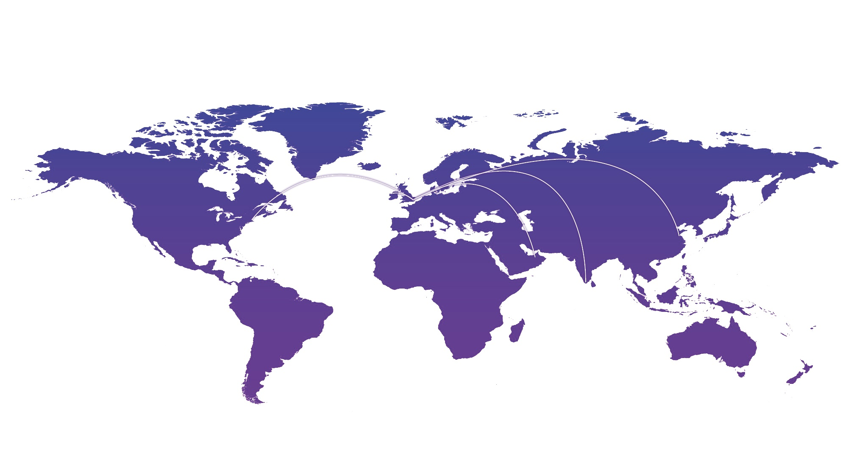
Global Research Centres
Adastral Park
Ipswich, Suffolk
BT Ireland IC
Belfast, N. Ireland
BT - MIT
Boston, USA
30 year BT-MIT cross campus partnership spanning technical, management and policy research.
Est. in 2017 in Belfast, N. Ireland as a 10-year research and innovation programme co-funded by BT (Technology’s IT and AR), Ulster University and NI Government.
BT CRC
Beijing, China
EBTIC
Abu Dhabi, UAE
BT China Research Centre (BT CRC), Est in 2007 in China.
Primarily a partnership with Tsinghua University in Beijing since 2009. Extended with a collaboration with Shanghai Jiao Tong University.
Est. in 2009 in the UAE by BT, Etisalat, Khalifa University and the UAE gov.
BT IRC
Bangalore, India
Presently BT (Technology’s AR and Bangalore GDC) is collaborating with Indian Institute of Science and Indraprastha Institute of Information Technology Delhi.
Innovation scouting, university partners and cutting edge innovation around the globe
6
Notes:
In addition to our Global R&D centre at Adastral, we have global reach via the open innovation work we do with universities and partners around the world. Some examples of this include (but are not limited to):
Massachusetts Institute of Technology (MIT)
MIT is one of the world’s leading global centres for technology innovation. BT works in consortia to maintain an interdisciplinary focus that brings together thought leaders from industry, government and MIT faculty, researchers and students, conducting research in multiple areas. Areas of focus include cloud computing, distributed data storage and streaming, algorithms and machine learning, security and privacy, and visualisation.
EBTIC (Etisalat BT Innovation Centre), Abu Dhabi, UAE
EBTIC is a joint research and innovation centre established by Etisalat, BT and Khalifa University of Science, Technology and Research. It aims to advance intelligent systems technologies for the Next Generation Networks (NGNs) and NGN-enabled ICT applications and services.
Tsinghua University. Beijing, China
The premier technical university in China brings Chinese technology into BT as well as providing extra research and management
resource to the company. The collaboration means BT and its customers benefit from access to Chinese academic expertise in new technology and an understanding of the impacts on the Chinese economy and society.
The India-UK Advanced Technology Centre is a collaborative programme funded by the UK’s Engineering and Physical Sciences
Research Council (EPSRC), the Government of India’s Department of Science and Technology (DST) and industrial partners in both
countries including BT. The programme’s three main research activity areas are: applications and services, core network systems and protocols, and heterogeneous wireless access networks.
Cambridge University, UK
BT works across multiple departments and at a variety of levels, reflecting both BT’s own varied needs and the structure of the University itself. This includes BT supporting a number of PhDs at the Cambridge computer lab. Cambridge and BT are also university partners in the UK Quantum Communications Hub.
6

Slide 7
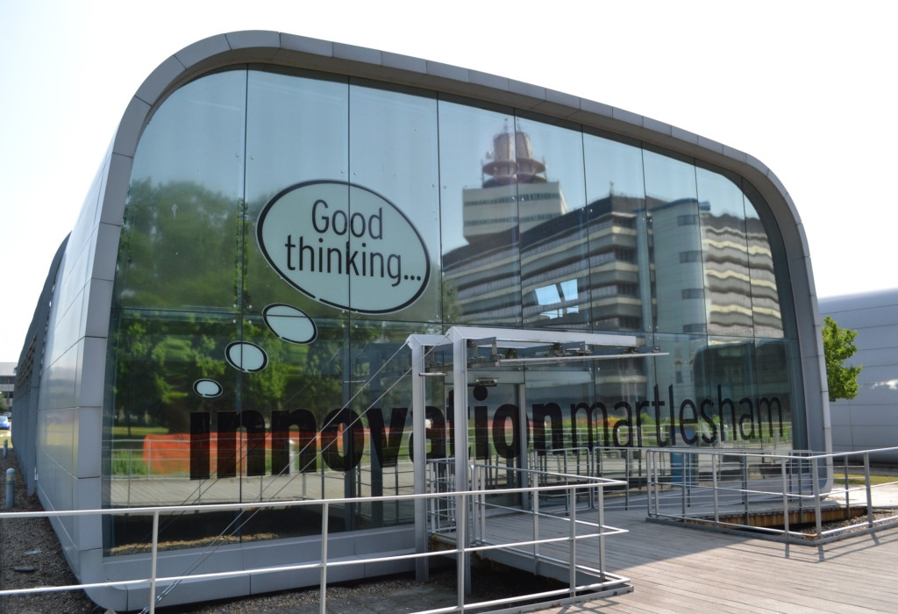
Innovation Martlesham Eco-System
ICT Cluster
Accelerator/Incubator
Serviced Offices
Business Club
Mentoring Group
Networking Opportunities
Investment Club
Growth of IM companies
Notes:
The cluster provides a premium environment for ICT companies from large corporates through to small start-ups
This helps cluster companies by providing access to mentoring, showcasing opportunities, and introducing investment prospects

Slide 8
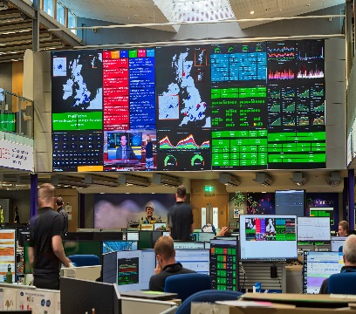
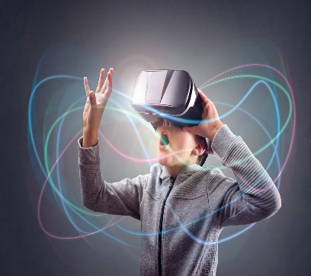
Our Research Themes
We have organised our research as a set of programme themes.
This enables us to group together skills and people as a centre of excellence to nurture and develop world-leading expertise in these areas.
The themes work across all of BT’s business units, facilitating the sharing of knowledge and ideas. This approach allows us to invent, publish and reap the benefit of our technical and service model research in a consistent and effective way.
The themes also provide research for Openreach in line with Our Commitments.
Converged Networks
including mobile, infrastructure, fast copper technology (G.fast) and quantum communications
Internet of Things (IoT) Futures
Security and Cyber Defence
Customer Experience
including people behaviours and network experience
Content and Communications including video networking and immersive entertainment
Operational Transformation
Artificial Intelligence Enablers
including Future analytics and Big Data
Future of
Education and Skills including outreach and university programmes
Customer Innovation & Incubation
Notes:
8

Slide 9
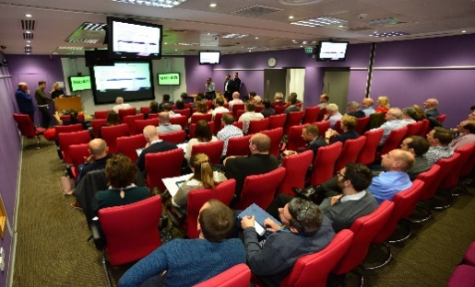
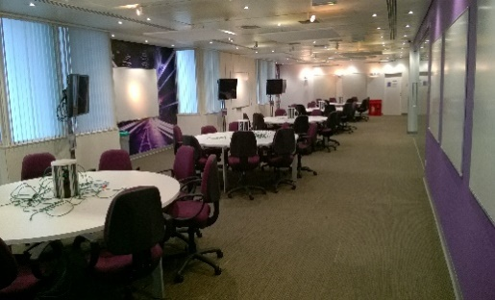
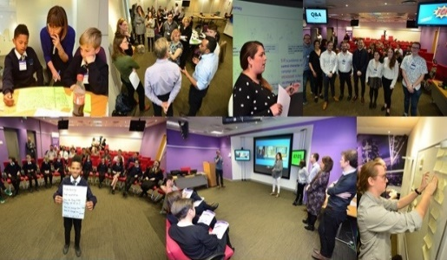
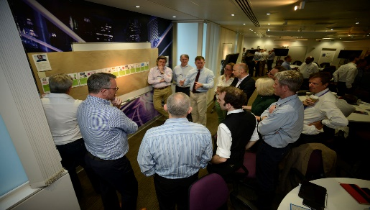
Hothouse – Making it happen quickly!
What is it?
3 Day Competitive Innovation Event
Multiple teams up to 80 people
Purpose built facilities
Rapid acceleration of innovations into implementation
Unblocking issues and problems
Outputs
End to end design
Implementation Plan
Working Prototypes
Propositions & Business Cases
Commonly agreed way forward
Ownership of implementation
Day 1 - Discovery
Understand
Design
Global
Scouting
Demo
Collaboration
Realisation
Innovation
Central
Day 2 - Solution
Understand
Benefits
Bring all interested parties together – internal and external
Direct and immediate customer input
Months of work done in days
Competition and collaboration lead to best results
Design
Demo
Applied
Research
Accelerator
Collaboration
Realisation
Day 3 - Resolution
Customer
Centre &
Showcases
Understand
Design
Demo
Collaboration
Hothouse
Realisation

