Slide 1

LEP Skills Advisory Panel
Employer led SAP reflective of growth sectors and geography
Funding from DfE for regular analysis and research to inform the SAP
Chaired by Helen Clements of Morgan Sindall – sits on main MPG group
Includes FE, HE and provider representation

Slide 2

South East LEP Skills Report
Published at
https://www.southeastskills.org.uk/labour-market-information/sap-sector-factsheets/
https://www.southeastlep.com/our-delivery/skills/skills-advisory-panel/
Executive Summary and launch coming soon!
Includes section on major projects and planned research into skills needs

Slide 3
Vision and priorities
Vision: to help deliver a flourishing and inclusive economy across the biggest LEP in the country by equipping employers, adults and young people with the skills, conditions and aptitudes required for significant and clean growth today and tomorrow.
Priorities:
• Increase apprenticeships and industry relevant qualifications for all ages, particularly in priority sectors and at higher and degree level
• Simplify the landscape for employers, stakeholders and individuals
• Build a diverse and inclusive economy and reduce polarisation
• Raise awareness of jobs and growth across SELEP and the area’s size, scale, national and international significance
• Foster and support the spirit of pride, entrepreneurship innovation and enthusiasm across SELEP to bring about change

Slide 4
Key challenges identified in Skills Report
2018-2022 Strategy headline | Still a challenge / priority?
Skills levels below the national average at levels 2-4 | YES
210,000 people with no qualifications | YES – still 201,400
Nearly 68,000 people on out of work benefits | YES – now 155,000
163,000 workless households | YES – still 155,400
Workplace earnings below national average / neighbouring LEPs | YES – still significantly below
Some of the most deprived and most wealthy areas nationally | YES
Fluctuating apprenticeship numbers and short-term decline | YES
Declining adult participation in further education | YES
High levels of out commuting to London / surrounding areas | Possible area of change
Shortage of Tutors | YES

Slide 5
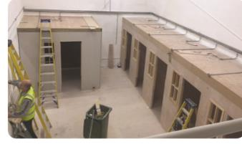
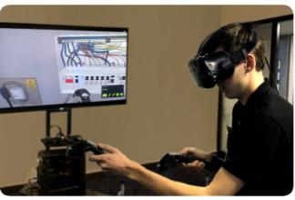
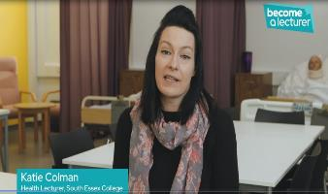
Progress to date
£69m+capital investment in facilities to ensure responsive to industry need
£80m European Social funding supporting people into and in work + recent £2m Pathways to employment for young people Call
LEP Evidence and research available to educators for bids and to ensure industry relevant delivery
Tutor Bursary and awareness campaign
Digital Skills Partnership in year 3

Slide 6
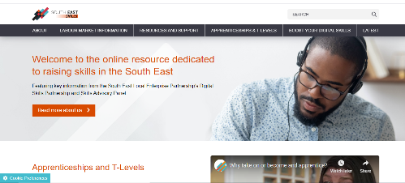
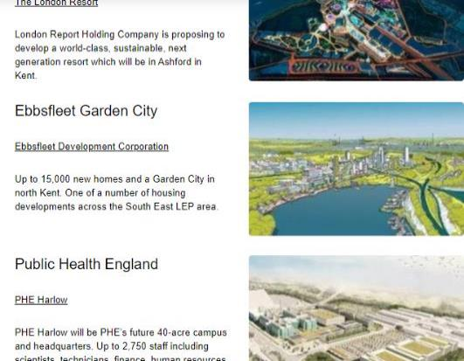
South East Skills website now live!
New website to house labour market information, courses, partner resources and updates
Bringing together the resources, partners and information for the LEP’s Skills Advisory Panel and Digital Skills Partnership
www.southeastskills.org.uk
Includes Major projects section to be added to regularly

Slide 7
Action Plan – building on existing work
Working with government funding such as the DWP Restart programme, DfE retraining scheme and ESF Programmes
Encourage more employers to become STEM Ambassadors, Enterprise Advisers and Governors
Work with organisations such as Career Ready, Career Colleges Trust, Go Construct, Women into Construction
Increase participation in government schemes such as Disability Confident
Work with industry bodies

Slide 8


Looking ahead
Delivering against our £4.4m Covid-19 Recovery Fund supporting individuals and businesses – webinar tomorrow with further information
Articulate growth areas outlined in Skills Report/ evidence base – Skills festival 19th and 21st October and themed, webinars planned – e.g. the future of work
Developing a shared action plan with our major projects and building on the forthcoming Mace Report
SELEP Virtual Skills festival

