Slide 1
EU Transition Impacts on East Sussex

Slide 2
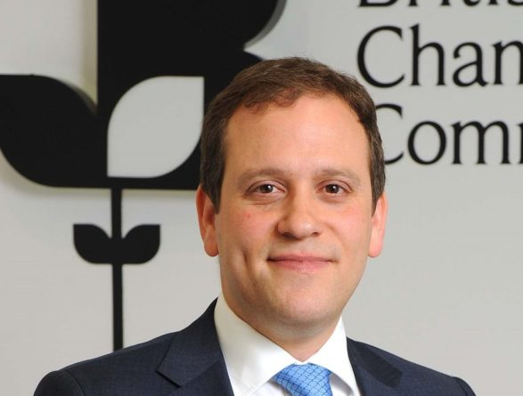
The BCC is a strong campaigning voice for the interests of over 80,000 businesses and 6,000,000 staff in the UK.
A nationwide network of 53 local Accredited Chambers of Commerce in the UK and 56 Accredited British Chambers around the World.
Notes:
We do feed into the British Chambers on all lobbying and policy issues. I will touch on this at the end to provide an brief update on the current weekend lockdown announcement.

Slide 3
Outline of the EU Transition
Timeline
Impact EU Deal or No Deal
Free Trade Agreements
Changes
Export documentation
Customs declarations
Grant funding
UK Global Tariffs
Webinars – Countdown to Change
Brexit Guidance Dashboard

Slide 4
Timeline
Intensified talks
Drafting legal texts
Early November – European Parliament
Mid November – Out of time
Notes:
Trade Agreements are still being discussed and drawn up

Slide 5
Impact of No Deal or EU Free Trade Agreement
Impact of No Deal
WTO Rules apply to EU
Tariffs payable on some goods
Rules of Origin and loss of cumulation
220m more customs declarations
Export Health Certificates
Loss of some Continuity Trade Deals
Impact of a UK:EU Free Trade Agreement
Tariffs free trade for most goods
Rules of Origin and cumulation
220m more customs declarations
Export Health Certificates
Continuity & New Trade Deal
Regulations & standards
Notes:
World Trade Organisation - rules between countries – where they open their markets for goods and services and have “ceilings” on customs tariff rates.
Tariffs – further detail will be provided later in the presentation
Rules of origin are the criteria needed to determine the national source of a product. Their importance is derived from the fact that duties and restrictions in several cases depend upon the source of imports
Customs Declarations - Currently 55m customs declarations are produced around the world – handled by approx. 7800 agents – will grow to 300m – not enough freight forwarders or agents. I will cover this later.
Export Health Certificates – required from Apr 2021 for all products of animal origin and plants, plant products - will require pre-notification and relevant health documentation.
Free Trade Agreement - a multinational agreement according to international law to form a free-trade area between the cooperating states

Slide 6
Free Trade Agreements
Typically Cover
Security
Politics & Prosperity
Build Trust
Aid + Trade
Good for Traders
Preferential Tariffs
Easier Borders
People & Goods
Data & Cash
Continuity Agreements
c. £125bn / 48 countries / c. 18% of UK Exports
EU27 Trade
£300bn / 27 countries / 43% of UK Exports
£372bn / 27 countries / 51% of UK Imports
Notes:
Free trade agreements generally build trust and is good for traders.
There will be 48 countries where continuity agreements will continue.
We current export 43% of UK goods and import 51% of goods from the EU.

Slide 7
Trade Agreements in place

Slide 8
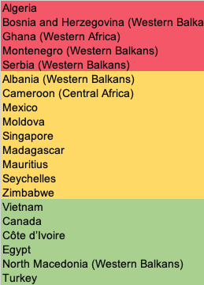
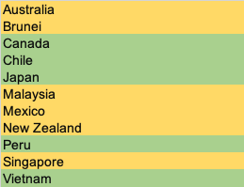
Trade Agreements yet to be finalised
EU Rollover
CP-TPP
Bi-lateral
United States of America
Australia
New Zealand
RED - Stalled / Low Progress
AMBER - Progressing but not likely to be agreed by end Dec 2020
GREEN - Agreed by end Dec 2020, and approved by UK Parliament
Notes:
Green – identifies trade agreements which will be in place by the end of Dec. Amber – those in discussion but will not be in place this year. Red – stalled.
CP – TPP - Comprehensive and Progressive Agreement for Trans-Pacific Partnership - a free trade agreement between Canada and 10 other countries in the Asia-Pacific region

Slide 9
Changes
GB-EU Border Operating Model
GB/Northern Ireland Border & Trader Support Service
Customs Declarations Service deployment by stealth
Goods Vehicle Movement System / Smart Freight
Border Inspection Posts
£200m Port Infrastructure Fund
Notes:
The updated GB-EU Border Operating Model:
Certain locations inland will provide the necessary additional capacity to carry out checks on freight.
Passports will be required for entry into the UK from October 2021 as the Government phases out the use of EU, EEA and Swiss national identity cards as a valid travel document for entry to the UK. Identity cards are among the least secure documents seen at the border and ending their use will strengthen our security as the UK takes back control of its borders at the end of the transition period.
Confirms, a Kent Access Permit will be mandatory for HGVs (Heavy Goods Vehicles) using the short strait channel crossings in Kent. The easy-to-use ‘Check an HGV’ service will allow hauliers to check if they have the correct customs documentation and obtain a Kent Access Permit.
Kent checks – concerns raised whether HGVs will try to avoid checks and use other road networks.
Staff shortages at some ports
Northern Ireland border and trader support service – a new service traders should sign up to – free end to end support package to manage import, safety and security declarations, educate businesses on what the protocol means with online training and explain movement of goods into NI. (Launched end Sep)
Customs Declarations – to be covered in my presentation
Goods Vehicle Movement System – new border IT system which is in development to administer movement of goods across borders – aim to be operational by July 2021.
BIPs – (Border Inspection Posts) are entry points for products of animal origin – dotted around the country. Only a handful will be introduced which will impact certain ports who will need to re-direct their goods. i.e. Shoreham or Newhaven will need to redirect animal products to Kent or elsewhere.
Port Infrastructure Fund – will provide space to build new infrastructure, warehouses and control posts.

Slide 10
Export Documentation – changes
Sussex Chamber of Commerce currently provides exporters with:
Certificates of Origin
Certificate of Conformity
Electronic Export documentation
Certification, Legalisation & Notarisation of Export Documentation
EUR1 & ATR customs authentication - changes
Letter of Credit processing service
ATA Carnet
Notes:
The national Accredited Chamber network provides export documentation for exporters and has done for years. But some current documents will change:
A UK Certificate of Origin is being designed by Department for International Trade as a replacement for the current certificates of origin in the EU. Exports to Arab League countries which usually require an Arab-British Certificate of Origin will be unaffected by Brexit and there will be no change in format of the document for the middle east.
Changes to EUR1s (will become a UK EUR1) and ATR’s. (Both are movement certificates – based on different tariff preferences). HMRC will issue new UK EUR1’s.

Slide 11
Trader Readiness
180,000 EU only Traders
73,000 EU & ROW Traders
68,000 ROW only Traders
Mostly Unprepared
Mostly Prepared
Notes:
ROW = Rest of the World
Bringing goods into the UK from the EU will involve a lot more paperwork than it does now. Many EU traders are unprepared.
To give some idea of the scale, around 180,000 UK businesses only trade within the EU, 68,000 only trade outside the EU and 73,000 trade in both. The EU27 accounts for just over half of all imports into the UK so the volume of ‘checked’ goods passing through our ports will increase significantly. Being outside the customs union will mean that imports into the UK from the EU will be treated the same as those from the rest of the world. They will shift from being goods in free circulation within the EU, to imports subject to duty and VAT.
Paperwork related to imports and exports is complex and can be confusing. To add to the difficulty, goods will be subject to increased border checks when we leave the EU, with any one of 26 government agencies taking an interest. For example, livestock and animal products will get the attention of the Plant Health Agency, the Port Health Authorities and the Rural Payments Agency. Other agencies include Trading Standards, Environmental Health and the National Measurement Office.

Slide 12
Customs Declarations will impact imports and exports
Customs Declarations are a necessity for all businesses that import and export goods.
As the UK leaves the EU, goods will be subject to increased border checks and declarations.
Currently 55 million declarations are carried out annually
This will increase to 300 million
Businesses who import will face a lot more administration
ChamberCustoms is the brokerage service for the Chambers of Commerce with direct links to all sea, air and road ports and terminals in the UK. This was launched to respond to the demand. This service is HMRC compliant.
www.chambercustoms.co.uk
Notes:
Michael Gove confirmed in parliament that 50,000 new recruits would be needed in the next 6 months to handle Customs Declarations Capacity Gap
Concern – not enough customs brokers which will impact businesses wishing to import or export.
The national Accredited Chambers have been training staff to be fully trained and able to process Customs Declarations. This will be a new service the Sussex Chamber will provide along with other national Chambers. We have set up ChamberCustoms to handle this.

Slide 13
What are Customs Declarations?
Forms to accompany goods entering or leaving a market.
Used internationally to communicate the origin of the product, its relevant tariff, to allow customs and regulatory authorities to calculate what duty is payable.
Allows authorities to know what goods are coming in/out.
Customs declarations are an official document that lists details of goods
A commodity code is used to identify the type of product/ goods – Customs set rates of duty and specific restrictions against each code
Goods are classified to identify the correct commodity code to describe the goods.
Notes:
Traders importing standard goods will need to prepare for basic customs requirements and will have up to six months to submit customs declarations to HMRC.

Slide 14
Making Customs Declarations
You need to know:
• The tariff code for each item in your consignment
• Do your goods require any special licenses or certificates?
• Does the UK have a trade agreement in place with the country of export from the UK?
• Are your goods subject to any quotas?
• Are you importing under a customs procedure?
• What is the origin of the goods?
• What duty and VAT will you expect to pay at import?
• What is the correct valuation of your imported goods, including freight and insurance costs?
Notes:
Considerations all businesses will need to consider as well as increased costs (paperwork, duty,)
It is the business’s responsibility to get the paperwork right. We can help provide guidance and advice.
Incorrect declarations – delays, HMRC impose penalties or prosecute.
Tariff codes will be covered shortly

Slide 15
Business Readiness – the basics
What is my EORI Number?
Will I use staged or full EU import controls?
How do I set up Postponed VAT Accounting?
Will I need a Duty Deferment Account?
How many customs declarations will I need each week/month/year?
Should we do our own declarations or get a customs broker to do them?
What are my responsibilities and what records must I keep?
What are the commodity codes for the goods we buy and sell?
What is the Customs Valuation for our goods (different from invoice value)?
What are the customs rules that apply to the borders I will trade across?
Notes:
Some questions business need to consider are included above.
EORI - Economic Operators Registration and Identification number

Slide 16
HMRC Grant Funding – customs
HMRC launched the Customs Intermediary Grant Funding and committed a further £50m.
Training Grants – up to £1,500 per course/ per delegate
IT Improvement Grant – 100% of eligible IT costs
Recruitment Grant – up to £15,000 per recruit
Notes:
HMRC has funding to help support business in preparation for Customs Declarations.

Slide 17
Training – Customs Declarations
Overview training
Live 1 day training (delivered remotely)
E-learning
Readiness package – intensive 4 day training
Notes:
Sussex Chamber can help provide the necessary training for Freight Forwarders or businesses that wish to have an overview and understanding of the documents required.

Slide 18
UK Global Tariffs (UKGT)
This will replace the EU’s Common External Tariff – it’s a lower tariff regime.
Support the economy – make it easier and cheaper for businesses to import goods from overseas and allow business to compete on fair terms.
60% trade will come in tariff free on WTO terms or through existing preferential access (following successful Free Trade Agreements).
Notes:
Tariffs are a set of rules and regulations covering duty applicable and importation/ exportation of goods.
There will have to be a trade agreement with the UK for the tariffs to apply.
The average customs duty tariff rate will reduce from 7% to 6% with tariffs on an additional £30bn of imported goods being cut to zero
Approx. 9,500 products to which the UKGT applies.
This does not include import duties, such as VAT.

Slide 19
UKGT
Maintaining tariffs on agriculture, automotive and fishing.
Support imports from world’s poorest countries.
Maintaining tariffs on agricultural products such as lamb, beef, and poultry.
Maintaining a 10% tariff on cars.
Maintaining tariffs for the vast majority of ceramic products.
Removing tariffs on £30 billion worth of imports entering UK supply chains. 0% tariffs on products used in UK production, including copper alloy tubes (down from 5.2%) and screws and bolts (down from 3.7%).
Notes:
Maintaining tariffs on Imports to support certain products and countries

Slide 20
UKGT
Here are some examples of sectors that will see a positive impact:
Articles of stone and plaster
Base metals and articles made of base metals
Machinery and mechanical appliances
Optical and photographic equipment
Vegetable products
Wood and articles made of wood

Slide 21
UKGT supporting renewable energy
We will promote a sustainable economy by cutting tariffs on over 100 products to back renewable energy, energy efficiency, carbon capture, and the circular economy. The following are all dropping to zero tariffs:
Thermostats (down from 2.1%).
Vacuum flasks (down from 6.7%).
LED lamps (down from 3.7%).
Bike inner tubes (down from 4%).

Slide 22
UKGT – Covid-19
Almost all pharmaceuticals and most medical devices (including ventilators) are tariff free in the UKGT.
Some products used to fight COVID-19 maintain a tariff.
To ensure those working on the frontline can access vital equipment easily, the UK has introduced a temporary zero tariff rate on these products. This relief waives the tariff and VAT for personal protective equipment (PPE), medical devices, disinfectant and medical supplies from non-EU countries.

Slide 23
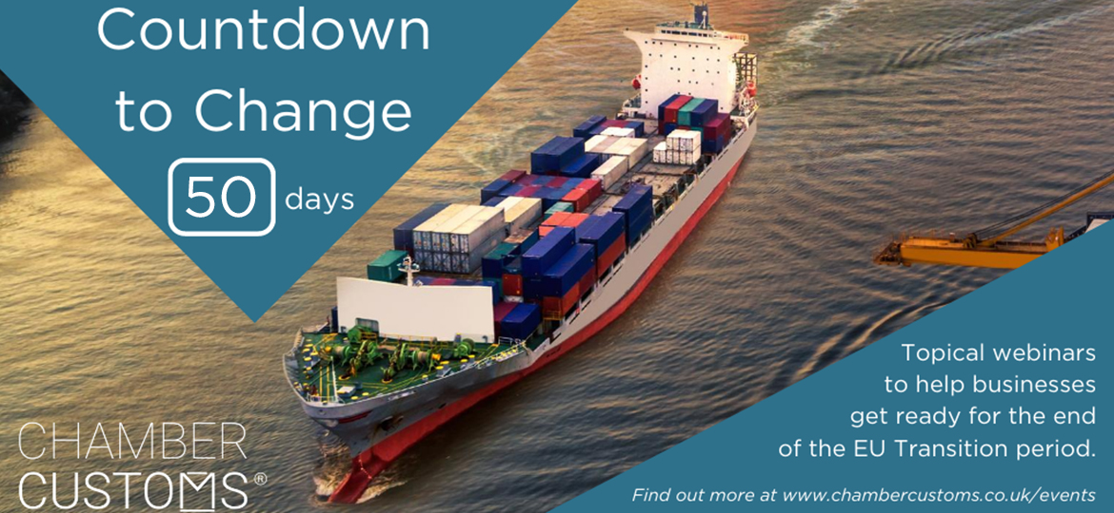
National Webinars to inform business
National webinars leading to the end of the EU Transition period (50 days to and 30 days)
11November: https://www.sussexchamberofcommerce.co.uk/events/chamber-events/countdown-to-change-chambercustoms-series-webinar-3-50-days-to-go
1December:
https://www.sussexchamberofcommerce.co.uk/events/chamber-events/countdown-to-change-chambercustoms-series-webinar-4-30-days-to-go
Notes:
The Chamber network has a series of national webinars to inform business of the changes.

Slide 24
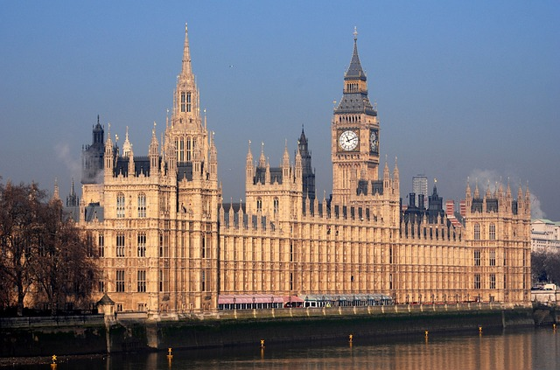
Policy and Representation
Our relationships with decision makers at local, regional and national levels allow the voices of our members to be heard in the right place at the right time.
Guidance Dashboard – unanswered questions
People
Funding
Tax
Regulation
Digital
Borders
Customs
https://admin.britishchambers.org.uk/admin/media-manager/get/End%20of%20Transition%20Period%20Guidance%20Dashboard.pdf
Notes:
The Guidance Dashboard was issued to government with 26 unanswered questions.
The EU Transition will impact every business regardless of whether they import or export – the dashboard also covers GDPR, people, e-commerce and other areas.

Slide 25
Any questions?
customs@sussexchamberofcommerce.co.uk
Review the government transition questionnaire to highlight any potential issues for your business
https://www.gov.uk/transition-check/questions

