Slide 1
Preventing Digital Exclusion: Access for All
George Anibaba, Kent Surrey Sussex Academic Health Science Network (KSS AHSN)
Digital + Skills = Industry 4.0
8th October 2020
Notes:
Introduction…
My personal experience/anecdote of how this affects the community…including an outreach Sunday school, now online, highlighting digital access issues

Slide 2
Notes:
Covid-19 has changed everything about the way we live, work, trade, sell and consume. Universities and schools have had to start teaching online, GPs are doing online consultations, musicians have been performing remotely, and high street businesses have become digital to stay in business and…parents are bringing their families to work.

Slide 3
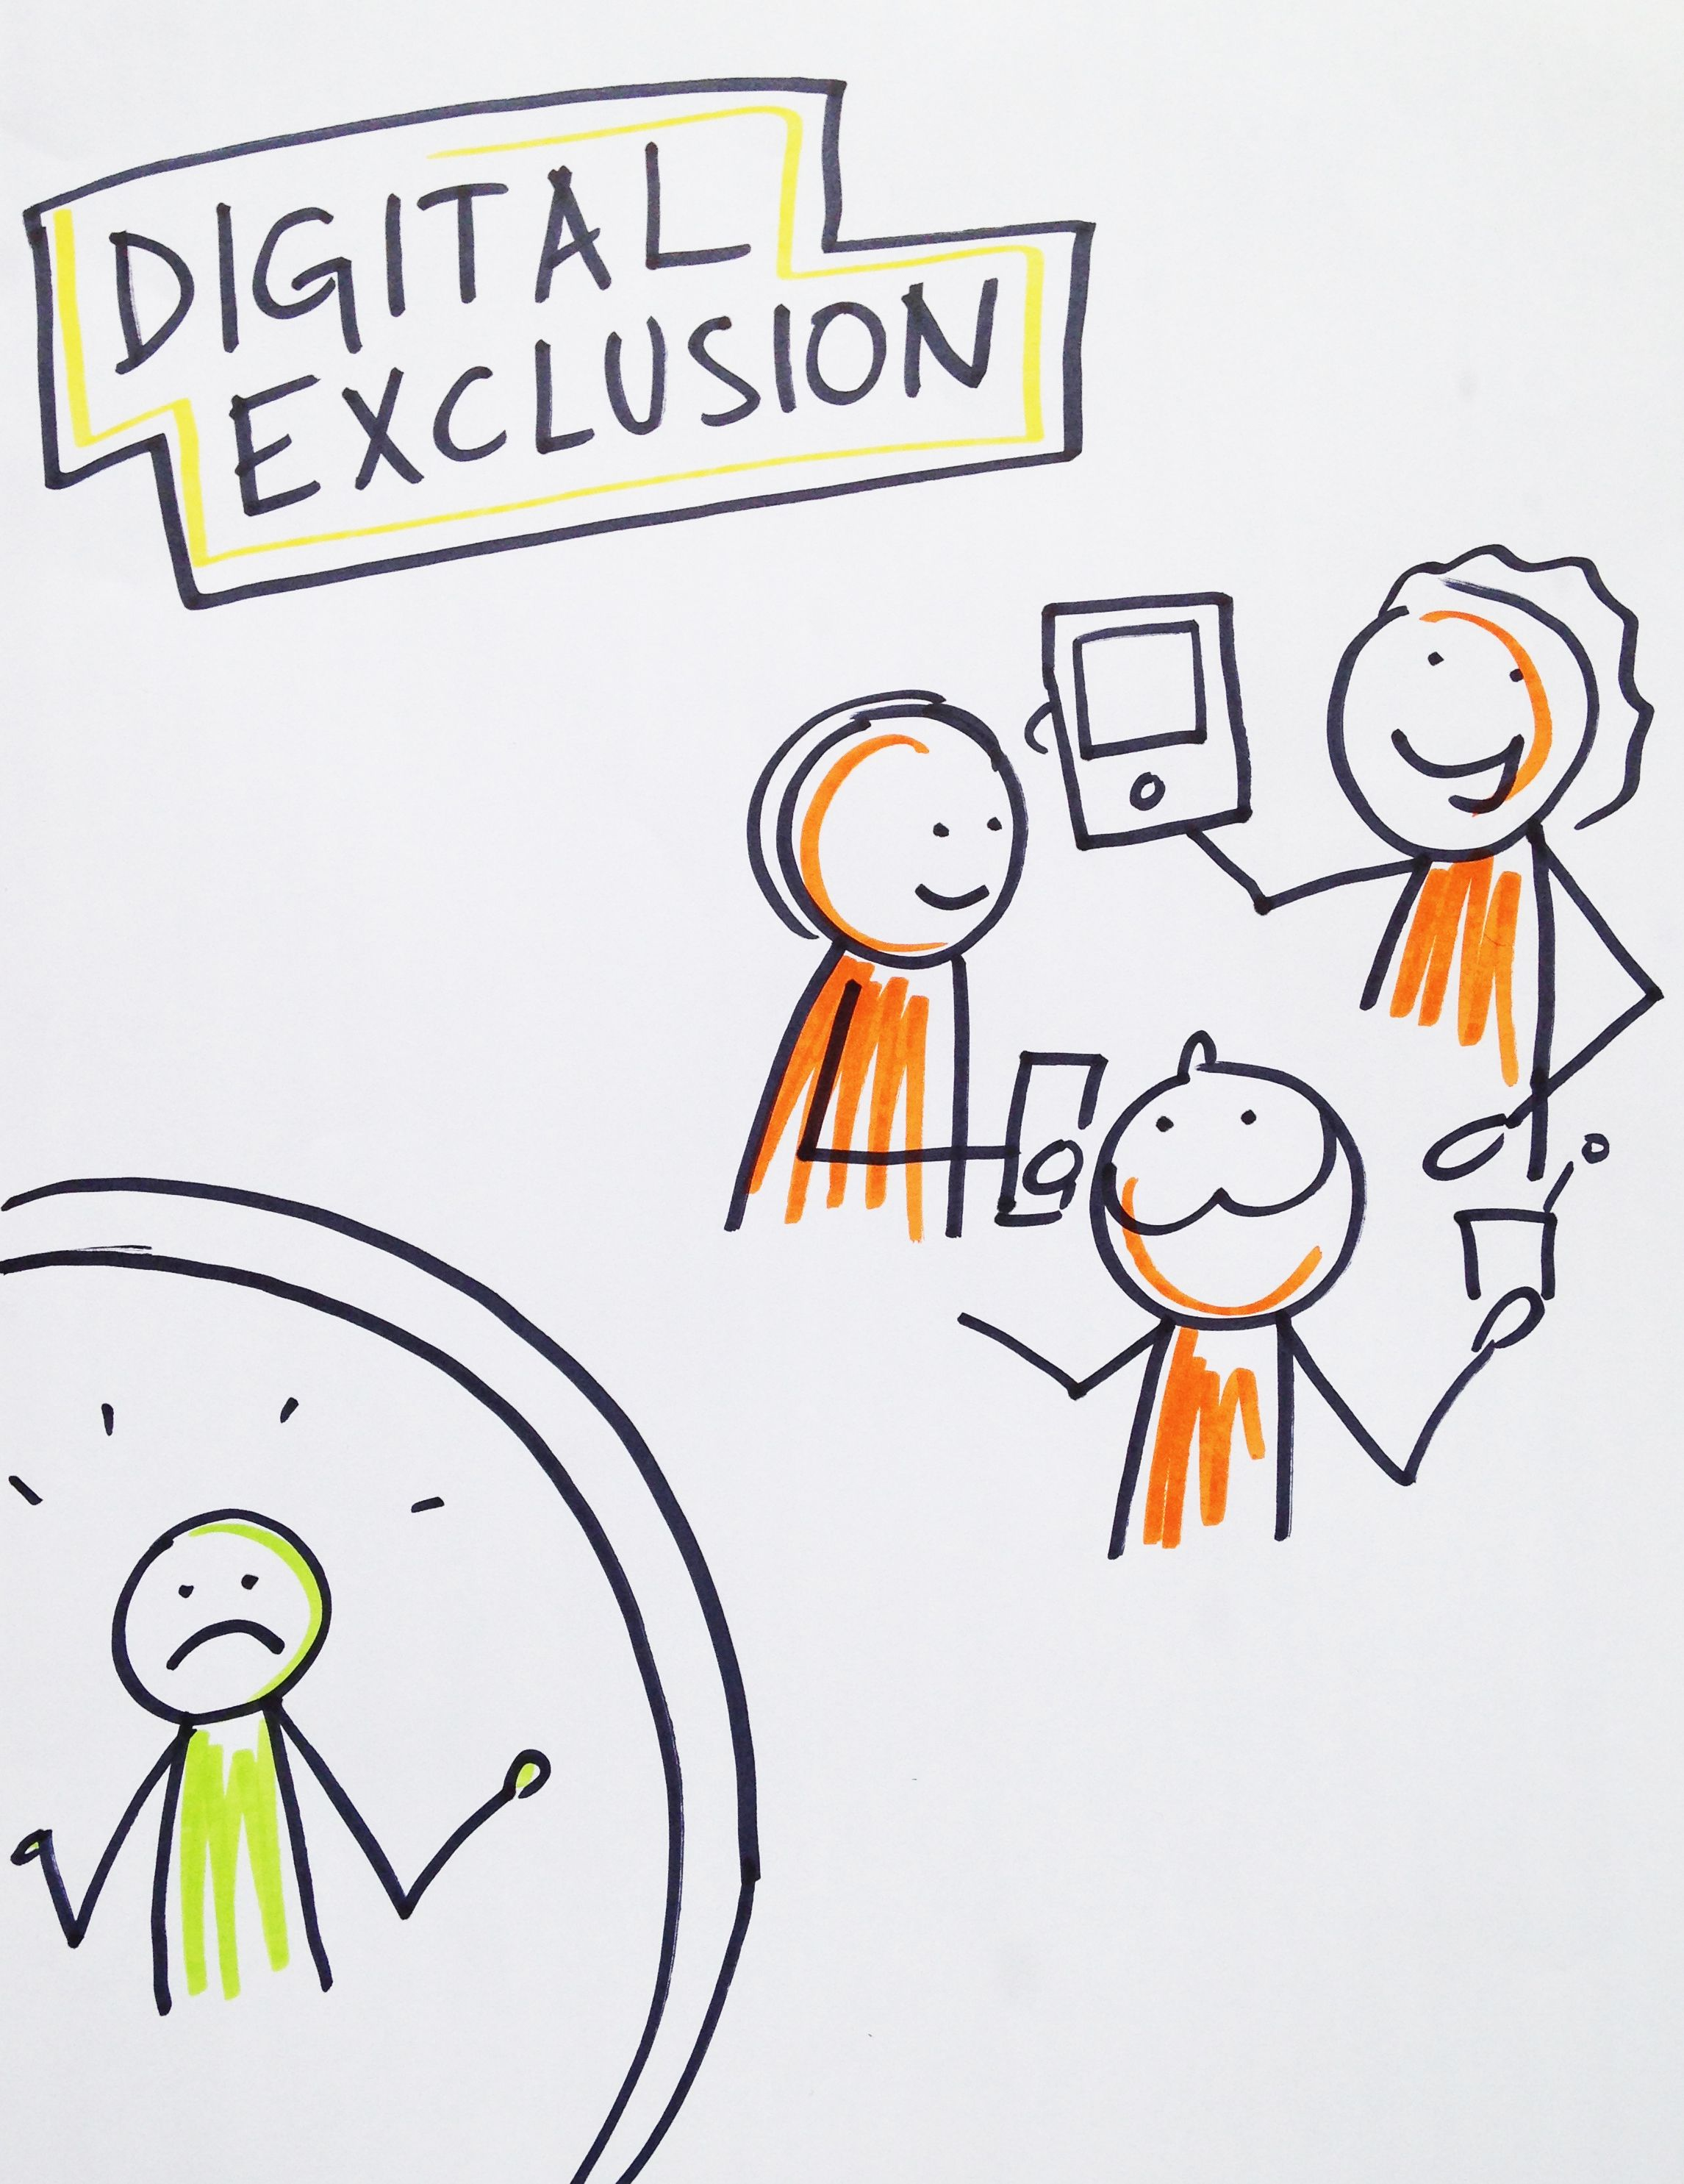
A societal issue
Employment
Education
Communication
Essential services
Communication
Time and efficiency savings
Notes:
Covid-19 has changed everything about the way we live, work, trade, sell and consume. Universities and schools have had to start teaching online, GPs are doing online consultations, musicians have been performing remotely, and high street businesses have become digital to stay in business.
Getting online and having basic digital skills are now as important in getting a job as English and maths. And given the new reality where many of us are being asked to work from home, if you can’t get online, you won’t be able to survive. Yet according to research by the Good Things Foundation, nine million people who struggle to use the internet independently have been locked out of this digital economy and are being left behind.
“This is a complex societal issue and not completely understood, it’s dynamic, not static and requires listening and partnership working in order for the right problems to be addressed in the right way and at the right time.
The Essential Digital Skills Framework defines the skills needed to safely benefit from, participate in and contribute to the digital world of today and the future.
There are five categories of Essential Digital Skills for life and work:
Communicating
Handling information and content
Transacting
Problem Solving
Being safe and legal online
In an ever evolving Digital world, societies/communities that thrive digitally, can experience:
Employability benefits and earning benefits
Education attainment
Better outcomes and experience related to access to essential services
Retail transaction benefits
Communication benefits i.e. reducing social isolation
Time and efficiency savings
In 2015, UK signed up along with all the other UN countries to help achieve the ‘Sustainable development goals’ which include:
End poverty
protect the planet;
Improve lives and prospects of everyone everywhere
In global context UK still lags behind many other G20 countries in terms of inequality i.e. access to fast broadband and digital skills of citizens. Though one of the more prosperous regions in the country, it is true of SE LEP region
Risk of people being left behind in an increasingly Digital age
Digital divide between the ‘haves’ and ‘have nots’

Slide 4
Key regional issues
19% of the South East’s population (804,000) do not possess essential digital skills for life (Lloyds Consumer Digital Index), estimated that 7% will still lack in 2030
Around 14% of JCP (JobCentre Plus) claimants are digitally disengaged
11% of people in Essex and Kent are digitally disengaged, and 11% across Surrey, East and West Sussex
Average proportion of client group, upon engaging with voluntary services, having no digital skills whatsoever – 14%
Average proportion of client group that have no access to internet/digital hardware – 8%
Notes:
A multiplicity of issues and regional challenges…

Slide 5
DSP: Preventing Digital Exclusion
Tackling the South East’s Digital Divide
Our (working) manifesto:
“To fight injustice and inequality in the South East region through ensuring all of our citizens have the access and the skills required to realise the benefits of digital technologies”.
“To make universal internet connectivity a priority”
Notes:
Whilst our nation’s leaders are trying to follow-up on their intention to address this inequality and ‘level up’ underperforming and left-behind parts of the UK (through a programme of infrastructure development, investing in education, skills and scientific R&D)…the spirit of Covid response (mucking in) continuesto prevail particularly at local levels in addressing specific population needs, of which access to digital is one
Our manifesto:
Our ambition should be to make sure no-one in the south east is excluded because they don't have the skills or can't afford the equipment or connection.
Resonates with KSS AHSN strapline of ‘Transforming lives through innovation’. Particularly the lives of those with most need, who for socio-economic or other issues are unable to get access to basic and sometimes more ground-breaking but potentially impactful solutions to their pressing problems

Slide 6
Our working groups, vision and themes
Preventing Digital exclusion
Access for all: Achieve 0% digital exclusion
Charities: Support to charities supporting vulnerable residents
Employment: Improving training, education, careers advice and information for the unemployed across the South East
Vision: Universal minimum digital skills level
Themes: Sharing stories Ensuring representation Identifying and Accessing Funding Opportunities
Notes:
Preventing Digital exclusion working group, with three subgroups:
1. Access for all
2. Support to charities supporting vulnerable residents (Upskilling charity staff and leadership, linking support with training and education)
3. Improving training, education, careers advice and information for the unemployed across the South East

Slide 7
Our working group: Access for all subgroup members
Sathish Sivasubramanian (Co-chair), ICT and Computing co-ordinator, The Howard School, Gillingham
Vikki Liogier, National Head of EdTech & Digital Skills, Education and Training Foundation
David Barker, Internet and Social Entrepreneur, Techcentre
Sam Rhodes, Employability and Skills Officer, East Sussex
Preventing Digital Exclusion working group leads:
Rhona Drever, Library Strategy and Performance Manager, East Sussex County Council
Will Pickford, Vice Principal, Thurrock Adult Community College
Notes:
Launched in August
A collective of individuals representing a number of sectors and organisations across Kent, Essex and Sussex…all with skin in the game and a shared purpose and ambition to make a difference

Slide 8
Progress
Access for All group formed in August, and initially focussing on:
Issues, who’s affected and how do we address and overcome true needs
Information and recommendations for regional and local policy makers + information sharing and awareness raising
Impact of giving people access to hardware and the internet
Notes:
With the three themes in mind (Sharing stories, ensuring representation, identifying and Accessing Funding Opportunities) we’ve agreed to hone in on three Is

Slide 9
Making a difference…how will we know? (A work in progress…)
Outcomes | Measurable outputs
Eradicate digital exclusion in the South East | 0% digital exclusion
Increased awareness of digital skills resources and information | Number of organisations reached (by sector) Posts, Tweets, publications: Social media to raise awareness i.e. LinkedIn, Twitter i.e. Tweeting once £ landed
 | Number of communications with relevant networks
Improved access to digital kit and skills | Number of residents benefiting from initiatives such as DevicesDotNow in Swanscombe/Northfleet/Thanet/Dover (Kent), Hastings (Sussex) and Tendring (Essex)
 | Amount of kit distributed across the South East Number of beneficiaries across all initiatives (by initiative i.e. Google Chromebooks in East Sussex)
Increased inward investment | Number of funding opportunities maximised / bids submitted
 | £ brought in to the region and leveraged
Impact / Stories | One-pagers from beneficiaries re what they’ve done with the funding and kit
 | Feedback from beneficiaries including photo opps, Tweets, Local press publications
 | Data (outputs/outcomes) relating to distribution of kit specifically for DevicesDotNow Enablers: Impact of digital mentors / champions
Notes:
A fundamental improvement question is: Once we’ve identified the problem and have also identified potential interventions, how will we know we’ve made a difference.

Slide 10
Making a difference…A work in progress…
Partnership with Coursera
DevicesDotNow initiative
Partnership with Futurefit AI
Digital skills prospectus
Coming soon…
£2m SELEP Skills Fund
Notes:
Louise will talk later on in the agenda about the fund but, from the point of view of the DSP’s Inclusion Working Group, we’re excited not only by the strong digital flavour to upcoming tenders but particularly a portion of the fund that has been specifically targeted at improving digital access and basic digital skills. As I say Louise is going to talk in more detail later in the day, but we should make the point that discussions in the inclusion working group and the wider DSP have led to this being an important element of the fund, and one that could have significant impact around digital inclusion.

Slide 11
Making a difference…
FREE COURSERA courses
Coursera offering access to their online courses for those facing the threat of redundancy, furloughed staff and the unemployed, at no cost.
The courses are free to sign up to until the end of October 2020, and must be completed by the end of December 2020.
You can access SELEP’s Coursera portal via the SELEP DSP’s website and begin completing courses now.
Courses on offer:
Business entrepreneur
Cyber security
Digital marketing
Web development
Health and Social care
Business skills
Notes:
They’re working now to curate courses, according to key sectors and knowledge of shortage occupations in the region, meaning learners will be guided towards particular courses depending on the career pathway they’re thinking of taking.
There are more than 4,300 courses available to those facing redundancy, on furlough, or those looking to reskill to enter a new industry.

Slide 12
Making a difference…
DevicesDotNow initiative – Good Things Foundation (GTF)
Secured laptops/tablets and connectivity for individuals in Hastings, Tendring and Swanscombe/Northfleet
Pfizer and Discovery Park also making donations to GTF to focus on people in Thanet and Dover
Notes:
Good Things Foundation are UK-based registered charity, the objective of which is to make the benefits of digital technology more accessible. It is responsible for managing the Online Centres Network and the Learn My Way learning platform
We’ve made a donation of £10,000 to the Good Things Foundation, in order to secure laptops/tablets and connectivity for individuals in Hastings, Tendring and Swanscombe/Northfleet. GTF are currently working with their ‘Online Centres’ in those areas to identify beneficiaries and secure the relevant kit and connectivity. The Good Things Foundation’s Online Centre network will be responsible for distributing and providing support to individuals, including helping them access learning, using GTF’s Make it Click and Learn My Way platforms. Off the back of our donation, Pfizer and Discovery Park have also agreed to make a donation to GTF, this time to focus on beneficiaries in Thanet and Dover. Perhaps you could use the presentation to encourage other organisations to consider making their own donation to GTF, to support their local community? Or at least encourage organisations to work closely with their local Online Centre?

Slide 13
Making a difference…coming soon
Partnership with Futurefit AI
100 residents to get free access to their platform over the next couple of months
Benefits include:
support from careers professionals,
access to CV and interview skills support,
access to the latest labour market information
benefit from skills gap analysis and recommendations for learning
Notes:
FutureFit AI is an AI-powered intelligence platform for the future of work. Described as the 'Google Maps for your Career'​, it draws on over a billion data points to identify future skills, assess current capabilities, and map upskilling & reskilling pathways for individuals, enterprises, and governments.
We’ve agreed a partnership with Futurefit that will see 100 residents get free access to their platform over the next couple of months. Individuals will be encouraged to sign up to take part in the programme, and they’ll benefit from support from careers professionals, access to CV and interview skills support, access to the latest labour market information, benefit from skills gap analysis and recommendations for learning. We hope to offer this opportunity to residents in the very near future.

Slide 14
Coming soon…
Digital Skills prospectus & SELEP skills fund
Online tools, resources and learning opportunities
Fund targeted at improving digital access and basic digital skills
Notes:
At the beginning of the COVID outbreak we moved quickly to post lists of online tools and resources for individuals on the DSP website, broken down into resources for educators and students, SME’s and charities and those for residents. Those lists remain in place but, as part of the new SELEP Skills website (that’s launched on the same day as this conference), we’ve now compiled a broader list of online tools, resources and learning opportunities, split into various classifications to enable individuals to navigate the abundance of information that’s out there.
The DSP’s Inclusion Working Group are excited not only by the strong digital flavour to upcoming tenders, but particularly a portion of the fund that has been specifically targeted at improving digital access and basic digital skills.

Slide 15
Hexitime
National skills exchange timebank for the health and social care system
Allows staff to share improvement ideas and exchange their skills to deliver service improvements
Members do not exchange money, but instead earn credits which they can use for further improvement activity
The health and social care sector in Kent, Surrey and Sussex is the first part of the country to have a formal partnership with Hexitime – making it easier to share skills and expertise across the region.
Find out more and SIGN UP FOR FREE at https://hexitime.com/
Notes:
Slide and spiel

Slide 16
BIG NEWS!
New Diversity and Inclusion lead for DSP!
Congratulations Kit Ahweyevu, (CEO Mindweaver)!
Notes:
Kit has agreed to take up a lead post around diversity and inclusion across the DSP, we welcome this and look forward to working with Kit in the future! Kit will also be on the panel later!

Slide 17
How you can help?
Raise awareness of the DSP’s function and role in addressing Digital exclusion
Share resources, insights and ideas
Contribute to worthy causes
Any blind spots?
Notes:
Any blind spots? Please get in touch with us to share any resources, insights and ideas that might help us further the cause

Slide 18
More useful information and resources
accuRx webinar recording from 5th August, 6:30pm on 'Accessible Design and Digital Inclusion in Healthcare'
Digital Skills and Inclusion Policy – from the DCMS (Department for Digital Culture Media & Sport).
Digital Inclusion - The Good Things Foundation
Digital Inclusion Policy Starter Kit
Exploring the UKs Digital Divide – ONS
Essential Digital Skills Framework – DFE
The Skills toolkit
Lloyds Consumer Digital Index 2019
Learn My Way: Free courses for people to learn digital skills to stay safe and connected
The Inspiring Digital Enterprise (iDEA) Award
Enhance Digital Teaching Platform and Essential Digital Skills (EDS) programme
Edge Foundation blog promoting the Digital Divide Fund
Donate Devices or funding through the DevicesDotNow initiative

