Slide 1
Digital + Skills = Industry 4.0: SELEP's SAP and DSP Annual Conference, 8th October 2020

Slide 2
Focus on the Adult Social Care Workforce Nationally and in the South East LEP Region Digital Skills of the National Adult Social Care Workforce Emma White, Locality Manager Essex, Southend and Thurrock Diane Buddery, Programme Head, Sector Digital

Slide 3
Who are Skills for Care?
Skills for Care is an independent charity with over 20 years experience of developing the adult social care sector to help create a well-led, skilled and valued adult social care workforce. We support employers to deliver what the people they support need and what commissioners and regulators expect. We are a delivery partner of the Department of Health and Social Care, and we work with a wide range of partners such as health and local authorities to achieve our aims.

Slide 4
What are our main areas of work? As our name would suggest, our work programme is responsive to sector need, and focusses on the skills of the adult social care workforce from initial recruitment through to the ongoing development of staff and equipping existing and future leaders to have the right skills to lead outstanding care services. Increasingly, this skill set includes digital skills and digital leadership.

Slide 5
How do we invest in skills for the workforce?
Develop Qualifications and Training
Fund Training and Development
Develop and Produce Resources, Webinars and Events
Provide Peer to Peer Support Opportunities
Work Nationally and Locally with Partners to Access Funding
Provide Local Skills Support and Information
Gather Data and Workforce Intelligence to Identify Skills and Gaps

Slide 6
What does Adult Social Care look like in England and in the South East LEP region specifically?

Slide 7
In England we continue to have a growing workforce need and currently have on average a vacancy rate of around 130,000 care roles at any one time, with more workers needed year on year to meet demand of an increasing, ageing population with complex care needs.

Slide 8
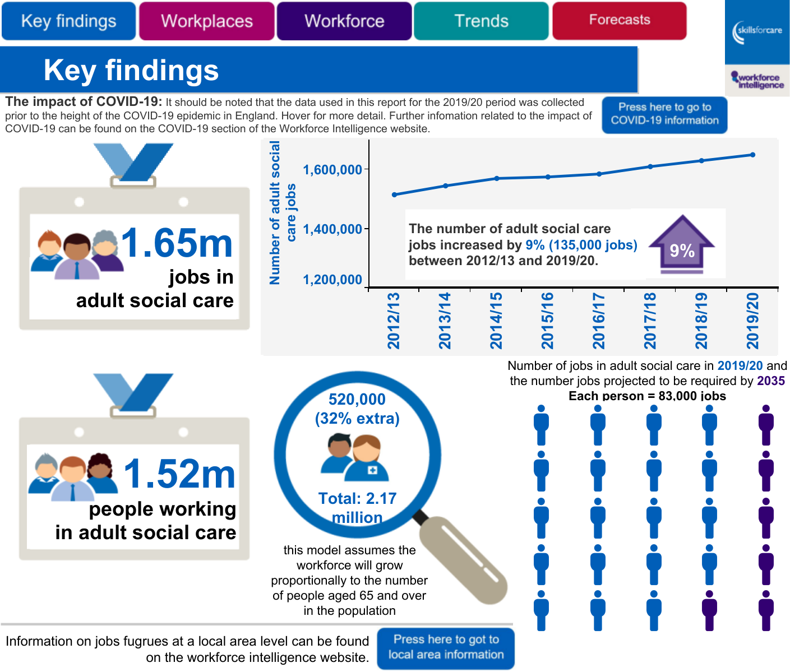

Slide 9
Workforce Intelligence for SELEP Region
Area | No of jobs | Permanent workers | Turnover of staff | Stay in the sector | Qualified up to L4 and above
Essex | 39,000 | 90% | 32.3% | 68% | 48%
Thurrock | 4,500 | 78% | 41% | 71% | 41%
Southend | 6,600 | 81% | 36.8% | 62% | 53%
Kent | 45,000 | 87% | 31.2% | 71% | 48%
Medway | 6,500 | 95% | 28.7% | 73% | 46%
East Sussex | 19,000 | 93% | 32.5% | 67% | 48%
Total | 120,600

Slide 10
Economic Impact of Adult Social Care in England In 2018 a report commissioned by Skills for Care identified that:
Adult social care employers contributed £38.5 billion to the English economy, across over 40,000 sites, creating over 1.5 m job roles
Gross Value Added (GVA) directly generated by employers including wages paid to workers filling the many different job roles in adult social care was £20.3 billion
GVA created by the sector in its supply chain by purchasing services from other sectors of the economy that might include cleaning services or food suppliers to parts of the sector was 8.9 billion
GVA created by those who are employed directly in the sector and those employed indirectly spending their wages in other sectors of the economy was 9.3 billion

Slide 11
Economic Impact of Adult Social Care in SELEP Area 2019/2020
Area | Economic Impact
Essex | 1,150 million
Thurrock | 90 million
Southend | 170 million
Kent | 1,250 million
Medway | 150 million
East Sussex | 630 million

Slide 12
COVID 19 and Adult Social Care Sector
What have we learned about the skills of the adult social care workforce?
We have always known that the ASC sector is:
But there are gaps…
Highly skilled and adaptable with a wide range of care skills and soft skills
Resilient and responsive to change

Slide 13
COVID 19 has forced change but exposed weaknesses..
We already knew that the sector was varied in it’s use of technology (it’s digital maturity)
Whilst there is no definitive research, IPC Brooks 2019 research indicated an even split of thirds across the sector; a third relying on paper based systems, a third having a mix of paper based and digital and a third being exclusively digitally based.
Covid 19 has been particularly difficult for those in the first two thirds.
We need to continue to work to embed digital ways of working and the skills needed to do this.

Slide 14
What do we mean by ‘using digital ways of working?
Assistive technologies (TEC?)
‘back office’ functions (rotas, payroll, sickness?)
Secure communication software that enables sharing of info?
Apps to support staff communication?
Using digital ways of learning?
Using technology alongside those we support?
Using technology to prevent those we support needing our services
All of the above!

Slide 15
COVID 19 has forced change but exposed weaknesses..
All of Skills for Care’s previous work and the experience of CV19, pointed us to two key areas of concern.
Digital Leadership
Digital Skills

Slide 16
Digital Leadership
Leaders feel underconfident and under skilled in the use of digital.
They wished to learn and hear from their peers to share the journey!
They reported having no clear idea of how to improve their skills (opportunities to learn had been ad hoc).
The notion/role of a digital leader was not well understood
How to enable culture change in this area was seen as a challenge.
There was no clear standards or articulation of what digital leaders should be able to know/do.

Slide 17
Digital Skills
All learning was ad hoc, with varying levels of success and confidence from this.
Time to learn was a real issue
There were seen to be no standards or recognition for what was needed in terms of digital skills in a care environment

Slide 18
What are we proposing?
Digital Leadership in Adult Social Care
Concepts that we’ll be testing..
Developing a Digital Leadership standards framework
Developing peer to peer network and learning opportunities.
Increasing and enabling access to learning opportunities.
Can you help?

Slide 19
What are we proposing?
Digital skills
Concepts we’ll be testing…
Developing/supporting Digital Skills Hubs to include blended learning, resources, peer to peer support.
Developing and providing a ‘gold standard’ digital champions model.
Can you help?

Slide 20
Would you like to know more?
Visit our website
www.skillsforcare.org.uk
Contact:
Diane Buddery, Programme Head – Sector Digital
diane.buddery@skillsforcare.org.uk
Emma White, Locality Manager – Essex, Southend and Thurrock - emma.white@skillsforcare.org.uk
Karen Stevens, Locality Manager – East Sussex
karen.stevens@skillsforcare.org.uk
Pia Rathje-Burton, Locality Manager – Kent and Medway
Pia.Rathje-Burton@skillsforcare.org.uk

