Slide 1
Welcome
Lynne Matthews
October 2020

Slide 2
What is Bradwell B?
A proposed new nuclear power station on the Dengie Peninsula
It would make a vital contribution to the UK’s future need for low carbon, secure and affordable energy
It would power around four million homes across the UK and provide long-term jobs for 900 people for at least 60 years
There would be tens of thousands of jobs and significant business opportunities during construction

Slide 3
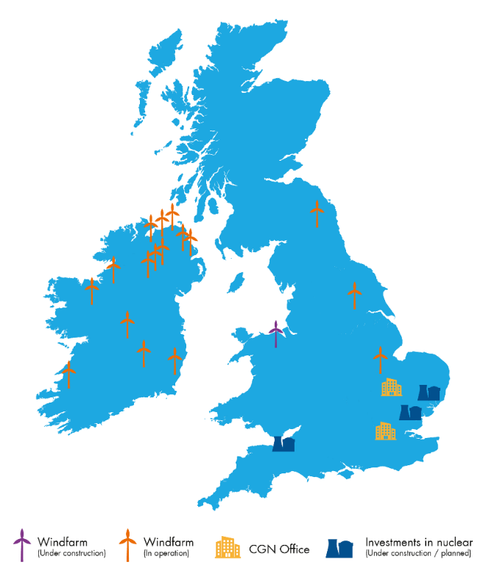
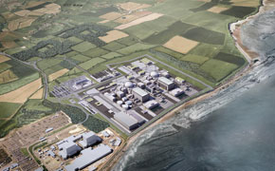
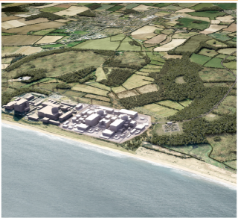
CGN in the UK
CGN UK
CGN’s UK project shareholding
Committed more than £10 billion to UK new nuclear
HPC
SZC
BRB
General Nuclear System
33.5%
20%
66.5%
66.5%
Hinkley Point C (HPC)
Sizewell C (SZC)
Bradwell B (BRB)
CGN Renewables in UK
300MW of onshore wind in operation in Ireland and UK
Further 40MW being built now at Brenig in Denbighshire
Also has a small fuel-trading business based in Cambridge
Technology EPR
Status
Construction
Technology EPR
Status
Development
Technology UK HPR1000
Status
Development
©2020 Bradwell Power Generation Company Ltd. All rights Reserved. NOT PROTECTIVELY MARKED.

Slide 4
BRB Skills - A Partnership Approach

Slide 5
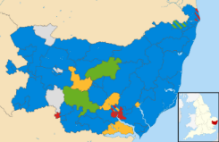
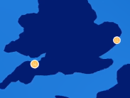
Education, Skills and Employment: Our overarching approach
Four Basic Objectives:
Our guiding principles are to:
Secure planning consent
Minimise workforce risk, maximise productivity
Supply the required workforce
Deliver more than a power station – social mobility and local benefit
Be Demand-led
Learn from HPC
Understand the
Landscape
Focus on the critical needs of the project – the legacy left by BRB will be strongest if the project is successful and runs to programme.
Make the most of the information and experience available to us: Redeploy best practice and revise approach where improvements are needed.
Ensure that local characteristics, issues and stakeholder relationships are fully understood and accurately reflected in our approach.
If we are successful, we will have:
Maximise the
Fleet Effect
Invest Wisely
Grow the Pool
Secured the right workforce, in the right place, at the right time

Utilise the intellectual capital and supply chain knowledge gained through delivering HPC to drive productivity and deliver cost savings.
Don’t reinvent the wheel – work with local and regional partners to support existing service provision where it can meet project needs, following a ‘plug and play’ model.
Mitigate workforce risk by working proactively with local service providers and complementary industries in the region to improve skills locally.

Managed workforce churn and
displacement effectively

Minimised wage inflation and maintained a stable IR framework

Collaborated positively with supply chain and other sectors

Delivered a sustainable legacy and generated real social value

Slide 6
Based on HPC- Indicative Phases and Key Skills

Slide 7
Our strategic approach: Pipelines into opportunity
HPC Case study - Developing clearer pathways into opportunities

Slide 8
Hinkley Point C: The UK Experience So Far
£2.2bn spent with South-West Companies
10,300 job opportunities
644 apprentices
64% of construction cost due to be spent in UK
©2020 Bradwell Power Generation Company Ltd. All rights Reserved. NOT PROTECTIVELY MARKED.

Slide 9
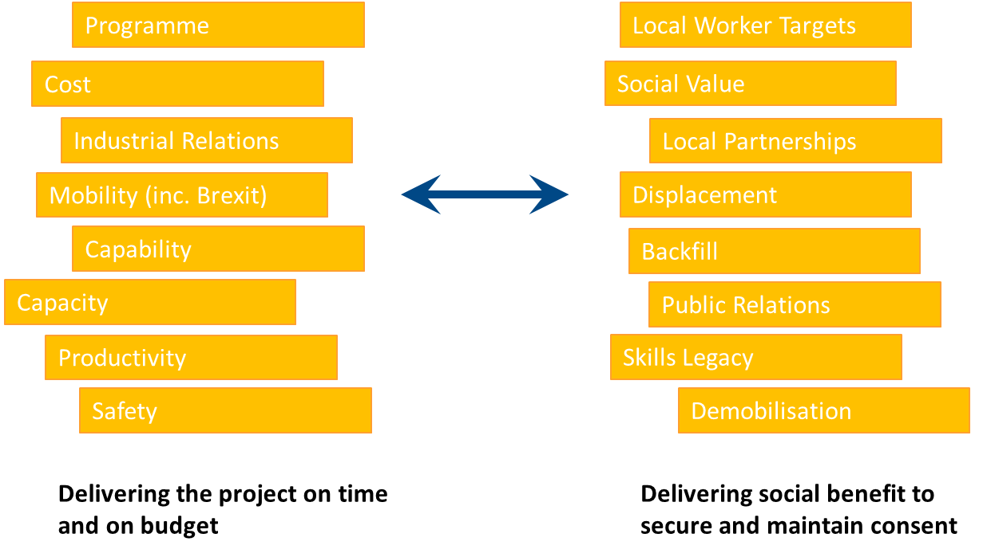
Balancing Risk and Maximising Social Value/ Covid Recovery

Slide 10
Four Strategic Pillars for workforce and skills and benefits derived
Creating Economic Benefit - Addressing key national, regional and local priorities and leaving a sustainable legacy
Minimising Workforce Risk – Right skills, right place, right time
Being a ‘Force for Good’ in the Region – Using DCO commitments to leverage further investment
Integrating HPC, SZC and BRB Activity – Maximise efficiencies to drive productivity

Slide 12
Thank you

