Slide 1



SELEP Board
Steve Grimshaw, Strategic Programme Manager
Kent County Council

Slide 2
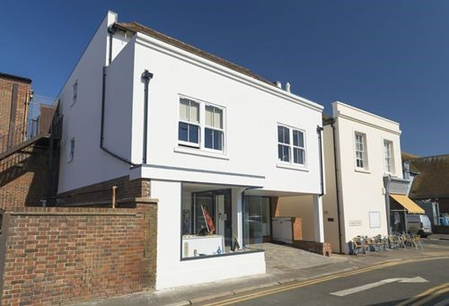
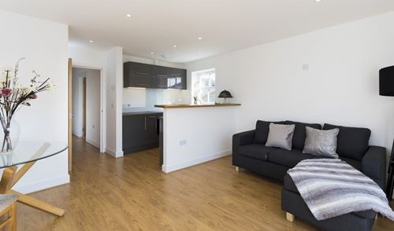
Commercial
Residential above

Slide 3
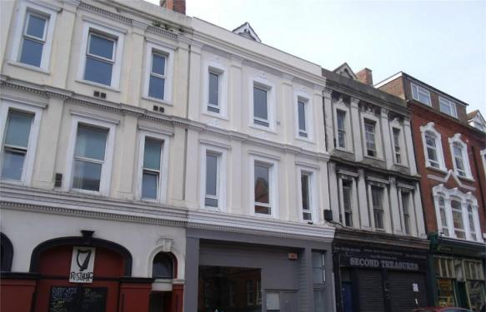
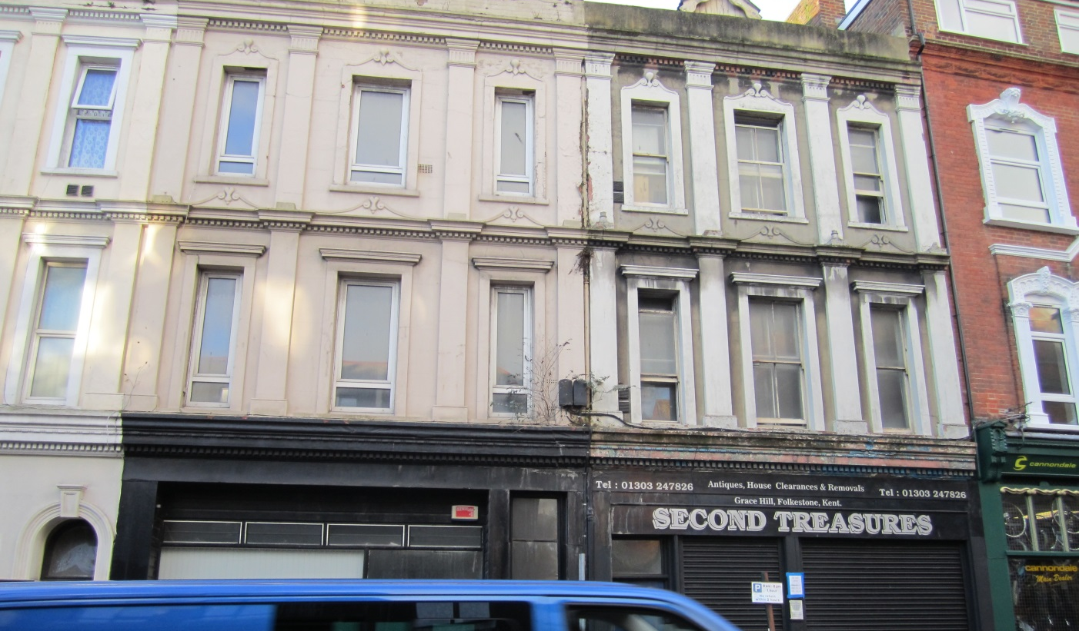
Commercial
Commercial
Residential above

Slide 4
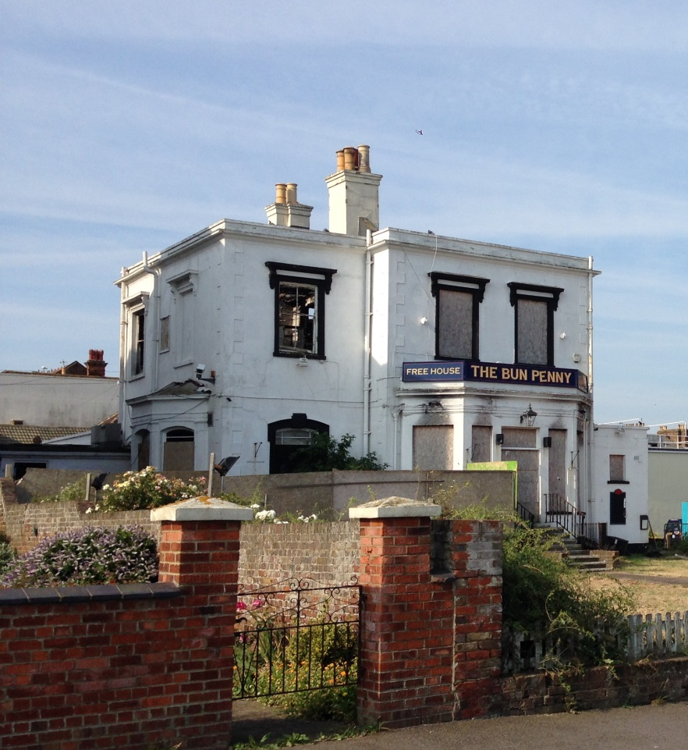
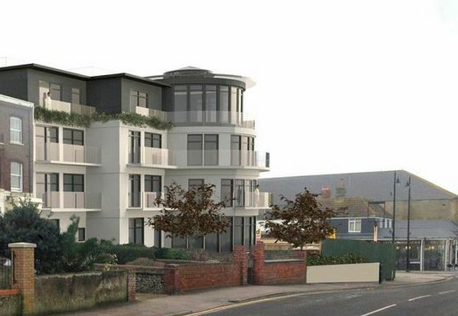
Bun Penny, Herne Bay

Slide 5
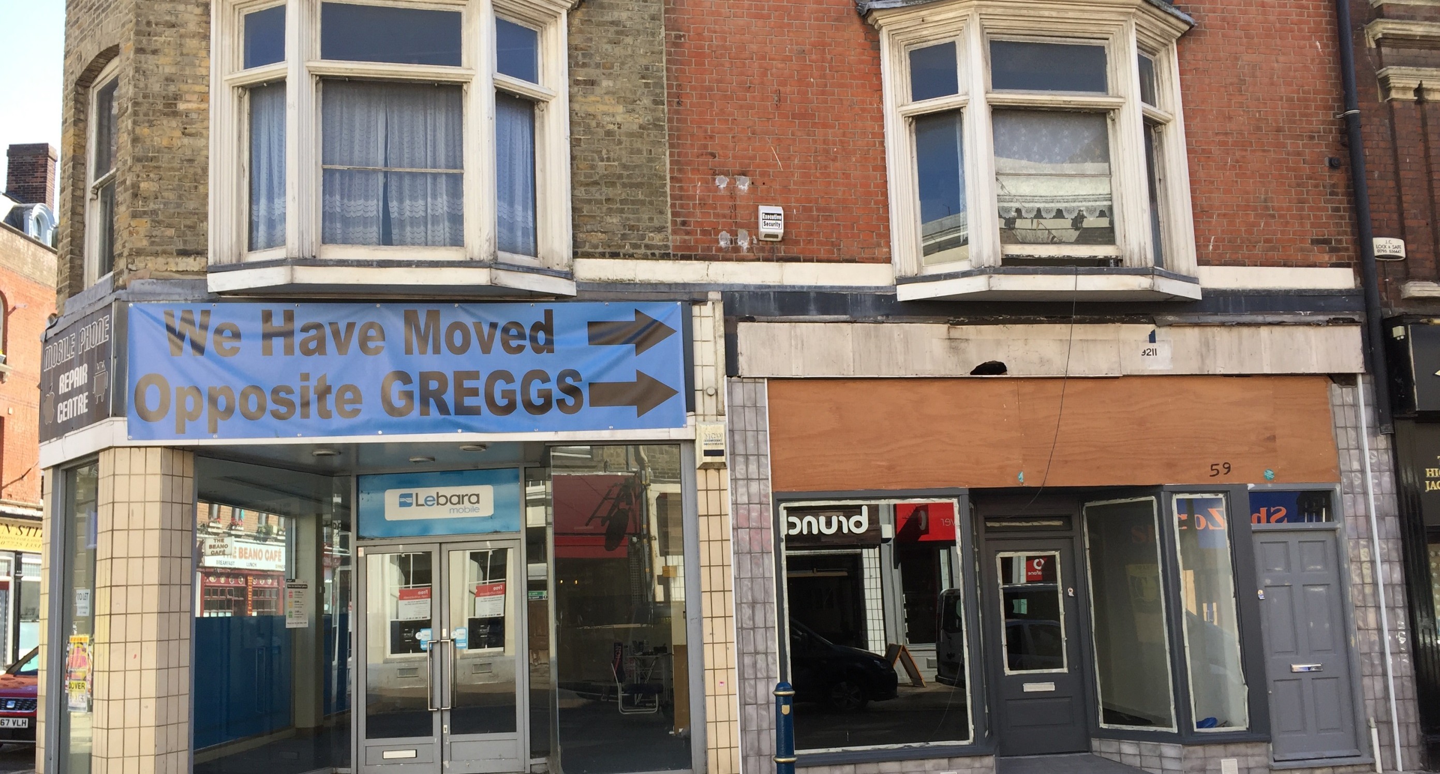
Biggin Street, Dover

Slide 6
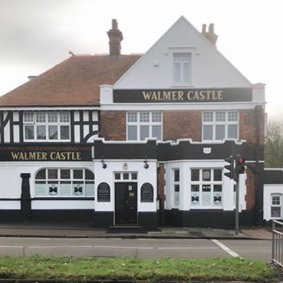
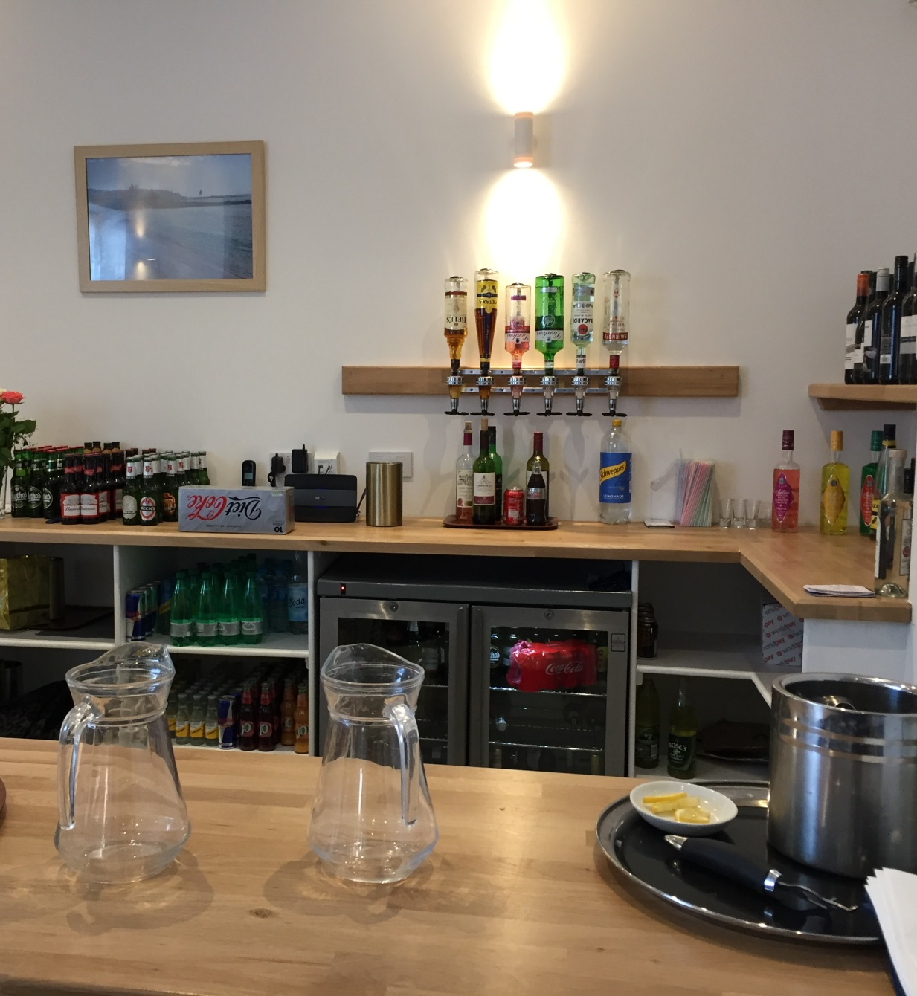
Commercial, Community & Residential, Margate

Slide 7
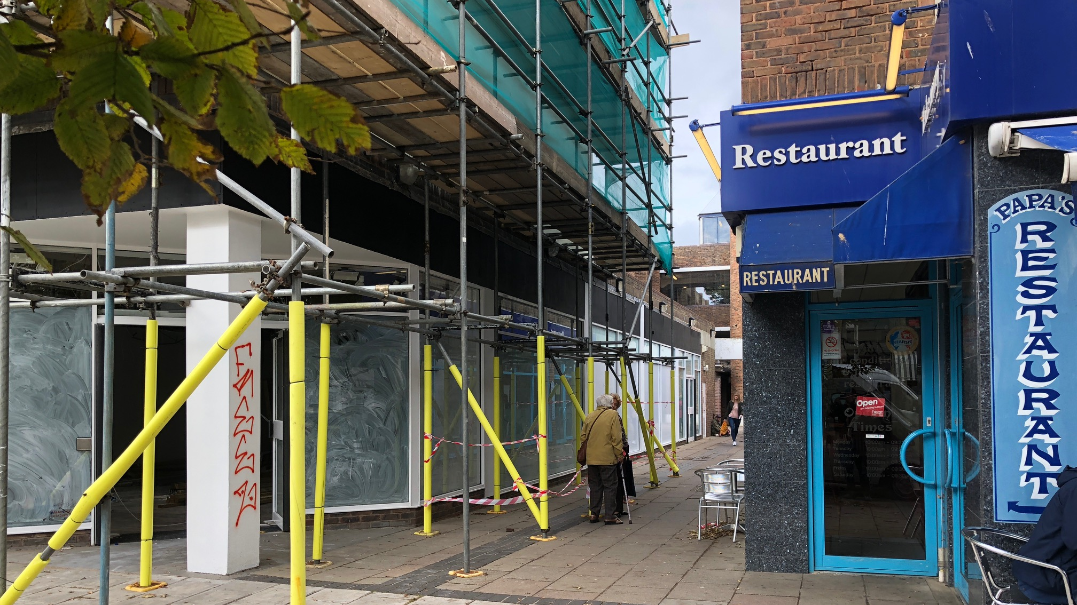
Sandgate Road, Folkestone

Slide 8
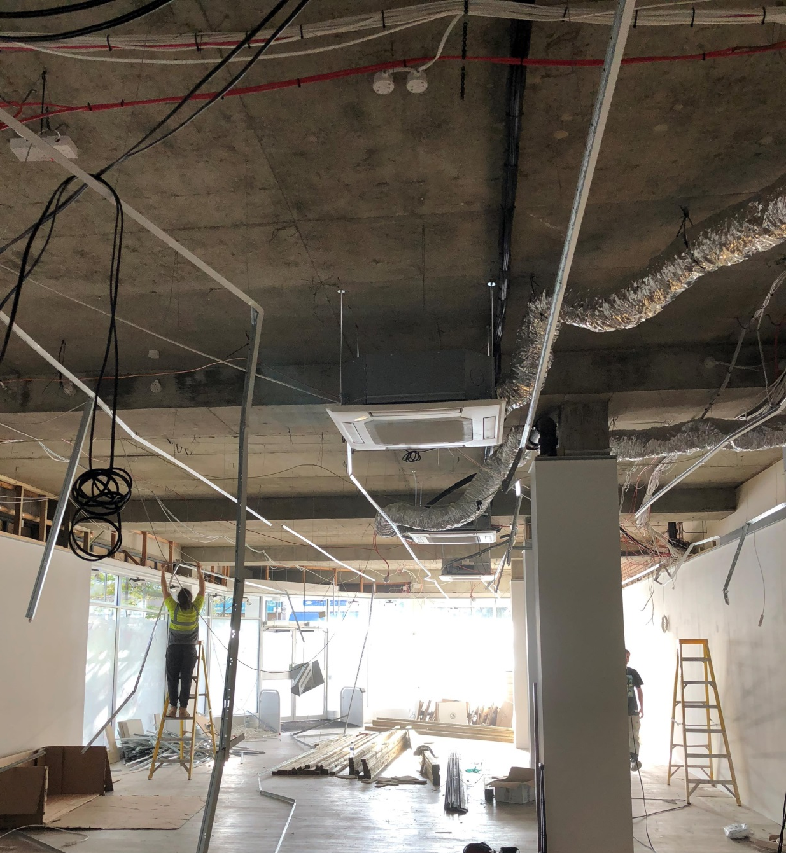
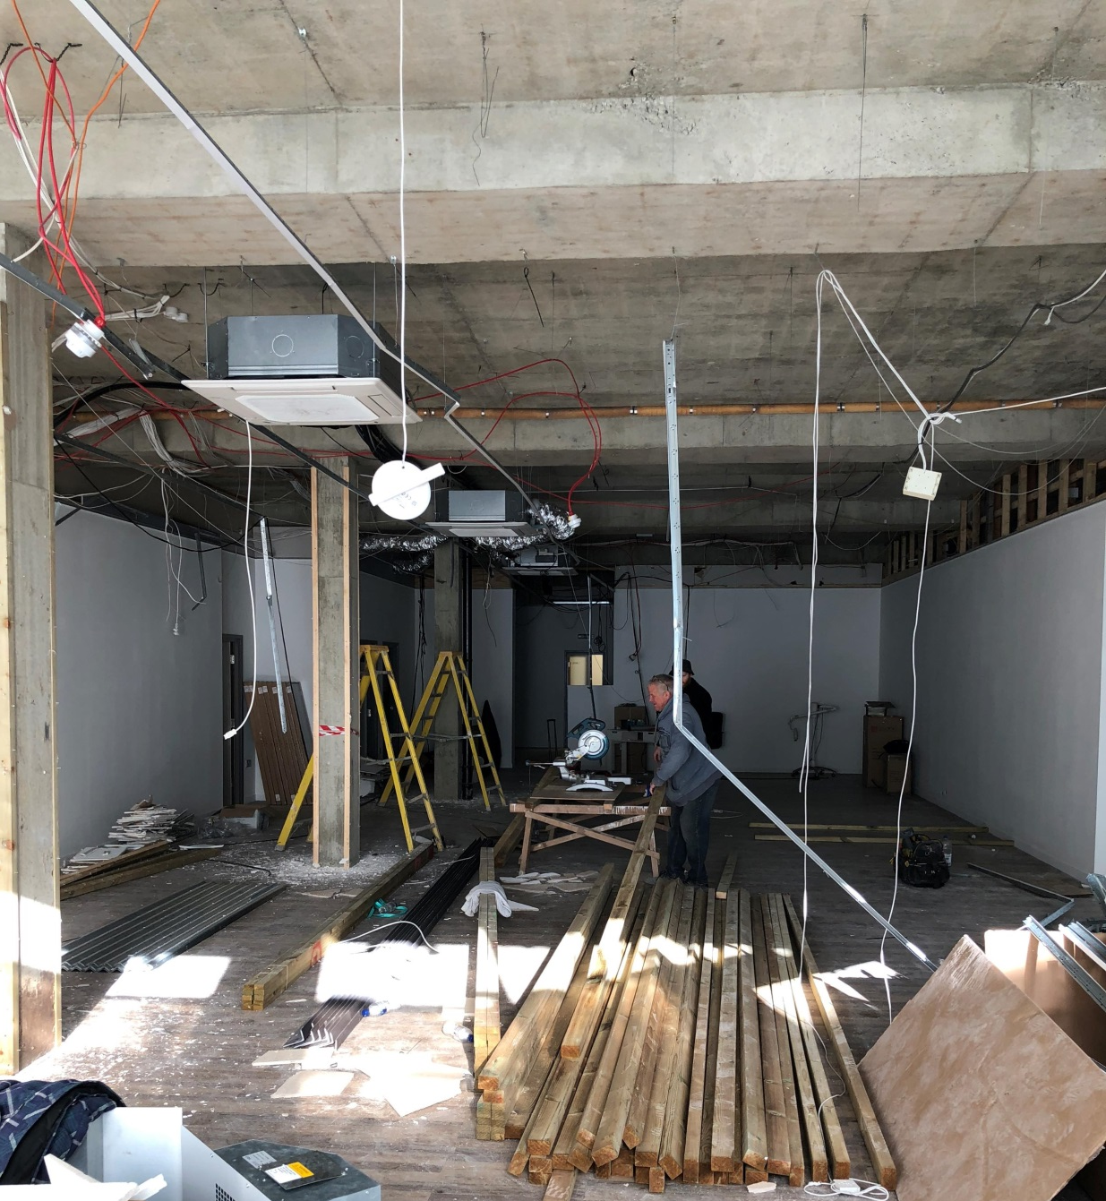

Slide 9
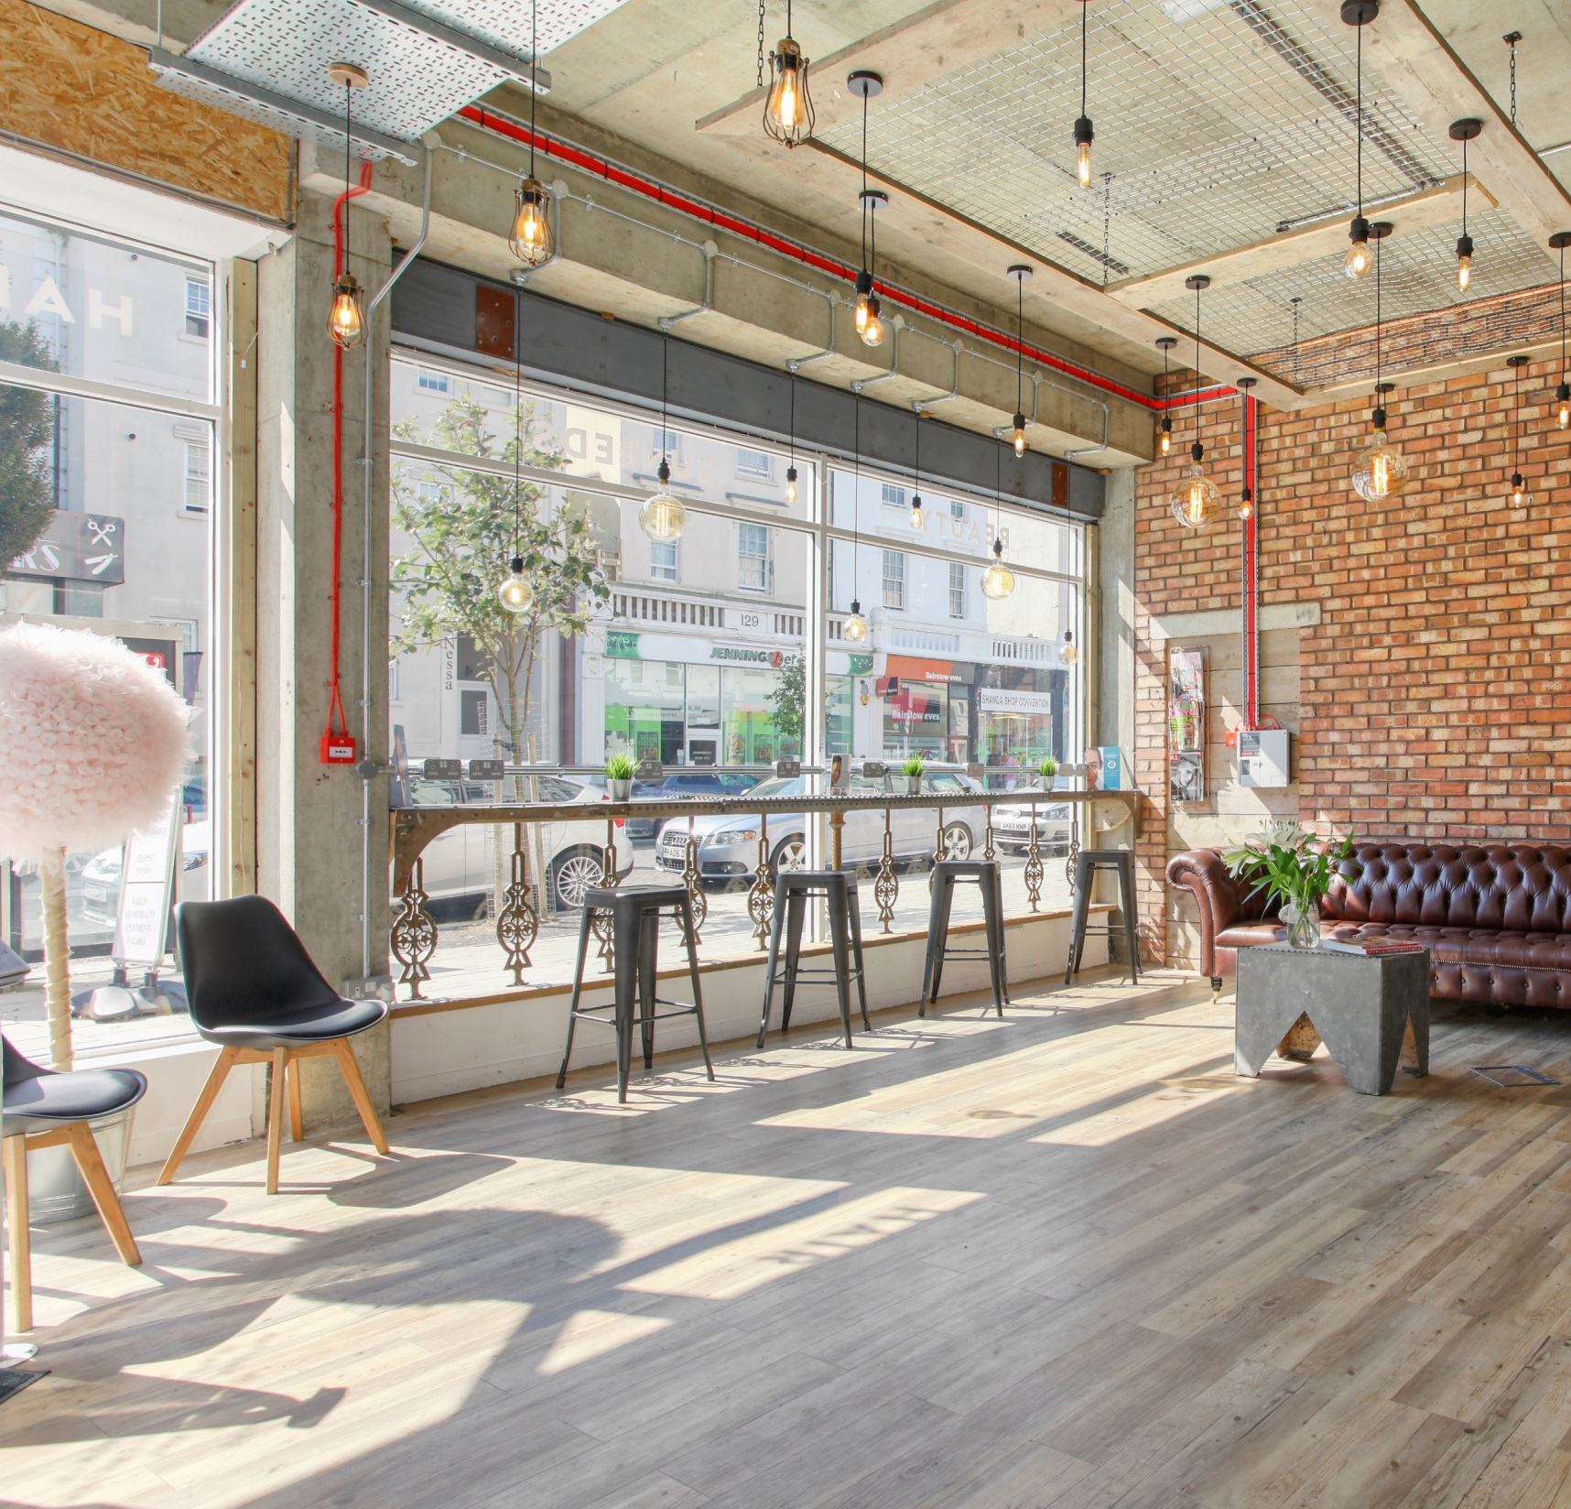
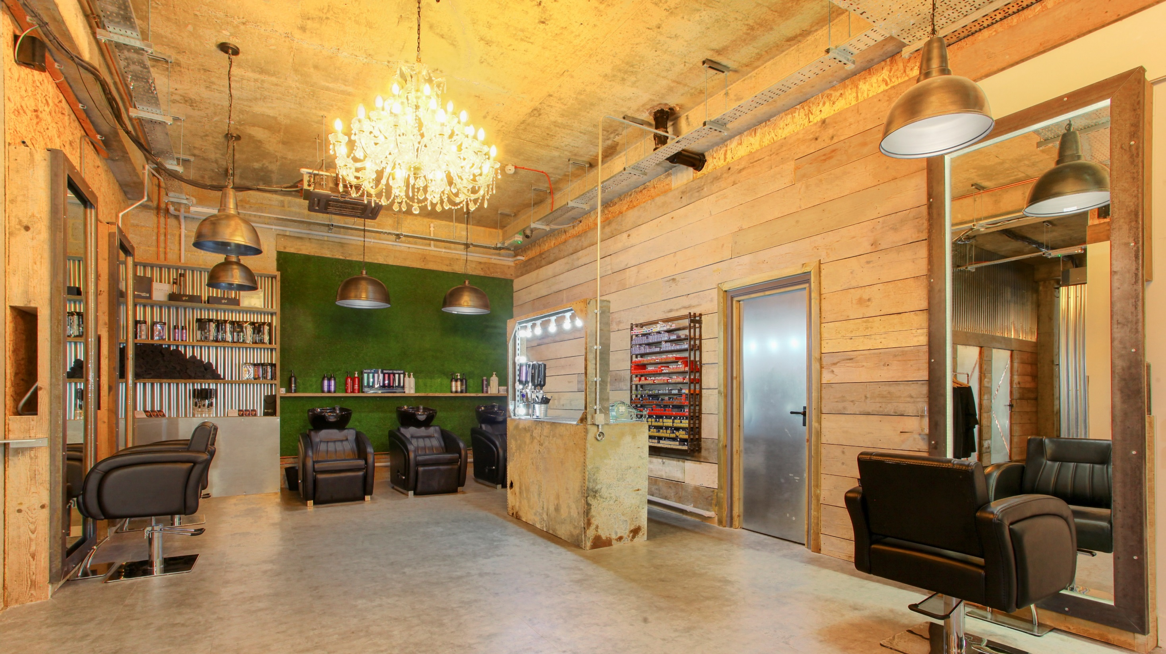

Slide 10
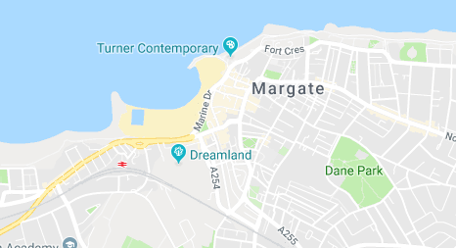

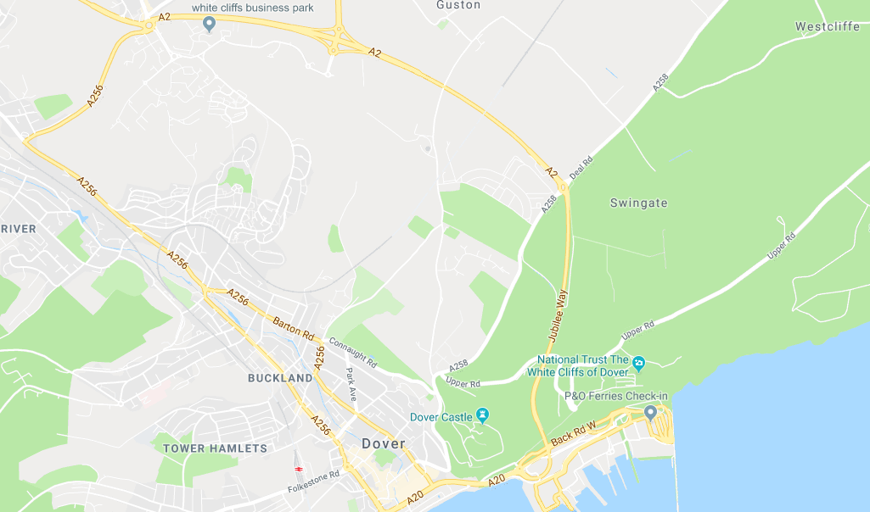
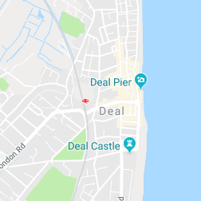
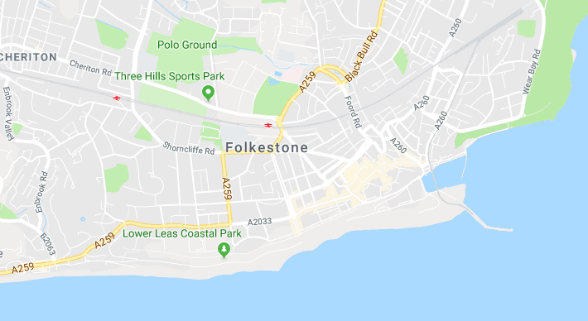
TARGET: To return back into use a total of 8 COMMERCIAL UNITS and create 28 RESIDENTIAL HOMES – GPF Awarded £1M
Commercial Units | Residential Homes | Total | GPF £ | LEVERAGE £ | TOTAL £
2 | 1 | Deal | 85,000 | 40,000 | 125,000
8 | 13 | Dover | 470,000 | 1,026,000 | 1,496,000
4 | 13 | Folkestone | 405,000 | 1,165,000 | 1,570,000
2 | 5 | Margate | 40,000 | 311,867 | 351,867
16 | 31 | Investment | 1,000,000 | 2,542,867 | 3,542,867
Margate
Dover
Completions to date:
4 Commercial Units
12 Residential Homes
Works In Progress:
12 Commercial Units
19 Residential Homes
Folkestone

