Slide 1
Assurance Framework and Board Recruitment Policy
Suzanne Bennett
Chief Operating Officer

Slide 2
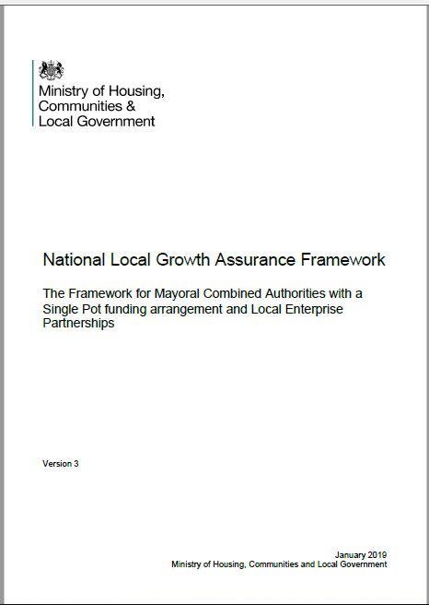
National Assurance Framework
MHCLG publish National Assurance Framework
LEPs and MCAs: Local Assurance Frameworks
NOT a legal document
Different levels of requirements: some very clear requirements on value for money for example
Some requirements are to set out what has been agreed locally – e.g. prioritisation, but with some assurances around transparency

Slide 3
Local Assurance Frameworks
Assurance Framework ‘seeks to provide a framework of common understanding of the assurance required for local growth funding’
Covers ALL LEP activities
Minimum set in NAF but can exceed
Pulls together other governance documents
Reference document for many stakeholders
SELEP document – can be changed
Policies contained therein – protect us all
Must have LAF and must comply with NAF
S151 Assessment and letter by end of February

Slide 4
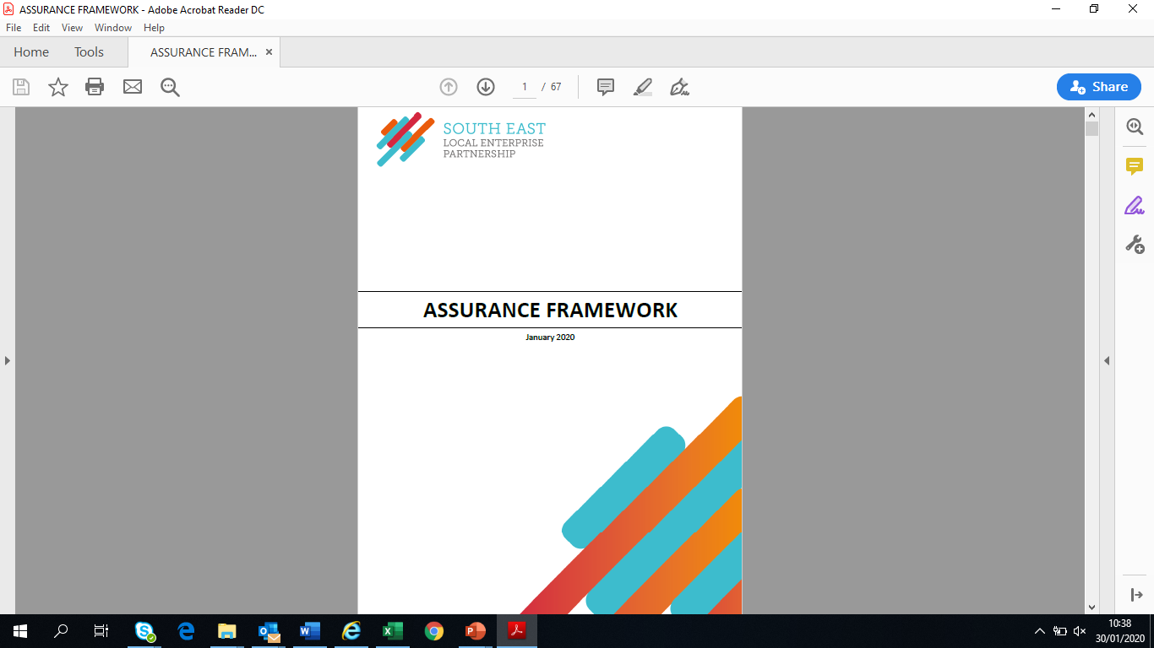
SELEP LAF 2020/21
No changes to NAF to be reflected
Structure/format updated to assist in navigation – added index
Guide to Governance added
Updated to reflect changes to structure for SELEP Ltd
Updated Board composition
Will comply with NAF
NO changes to prioritisation/Investment Panel as agreed by Board
Be adopted on registration of SELEP Ltd

Slide 5
What you need to know…
Who we are: how we are structured, roles of different Boards, Panels, Secretariat, Accountable Body, working groups, recruitment policies
How we work: Principles of Public Life, our policies on behaviours and registers of interest
How we make decisions: who can decide what and when?
How we manage our programmes: ensuring value for money, prioritisation, programme management

Slide 6
Board Recruitment Policy
Consolidates three former policies:
  Board recruitment policy
  Chair recruitment policy
  Deputy Chair recruitment policy
Put processes into the correct document – e.g. removed substitutions to ToR document
More detail on Succession Planning, better timeline and forward planning on Senior members of Board
Will need to develop further to encompass any changes re diversity

Slide 7
Terms of Reference
For information only – needed as LAF refers out to it
Updated to reflect new Board composition and Articles of Association
Duplications removed – eg working groups
Comments to be included and final draft to new Board in March

