Slide 1
Local Growth Fund (LGF) spend beyond 31 March 2021
Rhiannon Mort
Capital Programme Manager
31 January 2020
SELEP Strategic Board

Slide 2
Informal Advice from Government Officers
The expectation of Government is that LEP’s will deliver on outcomes they have specified in their published Growth Deal documents.
MHCLG has informally advised that they would potentially have concerns about planned LGF spend beyond the Growth Deal, where the project is not already underway. However, if SELEP has strong justification for why SELEP is supporting this project then there is nothing in the conditions of the grant to prohibit this”.

Slide 3
Five conditions agreed by Accountability Board
A clear delivery plan with specific delivery milestones and completion date to be agreed by the Accountability Board; and
A direct link to the delivery of jobs, houses or improved skills levels within the SELEP area; and
All funding sources identified to enable the delivery of the project. Written commitments will be sought from the respective project delivery partner to confirm that the funding sources are in place beyond the Growth deal; and
Endorsement from the SELEP Strategic Board that funding should be retained against the project beyond the 31st March 2021; and
Contractual commitments being in place with the construction contractors by 31 March 2021 for the delivery of the project.

Slide 4
Projects with LGF spend forecast beyond 31 March 2021
A127 Fairglen Interchange Junction Improvements and New Link Road, Essex
Thanet Parkway, Kent
A28 Sturry Link Road, Kent
Exceat Bridge, East Sussex
Innovation Park, Medway

Slide 5
Impact
Pros
Supports the realisation of the benefits of existing LGF projects that have previously been identified as a funding priority. There is limited time available to bring forward alternative projects, which will can demonstrate scale of impact.
Cons
The hold of LGF allocations against specific projects for spend in future years will prevent the delivery of alternative projects, including those identified on the LGF3b pipeline The consequences of slipping LGF spend beyond the Growth Deal period on future funding allocations from Central Government is not entirely clear If SELEP stills holds a substantial amount of LGF underspend, this will likely impact SELEP’s reputation and weaken the case for further funding investment in the area If it is agreed that several LGF projects can spend beyond 31 March 2021, this may reduce the pressure on local partners to delivery projects to the agreed timescales.

Slide 6
A127 Fairglen Interchange Junction Improvements and New Link Road, Essex
Benefits
Improve capacity and help support planned growth. Up to 9,569 new homes.
In addition it will be a catalyst for the South Essex Strategic Housing market assessment which identifies the need for a total of 12,800 new homes.
Completion
Expected to complete in April 2022
Spend beyond 31 March 2021
The forecast suggests that £3.862m LGF will be spent in 2021/22
Total Project LGF Allocation
£21.235m LGF has been allocated

Slide 7
Thanet Parkway, Kent
Benefits
Accelerates the pace of housing delivery in Thanet, 1,600 to 3,200 new Homes
Additional 400 to 800 new jobs
Increasing rail trips, in excess of 50,000 new rail journeys
Completion
Expected to complete between December 2022.
Spend beyond 31 March 2021
The forecast suggests that £4.725m will be spent in 2020/21
Total Project LGF Allocation
£14m LGF has been allocated

Slide 8
A28 Sturry Link Road, Kent
Benefits
Tackles existing congestion
Additional jobs 1,700 and delivery of 4,220 new homes
Completion
Expected to complete by December 2022
Spend beyond 31 March 2021
The forecast suggests that £760,000 will be spent beyond the Growth Period
Total Project LGF Allocation
£5.9m LGF has been awarded

Slide 9
Exceat Bridge, East Sussex
Benefits
Ease congestion
Support Local Plan proposing 6,900 homes
Completion
Expected to commence on site March 2021
Spend beyond 31 March 2021
The forecast suggests that £1.5m will be spent beyond the Growth Period. This will increase by £610,579, if the Tranche 2 LGF allocation becomes available through LGF3b pipeline.
Total Project LGF Allocation
£1.5m is currently allocated and a further £610,579 Tranche 2 funding is identified in the pipeline for the projects, if sufficient funding becomes available.

Slide 10
Innovation Park Medway Phase 2
Benefits
Expected to create 3,000 high value jobs
Completion
Expected to complete in April 2021, subject to approval of the Local Development Order (LDO)
Spend beyond 31 March 2021
The forecast suggests that £350,000 will be spent beyond the Growth Period, but could rise subject if LDO approval is delayed
Total Project LGF Allocation
£3.7m has been allocated for Phase 2
A further £1.519m LGF was prioritised by the Investment Panel for Phase 3, but recommendations will be made to the Accountability Board for the reallocation of this funding

Slide 11
Risk of additional LGF slippage beyond 31 March 2021 being identified
East Sussex
Bexhill Enterprise Park North
Hailsham/Polegate/Eastbourne Movement and Access Package
Hastings and Bexhill Movement and Access Package
Eastbourne Town Centre Phase 2
Essex
Basildon Innovation Warehouse
University of Essex Parkside 3
Kent
Maidstone Integrated Transport Package
Thurrock
Stanford Le Hope
Grays South
A13 Widening

Slide 12
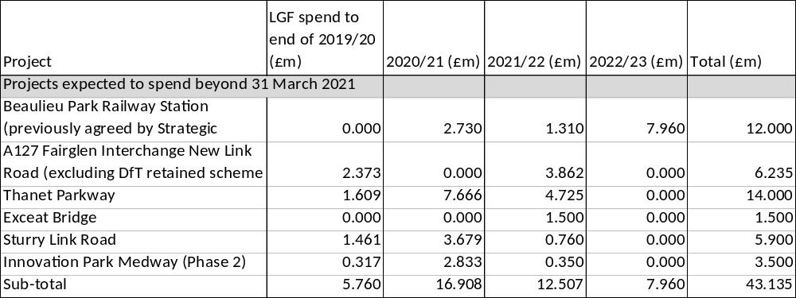
LGF spend beyond Growth Deal period

Slide 13
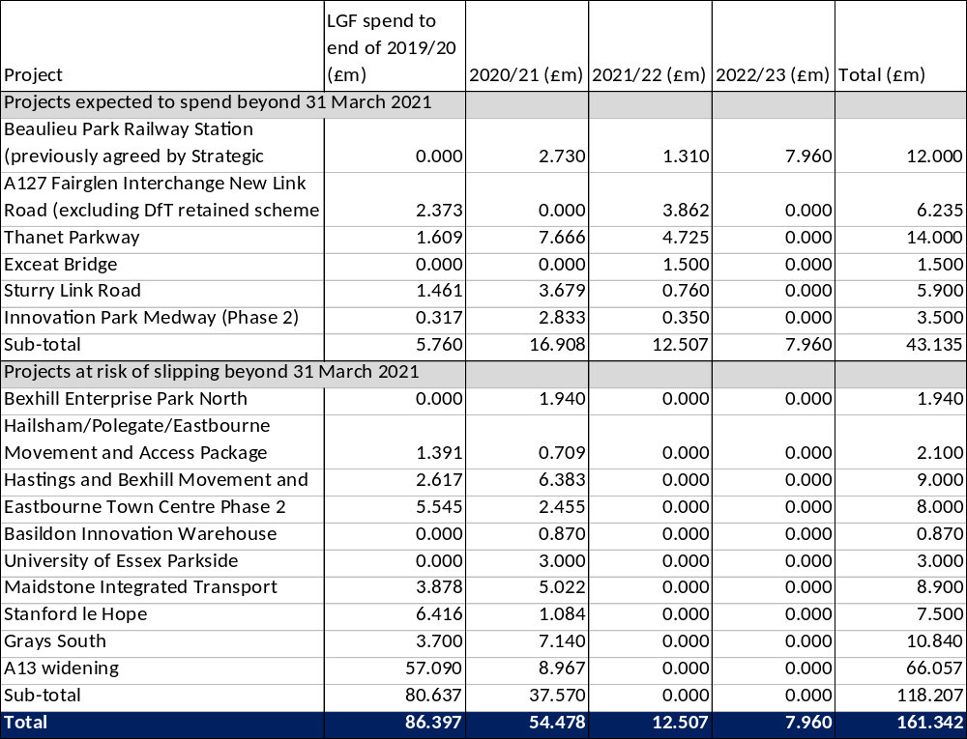
Risk of LGF spend beyond Growth Deal

