Slide 1
South East Local Industrial Strategy Rural Working Group Presenter: Helen Russell / Sharon Spicer Date: 8th October 2019

Slide 2
2.4% R&D target
Grand Challenges
Five Foundations
Technical Education & Training
Ageing society
Housing Deals & TCF*
Artificial intelligence & data
Invest-ment Funds
Clean Growth
Stronger Towns & FHSF^
Future of mobility

Slide 3
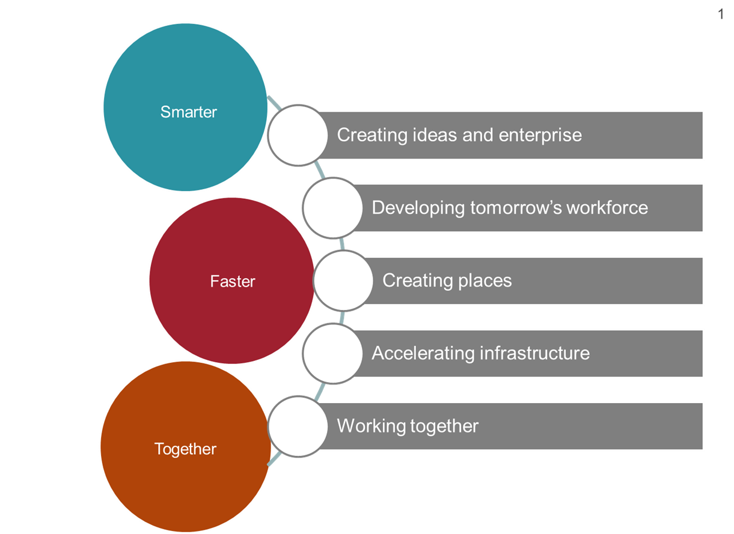
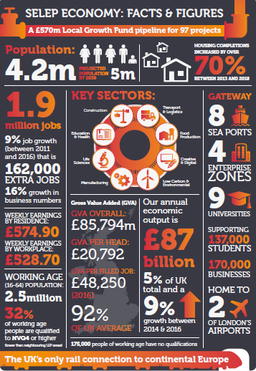
Working towards a local industrial strategy
Vision and Priorities
Strategic Opportunities & Challenges
South East
Local Industrial Strategy
South East
Local Industrial Strategy
Grand Challenges
Foundations of Productivity

Slide 4
Timelines
Stage 1: Evidence base creation & review
Draft Evidence Base Report
Stage 2:
Developing Propositions/ Intervention
Draft Local Industrial Strategy
Finalise Evidence Base
Stage 3:
Government co-design
LIS Finalisation & Publication
July – September October - November December – March 2020
We are currently here!

Slide 5
Initial observations
Strengths
Weaknesses
Home to growing sectors – Creative, Life Sciences, Maritime and Low Carbon
Has a strong culture of Enterprise
Internationally important transport network, more so after Brexit
Strong track record of attracting Inward Investment
A broad range of economic assets
Assets are clustered around London fringe, less so wider SELEP area
GVA data reveals that SELEP has a productivity challenge to overcome
Poor Economic Performance of the Coast
Significant pressure on the transport network
Opportunities
Threats
The creation of a stronger innovation culture
60% of the UK’s Garden Communities programme are located in SELEP
Transport Gateways will play a different role post Brexit
Greater Coastal and Rural contribution to economic growth
A powerhouse of research – 9 Higher Education facilities
Fast paced population growth
Persistent and acute areas of deprivation
Business base is overwhelmingly made of SMEs
Dispersed nature of the geography mean assets are dispersed and competing
Housing affordability and challenges to deliver housing growth

Slide 6
Economy and Productivity Overview
Productivity Issue | Potential opportunity / intervention
Low GVA indicators across the board, linked to SELEP’s sectoral profile – suggests that SELEP’s workforce and economic activity is less productive and efficient than elsewhere | Evidence points to particular growth opportunities within creative/digital, marine/maritime, life sciences and low carbon technology – how to maximise these growth opportunities and enable local clusters/employers/sectors to thrive How can SELEP better position itself to respond to macro trends such as digitalisation, the continuing need to reduce carbon consumption and maximise resource efficiency, and ageing demographics?
Significant geographical variation in productivity performance across SELEP | How to spread strong GVA/productivity performance across more of the SELEP area (geographically and sectorally) Presence of particular sector concentrations and clusters across SELEP reflect inherent economic assets, strengths and locational advantages - bespoke strategies are therefore required to support productivity growth across different sectors

Slide 7
Ideas
Productivity Issue | Potential opportunity / intervention
Low levels of R&D intensity and R&D spending amongst SELEP’s business base | How can more firms be encouraged to engage and invest as part of growing a stronger innovation culture? How to engage science and technology sectors in R&D activity?
R&D expenditure by HE sector amongst the lowest in the country | How can we support HE institutions to increase R&D expenditure, including to respond to the Grand Challenges? Scope to invest in the wider innovation ecosystem, centred around the U9 and their existing networks
SELEP’s share of innovation funding lower than its share of population and business stock | How can collaboration between SELEP’s HE and business base be improved to better respond to opportunities and draw down more funding? Opportunities for creating large scale collaborative R&D programmes in SELEP e.g. in agri-food, transport & logistics, life science & med-tech, construction and low carbon

Slide 8
People
Productivity Issue | Potential opportunity / intervention
Relatively low proportion of working-age population and an ageing society across many parts of SELEP | How can SELEP’s coastal communities in particular attract broader demographic mix and more economically active population? Enabling skilled young workers to locate within SELEP is critical to its future competitiveness as a business location How can we harness the power of innovation to meet the needs of SELEP’s ageing society?
SELEP’s population lacks many of the higher level skills that will be crucial to drive productivity growth in the future Significant spatial variation in higher level skills across SELEP area | How can we better promote HE/FE opportunities to encourage upskilling amongst local population? Targeting coastal communities in particular where skills levels are generally lowest
Pockets of persistent socio-economic deprivation, constraining the ability of some residents to contribute to the economy/labour market | Addressing these long term challenges offers potential to deliver significant net gains for SELEP, by increasing labour market participation and reducing welfare dependency

Slide 9
Business Environment
Productivity Issue | Potential opportunity / intervention
Levels of business base growth and start-up rates are trailing behind the national average | How can SELEP encourage and support business start-ups?
SELEP’s business base underperforms when it comes to scaling up, constraining the ability of highly productive firms to grow and maximise their economic output | How can existing SELEP firms be supported to overcome barriers and obstacles to scale-up and growth? This might be linked to other opportunities around skills development/upskilling, accessing innovation funding and quality business space
Low business representation is most productive sector groups (e.g. ICT, finance and insurance), and some of the more productive sectors are less productive in SELEP than they are nationally | How can SELEP attract/target high productivity sectors to locate and grow here? How can SELEP’s unique assets and USPs be exploited as part of this offer? Maximising the potential of SELEP’s innovation clusters (e.g. science parks, EZs) to support and facilitate commercial spin-offs/business start-ups linked to high tech, high value sector activity – recognising that inward investment interventions are unlikely to deliver sufficient a step change in isolation

Slide 10
Infrastructure
Productivity Issue | Potential opportunity / intervention
SELEP’s transport infrastructure (in particular road and rail) suffers from congestion despite receiving major investment Ensuring the continued resilience of SELEP’s transport networks is a local and national challenge, with a number of strategic infrastructure priorities identified | The international gateway role played by SELEP underlines the case for future investment in the area’s infrastructure networks, particularly post-Brexit How can SELEP’s unique infrastructure assets be harnessed/maximised to boost local and national productivity? A number of major long-term infrastructure priorities are well articulated (e.g. Lower Thames Crossing, road corridor improvements, GEML, Crossrail to Ebbsfleet, HS1 to East Sussex), but what is the relative role of each in driving productivity improvements?
Identified risks from flooding and coastal erosion across many coastal parts of SELEP as the climate continues to change | Opportunities for local research institutions to respond to climate change challenges through pioneering innovative resource management solutions Targeting productivity improvements through resource efficiency, spearheaded by SELEP’s existing strengths in nuclear and offshore wind energy Explore the potential for climate change resilience to act as a driver for clean growth and emerging sector opportunities

Slide 11
Place
Productivity Issue | Potential opportunity / intervention
Dispersed nature of SELEP’s geography, economic areas and assets, posing challenges to achieving critical mass of economic activity, agglomeration and collaboration between different organisations | No single centre dominates – this can provide opportunities for local economic distinctiveness ad for different centres within SELEP to develop their own unique economic identity Opportunities exist to maximise growth potential and collaboration within existing business clusters/hubs (e.g. EZs, science parks and other business parks)
Housing provision – key challenges relating to housing supply, both in terms of quantity and relative affordability | Significant opportunities to accelerate housing (and wider mixed use) delivery through new settlements and urban extensions How can these new settlements contribute to business-led productivity growth through provision of high quality business space/accommodation, and also act as test beds for new technologies and growth sectors?
Evidence points to particular challenges to growth and prosperity in coastal and rural areas, which represent a significant proportion of the SELEP area | How can SELEP’s rural and coastal economies more effectively harness natural capital, heritage and cultural assets? Particular opportunities around creative industries, marine and maritime, agri-food and low carbon technology Technological change and ‘quality of life’ offer have the potential to create new opportunities e.g. ability to work remotely opens up new employment choices in coastal and rural parts of the SELEP area

Slide 12
Routes to Engagement: LEP Events
Workshop | Date
Internal Stakeholder – Regular meetings | Monthly
Partner – Various planned events | Throughout
Developing Future Skills (via Skills Advisory Panel) | 10th October
Foundations of Productivity | 14th October
Building new communities | 5th November
Modelling future connectivity | 5th November
Accelerating business productivity and growth | 7th November
Maximising natural assets | 7th November
Internal stakeholder – focused on contributions into the process and progress of the LIS development via established LEP/Federated structures.
Thematic events - aimed primarily at business, academia and other partners to focus on developing qualitative evidence and specific interventions around the strategic opportunities and Grand Challenges.
Partner events – planning local sessions with LAs, businesses, education, and business intermediaries, to consider the evidence and interventions that are emerging and input to the development.
A wider ‘summit’ may also take place to engage with businesses and others on the LIS overall.
All feedback will be integrated into the evidence base
Notes:
Questions for natural assets workshop?
What are the biggest growth opportunities in our coastal and rural areas?
The area has many natural assets – our coastline, our rural landscape etc. but how do we best maximise these assets to better advantage? What challenges exist such as connectivity (physical and digital)?
What are the opportunities unique to a coastline of such scale? How can this support clean growth and community resilience e.g. water stress and flooding risks
How can we boost our visitor economy through our natural assets and beyond? What role can the creative and cultural sector play/TEPC?
How can these assets be utilised for growth and innovation of the agri-food and agri-tech sector, for a more self-sustaining economy?
How do we protect our natural assets and improve productivity at the same time?

Slide 13
Grand Challenges
AI & Data
Clean Growth
We will put the UK at the forefront of the AI and data revolution
We will make the UK a global centre for artificial intelligence and data-driven innovation
We will help people develop the skills needed for jobs of the future
We will support sectors to boost their productivity through artificial intelligence and data analytic technologies
We will lead the world in safe and ethical use of data and artificial intelligence giving confidence and clarity to citizens and business
We will maximise the advantages for UK industry from the global shift to clean growth
We will develop smart systems for cheap and clean energy across power, heating and transport
We will transform construction techniques to dramatically improve efficiency
We will make our energy-intensive industries competitive in the clean economy
We will put the UK at the forefront of the global move to high-efficiency agriculture
We will make the UK the global standard-setter for finance that supports clean growth

Slide 14
Grand Challenges
Future of Mobility
Ageing Society
We will become a world leader in shaping the future of mobility
We will establish a flexible regulatory framework to encourage new modes of transport and new business models
We will seize the opportunities and address the challenges of moving from hydrocarbon to zero emission vehicles
We will prepare for a future of new mobility services, increased autonomy, journey-sharing and a blurring of the distinctions between private and public transport
We will explore ways to use data to accelerate development of new mobility services and enable the more effective operation of our transport system
We will harness the power of innovation to help meet the needs of an ageing society
We will support new products and services for the growing global population of older people, meeting important social needs and realising the business opportunity for the UK
We will support sectors to adapt to a changing and ageing workforce
We will leverage our health data to improve health outcomes and UK leadership in life sciences
We will support care providers to adapt their business models to changing demands, encouraging new models of care to develop and flourish

Slide 15
Questions for discussion
What are the unique opportunities for SELEP linked to our rural economies?
What infrastructure improvements are needed to support future economic growth and productivity in rural areas?
What support is needed to help businesses innovation and growth?
How do you think SELEP could contribute to the grand challenges?

