Slide 1

South East Local Industrial Strategy
Presenter:
Date:
Notes:
This slide deck is designed to support any event or meeting that presents the opportunity to share knowledge and seek input to help shape and develop the South East Local Industrial Strategy
The person delivering the presentation can pick and choose the relevant slides dependent on the aim of the event/meeting and its audience AND/OR adapting this to align with any local economic strategy work taking place. Please note though, it is important that the audience understands that they are discussing and contributing to the development of the South East LIS document, directly.

Slide 2
Aims of the Session
Introduce the Government’s Industrial Strategy
Introduce the purpose of the Local Industrial Strategy and what it is (and isn’t)
Outline the approach to developing the South East Local Industrial Strategy
Outline some economic characteristics and performance of the South East
Propose potential strategic challenges and opportunities for discussion
Help develop the interventions needed to take those opportunities forward
Notes:
This slide sets out the structure of this slide deck and the discussion it is designed to support
The aim of today’s session is to:
Introduce what the LIS is and the work we are doing on it, led by the LEP but working with businesses, colleges, universities and local councils.
To discuss the major economic and business opportunities that are ahead
And to get your views on the actions that are needed to make sure that our business and communities can benefit

Slide 3




2.4% R&D target
Grand Challenges
Five Foundations
Technical Education & Training
Ageing society
Housing Deals & TCF*
Artificial intelligence & data
Invest-ment Funds
Clean Growth
SPF, Stronger Towns & FHSF^
Future of mobility
Notes:
This slide sets out the main aims and elements of the Government’s National Industrial Strategy
It looks at productivity through 5 Foundations, which are well established drivers of the national and local economy:
Ideas – innovation
People – Skills and earnings, the labour market
Infrastructure - including digital
Business Environment – business support and finance
Places – building sustainable, resilient and buoyant communities
It also sets out 4 challenges which the UK and global economy faces, with a mission for the UK economy and firms to adapt and play a leading role in each:
AI and Data
Ageing Society
Clean Growth
Future of Mobility
The Government asked each place, led by LEPs, to prepare a local industrial strategy by March 2020. The primary purpose of the local industrial strategy is to set out how future growth and productivity gains can be achieved in ways that benefit the whole population and, crucially, to start to make the case for future growth funding, once the current round of UK and EU growth funding is complete.
It asks that these strategies are approved with Government and are specific about the distinctive contribution and strengths that each place can offer.
Really importantly, the industrial strategy is not just a public sector strategy. Taking the opportunities and meeting the challenges ahead, say on labour or automation, is going to mean businesses in many sectors are going to have to change, adapt and invest. This strategy has to show how they can be helped to do so.
*Transforming Cities Fund
^ Strengthening Places Fund and Future High Street Fund (SELEP has 7 of latter)

Slide 4
A Local Industrial Strategy…
Is… | Is not…
A future looking local (LEP) strategy, feeding into the Government’s Industrial Strategy, to drive productivity and growth and tackle national/global challenges | An economic plan for the SELEP, including lists of potential projects, as the 2014 Strategic Economic Plan was
An evidence-led strategy highlighting specific strengths and opportunities that can be capitalised on, and that if supported and invested in, could achieve greater productivity impact | Replacing other local economic policy or plans but to better co-ordinate and align them at a LEP level for greater gains, including across-LEP boundaries
A document that will support and underpin the allocation of future Government growth funding | A bidding document. The process for bidding for future growth funding will be announced in due course
A mechanism through which private, public and civic partners come together to agree the productivity generating long term ambitions for the area | A public sector strategy for growth
The five policy principles of Local Industrial Strategies
Evidence
Set out a robust and open evidence base
Focus
Map out specific opportunities and challenges
Collaboration
Make clear how LEPs will work in partnership
with public and private stakeholders
Prioritisation
Prioritise specific, achievable & long-term
ambitions
Evaluation
Set out clear plans to evaluate progress
Notes:
This slide to provide some clarity on what the Local Industrial Strategy is and, as importantly, what it is not.
As said, these strategies are primarily for local areas (defined as LEP area) to show how they can contribute to the opportunities, challenges and ambitions set out in the national Industrial Strategy.
The Local Industrial Strategies are to provide a strategic direction of travel, highlighting strengths, priorities and interventions that will have the greatest impact on productivity. It is not intended to replace other local economic plans but to focus on improving co-ordination of local economic policy and highlighting specific strengths and opportunities that can be capitalized on, and that if supported and invested in, could achieve real productivity impact.
It is not yet clear what funding for growth and infrastructure is going to look like post March 2020. But our industrial strategy is not a bidding document in its own right but an important opportunity to show Government the future potential of the South East economy and why it makes sense for private and public investment to come here.
Government is clear that strategies should be evidence led, they should stimulate collaboration across boundaries, they must be focused and clearly state priorities and any propositions, and although a full implementation plan must follow, the strategy should also indicate how any interventions will be evaluated.

Slide 5
Our local industrial strategy will…
Be a vehicle through which we can drive productivity and business growth
Focus on areas where we have competitive advantage and strategic opportunities. It will not cover everything!
Be business-led and owned by all partners
Place the South East in prime position to secure investment from the
private sector and government and to influence policy
Notes:
To deliver a ‘best in class’ Local Industrial Strategy that meets the needs of SE, including making the case for future investment, our local industrial strategy will:
Define our key actions to drive productivity and business growth
Focus on activity where we have competitive advantage and clear strategic opportunities. Don’t try to cover everything or start again.
Achieve Government recognition of our distinctive strengths and contribution, based on robust evidence
Be business-led and owned by all partners
Place the South East in prime position to secure Government funding and influence policy, through the UK Shared Prosperity funds and a range of other public and private sector funding pots

Slide 6
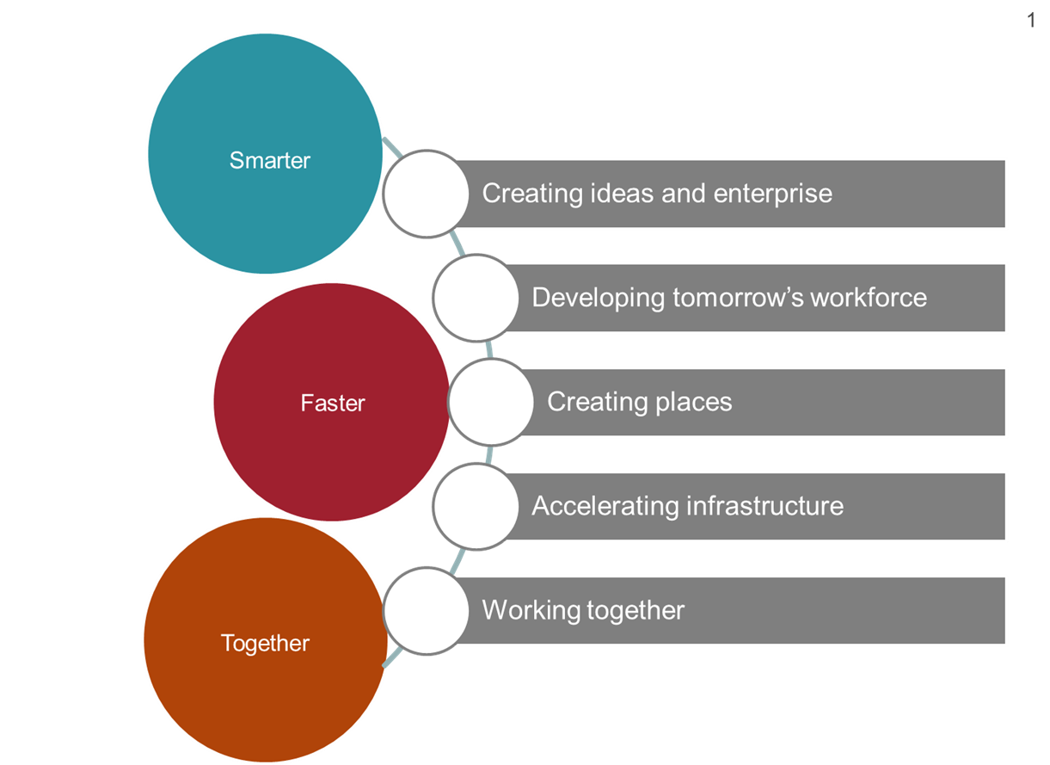
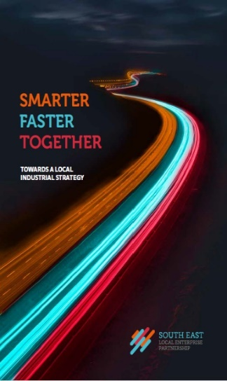
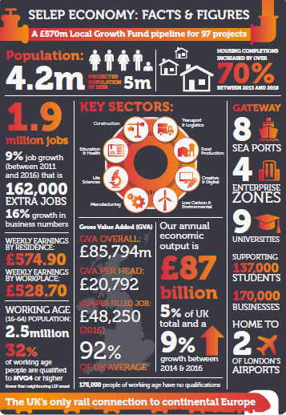
Working towards a local industrial strategy
Vision and Priorities
Local place and sector productivity and growth strategies
Strategic Opportunities & Challenges
South East
Local Industrial Strategy
South East
Local Industrial Strategy
Grand Challenges
Foundations of Productivity
Notes:
This slide shows how we want to use the local industrial strategy to focus down on those strategic opportunities which offer the greatest scope for our communities, people and firms to benefit, whilst driving overall productivity and future growth.
The Local Industrial Strategy is the next stage in the evolution and implementation of the Smarter, Faster, Together economic statement, published late 2018. It will build on the Statement by setting out in more detail the interventions we will collectively undertake to improve productivity and drive growth.
The slide shows how we are intending to build on the vision, priorities and opportunities identified in the Economic Statement, together with the Grand Challenges and Productivity approach set out in the National Industrial Strategy.
We will also ensure that where national sector deals have identified particular opportunities for SE e.g. Tourism zone that we build on these in our local industrial strategy.
The aim is to then to focus our local industrial strategy on those strategic opportunities where we have greatest distinctive strengths.

Slide 7
Timelines
Stage 1:
Evidence base creation & review
Draft Evidence Base Report
Stage 2:
Developing Propositions/
Intervention
Draft Local Industrial Strategy
Finalise Evidence Base
Stage 3:
Government co-design
LIS Finalisation & Publication
July – September September - November December – March 2020
We are currently here!
Notes:
This slide shows the LIS development timeline
There are three core stages to the development of the LIS –
Stage 1 – evidence base creation, review and enhancement
Stage 2 – wide consultation to develop key propositions and interventions, drafting of the strategy itself and finalizing the evidence base to reflect the findings from the consultation
Stage 3 – co-design/negotiations with Government in order to reach consensus on a jointly owned document
We are currently towards the end of stage 1 (as of August 2019)

Slide 8
EVIDENCE BASE FINDINGS SO FAR
Economic & Productivity Overview
SELEP performs relatively poorly across a variety of economic output and productivity measures
But generates more GVA than any other LEP outside London
Marked variations in GVA output at a local level:
  Most coastal areas generate lower levels of economic output
  Higher levels of economic output are recorded in areas closer to London, or where there are larger urban centres
SELEP’s economy provides 1.6m jobs, but recent job growth has lagged behind national average
Particular concentrations of jobs in health, retail and education
Growth opportunities within creative and digital industries, marine and maritime, life sciences, and low carbon technology

Slide 9
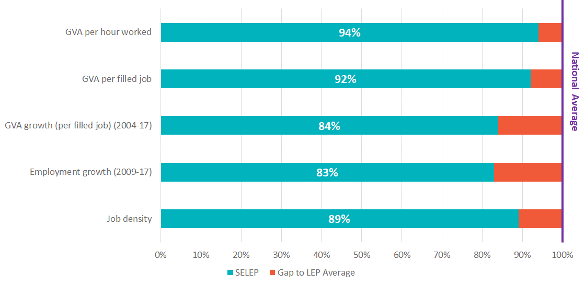

Economic & Productivity Scorecard
Economy and productivity ‘scorecard’

Slide 10
Ideas
Mixed performance across ideas and innovation themes:
  R&D intensity and business expenditure on R&D lags behind national levels
  Better performance in terms of number of firms engaged in product or process innovation. Significant concentrations of employment within science and technology sectors that offer strong opportunities for productivity growth
  Strong higher education base, but R&D expenditure by higher education sector is amongst lowest in the country and graduate start-ups are relatively weak
  SELEP’s share of innovation funding is substantially lower than it’s share of population or business stock
Number of key innovation assets of national/international significance, many aligning with SELEP’s key sector strengths
Collectively, all sectors in SELEP area need to do more to become more innovative, create a stronger local innovation culture and commercialise its world leading science base to drive growth across the UK

Slide 11
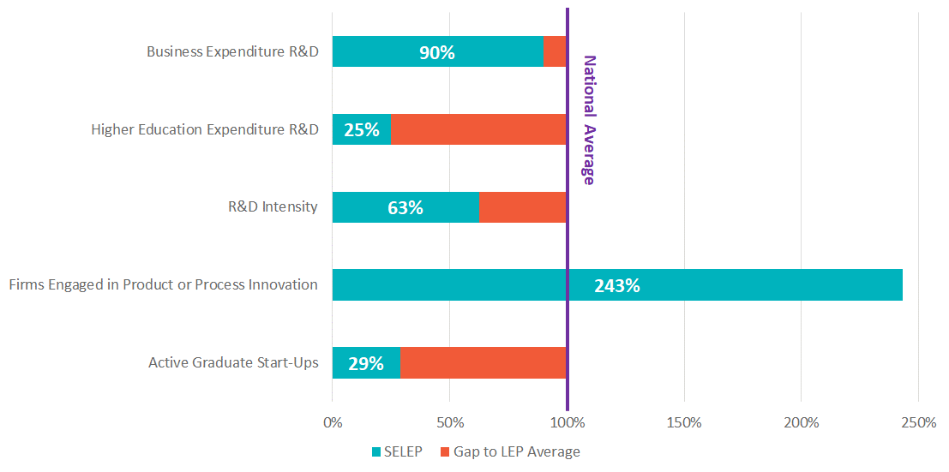
Ideas Scorecard
Ideas ‘scorecard’
Source: Various

Slide 12
People
Strong population growth in recent years, but SELEP’s proportion of working-age population falls behind the national average
Going forward, population growth expected to exceed England-wide projections, with locations on the fringe of Greater London projected to see fastest growth
Relatively high levels of employment and economic activity = proportion of SELEP’s population in employment and contributing towards creation of economic output is high compared with national rate
SELEP productivity is likely to be adversely affected by:
  Current occupational structure (weighted towards lower skilled occupation types)
  Resident skills base (which falls behind national average on higher level skills (NVQ4+))
Levels of socio-economic deprivation are relatively low compared with other LEP areas. However, pockets persist with acute deprivation evident in parts of Isle of Sheppey, Clacton-on-Sea and Thurrock

Slide 13
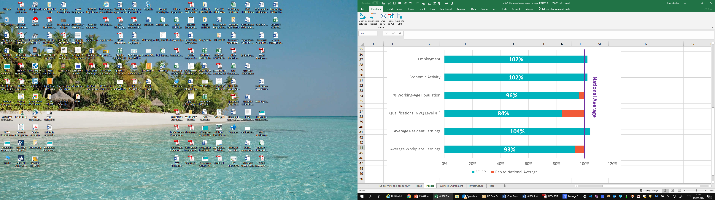
People Scorecard
People ‘scorecard’
Source: Various

Slide 14
Business Environment
SELEP has a sizeable business base and strong levels of business density relative to the national average
Relative underperformance in business base growth in recent years underpinned by slightly lower business start-up rates compared with the national average
Average performance on business scale-up compared with other LEP areas. High representation or growth in scale-ups can help to drive growth in employment and value in local areas
Reflecting national trends, SELEP’s business stock is overwhelmingly made up of small enterprises
SELEP’s business base is relatively under-represented in the most productive sector groups (e.g. ICT, finance and insurance), and some of the more productive sectors are less productive in the SELEP area than they are nationally
The area has historically been successful at attracting and capturing inward investment. Looking ahead, the LEP and its partners will need to re-think their approach to securing investment, with challenges including investor concerns about skills availability and the reliability of infrastructure

Slide 15
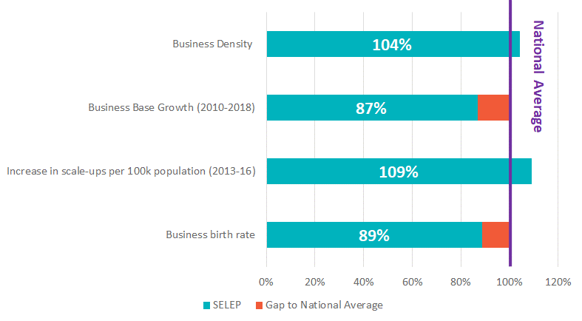
Business Environment Scorecard
Business environment ‘scorecard’
Source: Various

Slide 16

Infrastructure
SELEP is highly significant from a national infrastructure point of view, including two of London’s airports, major ports, the UK’s only rail connection to continental Europe and an extensive strategic road and rail network
The local road network performs relatively well with average speeds on SELEP’s ‘A’ roads exceeding national average. But increased congestion has resulted in reduced average speeds over recent years
South East rail network is the busiest and most congested in the country. It requires further investment to enhance connections, particularly to coastal communities, to address congested commuter routes and to serve population growth in SELEP
Digital connectivity is generally good (or at least equivalent to national provision) across SELEP, with the fastest broadband speeds and highest quality mobile coverage found in and around main towns such as Chelmsford, Medway and Southend-on-Sea
Beyond transport infrastructure, the SELEP area also makes a substantial contribution to UK energy generation, with new nuclear facilities planned at Bradwell and major offshore wind generation capacity in the Thames Estuary, North Sea and English Channel

Slide 17
Place
SELEP has a dispersed geography with no single centre dominating. Much of SELEP is substantially urbanised, with pockets of highly urbanised areas located within South Essex and North Kent
Travel flows are complex, with substantial outflows to London, but more tightly defined travel-to-work areas towards the coast. SELEP contains or overlaps with 16 travel to work areas which extend into wider hinterlands beyond the LEP’s own boundary
Housing affordability and delivery are significant challenges in the SELEP area. The housing ‘affordability ratio’ is above the England average in all but one district
SELEP contains around 21.3m sq.m. of ‘employment floorspace’, the vast majority of which is industrial. Overarching trend of declining industrial floorspace and some growth in office stock over the past 10 years, although changes have played out quite differently across the LEP area
Rural and coastal economies make a significant contribution towards overall economic prosperity and growth at the SELEP level, but coastal economies face a unique range of issues and challenges
Creative industries play an important role in driving SELEP’s visitor and cultural economy and have been representing an increasing share of the area’s business base. Retail and leisure centres (Bluewater Shopping Centre being the highest ranking) can collectively play a key role in supporting growth in economic output by attracting additional visitors and tourism expenditure to the area

Slide 18

Initial observations
Strengths
Weaknesses
Home to growing sectors – Creative, Life Sciences, Maritime and Low Carbon
A powerhouse of research – 9 Higher Education facilities
Has a strong culture of Enterprise
Internationally important transport network, more so after Brexit
Strong track record of attracting Inward Investment
A broad range of economic assets
Assets are clustered around London fringe, less so wider SELEP area
GVA data reveals that SELEP has a productivity challenge to overcome
Poor Economic Performance of the Coast
Significant pressure on the transport network
Opportunities
Threats
The creation of a stronger innovation culture
60% of the UK’s Garden Communities programme are located in SELEP
Transport Gateways will play a different role post Brexit
Greater Coastal and Rural contribution to economic growth
Fast paced population growth
Persistent and acute areas of deprivation
Business base is overwhelmingly made of SMEs
Dispersed nature of the geography mean assets are dispersed and competing
Housing affordability and challenges to deliver housing growth

Slide 19


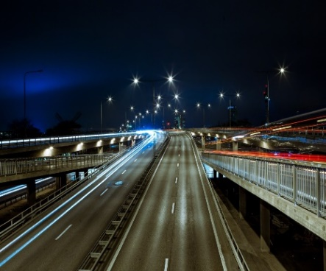
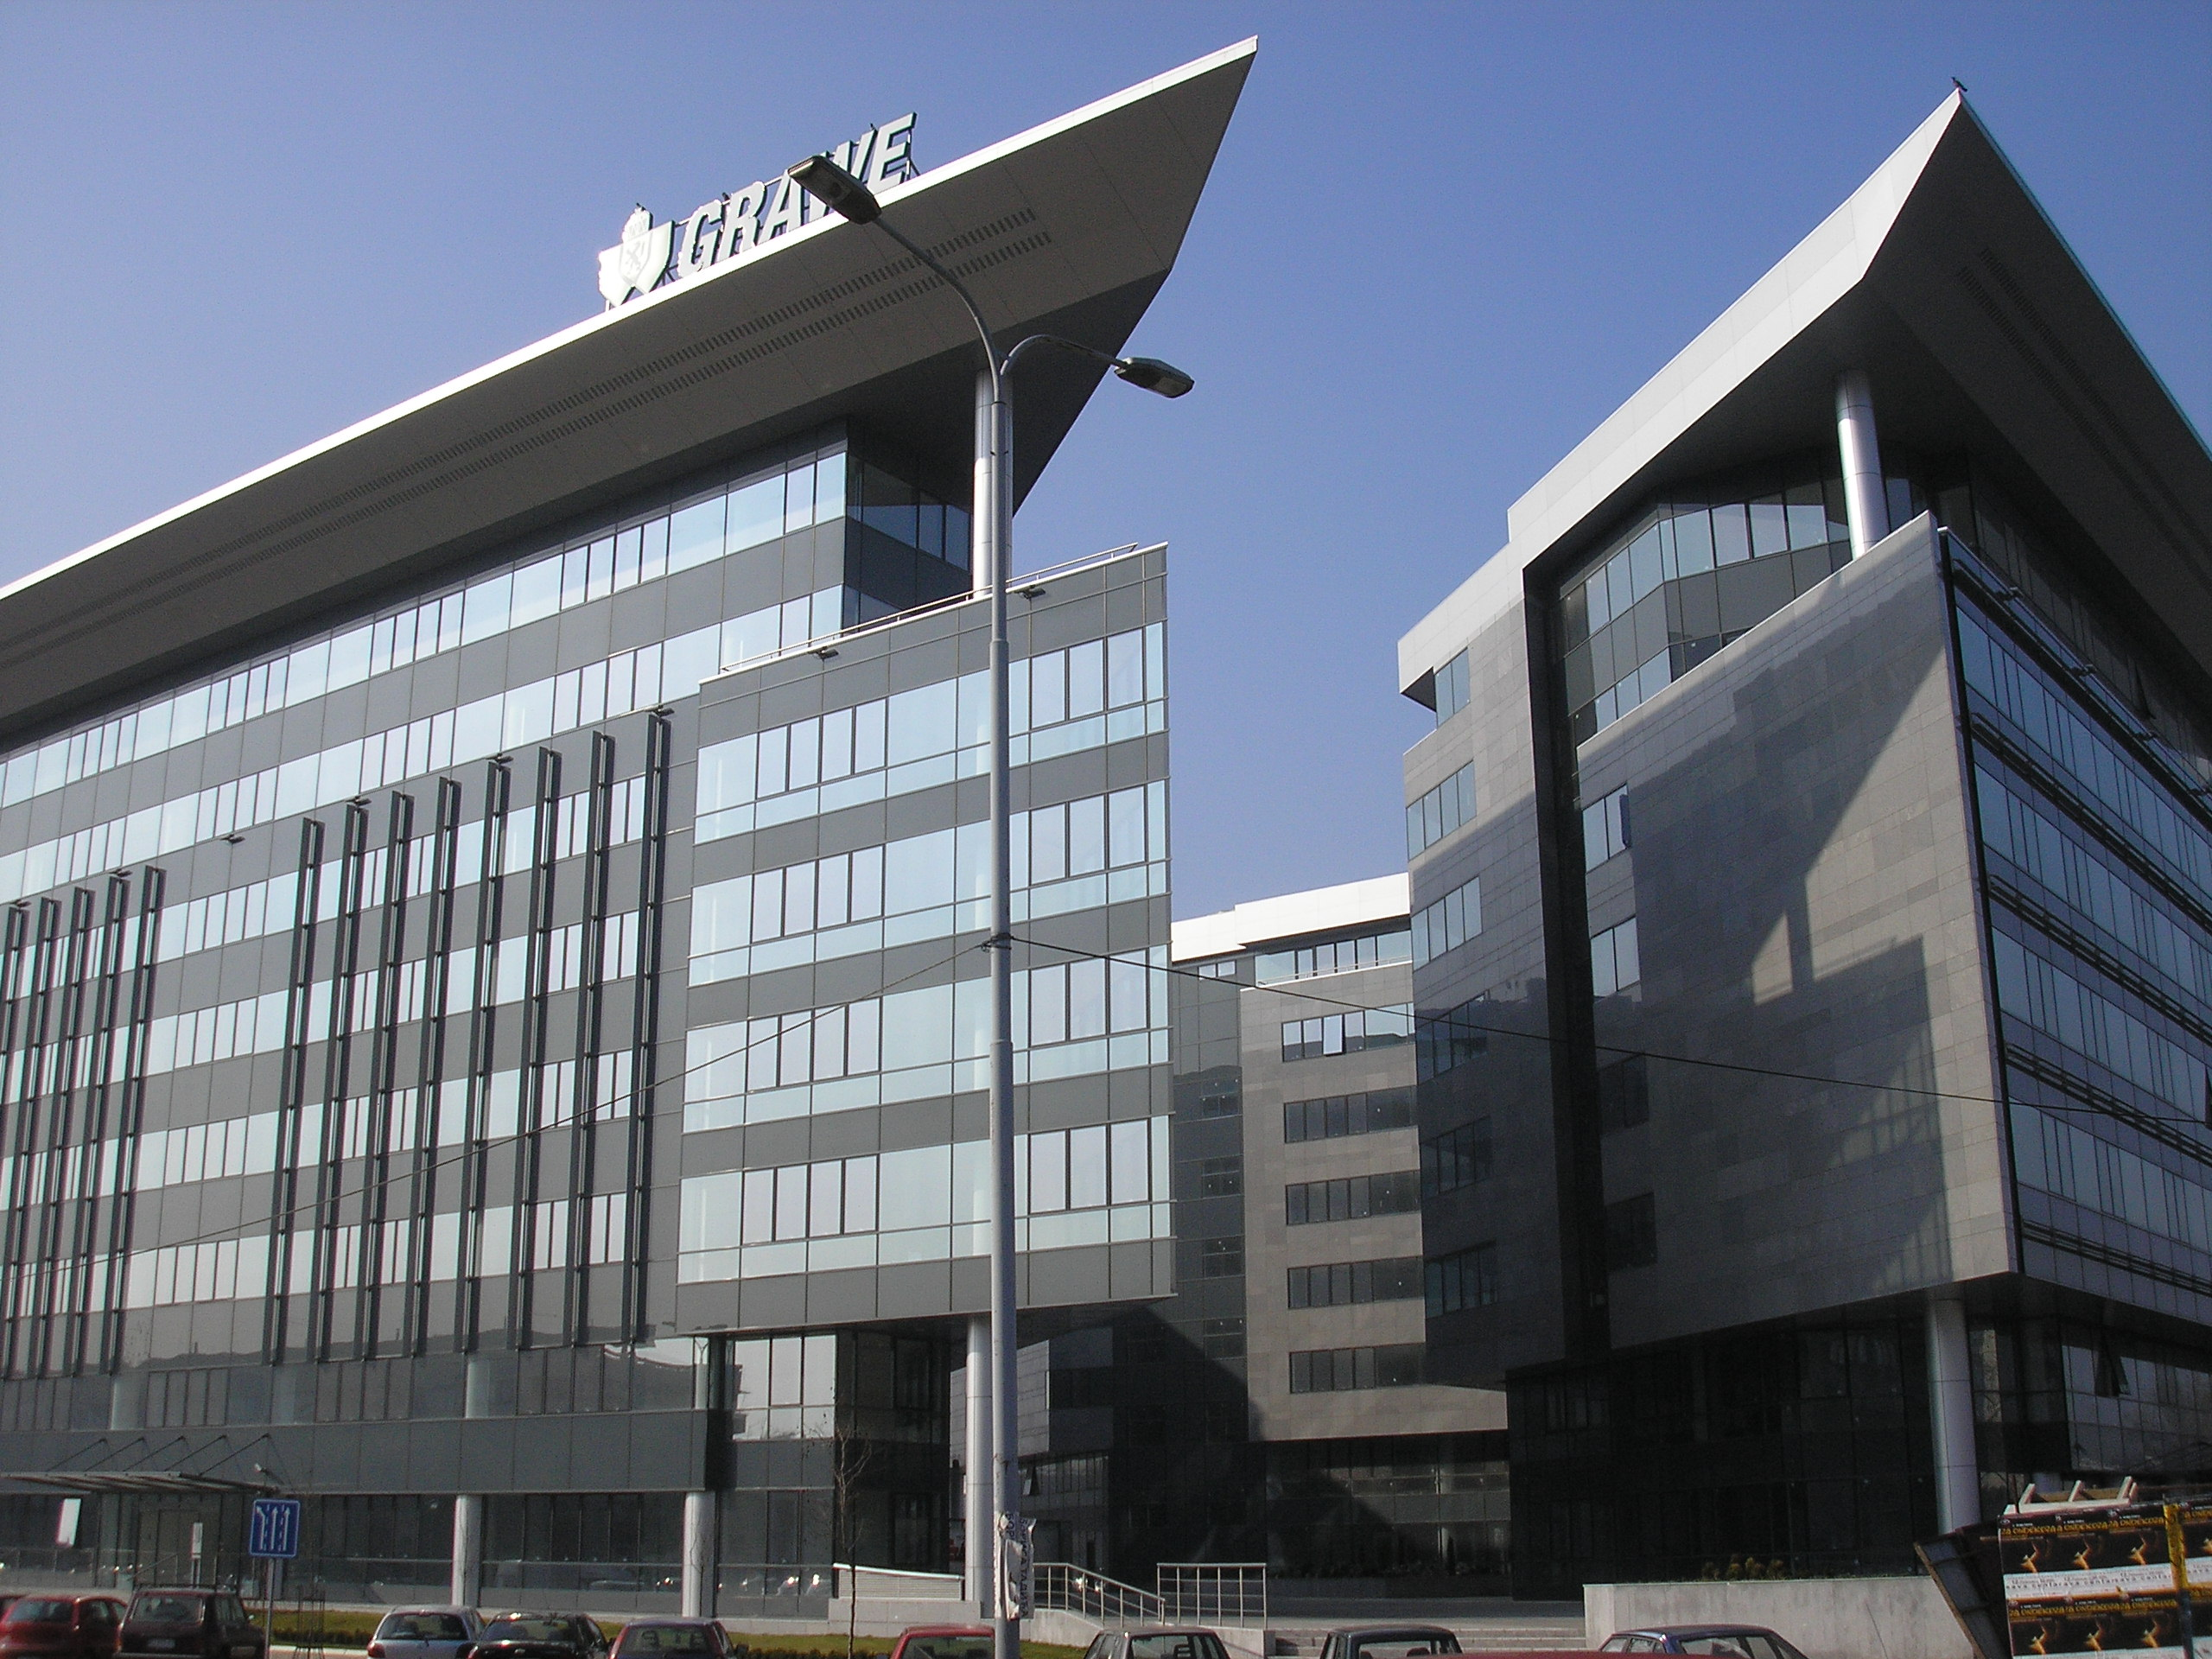
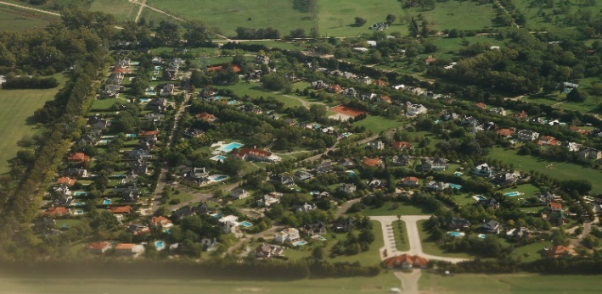
So what are our key productivity opportunities ?
Ideas
Advance the role of EZ
Create an innovation board/ forum
Increase R&D spend – business & HE
Advance digital tech (application of)
Sector/cluster approach e.g. agri-tech & links to London/ Cambridge
People
Develop Leadership & Management Skills in SME’s
Expand digital skills development – sectors/rural/coastal?
Support businesses with training & apprenticeship growth
Infrastructure
LTX
HS1 from East Sussex
Extension of Crossrail to Ebbsfleet Connectivity to Garden Communities
Road and rail access for the major ports & airports
Unlock potential of our ports
Investment in green
Business Env.
Creation of future/grow on workspace – Garden Communities, High St
Collaboration on R&D funding & commercialization of
Boosting high growth start and scale up enterprises – Growth Hubs, Universities
Place
Develop sustainable garden communities, through innovative place making & as a testbed for new design & construction innovation
Creation of a Tourism Zone (creative & cultural)
Boosting the product innovation leaders as key sectors to place making*
Notes:
This slide is starting to set out some of the potential broad opportunities that the South East could take advantage of. (THIS IS NOT SET IN STONE and will be refined throughout the evidence base and consultation processes.)
The points cited here are taken from previous strategy work and discussions so far on the LIS and is designed purely to stimulate discussion in this session.
OPTION FOR INTERACTION: ask the audience to name one point in each of the foundations that they would agree with most strongly, or to add one that they feel is more important to form part of the feedback to the SELEP team.
If possible, bring the Grand Challenges back into the discussion here to gain views on those that the audience feel we are best placed to contribute to and why.
*Product innovation leaders are construction, machinery, transport & med-tech sectors

Slide 20
Routes to Engagement – Local Channels
SELEP Strategic Board
Essex Business Board
Kent & Medway Economic Partnership
Team East Sussex
Housing & Development Group
Opportunity South Essex
South East Creative Enterprise Network
Coastal Communities Group
Rural Communities Group
Social Enterprise Group
Skills Advisory Panel/ Group
Businesses and wider stakeholders can feed into the SELEP LIS through a variety of forums as well as through our feedback template

Slide 21
Routes to Engagement: LEP Events
Workshop | Date
Internal Stakeholder – Regular meetings | Monthly
Partner – Various planned events | Throughout
Thematic – Foundation/ Grand Challenge | Mid-Oct (tbc)
Thematic – Foundation/ Grand Challenge | Mid-Oct (tbc)
Thematic – Foundation/ Grand Challenge | Mid-Oct (tbc)
Thematic – Foundation/ Grand Challenge | Mid-Oct (tbc)
Thematic – Foundation/ Grand Challenge | Mid-Oct (tbc)
Summit | November (tbc)
Internal stakeholder – focused on contributions into the process and progress of the LIS development via established LEP/Federated structures.
Thematic events - aimed primarily at business, academia and other partners to focus on developing qualitative evidence and specific interventions around the strategic opportunities and Grand Challenges.
Partner events – planning local sessions with LAs, businesses, education, and business intermediaries, to consider the evidence and interventions that are emerging and input to the development.
A wider ‘summit’ may also take place to engage with businesses and others on the LIS overall.
All feedback will be integrated into the evidence base
Notes:
This slide just shows the main events that are planned, to generate and test emerging themes and interventions
There is a need to evolve the current evidence base to support the development of interventions and the continued monitoring of the interventions once the LIS is published. Much of the evidence work will be focused on qualitative evidence.
One of the ways we will gather this evidence will be through a range of events and engagement activities – such as this one
The are a range of events:
Internal – core & stakeholder groups and meetings with Leaders and federated board chairs
Thematic Events – A series of events aimed primarily at business and academia which will focus on developing qualitative evidence and specific interventions, within the themes and Grand Challenges. Likely to be invite events.
Partner Events – planned local sessions with LA, businesses, education, and business intermediaries to consider the evidence and interventions that are emerging and provide opportunity for a wider audience to input.
Potential for a wider summit, primarily for businesses on the topics of the LIS

Slide 22
Questions for discussion
Do the productivity challenges and potential opportunities identified, reflect the situation in your area?
What do you perceive to be the main opportunities and challenges ahead for businesses in your area / sector?
What are the main business opportunities and challenges ahead? How could these opportunities, or the removal of barriers, improve productivity and business growth?
What actions could businesses take to adapt and take up those opportunities? How can the public sector help?
Please respond in terms of the what, how, who and when… ☺
Notes:
This slide is to prompt input from the audience for feedback.
To prompt more specific discussion/feedback, more detailed questions could be asked, such as:
What are the main barriers to future economic growth and productivity?
What skills issues are impacting negatively on economic growth and productivity?
What infrastructure improvements are needed to support future economic growth and productivity?
What support is needed to help businesses to grow, innovate, become more productive and access new markets?
What specific economic challenges are faced by the urban and rural areas?
Which industrial sectors will drive future economic growth and productivity?
What can be done to ensure that all South East residents benefit from future economic growth?
What can the South East contribute to the four Industrial Strategy Grand Challenges?
What opportunities are there for collaboration within the corridor/region and/or wider UK to improve economic growth and productivity?
The intention will be to refine these questions once we have the evidence base findings to hone our focus and further debate

Slide 23
How to feedback
Please capture the essence of the key points discussed in your groups and structure your notes under each question. A template for doing this is available.
We have included a section for any other points that you want us to capture and feed into to the strategy development work.
Please send your completed notes to sharon.spicer@southeastlep.com and helen.russell@southesatlep.com
Thank you for your contribution.
Notes:
We request that the feedback form is completed for the group. Individuals are welcome to complete a feedback template themselves, if they wish to.

