Slide 1
Regenerating, Investing & Driving Growth
Peter Sharp – Head of Regeneration, LDC/EBC
24 June 2019

Slide 2
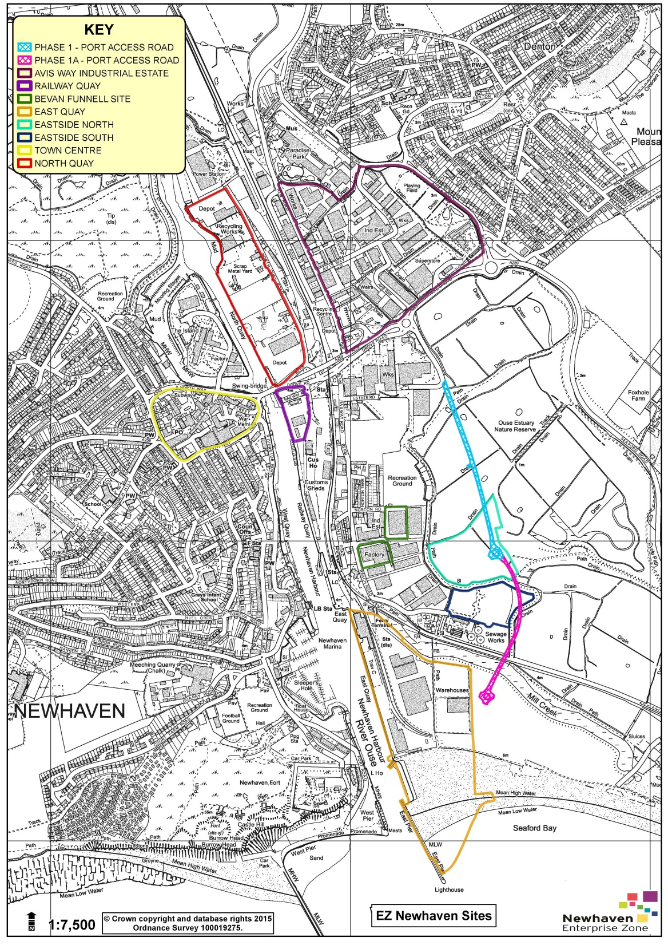
8 sites, covering 79ha
25-year lifespan from April 2017
Create 55,000m² of new employment floorspace
Refurbish 15,000m² of employment floorspace
Create / sustain 2,000 FTE jobs

Slide 3
Strategic Framework
Catalyst for positive growth
Three key priorities:
Quality Growth
Inclusive Growth
Sustainable Growth

Slide 4
EZ - Key Outputs to date
Business rate relief granted to 13 businesses, leveraging £3.8m private sector investment
£1m business rates uplift in 1st two years
108 FTE jobs created, 26 FTE safeguarded
5,815m² employment floorspace created
13,748m² employment floorspace refurbished
Enhanced business engagement

Slide 5
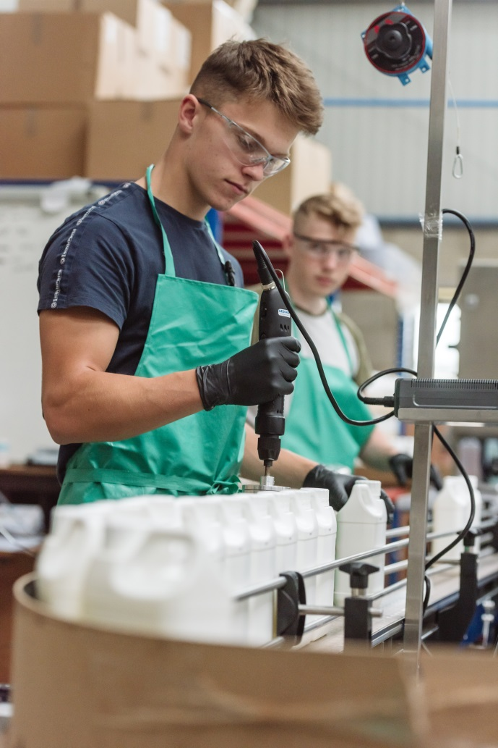
EZ - Key Achievements to date
EZ Community Fund
AWNQ Business Forum
Employment & Skills Workstream

Slide 6
What Next for the EZ?
Forecasts for 2019/20:
£845,000 business rates uplift
£2.3m private sector investment
Ongoing discussions with National Maritime and creative workspace providers
Addressing Challenges
Launch of updated website

Slide 7
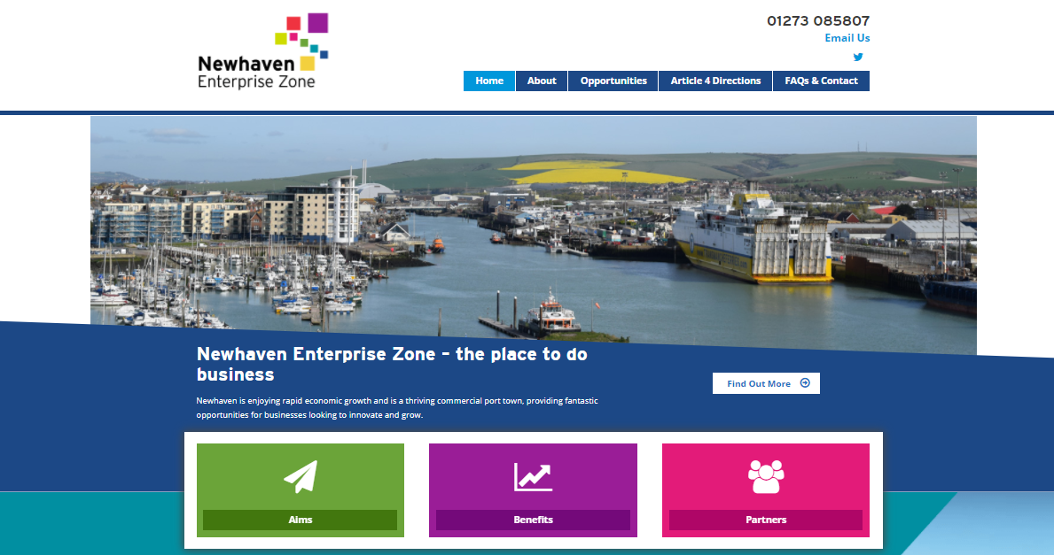
More Information
www.newhavenenterprisezone.com
Peter Sharp
Head of Regeneration
LDC/EBC
E: peter.sharp@lewes-eastbourne.gov.uk
Corinne Day
Newhaven EZ Programme Manager
LDC/EBC
E: corinne.day@lewes-eastbourne.gov.uk
follow us at @EZNewhaven
#NewhavenEZ

