Slide 1

Local Industrial Strategy
Adam Bryan
Chief Executive Officer
Strategic Board
28th June 2019

Slide 2

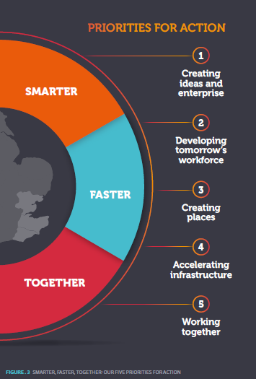
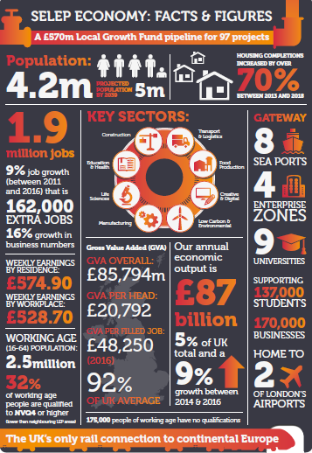
The story so far
Local Industrial Strategies to be agreed by March 2020
Smarter, Faster Together as a starting point
Strategy and Intelligence Managers in post
Stakeholder group and core group in place to drive LIS work and engagement across SELEP
Review of our existing evidence base is underway, which will also identify gaps /areas for further exploration
Engagement and delivery plans in development
Dialogue with neighbouring LEPs in progress
Notes:
Evidence base work will review the existing evidence base library that has been created, aiming to pull out key strengths or opportunities for proposition focus and consultation. It will also identify gaps in evidence, some can possibly be plugged easily in parallel to review and consultation and others may require the commissioning of ‘deep dive’ research.
Nothwithstanding the findings, it is expected that thematic workshops will be run with partners in Sept to build up the propositions.
It is intended that the evidence base work is completed by end of Sept.

Slide 3
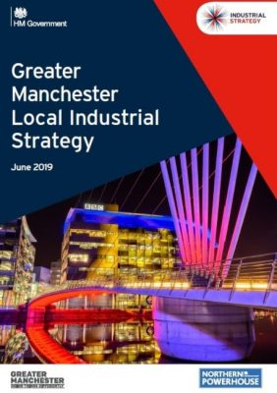
Progress in other LEPs
2 LIS now agreed by Government – very closely aligned to national guidance and the five foundations of productivity
West Midlands focuses on strengths in research, manufacturing and transport innovation
Greater Manchester focuses on health innovation, digitalisation, and a commitment to be carbon neutral by 2038
Implementation plans will follow
A few others are close to being agreed
but the majority of LEPs working to
December deadline
How do we drive innovation, increase technology adoption and create the skills and capabilities that we need to respond to the ‘grand challenges’ and thrive in a competitive, digitally enabled world?
How do we secure the infrastructure we need to support a growing and changing population – and the demands of an evolving economy, and how do we drive the pace and quality of housing delivery?
How do we ensure that everyone contributes to and benefits from productivity growth?
Notes:
Will be marked by Government

Slide 4
Our approach to the LIS
Provide an evidence based strategy that aligns with Government’s expectations of a LIS and reflects SELEP as a distinct area
Focus on productivity and growth and issues of pan-area relevance, including our relationship with London
Demonstrate the scale of what we can deliver and the impact on productivity
Reflect emerging issues from local productivity strategies and from SELEP/regional working groups
Reflect the grand challenges, highlighting particular strengths/opportunities for SELEP
Identify clear asks of Government aligned
with matching local commitment

Slide 5
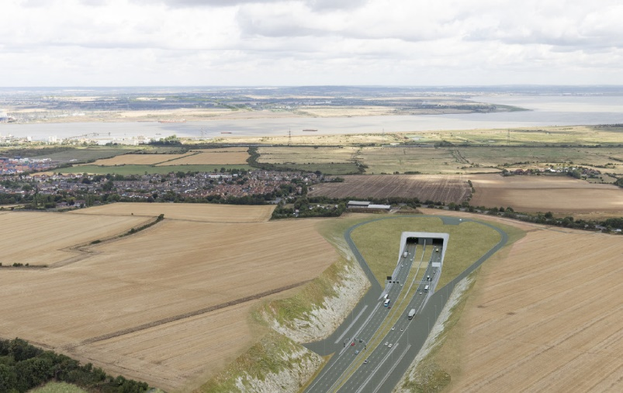
Emerging issues for consideration
The role of inclusive growth in addition to productivity
Identifying the unique strengths of SELEP that will set our LIS apart from others – a few bold messages
A potential role for Board members to sponsor each foundation
Defining our relationship with, and asks of, London
How best to engage with HMG, particularly
on challenging issues
Ensuring the strategy resonates with
stakeholders, particularly businesses
Notes:
Manchester LIS provides a tale of two halves – first being high impact productivity items & how to make them fly. The 2nd being the ‘long tail of productivity’ focused around the 5Fs and inclusive growth – SME’s, skills, housing, infrastructure etc. Leaves the reader with clear view on their ‘game changers’ but also that there are a significant amount of others things they are and want to do to promote growth across the area.

Slide 6
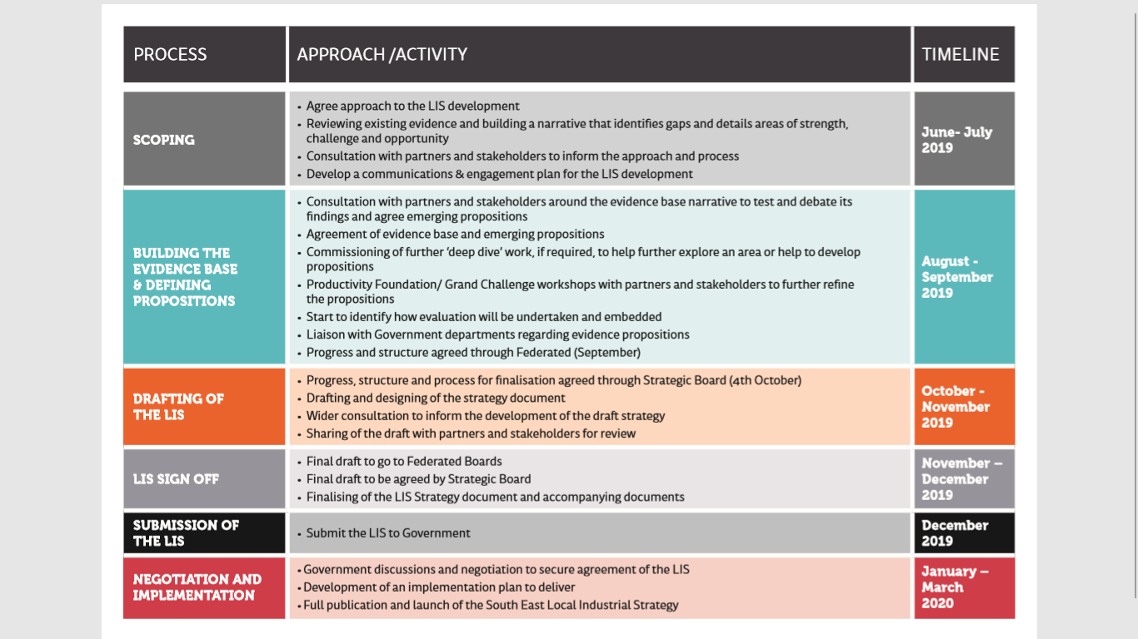
Engagement and delivery plan

Slide 7
Questions / Discussion

