Slide 1
Greater South East Energy Hub
Suzanne Bennett
Chief Operating Officer
Strategic Board
28 June 2019

Slide 2
Background on the Hub
Climate Change Act
New solutions and new approach to energy production nationally
Tri-LEP Energy Strategy
Supporting local solutions

Slide 3
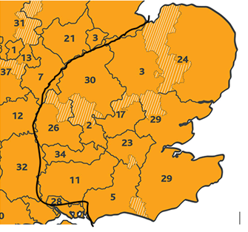
Greater South East Energy Hub
10 LEPs and the London Economic Action Partnership (LEAP)
CPCA Accountable Body
Hub Project Team
Rural Community Energy Fund
GSEEH Board

Slide 4
Future Decision
Partnership Agreement – MOU
Role of Board: criteria for prioritisation and selection of projects
Delegation to CEO
Timing – by electronic procedure

