Slide 1


Slide 2

A transport strategy for the South East
Rupert Clubb
Lead officer, Transport for the South East

Slide 3
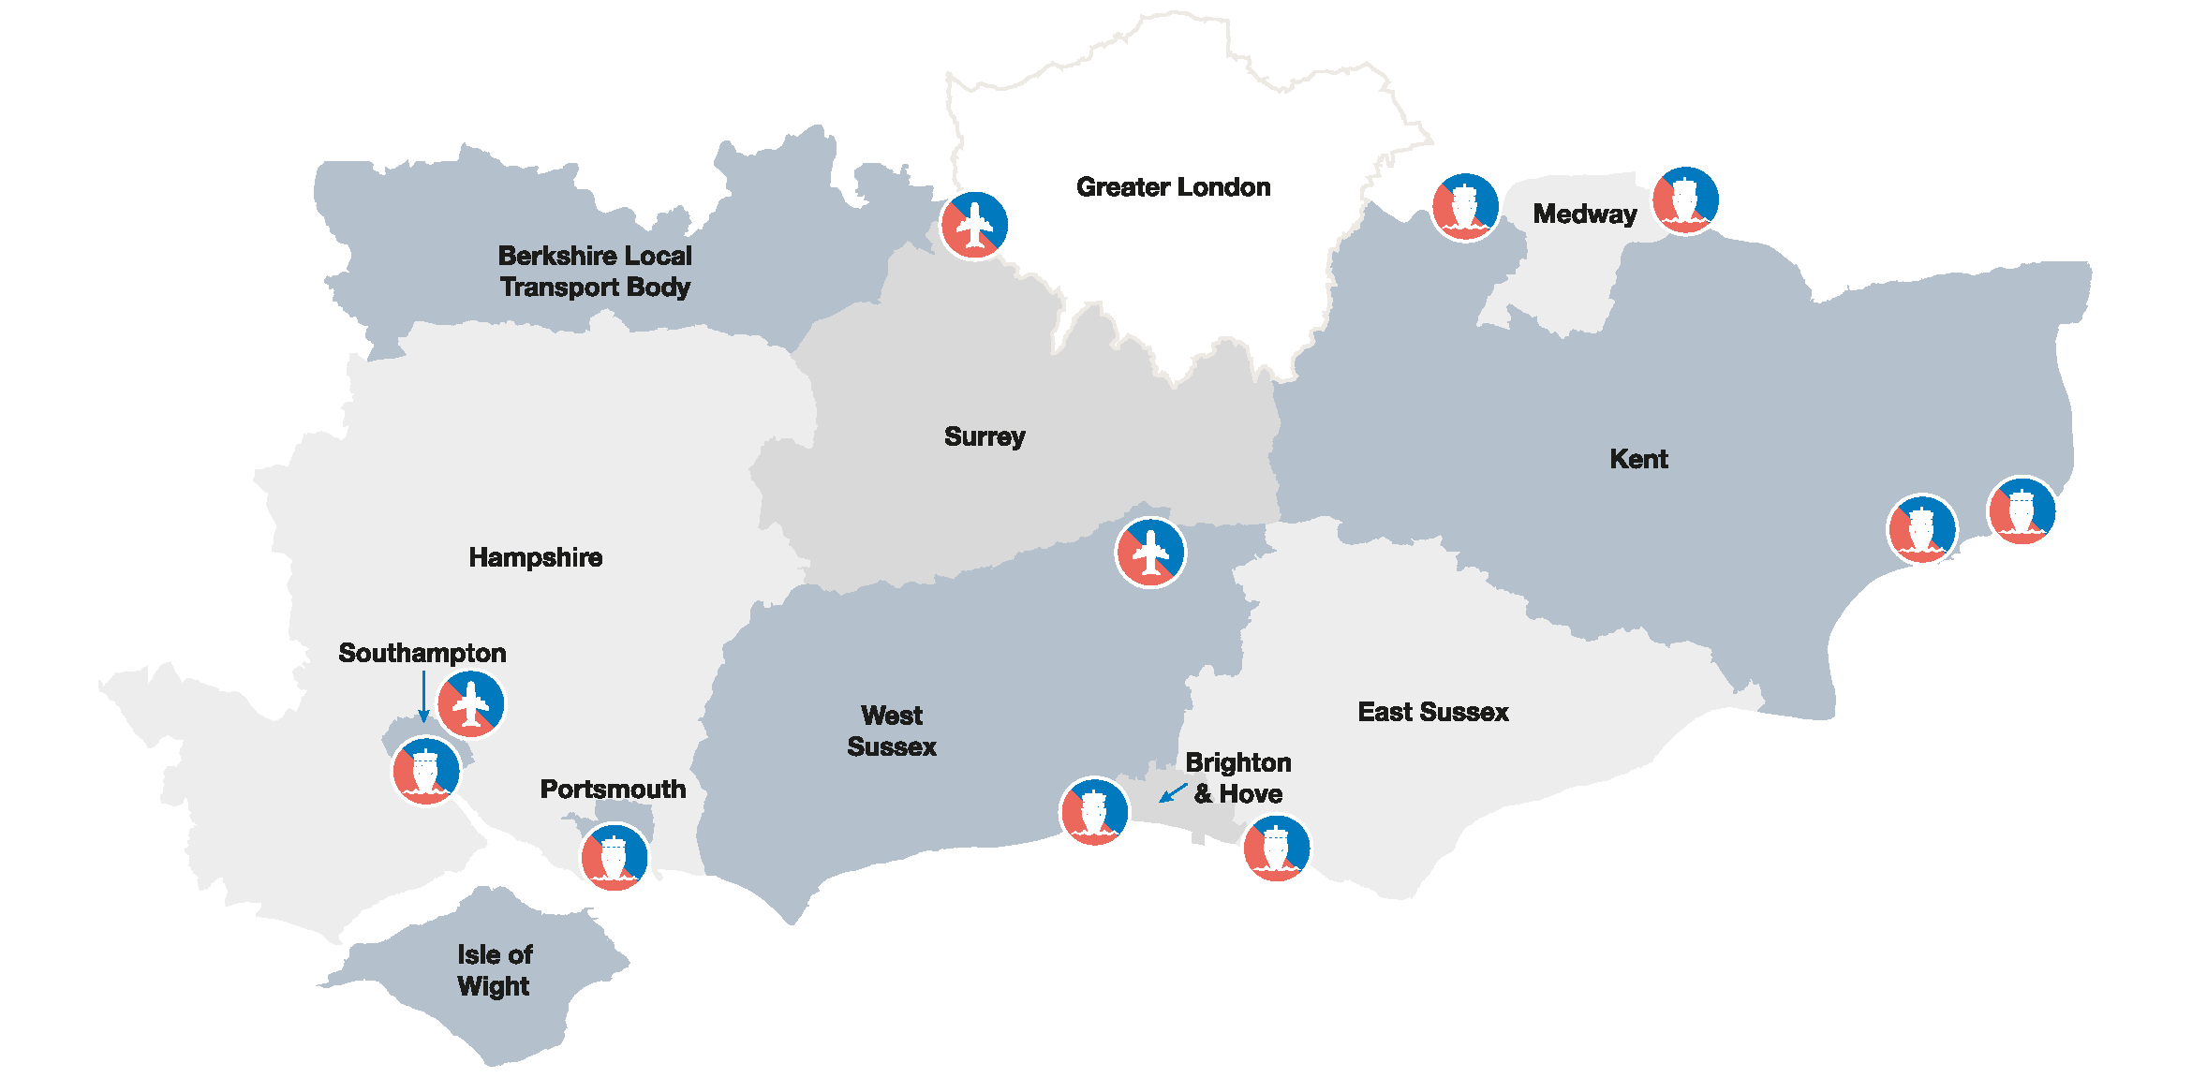
Our region
A motor for the UK economy and major international gateway

Slide 4
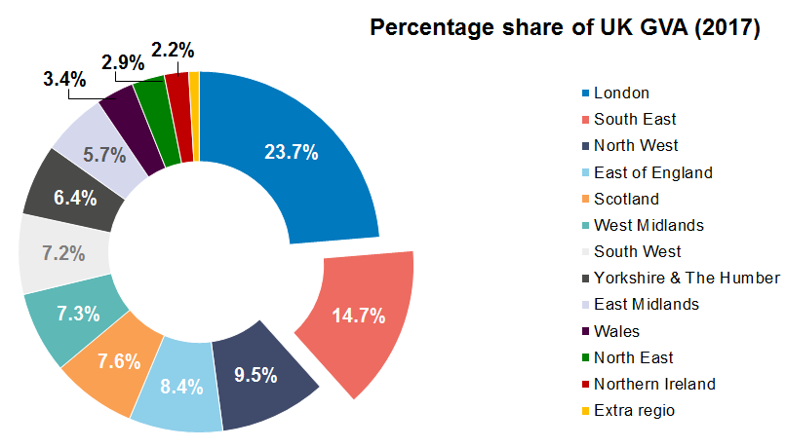
Our contribution to the UK economy
Second only to London – more than Wales, Scotland & NI combined

Slide 5
Our vision and strategic principles
“We will grow the South East’s economy by facilitating the development of a reliable, high-quality, integrated transport system that makes the region more productive and competitive, improves the quality of life for all and protects and enhances the environment .”
Improves productivity to grow our economy and compete in the global marketplace
Improves safety, quality of life and access to opportunities for everyone
Protects and enhances the South East’s unique natural and historic environment

Slide 6
Developing our
transport strategy

Slide 7
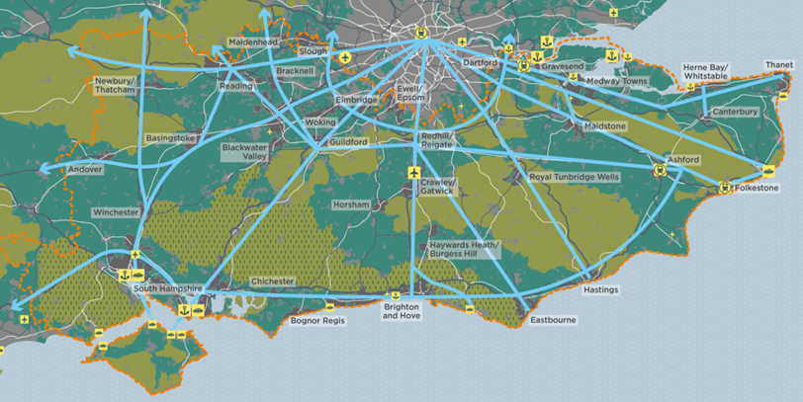

Economic Connectivity Review

Slide 8
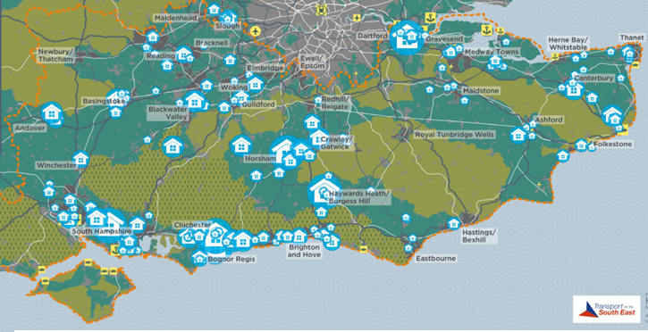
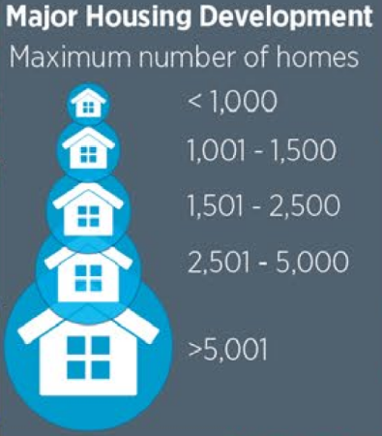

Planned housing development

Slide 9
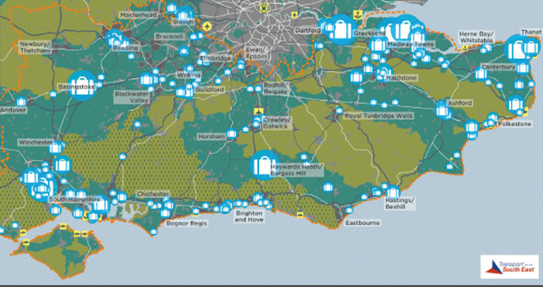
Planned employment sites
250 - 1000
1,001 - 2,500
2,501 - 5,000
5,000 -10,000
>10,000

Slide 10
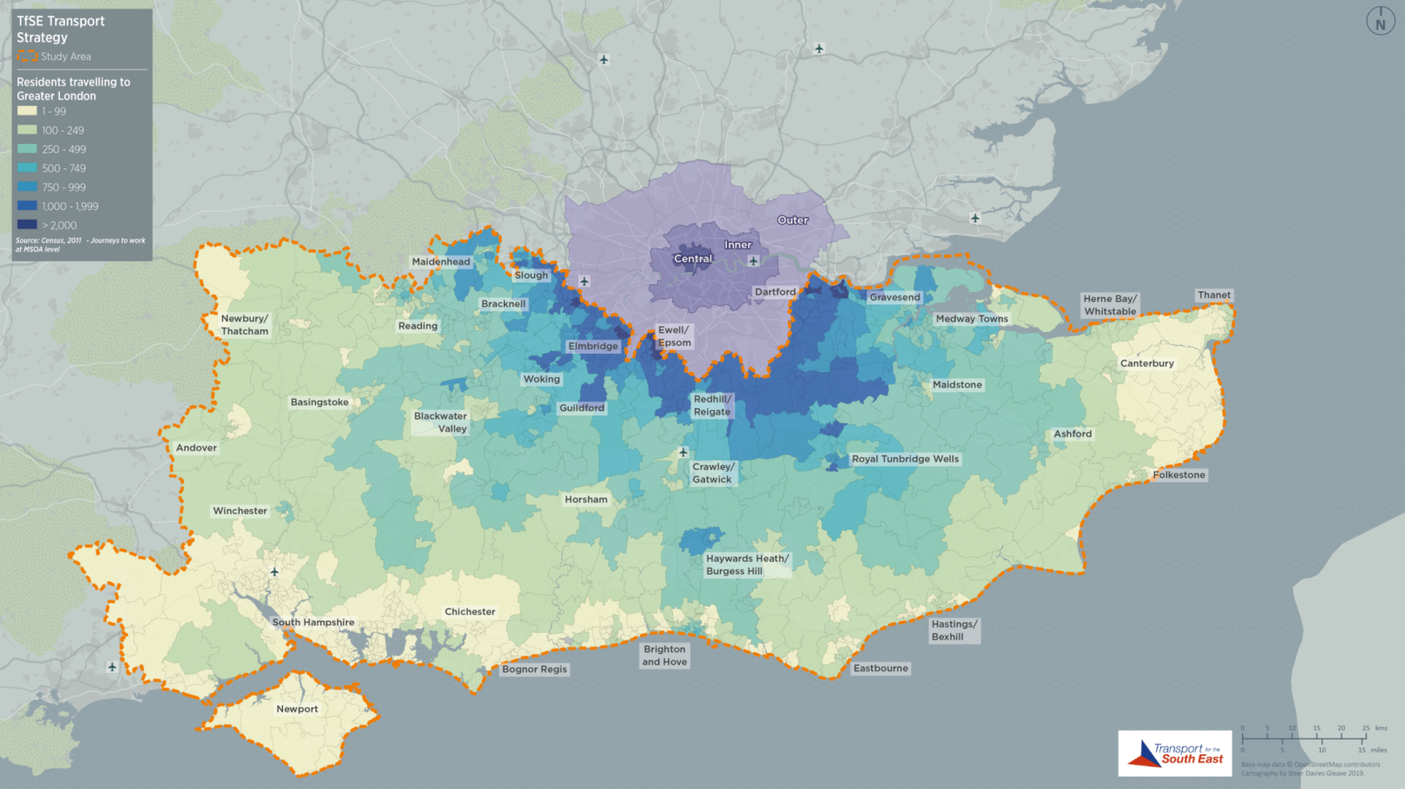
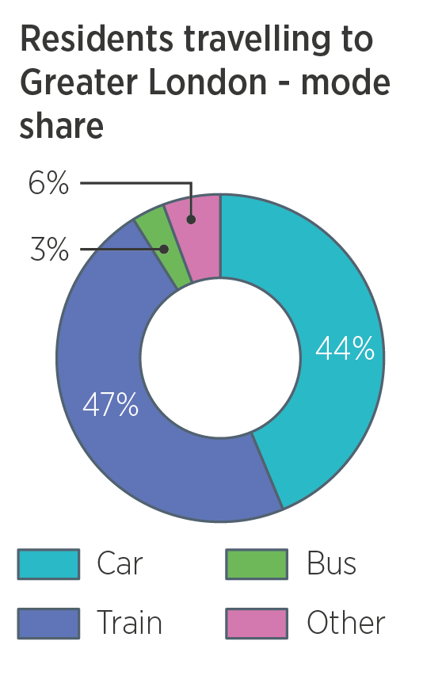

London commuter flows

Slide 11
Transport strategy route map
June 2018
Sept 2019
Dec 2019
Mar 2020
Mar 2021
Economic Connectivity Review
Strategy
development
Public
consultation
Final strategy
Corridor studies
Strategic
Investment Plan

Slide 12
Major Road Network

Slide 13

MRN/LLM prioritisation
DfT have requested STBs prioritise schemes in their areas
Identify the 10 top priority MRN schemes
Prioritise LLM schemes where more than 2-3 candidates
National Roads Fund from 2020/21 to 2024/25
Assessment process agreed by TfSE board in March
MRN criteria
Deliverability (ideally need to spend DfT funding by March 2025)
Value for money
Fit with TfSE vision and objectives
Submit our priorities to DfT by 31 July 2019

Slide 14
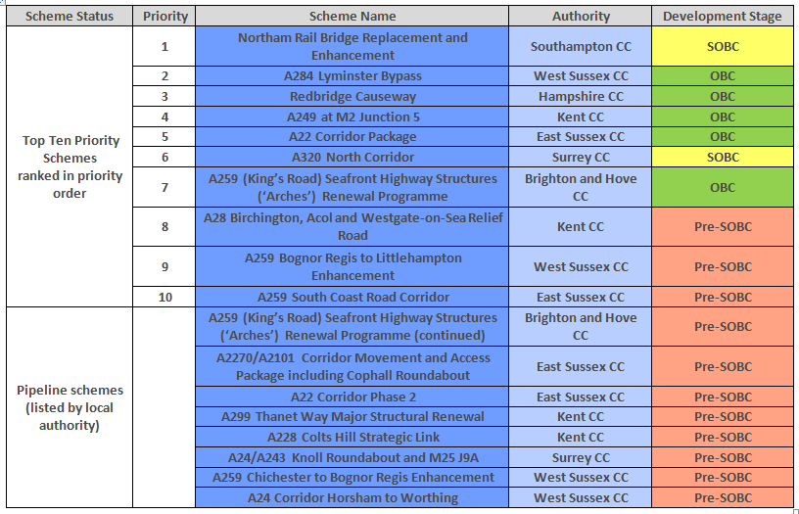
Top 10 priority schemes – ranked by overall score

Slide 15
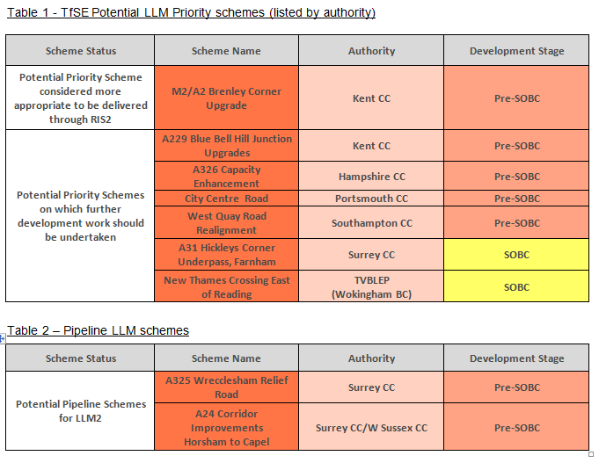
LLM scheme status
Emerging Priority Schemes
Further work by 16 August
  Strategic Case
  Economic Case
  Political considerations
  Deliverability
  Commitment to bring scheme forward
Decision on Priorities Shadow Partnership Board Meeting 19 September 2019

Slide 16
Becoming a
statutory body

Slide 17
Role for STBs
Planning
Infrastructure
National government
National
National Planning Policy Framework + Guidance
Highways England
Network
Rail
Regional
Sub-National Transport Body
LTAs
LEPS
Operators
Local Planning Authorities
Local
LTP
LGF
Local Plans & IDPs

Slide 18
Statutory status
Permanence and longevity
Influence over SoS investment plans for road and rail
Regional transport strategy to ensure better coordination of transport arrangements across boundaries
Better links to international ports and airports
Support growth plans and housing proposals
Seeking concurrent powers with local transport authorities – not removing any powers - only to be exercised with consent from the Las concerned
Will help to coordinate transport functions across local authority boundaries
Support the region to access strategic transport investment

Slide 19
Proposed Functions
General STB Functions
Rail
Highways
Make capital grants for the provision of public highway facilities
Bus service provision
Integrated ticketing
Clean air zones
Promote or oppose bills in parliament
Incidental powers

Slide 20
Next steps
Formal consultation May-July 2019
Shadow Partnership Board to agree next steps in September 2019
Formal consent from constituent authorities in autumn 2019
Submission to Government

Slide 21
Join the conversation
Web tfse.org.uk
Facebook TransportForTheSouthEast
Twitter @TransportfSE
LinkedIn transport-for-the-south-east

Slide 22
Assurance Framework
Rhiannon Mort
Capital Programme Manager
Strategic Board
28/06/2019

Slide 23
New Version
Has been updated to reflect the new 2019 National Assurance Framework
Feedback from March 2019 meeting has been considered
Diagrams added for clarity

Slide 24
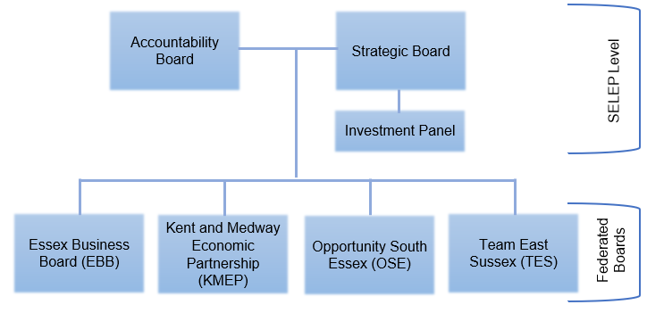
SELEP Structure

Slide 25
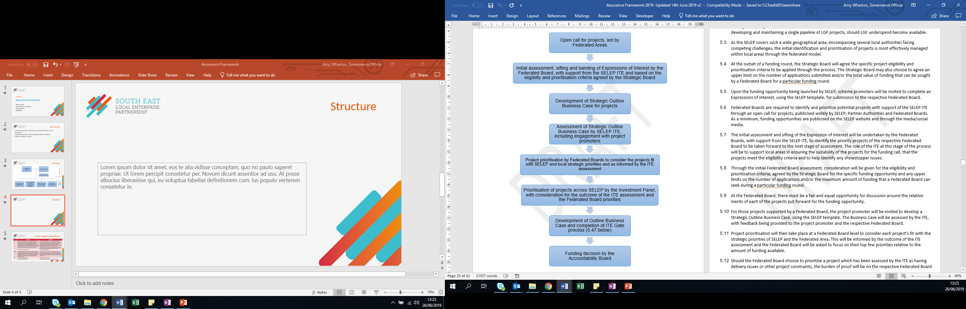
Prioritisation of LGF

Slide 26
Further suggested amendments
 | Original | Suggested
1.4 | The Assurance Framework is not a legal document, but provides a framework to set out the systems and processes in place that are necessary to manage the delegated funding from Government budgets effectively. It is intended to provide Government and Partner Authorities and wider stakeholders with the assurance that decisions over funding are proper, transparent and deliver value for money. | The Assurance Framework is not a legal document, but provides a guide to the structure of SELEP together with the processes and systems which are used to manage its business including the detailed processes applied to manage the funding delegated from Government budgets. It is intended to provide Government, Partner Authorities and wider stakeholders with the assurance that decisions over funding are proper, transparent and deliver value for money.
2.1 | The SELEP is a clear partnership… | The SELEP is a partnership…
2.28(c) | (The Investment Panel’s role and responsibilities include:) c) Making recommendations for the provisional allocation of funding to projects prioritised by the Investment Panel. The final award of funding will be subject to an Accountability Board decision, in line with the Assurance Framework requirements; and | (The Investment Panel’s role and responsibilities include:) c) Making recommendations for the provisional allocation of funding to projects prioritised by the Investment Panel. The final award of funding will be made by an Accountability Board decision; and
2.33 | (regarding Federated Boards) They have responsibility for: | (regarding Federated Boards) They have responsibility in their respective areas for:

Slide 27
Terms of Reference -
Suggested Amendments
To increase the length of the chair term to 2+2+2, to be consistent with the response to the LEP review.
To change SELEP to “SELEP Strategic Board” for clarity.
The Board are asked to approve the new Terms of Reference.

Slide 28
LEP Review Update and Company Form
Suzanne Bennett
Chief Operating Officer
Strategic Board
28 June 2019

Slide 29

Introduction and Overview
Strengthened Local Enterprise Partnership Review – published July 2018

Slide 30
Working Groups
Working Group 1: Board Size, Composition, Chair and Board Member Recruitment and Diversity
Working Group 2: Legal Personality
Groups made up Board Members
Advisory Groups: make recommendations to Strategic Board

Slide 31
Company Form
Decision today won’t restrict options for either working group
Company won’t be registered following today’s decision
Nil Return Company
Role of Accountability Board

Slide 32

Types of Company
Discounted Company Types
Company Limited by Shares
Charitable Company
Community Benefit Societies

Slide 33
CLG vs CIC
Company Limited by Guarantee Vs Community Interest Company
CLG | CIC
Directors and Members model | Directors and Members model
Standard Reporting to Companies House | Additional Reporting to Companies House
No asset lock | Asset lock
18 LEPs adopted form | 3 LEPs adopted form

Slide 34
Local Industrial Strategy
Adam Bryan
Chief Executive Officer
Strategic Board
28th June 2019

Slide 35

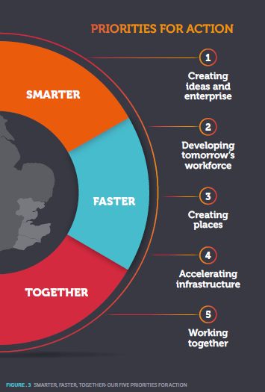
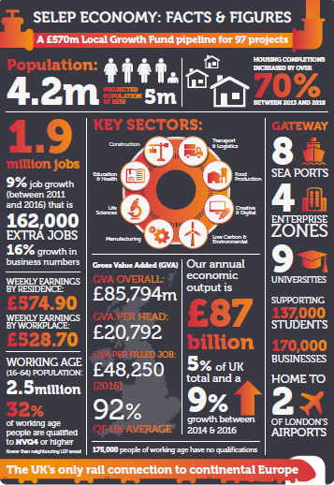
The story so far
Local Industrial Strategies to be agreed by March 2020
Smarter, Faster Together as a starting point
Strategy and Intelligence Managers in post
Stakeholder group and core group in place to drive LIS work and engagement across SELEP
Review of our existing evidence base is underway, which will also identify gaps /areas for further exploration
Engagement and delivery plans in development
Dialogue with neighbouring LEPs in progress
Notes:
Evidence base work will review the existing evidence base library that has been created, aiming to pull out key strengths or opportunities for proposition focus and consultation. It will also identify gaps in evidence, some can possibly be plugged easily in parallel to review and consultation and others may require the commissioning of ‘deep dive’ research.
Nothwithstanding the findings, it is expected that thematic workshops will be run with partners in Sept to build up the propositions.
It is intended that the evidence base work is completed by end of Sept.

Slide 36
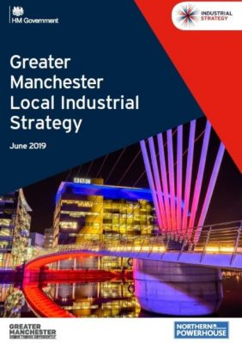
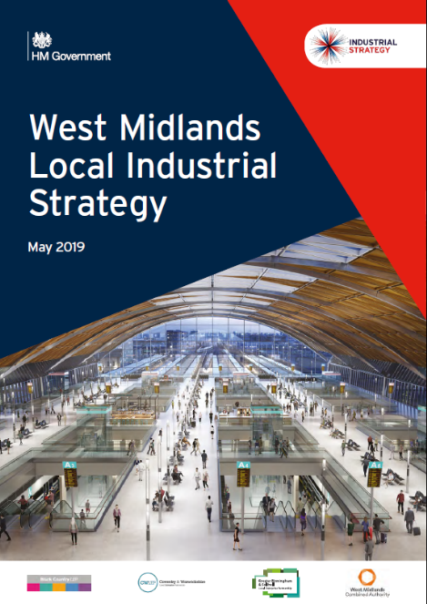
Progress in other LEPs
2 LIS now agreed by Government – very closely aligned to national guidance and the five foundations of productivity
West Midlands focuses on strengths in research, manufacturing and transport innovation
Greater Manchester focuses on health innovation, digitalisation, and a commitment to be carbon neutral by 2038
Implementation plans will follow
A few others are close to being agreed
but the majority of LEPs working to
December deadline
How do we drive innovation, increase technology adoption and create the skills and capabilities that we need to respond to the ‘grand challenges’ and thrive in a competitive, digitally enabled world?
How do we secure the infrastructure we need to support a growing and changing population – and the demands of an evolving economy, and how do we drive the pace and quality of housing delivery?
How do we ensure that everyone contributes to and benefits from productivity growth?
Notes:
Will be marked by Government

Slide 37
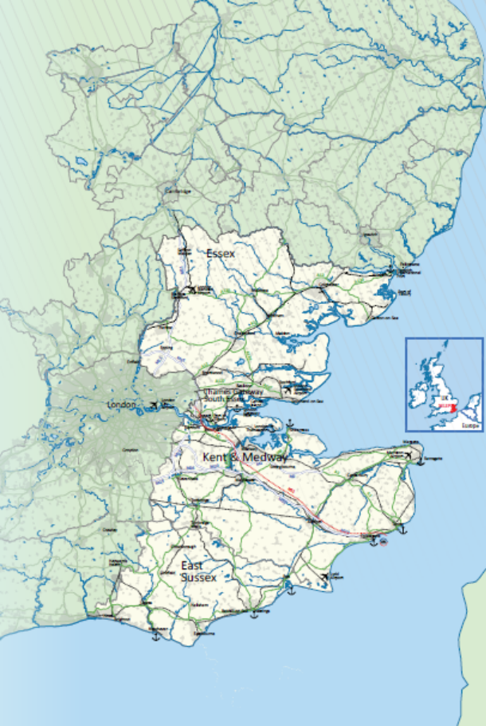
Our approach to the LIS
Provide an evidence based strategy that aligns with Government’s expectations of a LIS and reflects SELEP as a distinct area
Focus on productivity and growth and issues of pan-area relevance, including our relationship with London
Demonstrate the scale of what we can deliver and the impact on productivity
Reflect emerging issues from local productivity strategies and from SELEP/regional working groups
Reflect the grand challenges, highlighting particular strengths/opportunities for SELEP
Identify clear asks of Government aligned
with matching local commitment

Slide 38
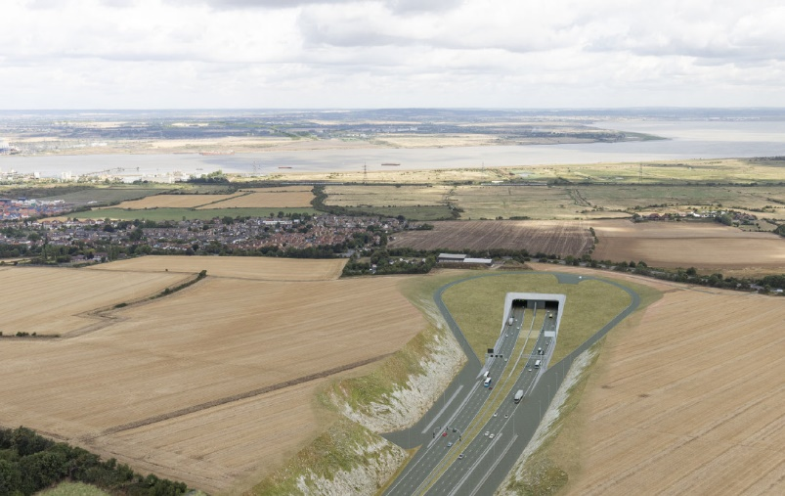
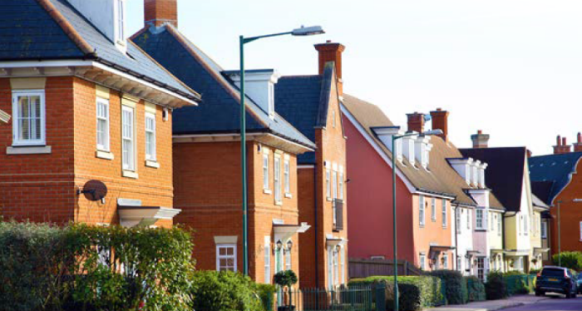
Emerging issues for consideration
The role of inclusive growth in addition to productivity
Identifying the unique strengths of SELEP that will set our LIS apart from others – a few bold messages
A potential role for Board members to sponsor each foundation
Defining our relationship with, and asks of, London
How best to engage with HMG, particularly
on challenging issues
Ensuring the strategy resonates with
stakeholders, particularly businesses
Notes:
Manchester LIS provides a tale of two halves – first being high impact productivity items & how to make them fly. The 2nd being the ‘long tail of productivity’ focused around the 5Fs and inclusive growth – SME’s, skills, housing, infrastructure etc. Leaves the reader with clear view on their ‘game changers’ but also that there are a significant amount of others things they are and want to do to promote growth across the area.

Slide 39
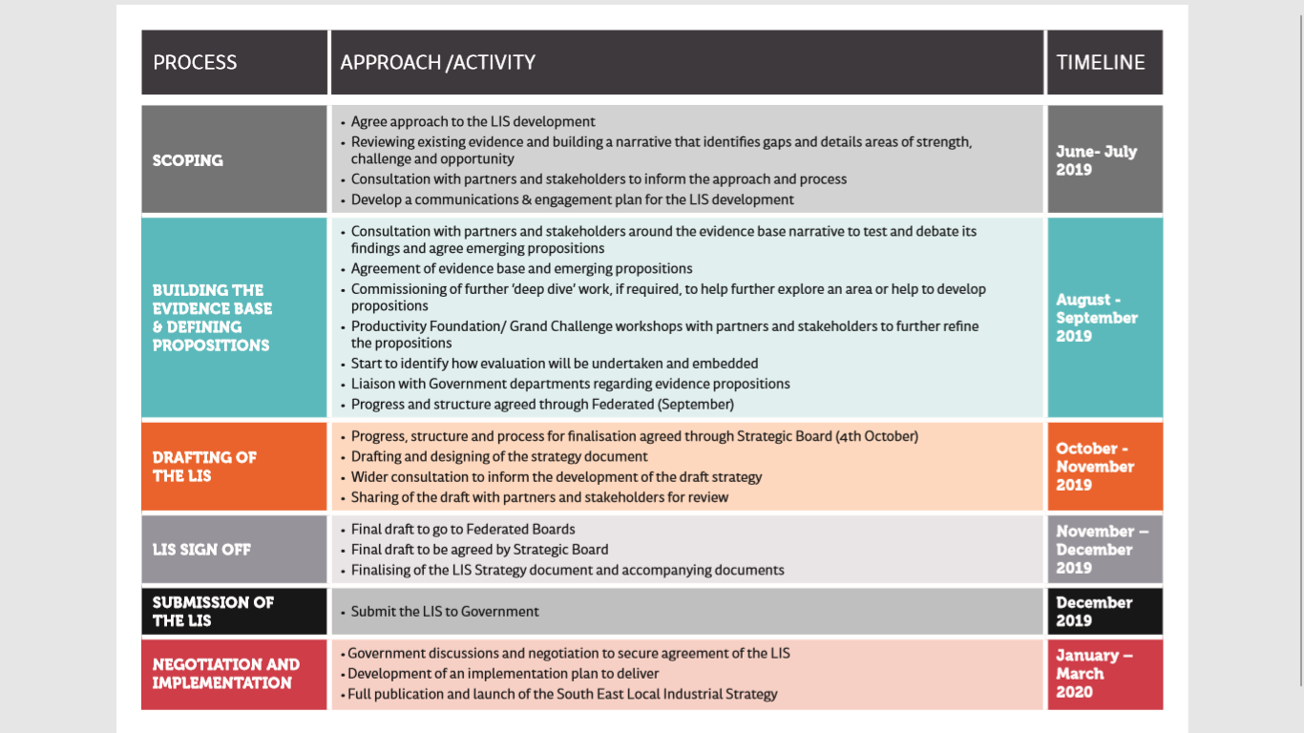
Engagement and delivery plan

Slide 40
Questions / Discussion

Slide 41
Greater South East Energy Hub
Suzanne Bennett
Chief Operating Officer
Strategic Board
28 June 2019

Slide 42

Background on the Hub
Climate Change Act
New solutions and new approach to energy production nationally
Tri-LEP Energy Strategy
Supporting local solutions

Slide 43
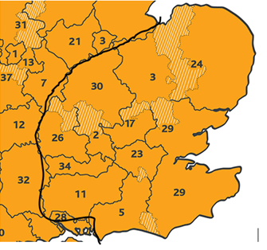
Greater South East Energy Hub
10 LEPs and the London Economic Action Partnership (LEAP)
CPCA Accountable Body
Hub Project Team
Rural Community Energy Fund
GSEEH Board

Slide 44
Future Decision
Partnership Agreement – MOU
Role of Board: criteria for prioritisation and selection of projects
Delegation to CEO
Timing – by electronic procedure

Slide 45
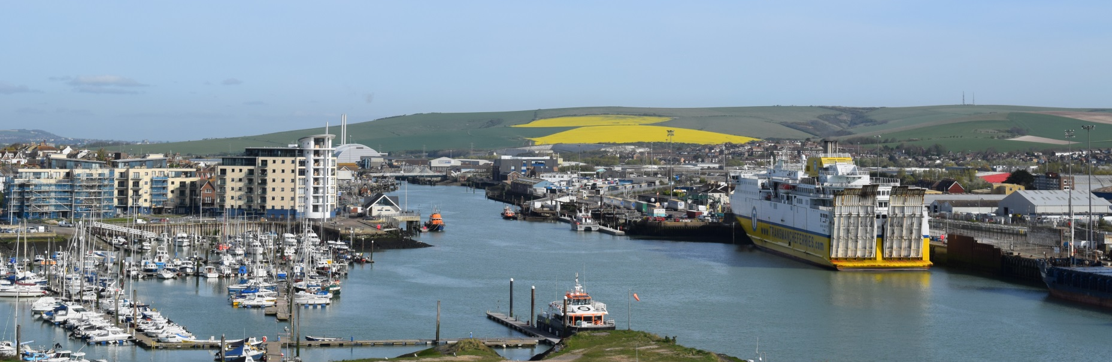
Regenerating, Investing & Driving Growth
Peter Sharp – Head of Regeneration, LDC/EBC
28 June 2019

Slide 46
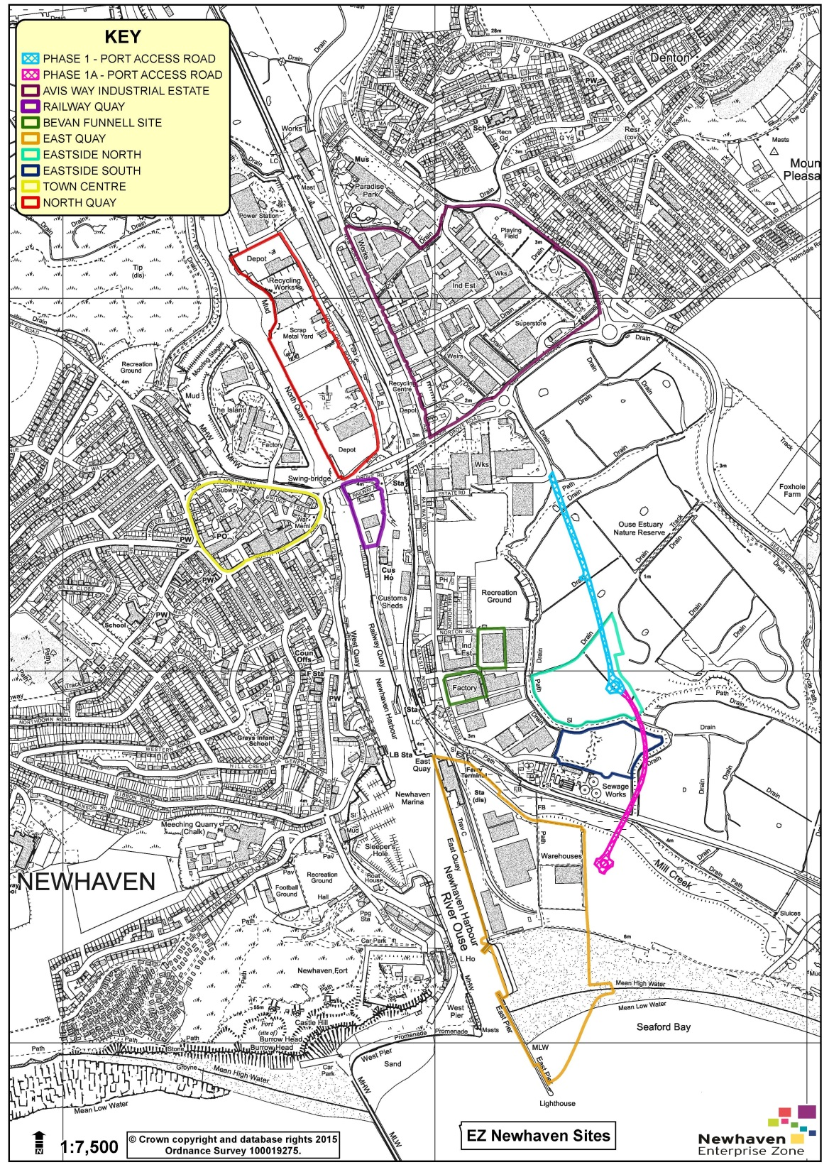
8 sites, covering 79ha
25-year lifespan from April 2017
Create 55,000m² of new employment floorspace
Refurbish 15,000m² of employment floorspace
Create / sustain 2,000 FTE jobs

Slide 47

Strategic Framework
Catalyst for positive growth
Three key priorities:
Quality Growth
Inclusive Growth
Sustainable Growth

Slide 48
EZ - Key Outputs to date
Business rate relief granted to 13 businesses, leveraging £3.8m private sector investment
£1m business rates uplift in 1st two years
108 FTE jobs created, 26 FTE safeguarded
5,815m² employment floorspace created
13,748m² employment floorspace refurbished
Enhanced business engagement

Slide 49

EZ - Key Achievements to date
EZ Community Fund
AWNQ Business Forum
Employment & Skills Workstream

Slide 50
What Next for the EZ?
Forecasts for 2019/20:
  £845,000 business rates uplift
  £2.3m private sector investment
Ongoing discussions with National Maritime and creative workspace providers
Addressing Challenges
Launch of updated website

Slide 51
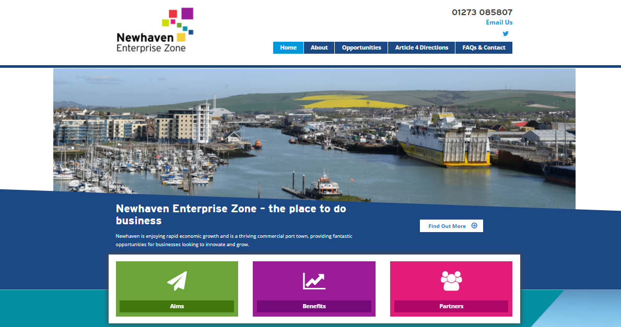

More Information
www.newhavenenterprisezone.com
Peter Sharp
Head of Regeneration
LDC/EBC
E: peter.sharp@lewes-eastbourne.gov.uk
Corinne Day
Newhaven EZ Programme Manager
LDC/EBC
E: corinne.day@lewes-eastbourne.gov.uk
follow us at @EZNewhaven
#NewhavenEZ

