Slide 1
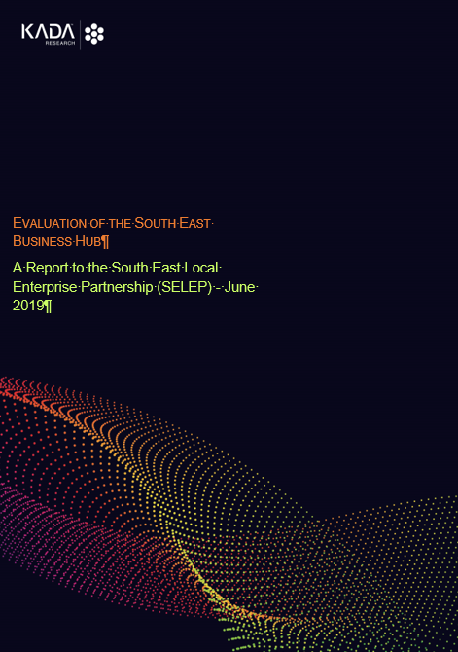
SEBH Evaluation
A Presentation
to SE LEP
July 2019
Final Report
Findings

Slide 2
Study Aims
Long-term economic impact.
Customer satisfaction.
The impact of the scaleup support.
Strategic partnership working and stakeholder feedback.
Progress against 2018 evaluation recommendations.
Recommendations for the future evaluation.
Notes:
• The long-term economic impact of the SEBH.
• Customer satisfaction of businesses who have used the SEBH services including those who have been signposted to external organisations and their satisfaction of this signposting.
• The impact of the scaleup support including customer feedback and future opportunities.
• Strategic partnership working and feedback from stakeholders.
• Progress against recommendations made in the 2018 evaluation.
• Recommendations for the future evaluation, informed by consultation with hub staff and relevant stakeholders and in accordance with the new 2019 framework.

Slide 3
Approach
Desk review of context and performance.
Stakeholder discussions (18) and six team meetings.
Impact assessment.
On-line survey (LT) (145).
Telephone survey (M+H) (57).
3 case studies.

Slide 4
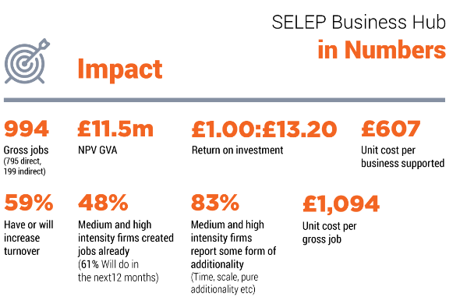

Slide 5
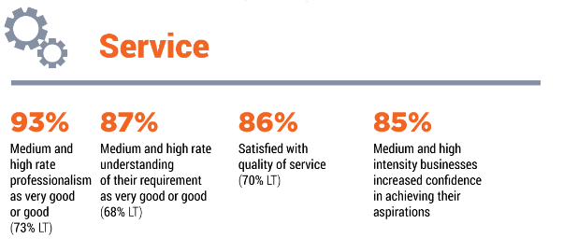

Slide 6
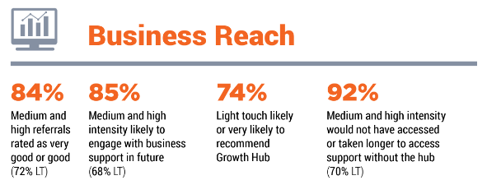

Slide 7
Delivery Headlines (I)
Federated Model rooted in the local economic landscape makes sense.
All areas proactive in co-ordinating local activity & steering groups to monitor performance and share information.
Good relationship between hubs & LAs.
Excellent integration with SEBB.
The relationship with national & local partners - deepened considerably in the last 12 mths.
Notes:
Links with IUK, Catapults, Better Business for All and Be the Business team could be improved.
Visibility of university and partner events could be engance

Slide 8
Delivery Headlines (II)
Visibility of partner business support expertise/events could be enhanced.
Live Chat quick/easy entry point, offering triage enquiries and can establish initial trust.
Potential for more joint working.
Differences collation of business support data.
Step change in the service offer but scope for more investment readiness support.
The hubs would welcome more feedback from referral providers.
Notes:
Links with IUK, Catapults, Better Business for All and Be the Business team could be improved.
Visibility of university and partner events could be enhanced

Slide 9
Delivery Headlines (III)
The overall awareness of the SEBH could be higher amongst the business community.
Scope for more sharing of info about events?
Shift to a central website makes sense provided local distinctiveness is not lost.
Recognition of delivery challenges in the face of changes by Central Government.
Hub appetite to work more closely together in next 12 mths.
Annual Showcases of Business Support Providers well received.
Push to understand the impact of the SEBH more widely.
Notes:
Links with IUK, Catapults, Better Business for All and Be the Business team could be improved.
Visibility of university and partner events could be enhanced

Slide 10
Conclusion
The SEBH has considerable geographical reach, strong stakeholder relations and wide publicity of local services.
The Federated Model has enabled a dedicated local service to be established in each area.
The benefits recognised included the ability to provide a staffed service with local, hands-on knowledge that local businesses can directly interact with.
The next phase of its development should be to maximise the sum of its parts – aligning measurement and resources, and sharing networking, expertise and company intelligence.

Slide 11
Operational Recommendations
Encourage partners such as libraries and the FSB to advertise their events on the hub websites free of charge.
More joint events between the three hubs and more routine cross referral.
Alignment of CRM systems.
New ways to better engage young people, women and ethnic minorities.
A cross hub marketing plan with appropriate measures and activities to deepen awareness of the brand.
Training for the SEBH Navigators on helping firms prepare for Brexit.
More routine aftercare and follow-up.
Notes:
(could the Kent Investor Network be introduced to more prospects elsewhere in the SELEP area?).
Ensure all three CRM systems are fully aligned.
Consider new ways to better engage young people, women and ethnic minorities.
A cross hub marketing plan with appropriate measures and activities to deepen awareness of the brand.
Training for the SEBH Navigators on helping firms prepare for Brexit.
More routine aftercare and follow-up.

Slide 12
Strategic Recommendations
Formalising the SEBH steering group to direct efforts towards the collective SELEP interests eg links with national providers.
Deepen links with IUK, Catapults , Better Business for All and Be the Business team.
Enhanced visibility of University & partner business support expertise & events.
Measures to simplify the skills, training and apprenticeships market.
Lobbying for funding for investment readiness, SEBB2 and funds to boost the number and capacity of Business Navigators.
Reflecting on the scaleup pilots, working with The ScaleUp Institute and developing a SELEP wide scaleup programme.
Engage hubs in the development of the LIS.
Notes:
Formalising the SEBH steering group so it directs its efforts towards the collective interests of the SELEP cascading intelligence from all three hubs.
Using the above to report back on links with national providers to ensure all hubs benefit.
Deepen links with IUK, Catapults, Better Business for All and Be the Business team.
How the visibility of University and partner business support expertise and events including DIT and FSB could be significantly enhanced.
Measures to simplify the skills, training and apprenticeships market.
Lobbying for new resources from the Shared Prosperity Fund and other sources for a new SEBH investment readiness product, SEBB2 and funds to boost the number and capacity of Business Navigators.
Reflecting on the scaleup pilots, working with The ScaleUp Institute and developing a SELEP wide scaleup programme.
Engage hubs in the development of the Local Industrial Strategy. Target catapults should be aligned with the Enterprise Zones’ industrial specialisms e.g. Off-Shore Renewable Energy, Medicine Discovery and High Value Manufacturing.

Slide 13
Recommendations on the Future Monitoring & Evaluation
Plan for the annual evaluation 2-3 months in advance to allow sufficient time to conduct company surveys, case studies etc.
How KPIs and monitoring data can be collated much more consistently between the three areas.
Whether there is scope to simplify the sharing of company data for evaluation purposes.
Plan in scaleup impacts to the 2019-2020 evaluation.
Notes:
Plan for the annual evaluation 2-3 months in advance to allow sufficient time to conduct company surveys, case studies etc.
How KPIs and monitoring data can be collated much more consistently between the three areas.
Although locational data has been made available, this has been collected at the level of towns and other small geographies. These are not formal boundaries such as local authority districts which would make the task of knowing whether areas are adequately supported more difficult.
A more clear and consistent method on data collection on sectors is needed by using an agreed level of a standard industrial classification.
Enquiry collection methods have varied across the three hubs. These need to be aligned to ensure the hours for each enquiry are recorded consistently.
The description of the type of enquiries or advice given (e.g. funding, IT, marketing etc.) should be clearly defined with all three hubs using identical categories.
The turnover ranges for companies should be collected consistently. This should be in line with BEIS requirements.
Whether there is scope to simplify the sharing of company data for evaluation purposes.
Plan in scaleup impacts to the 2019-2020 evaluation.

