Slide 1



Going Global – What support is available for UK companies?
David Roadway
International Trade Adviser

Slide 2
The Challenge
    <11%
    5.5 million
    220,000
    365,000
    UK businesses of which 2.5 million are VAT / PAYE registered in the UK
    have exported, but not in the last 12 months
    have an exportable product or service but are not exporting
    of UK businesses export
DIT objectives are:
to promote UK exports of goods and services
to deliver the best international trading framework for the UK outside the EU
to support Foreign Direct Investment
to ensure that no viable UK export fails for lack of finance or insurance
2

Slide 3

Department for International Trade – Overview
  Ministerial Department responsible for promoting British trade across the world and ensuring the UK takes advantage of the huge opportunities open to us.
  Represented in over 107 markets overseas.
  One-to-one help and advice by International Trade Advisers who all have commercial international business experience.
  9 English regional teams plus working with Devolved regions of Scotland, Northern Ireland and Wales.

Slide 4
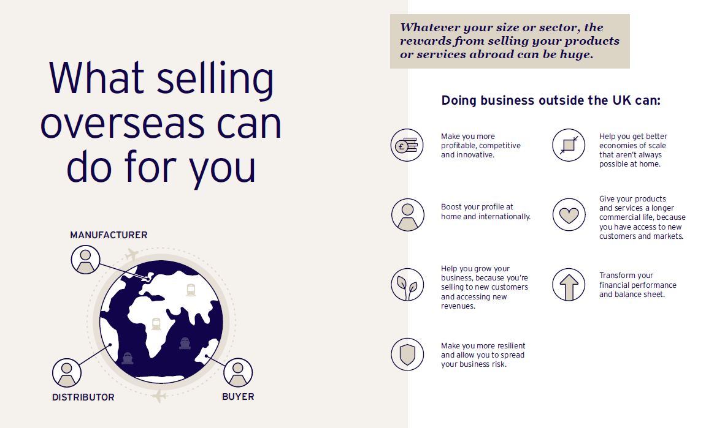
Tips for Exporting
4

Slide 5
Who we help in the UK
New and returning exporters
Exporters at risk of stopping
Growing exporters
businesses who we can help to maintain and grow their exports
currently exporting and exports account for less than c.10% of overall turnover
currently exporting and have won export orders in three countries or less
have exported before but not won an export order in the past twelve months
never exported before

Slide 6
ITAs - The Clients Export Journey Partner
Strategic Advice
Tactical Support
Market Research and Selection
Route to Market
Logistics and Fulfilment
Win Business
Desktop research
Personal networks
Posts
Risk / rewards analysis
Strategic advisory
Personal networks
Posts
Other bodies (e.g. CBBC)
EEN
Research prospects
Warm intros (posts)
Roadshows / events (posts)
Profile raising
Contracts / IP
Set up local office
Regulatory compliance
Logistics partners
Sticky situations…
Trade Missions, Trade Shows, MTB Events
Grants, Funding, UKEF
Leveraging the HMG Ecosystem

Slide 7

DIT – Strategic advice and practical support
  Export opportunities
  Overseas Market Introduction Service
  Trade missions
  Tradeshow Access Programme grants
  Trade Development Grants
  Master classes and Webinars
  Open to Export website - https://opentoexport.com/
  Global Growth Programme

Slide 8
How great.gov.uk helps businesses
    Create a Trade Profile
    Find the right online marketplace
    Events
    UK businesses can create their international profile on great.gov.uk. International buyers view these profiles through the Find a UK Supplier service on the same site.
    Selling online overseas helps businesses find the best online marketplaces to sell their products an take advantage of preferential deals.
    Access to a wide variety of events to help exporters across the UK including webinars
    Find an export opportunity
    Guides to exporting
    Invest in GREAT Britain
    Allowing UK businesses to search thousands of export opportunities and receive new announcements based on their interests.
    Guides, including country information, for new, occasional and existing exporters – helping businesses to be an exporting success.
Benefits of investing in the UK, sector information, translated information, signposts to more advice and support.
8
Notes:
8
8

Slide 9

UK Export Finance support
  UK Export Finance is the UK’s Export Credit Agency. It can:
    Help UK exporters by providing insurance to exporters and guarantees to banks to share the risks of providing export finance.
    Make loans to overseas buyers of goods and services from the UK.
    Insure UK exporters against non-payment by their overseas buyers.
    Help overseas buyers to purchase goods and services from UK exporters by guaranteeing or funding bank loans to finance the purchases.

Slide 10
Contact
  David Roadway
  Department for International Trade – South East Region
  M: 07977 422 872
  E: david.roadway@tradesoutheast.com
    GREAT.gov.uk
    www.gov.uk/dit
    https://www.contactus.trade.gov.uk/office-finder
  Follow us online:
  LinkedIn: International Trade with the UK – London
  Twitter: @tradegovuk_LSE

